Slide 1

Advanced Distributed Architectures for Mobile
gRPC, Protocol Buffers, and Transport Efficiency

Slide 2

The Mobile-Distributed Paradigm Shift
The "Mobile Tax"
The gRPC Solution
Traditional HTTP/1.1 and JSON impose significant overhead on constrained mobile devices. Verbose text serialization and frequent connection management lead to sluggish UIs, excessive data usage, and rapid battery depletion.
Born from Google's "Stubby," gRPC redefines mobile-backend interaction. It leverages Protocol Buffers for dense binary serialization and HTTP/2 for multiplexed transport, directly addressing the bottlenecks of latency and bandwidth.

Slide 3

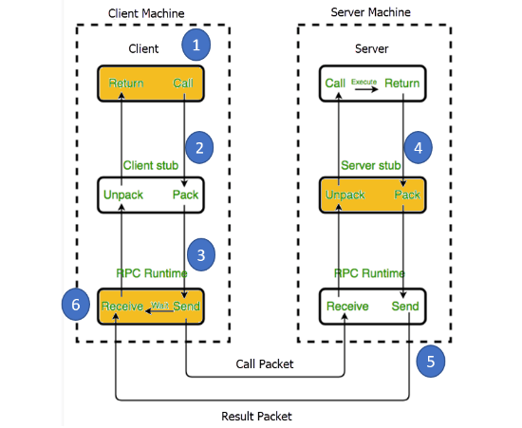
RPC vs. REST: Architectural Philosophy
REST (Resource-Oriented): Focuses on "Nouns" (Resources). Often suffers from the "N+1 problem" or chattiness, requiring multiple round-trips to fetch related data (e.g., User, Posts, Subscriptions).
RPC (Action-Oriented): Focuses on "Verbs" (Functions). Creates the illusion of local execution (e.g., getUserProfile(id)).
Mobile Impact: RPC allows for fine-grained control, aggregating data in a single call to minimize high-latency cellular round-trips.

Slide 4









Contract-First Development
Code Generation
Type Safety
Parallel Development
The protoc compiler automatically generates client stubs and server skeletons, eliminating manual parsing code and reducing bugs.
Strictly typed contracts prevent runtime errors. An int32 in the contract is enforced as an integer in Swift or Kotlin, not a string.
The .proto file serves as the single source of truth, allowing iOS, Android, and Backend teams to build in parallel against a defined interface.

Slide 5
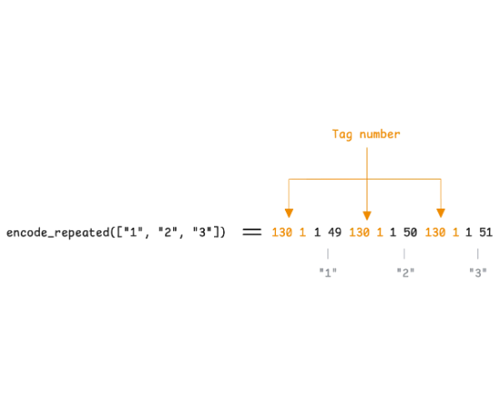
Protocol Buffers: The Wire Format
Unlike verbose text formats like JSON or XML, Protocol Buffers (protobuf) is a dense binary stream optimized for machine processing.
•
Size: 3x to 10x smaller than JSON.
•
Speed: Significantly faster parsing on mobile CPUs.
•
Precision: Distinct types for int64, float, and double prevent numeric precision loss common in JSON.

Slide 6


Binary Theory: Varints
Variable-Length Integers
Decoding Logic (Example: 300)
Standard integers use fixed 32-bit space (4 bytes) regardless of value size. Protobuf uses Varints to use only as many bytes as needed.
Each byte uses the MSB as a "Continuation Bit". If set to 1, the next byte is part of the integer. Small numbers (under 128) use just 1 byte.
(Reduced from 4 bytes to 2 bytes)

Slide 7
Field Tagging & Wire Types
Field names (e.g., "userId") are never sent over the wire. Instead, fields are identified by Integer Tags, drastically reducing payload size.
Wire Type | Name | Used For | Definition
0 | VARINT | int32, int64, bool, enum | Variable length
1 | I64 | fixed64, double | Fixed 64-bit
2 | LEN | string, bytes, messages | Length-delimited
5 | I32 | fixed32, float | Fixed 32-bit

Slide 8
Mobile Schema Evolution
Forward Compatibility
Backward Compatibility
Scenario: Old App (v1.0) receives data from New Server (v2.0). Mechanism: The parser encounters an unknown tag (e.g., Tag 3). Using the Wire Type, it knows exactly how many bytes to skip. The app does not crash; it simply ignores the new data.
Scenario: New Server (v2.0) receives data from Old App (v1.0). Mechanism: The server expects Tag 3 (e.g., email) but doesn't receive it. Protobuf assigns a default value (empty string/zero), allowing the server logic to proceed gracefully.

Slide 9
Architecture of Stubs: Concurrency
Blocking Stubs (Synchronous)
Async Stubs (Non-Blocking)
Calling stub.getUser() halts the thread until a response returns. On the mobile Main Thread, this causes UI freezes (Jank) and "Application Not Responding" (ANR) errors. Dangerous for mobile.
Returns immediately. Integrates with reactive frameworks (RxJava, Kotlin Coroutines, Swift Combine). The thread remains free to render UI frames at 60fps while the network operation is suspended.

Slide 10
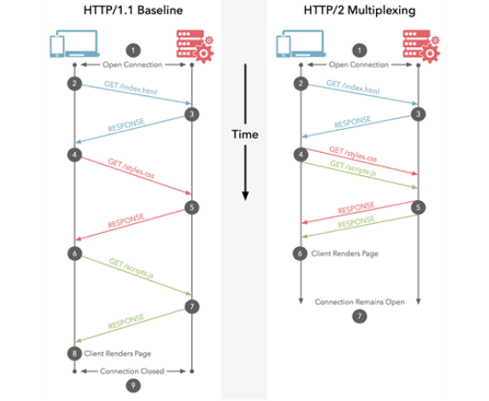
HTTP/2 Transport: Multiplexing
Solving Head-of-Line Blocking
In HTTP/1.1, requests are serial. One slow request blocks everything behind it. HTTP/2 introduces Binary Framing and Streams.
Multiple requests (GetProfile, GetPhotos) are split into frames and interleaved over a single TCP connection. This eliminates the expensive overhead of multiple TCP/TLS handshakes.

Slide 11
HPACK Header Compression
Efficiency for Metered Networks
99%
HTTP/1.1 sends verbose headers (User-Agent, Auth Tokens) as plain text with every request. HPACK uses Static and Dynamic tables to de-duplicate headers.
After the first request, repeated headers like 'Authorization' consume near-zero bandwidth, critical for users on slow or expensive data plans.
HEADER REDUCTION

Slide 12
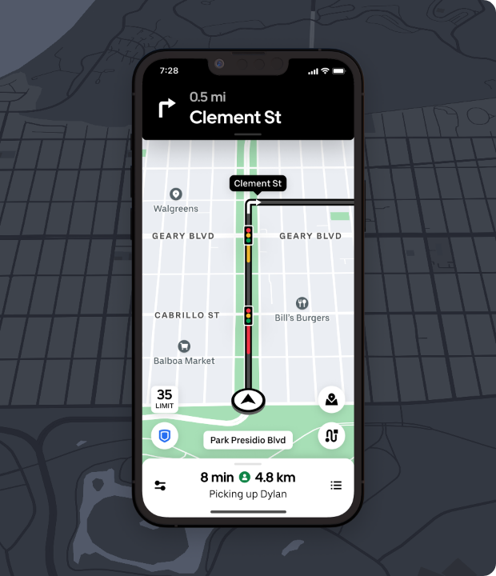
Streaming Capabilities
Real-Time Updates
gRPC treats streaming as a first-class citizen, replacing inefficient polling.
•
Server-Side: Subscribe to feeds (e.g., Stock Ticker).
•
Bi-directional: Full-duplex communication (e.g., Chat, Voice).
Uber Case Study: Migrated to gRPC bi-directional streaming for driver apps, eliminating polling latency and improving reliability in poor network conditions.

Slide 13
Deadlines & Cancellation
gRPC propagates deadlines across microservices. If a mobile client sets a 2s timeout, the server cancels processing immediately when time expires, preventing "zombie" computations and saving mobile radio battery.

Slide 14
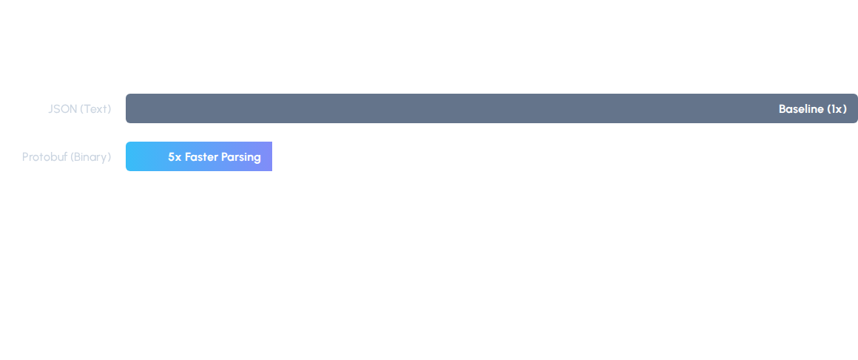
Performance: JSON vs. Protobuf
Protobuf parsing involves simple bitwise shifts and memory copying, whereas JSON requires complex string scanning. Payload sizes are also consistently 30-50% smaller.

Slide 15

Battery & The Radio Tail
The "Radio Tail" is the high-power state (DCH) the cellular radio remains in after data transmission (typically 5-10s).
REST Impact: "Chatty" sequential requests keep the radio active longer, draining battery.
gRPC Impact: Multiplexing allows bursting all data in a single window, allowing the radio to drop to Low Power (IDLE) sooner.

Slide 16

IPC & Memory Architecturesin Flutter
Platform Channels and Foreign Function Interfaces (FFI)

Slide 17
Architectural Foundations
The Flutter Runtime Environment & The Bridge

Slide 18


The Flutter Runtime Environment
The Embedder
The Strict Boundary
The Flutter Engine does not exist in a vacuum. It is hosted within a native application shell (Activity on Android, ViewController on iOS) that loads the library. This "Embedder" initializes the engine and bridges system events.
A hard separation exists between the managed Dart VM and the Host Platform. Unlike native apps, they do not share memory or threading models by default. Bridging this gap requires complex data marshaling and inter-process communication concepts.

Slide 19









Platform Channels: The "Easy" Path
MethodChannel
MessageCodec
BinaryMessenger
High-level API for named method invocations. Operates like an RPC mechanism using string-based dynamic dispatch.
Handles serialization (marshaling). The default StandardMessageCodec handles heterogeneous data but at a cost.
The transport layer moving raw ByteData between the Dart isolate and the platform-specific native components.

Slide 20

Serialization Economics
The Cost of Marshalling
The StandardMessageCodec employs recursive traversal for collection types. Encoding a deep Map or List implies an algorithmic complexity of:
On Android, sending a Dart results in the allocation of thousands of objects (Boxing), causing immense pressure on the Garbage Collector.

Slide 21




The Message Transmission Lifecycle
Invocation
Serialization
Context Switch
Execution
Dart calls invokeMethod. Arguments are prepared.
MessageCodec traverses the object graph, writing to a buffer.
Message posted to Platform Thread (Looper/GCD), causing thread hop.
Native handler processes the message and returns result.

Slide 22
The FFI Revolution
Synchronous Execution & Direct Memory Access

Slide 23


Dart FFI: The Synchronous Bridge
Direct Symbol Binding
Memory View, Not Copy
Dart uses dlopen and dlsym to bind directly to native C/C++ symbols. The Dart thread becomes the native thread, executing foreign machine code synchronously within the same process address space.
Unlike channels, FFI utilizes the class Pointer to view and manipulate native memory directly. This allows Dart to access native structs without the overhead of serialization or copying.

Slide 24




Platform Interoperability Details
Android (JNI)
iOS (Objective-C)
FFI to Java requires a "Double Thunk": Dart → C → Java. The JNI overhead (approx 150ns) and reference management can outweigh benefits for simple API calls.
Apple's is highly optimized. Static linking supports Link Time Optimization (LTO), making FFI a natural fit for the Apple ecosystem.

Slide 25

The Memory Copy Problem
Bandwidth Saturation
Moving large buffers (e.g., 4K camera frames) via Platform Channels is disastrous. It typically involves three copies: Native Source → Codec Buffer → Dart Heap.
This movement of 100MB+ of data saturates the memory bus and flushes CPU caches (L1/L2), causing "Cache Pollution" that slows down the entire UI rendering pipeline.

Slide 26
Zero-Copy Optimization Patterns
External TypedData: Allows Dart to create a Uint8List that views native memory directly via a C pointer, enabling zero-copy reads.
Isolate.exit: Performs an O(1) ownership transfer of heap memory between isolates, re-mapping memory pages instead of deep copying data.
Texture Registry: Renders native GPU textures (OpenGL/Vulkan) directly into the Flutter scene composite, completely bypassing the CPU and Dart heap.

Slide 27
Comparative Analysis
Feature | Platform Channels | Dart FFI
Communication Style | Asynchronous (Message Passing) | Synchronous (Direct Call)
Latency (Per Call) | High (~0.5ms - 2.0ms) | Negligible (~10ns - 100ns)
Data Transfer | Copy-by-Value (Serialized) | Shared Memory (Pointer View)
Threading | Context Switch (UI ↔ Platform) | Same Thread (Runs on Caller)

Slide 28
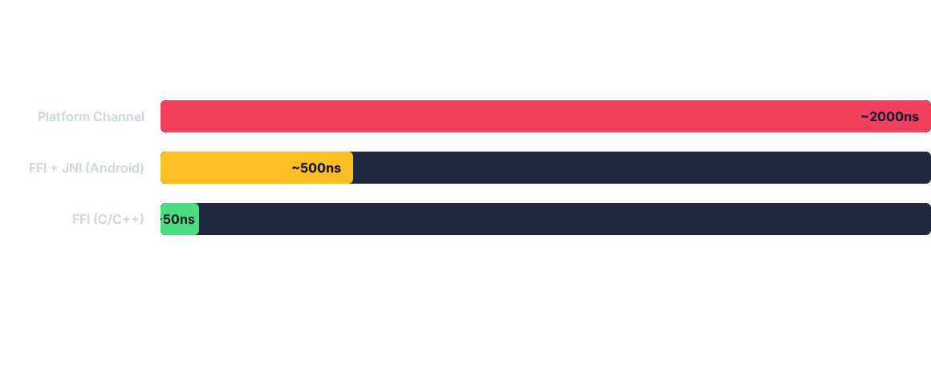
Latency Comparison (Approximate)
FFI calls are orders of magnitude faster. Channels suffer from tail latency due to main thread blocking.

Slide 29



Summary
1
2
3
Channels for Control Use for low-frequency, non-blocking intents where ease of use outweighs speed.
FFI for Compute Mandatory for high-frequency data paths (Audio, ML) to avoid frame drops.
Zero-Copy Essential for large buffers. Use pointers and ownership transfer to avoid bus saturation.

