Slide 1
Mobile and Embedded Computing
Laboratory 0. Orientation

Slide 2
Ing. Dinu-Ștefan RUSU
You can contact me on:
dinu_stefan.rusu@upb.ro
Teams
Senior Engineer @ Dell [Kotlin, Spring Boot]
45+ Launched apps on Google Play & App Store [Flutter, Java]
Speaker at DevTalks 2025 – Scaling Flutter to 100k MAU as a solo dev

Slide 3
Grading – 4P
Hands-on Flutter exercises
4 Milestones:
1. Build basic UI with mocked data (0.5p)
2. Integrate Firebase (0.5p)
3. State management & Offline first (1p)
4. Final presentation (2p)
These milestones may be solved individually or in a team of maximum 3 persons. Each contributor will be graded individually, based on their input to the developed application.

Slide 4
Milestones presentation schedule
1. Build basic UI with mocked data (0.5p) – 23 October 2025
2. Integrate with Firebase (0.5p) – 20 November 2025
3. State management & Offline first (1p) – 11 December 2025
4. Final presentation (2p) – 15 January 2026

Slide 5
Project topics – Project 1
TaskFlow: A Team Task Management App
Users can register/login with Firebase Auth (Email).
Create teams, add members, assign tasks with deadlines.
Real-time sync of tasks via Firestore.
Implement offline-first behavior with async/local caching.
Different roles (admin & member)

Slide 6
Project topics – Project 2
MediTrack: Personal Health & Medication Reminder
Users log in and store health records securely.
Set medication schedules → trigger local notifications.
Camera/Storage permissions for uploading prescriptions.
Secure data with Firebase App Check & Firestore rules.
Routing between dashboard, reminders, health logs.

Slide 7
Project topics – Project 3
EduNotes: Collaborative Learning & Note Sharing
Students sign up via Email.
Create, edit, and share notes with peers in real-time.
Support text + images (upload to Firebase Storage).
Notes can be starred, tagged, and filtered.
Use BLoC to separate UI (note editors) from logic (saving/sync).

Slide 8
Project topics – Project 4
TravelBuddy: Smart Itinerary & Expense Tracker
Create trips → add activities, bookings, and expenses.
Async fetch of currency conversion rates (mock external API).
Store user trips & expenses in Firestore.
Routing between trip overview, detailed day views, and analytics.
Optimize for low energy consumption (lazy loading data, efficient list rendering).

Slide 9
Project topics – Project 5
EventMate: Social Event Planning & RSVP App
Users sign up via Firebase Auth (email).
Create and manage events (title, date, location, description).
Invite friends (via email lookup or app sharing).
RSVP tracking with real-time updates in Firestore.
Calendar/contacts permission integration (optional).
BLoC to separate business logic from UI for event creation and RSVP flow.

Slide 10
Project topics – Project 6
FitTrack: Offline-Capable Fitness Logger with Analytics
Users log daily workouts (exercise type, duration, calories burned).
Offline-first design: store logs locally, sync with Firebase when online.
Visualize progress with charts (steps, calories, workouts).
Background async processing (e.g., aggregating weekly stats).
Optimize list rendering and data sync to reduce energy consumption.
Authentication with Firebase, secure storage for sensitive health data.

Slide 11
Project development MUST be tracked on GitHub
The application MUST be written in Flutter
The way of working will also be marked (Pull Requests, Branches, Code reviews, GitHub Issues, etc.)
Individual participation will be measured based on Commits, Lines of Code, and the quality of the code written. Each team member should know in detail what he has implemented and have at least a brief awareness of the other parts of the project
The readme MUST contain the following sections (in this order):
Team composition, 1 person / row (Name, Surname, Group)
Project description (brief) of the implemented app (what it does, what ‘screens’ it has, etc.)
Other information (anything else you would like to mention)
The final presentation will be a live demo accompanied by slides and must not take more than 15 minutes / team. Questions will be asked based on the code; you should NOT copy entire projects from the internet, and you should not vibe code stuff that you can’t explain later.

Slide 12
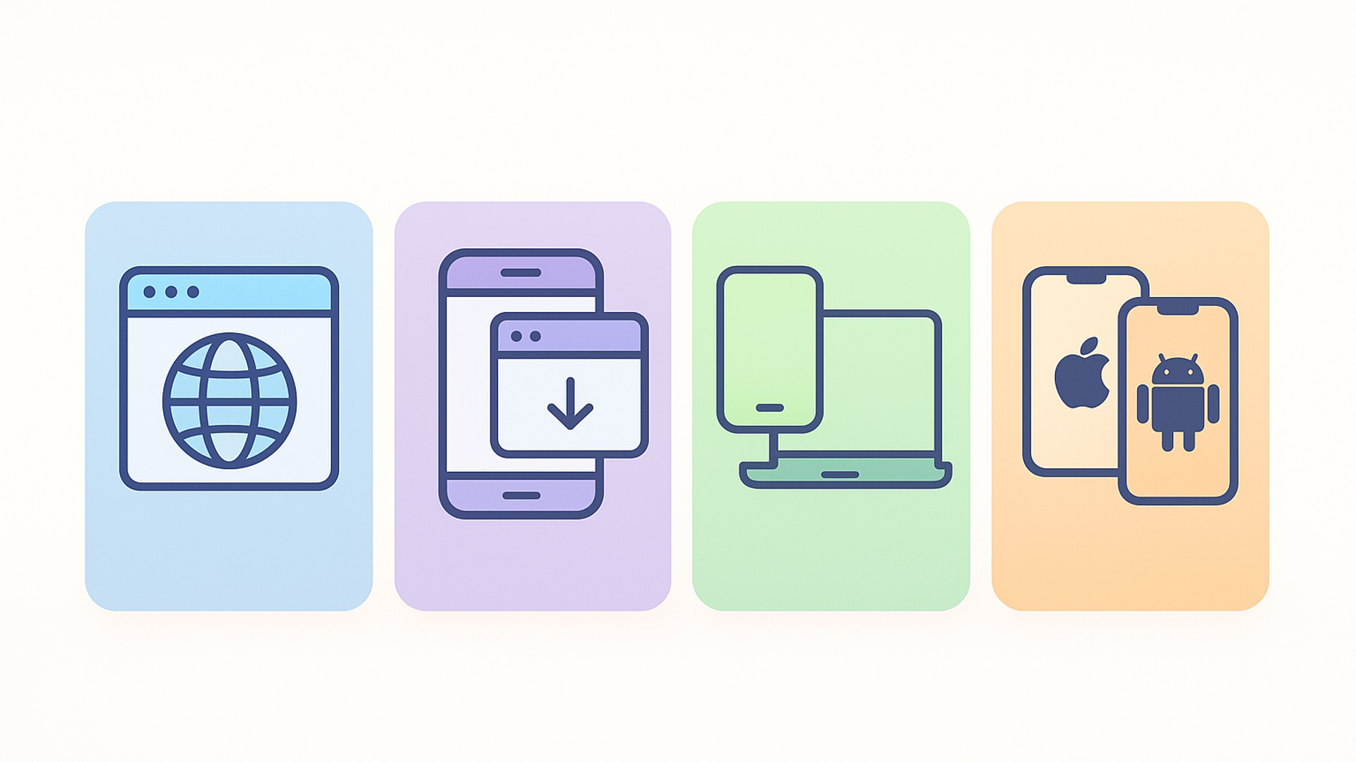
Laboratory 1. Platforms & Technology

Slide 13
Tasks
Set-up Flutter and your development environment
You should install Flutter by following the documentation (https://docs.flutter.dev/install) (Click on Install Manually in the Install Flutter section)
You will need Android Studio / Xcode
You will need IntelliJ to write the code (with the Flutter and Dart plugins)
Validate development environment by creating and running the default Flutter project
Organize in teams of maximum 3 for completing the milestones

