Slide 1
Mobile and Embedded Computing
Lecture 5. Server vs Client-Side code execution, Serverless vs VPS, http libraries, Firebase, Code generation

Slide 2
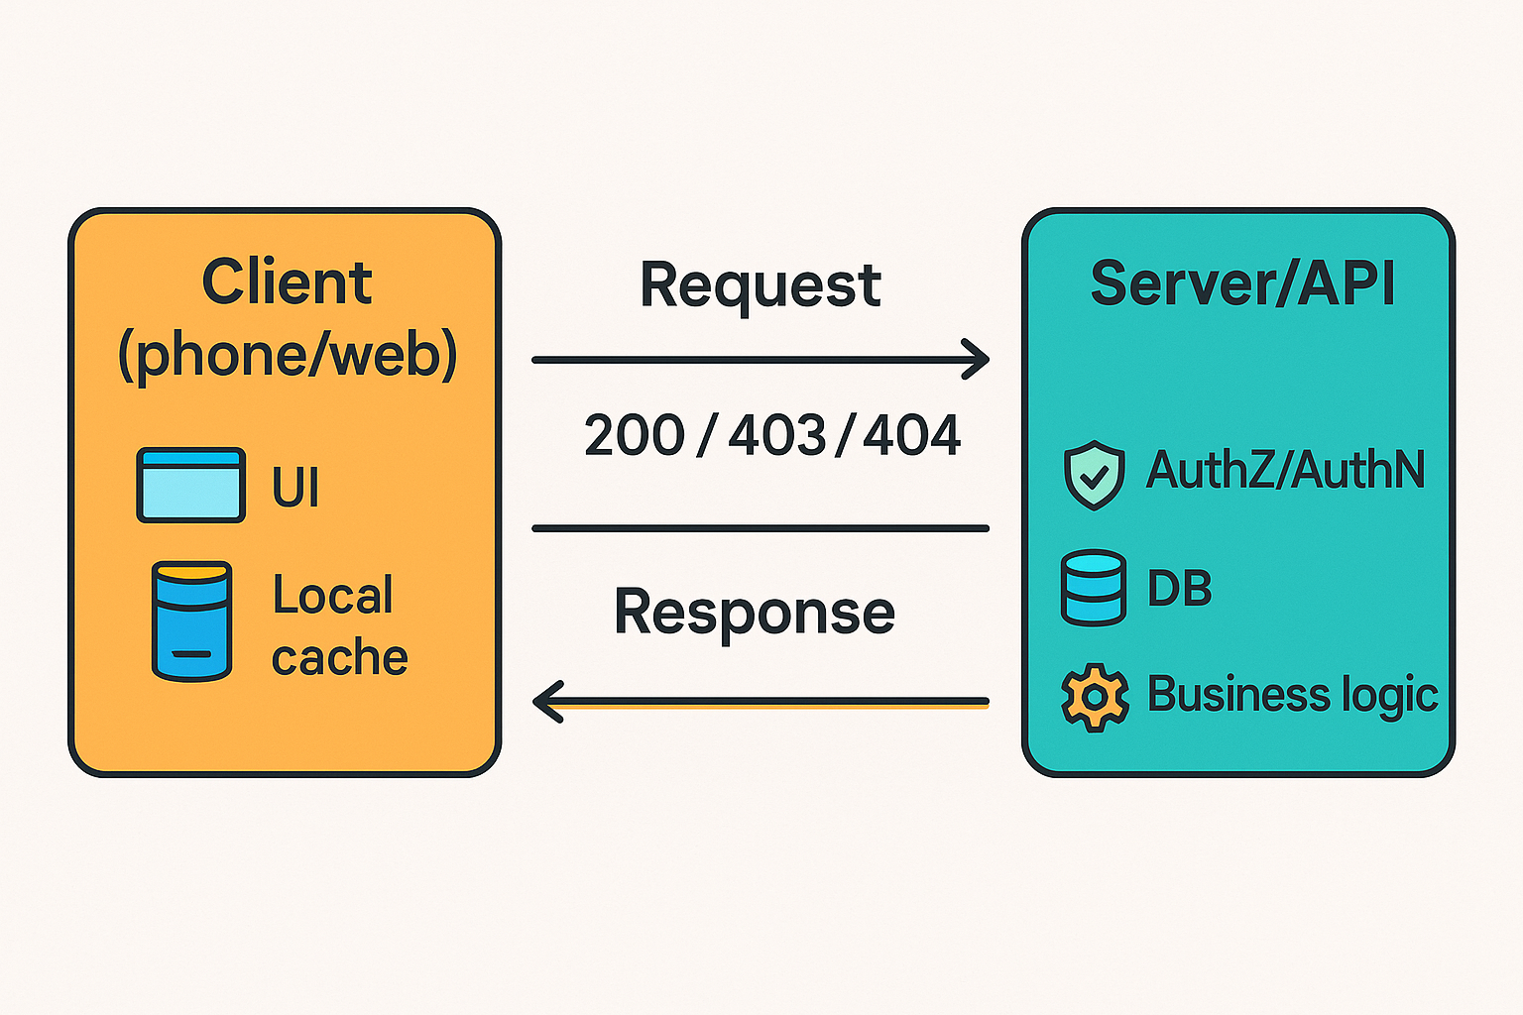
Server vs Client-Side Code Execution
Client-side runs on user devices (apps, browsers). Great for rendering UI, local state, caching, basic input checks.
Server-side runs on managed machines or platforms you control. Great for secrets, durable storage, heavy compute, and enforcing authorization.
HTTP request/response cycle: client sends request → server executes → returns status + body.

Slide 3
Security responsibility
Treat all client input as untrusted; validate on the server (syntax + semantics). Client checks are helpful UX, not sufficient security.
Typical server-side validations: content type, ranges, cross-field rules, auth checks.
Consequences of skipping server validation: injection, corrupted state, data leaks.

Slide 4
Serverless vs VPS
Functions-as-a-Service: deploy function code; platform handles provisioning, scaling, and patching.
Billing: pay per invocation and resource time (no charges while idle). Examples: AWS Lambda, Cloud Functions/Cloud Run functions.

Slide 5
Serverless benefits & downsides
Benefits
Automatic scaling to zero/peaks; ops surface is small.
Fine-grained cost alignment to usage.
Downsides
Cold starts add latency; mitigations include keeping min instances / provisioned concurrency.
Stateless runtime and execution time limits; limited control of networking/runtime.
Vendor-specific limits and configuration models.

Slide 6
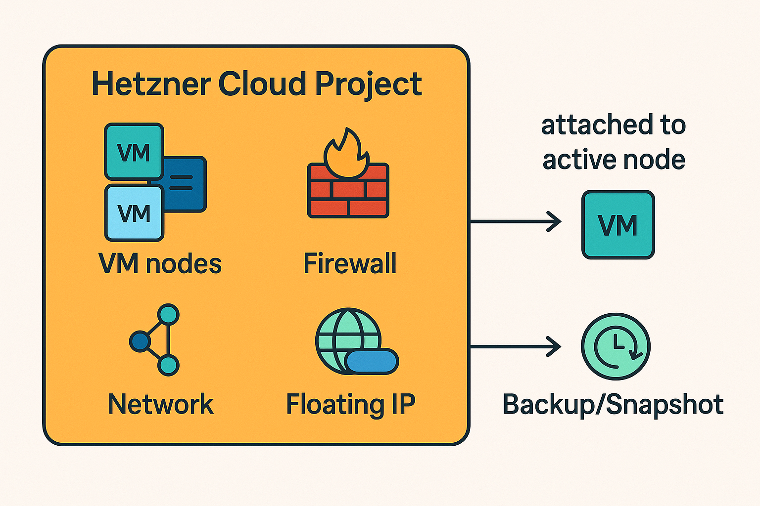
VPS (e.g. Hetzner Cloud)
You rent a VM: pick CPU/RAM/disk, install OS, configure everything (networking, security, runtime).
Hetzner Cloud supports Firewalls, Floating IPs (moveable IP for HA), Backups/Snapshots.
Billing is hourly/monthly; you pay even when idle. (See Hetzner pricing overview).

Slide 7
Serverless vs VPS
Scaling: Serverless auto; VPS = you design autoscale (or scale manually).
Latency: Serverless may have cold starts; VPS is warm but you manage capacity.
Control: Serverless sandboxed; VPS full root control (kernels, agents).
Security posture: Serverless shares more infra but is managed; VPS requires you to patch, firewall, rotate keys.
Cost: Serverless shines for spiky/low traffic; VPS often wins for steady loads or special workloads.

Slide 8
Coding tips — Serverless (Lambda, Cloud Functions)
Move
Warm-path init: Move SDK clients/DB pools to global scope to allow reuse across invocations. Google Cloud+1
Start
Cold start hygiene: Trim dependencies; lazy-load rarely used modules; consider min instances/provisioned concurrency for latency-sensitive endpoints. Google Cloud Documentation+2Firebase+2
Prefer
Connections: Prefer HTTP keep-alive; reuse clients; understand concurrency scaling (each concurrent request → separate runtime slot). AWS Documentation+1
Time
Time limits & idempotency: Design handlers to be idempotent where possible to allow safe retries.

Slide 9
Coding tips — VPS
Default
Security first: Default-deny Firewalls, explicit allow rules; keep OS patched; use SSH keys. Hetzner Docs
Use
Resilience: Use Snapshots/Backups before upgrades; rehearse restores. Hetzner Docs
Put
Failover: Put a Floating IP in front; reassign on node failure. Hetzner Docs
Monitor
Ops: Monitor CPU/RAM/disk IO; automate with Ansible/Terraform (Hetzner APIs are available).

Slide 10

Flutter HTTP Libraries

Slide 11
Options
package:http: simple, composable; RetryClient helper available.
dio: rich features (interceptors, cancel tokens, form/multipart, transformers).
Chopper: declarative API client generator (via code gen).
retrofit.dart: annotations + generator on top of Dio.
dart:io HttpClient: low-level control (TLS, sockets) when you need it.

Slide 12
Practical tips
Set timeouts (connect/read) explicitly.
Use Dio interceptors for auth headers, logging, unified error mapping.
Cancel in-flight requests on screen dispose (Dio CancelToken).
Prefer codegen clients (Chopper/retrofit) for larger APIs to keep call sites typed and consistent.

Slide 13
Retry Mechanisms
HTTP idempotent methods (GET, HEAD, PUT, DELETE, OPTIONS) are defined to be safe to repeat; beware POST/PATCH unless you add idempotency keys.
Respect server hints: Retry-After header gives wait time (e.g., after 429/503).

Slide 14
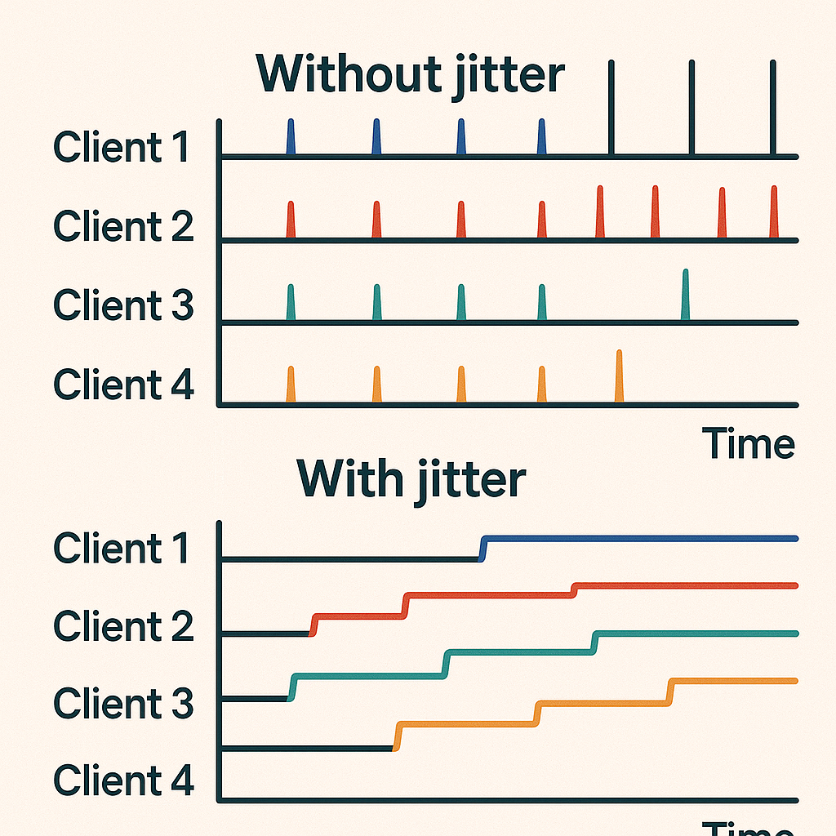
Backoff & jitter (why and how)
Use exponential backoff with jitter to avoid thundering herds and synchronized retries. Cap the max delay.
Client-side adaptive throttling can stabilize systems under overload.

Slide 15
Thundering Herds
When many clients retry failed requests at the same time (e.g., after a transient outage or rate-limit error), they can all flood the server simultaneously.
This synchronized retry surge can worsen overload and delay recovery.
To solve this: Increase the delay exponentially after each retry attempt:
Example: 1s → 2s → 4s → 8s → 16s …
This allows transient issues to resolve before retrying, reducing wasted retries.
Always cap the maximum delay (e.g., 30 seconds or 1 minute) to prevent excessive waiting.

Slide 16
Adding Jitter (Randomization)
Add a random factor (“jitter”) to break retry synchronization:
Without jitter, all clients follow the same delay pattern — they still collide.
With jitter, delays are randomized across clients, smoothing retry load.
Common strategies:
Full jitter: wait for a random value between 0 and the current exponential backoff delay.
Equal jitter: wait for half of the backoff delay + random half.
Decorrelated jitter: randomize around a moving average of delay times to adapt faster.

Slide 17
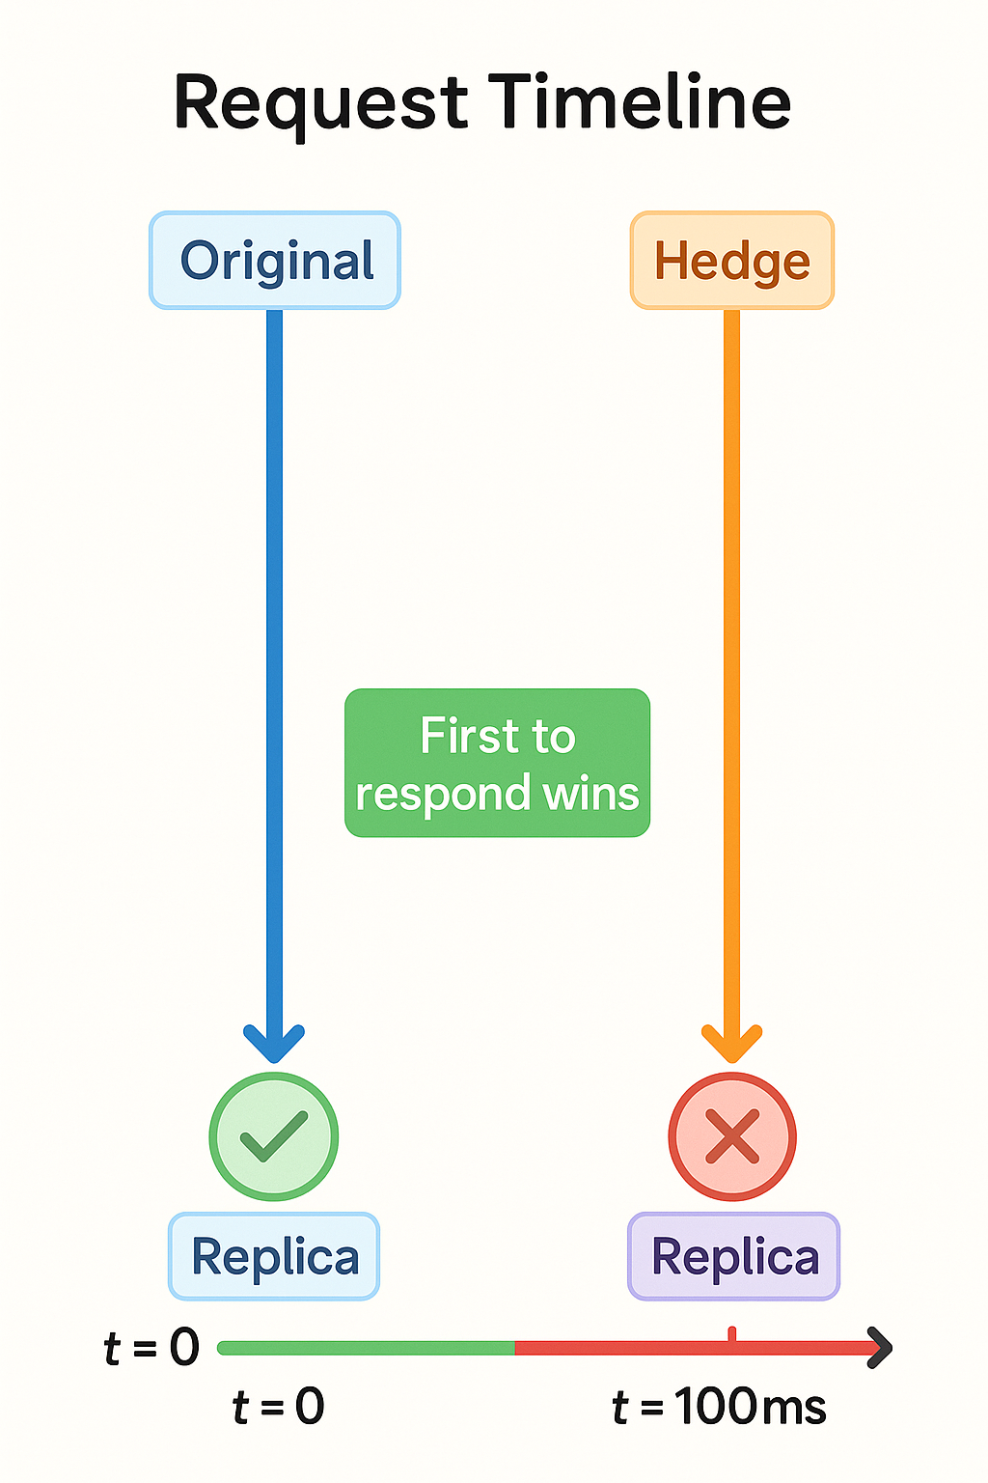
Hedged Requests (Speculative Retries)
In large systems a small fraction of requests suffer tail latency (e.g., p95/p99). Hedging sends a second copy of the same request after a short delay; you use the first successful response and cancel the rest.
This reduces visible tail latency with limited extra load when tuned (delay, max attempts).
gRPC supports hedgingPolicy natively.

Slide 18

When to hedge (and when not)
Good for read-only or idempotent operations; dangerous for non-idempotent writes unless guarded by idempotency keys.
Tune hedgingDelay and maxAttempts; ensure overall deadline covers the chain. (gRPC behavior).

Slide 19

Firebase & Firebase in Flutter
Integrated BaaS: Auth, Cloud Firestore (NoSQL), Storage, Cloud Functions, FCM, Hosting, analytics & crash reporting.
Pricing plans: Spark (free) and Blaze (pay-as-you-go); cost driven by reads/writes/storage/egress/functions.

Slide 20

Firestore & FCM notes
Firestore: client SDKs with realtime listeners and offline cache; good fit for mobile sync.
FCM (push): on iOS, you must request notification permission and have APNs token ready before some calls; add required Info.plist keys.

Slide 21

Firebase Functions (serverless)
Trigger on HTTP or events; can reduce cold starts by setting min instances if latency-sensitive.
For DB access, reuse clients in module/global scope to benefit from warm instances.

Slide 22
Dart Code Generation

Slide 23

Dart Code Generation
Eliminate boilerplate (JSON models, data classes, clients).
Common approach uses build_runner with source_gen-based packages.

Slide 24
Core tooling
build_runner: orchestrates builders, writes generated files.
Key commands: dart run build_runner build --delete-conflicting-outputs
dart run build_runner watch
source_gen: APIs to write generators over your annotated code.

Slide 25

Popular generators
json_serializable (+ json_annotation): @JsonSerializable() generates toJson/fromJson.
freezed (+ freezed_annotation): immutable classes, unions, copyWith, deep equality.
retrofit.dart / chopper: declarative REST clients via annotations.

