Slide 1
Secure Flutter Apps with Firebase
Authentication, OAuth, and App Check

Slide 2
Part 1: The "Who"
Authentication Fundamentals

Slide 3


AuthN vs. AuthZ
Authentication (AuthN)
Authorization (AuthZ)
Verifying Who You Are.
Verifying What You Can Do.
This is the "gatekeeper" at the front door, responsible for checking a user's credentials. It answers the question: "Is this user really who they say they are?"
This is the "keymaster" inside the building, determining which doors a verified user can open. It answers the question: "Now that I know who this is, what are they allowed to access?"

Slide 4





The Mobile Security Imperative
Sensitive Data
Personalization & Trust
Unique Threat Model
Mobile is the primary interface for financial, health, and personal records. A breach here can be catastrophic.
Personalized experiences require user trust, which is built on the bedrock of secure authentication.
Mobile devices face unique risks from being lost, stolen, or connected to insecure public Wi-Fi networks.

Slide 5
A Taxonomy of Authentication Factors
Factor Type | Description | Common Examples
Knowledge | "Something you know" | Password, PIN, Security Question
Possession | "Something you have" | Phone (for OTP/SMS), USB Key, Auth App
Inherence | "Something unique you are" | Fingerprint, Face ID, Iris Scan

Slide 6
Part 2: The "Service"
Firebase Authentication

Slide 7
The "Build vs. Buy" Dilemma
Immense Complexity: A secure system is more than a password check. It involves secure hashing (bcrypt/scrypt), cryptographic salts, token generation, and rate limiting.
Constant Maintenance: Security is not "set it and forget it." It requires constant vigilance and updates to patch new vulnerabilities.
High Cost (Time & Money): Building and maintaining this system is a full-time job for a dedicated team of specialists.
The BaaS Solution (Firebase): Delegates high-risk components to experts, allowing you to "focus on the rest of your application."

Slide 8
Firebase Authentication Providers
Category | Provider | Flutter Plugin(s) Required
Native | Email & Password | firebase_auth
Native | Phone Number | firebase_auth
Federated (OAuth) | Google | firebase_auth, google_sign_in
Federated (OAuth) | Apple | firebase_auth, sign_in_with_apple
Anonymous | Anonymous Sign-In | firebase_auth

Slide 9
Robust Error Handling
Error Code (e.code) | User-Friendly Message
'user-not-found' | "No user found for that email."
'wrong-password' | "Incorrect password. Please try again."
'email-already-in-use' | "This email address is already in use."
'weak-password' | "Password is too weak. Please use a stronger password."
'invalid-email' | "Please enter a valid email address."

Slide 10
Part 3: Managing the User
Lifecycle

Slide 11

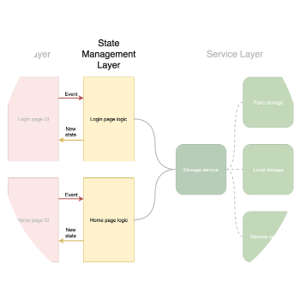
The "Auth Gate" Pattern
Don't Check, Listen
A flawed pattern is checking auth state and pushing a new screen. The robust, declarative solution is to listen to the authStateChanges() stream.
This stream emits a new value (User? or null) every time the auth state changes (login, logout, app start).
A StreamBuilder (the "Auth Gate") at the root of your app listens and declaratively builds the correct UI: LoginScreen or HomeScreen.

Slide 12

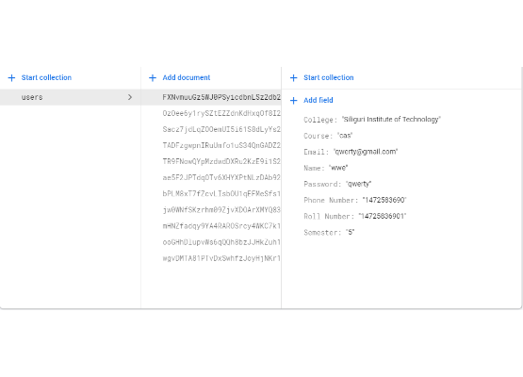
Storing User Profile Data
Decouple Auth from Data
The Firebase User object is for authentication, not application data. You cannot add arbitrary fields (like a user bio).
Best Practice:
•
Create a users collection in Cloud Firestore.
•
After registration, get the uid from the UserCredential.
•
Use this uid as the Document ID for a new document in your users collection.
•
Store all profile data (bio, username, theme) in this document.

Slide 13
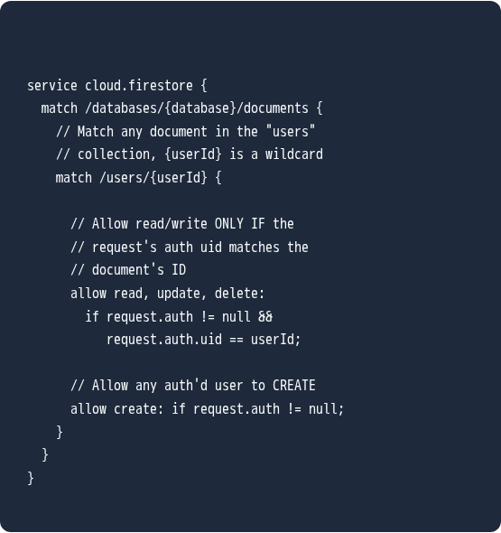
Securing Profile Data with Rules
Authorization (AuthZ)
firestore.rules
This new data must be secured. We must write Cloud Firestore Security Rules to ensure a user can only read and write their own profile document.
The rule uses the request.auth.uid variable (the logged-in user) and compares it to the userId in the document path.

Slide 14
Part 4: The "Easy Button"
Implementing OAuth Providers

Slide 15
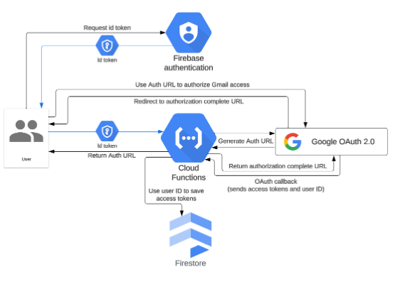
The OAuth "Credential Handoff"
The Two-Step Flow
Firebase trusts the provider (e.g., Google) to have verified the user. The process is a "credential handoff."
1.
App → Provider SDK: App triggers google_sign_in.
2.
Provider → App: Google returns an ID Token and Access Token to the app.
3.
App → Firebase: App creates a GoogleAuthProvider.credential and passes it to Firebase.
4.
Firebase: Verifies the token and creates its own Firebase session for the user.

Slide 16
Part 5: The "What"
Securing Your Backend with Firebase App Check

Slide 17



The "Other" Security Problem: App Impersonation
The Threat
The Attack
The Impact
An attacker decompiles your app, extracts your API keys (e.g., google-services.json), and finds your database URL.
They write a script (Python, Node.js) to make requests directly to your backend, completely bypassing your mobile app.
Billing Fraud (millions of writes, massive bills) and Data Poisoning (spamming your database with malicious data).

Slide 18
The Three Layers of Firebase Security
Security Layer | Question It Answers | Who It Protects
1. Firebase App Check | "Is this my real, unmodified app?" | The Developer (from abuse, billing fraud)
2. Firebase Auth | "Is this a known, valid user?" | The User (from unauthorized access)
3. Security Rules | "Is this user allowed to do this?" | The Data (from misuse by valid users)

Slide 19
The App Check Development "Catch-22"
The Problem: Production providers (Play Integrity, App Attest) are designed to only validate real, physical devices.
The Result: Your Android Emulator and iOS Simulator are not real devices. All requests from your dev environment will be blocked.
The Solution: Use the Debug Provider during development.
The Workflow:
1.
Run your app with AndroidProvider.debug.
2.
Look in the debug console for the printed debug token.
3.
Copy/paste this token into the Firebase Console (App Check > Manage debug tokens).

