Slide 1
Advanced Flutter Development
WebSockets, Permissions, and Routing

Slide 2

Part 1: The Real-Time Connection
Flutter & WebSockets

Slide 3


The Problem with HTTP for Real-Time
The HTTP Model
The "Polling" Problem
HTTP operates on a "request-response" model. The client (your app) asks for data, and the server sends a single response. After the response, the connection is done. The server cannot "push" new data to the client.
To simulate real-time, apps must repeatedly ask, or "poll," the server (e.g., "Any new messages? ... Any new messages?"). This is inefficient, creates high network traffic, increases server load, and introduces latency.

Slide 4






The WebSocket Solution
Persistent
Full-Duplex
Server-Push
The connection is opened once via a "handshake" and stays open, eliminating the overhead of new requests.
Once open, both the client and server can send messages at any time, without waiting for a "request."
The server can actively "push" data to the client, enabling true low-latency, real-time experiences.

Slide 5
HTTP vs. WebSockets
Feature | HTTP (with Keep-Alive) | WebSockets
Connection Model | Transactional (Request-Response) | Persistent, Stateful
Data Flow | Half-Duplex (Client requests) | Full-Duplex (Client & Server send)
Server-Push? | No (Requires client polling) | Yes (True server-push)
Use Cases | REST APIs, static content | Live chat, real-time feeds, gaming

Slide 6
The WebSocket Handshake
Client Request: The client sends a standard HTTP GET request, but with special headers: Upgrade: websocket and Connection: Upgrade.
Server Response: A WebSocket-aware server recognizes this and replies with an HTTP 101 Switching Protocols status code.
Connection Upgraded: The handshake is complete. The same TCP connection is "hijacked" and becomes the persistent, full-duplex WebSocket.

Slide 7


Flutter: web_socket_channel
The official web_socket_channel package provides an elegant abstraction for WebSockets in Dart.
1. The Stream
channel.stream is a Stream of messages from the server. You listen to this to receive data.
2. The Sink
channel.sink is a StreamSink for messages to the server. You add to this to send data.

Slide 8
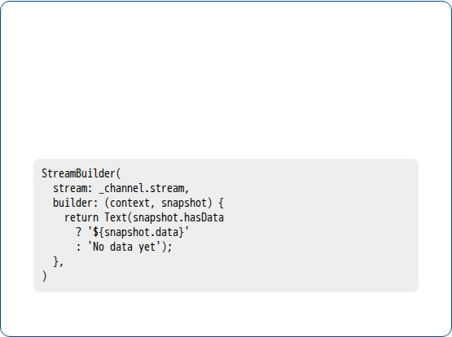
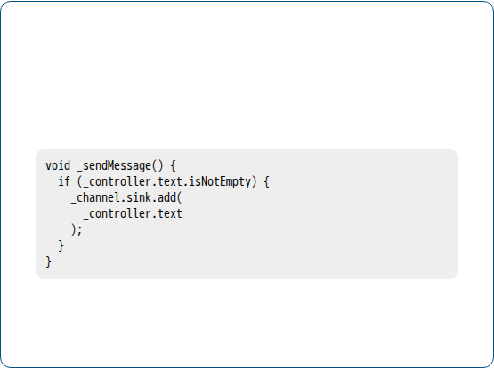
Code: Simple Echo Client
Listen with StreamBuilder
Send with the Sink
The StreamBuilder widget is the perfect tool. It listens to channel.stream and rebuilds the UI every time a new message arrives.
To send a message, you simply call .add() on the sink with your data. This pushes it to the server instantly.

Slide 9
Critical Best Practice: Dispose!
A WebSocket is a persistent connection. If channel.sink.close() is not called in the dispose() method, it creates a resource leak (memory, battery, and network).
"
"
— This is a mandatory cleanup step for any stateful widget using WebSockets.

Slide 10
Part 2: Managing Device Access
The Flutter Permission Model

Slide 11
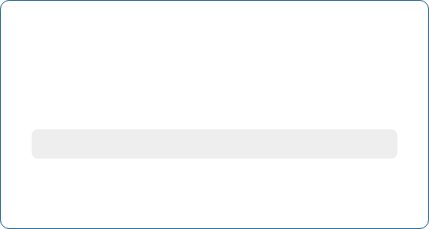
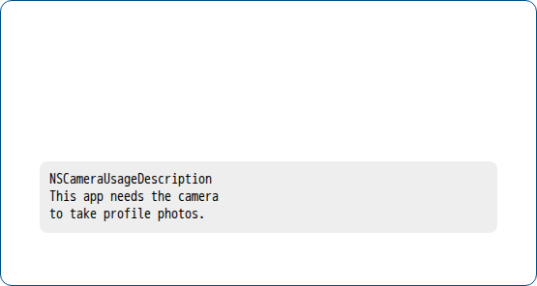
Step 1: Static Configuration
Android: AndroidManifest.xml
iOS: Info.plist
You must declare your *intent* to use a permission. This tells the OS what your app *might* ask for.
You must provide the *exact string* that will be shown to the user. If this is missing, your app will crash.

Slide 12








Step 2: Runtime Handling with permission_handler
isGranted
isDenied
isPermanentlyDenied
isRestricted
You're in. Proceed with the feature.
User said no, but you can ask again. Show a rationale first!
A "one-way gate." User checked "Don't Ask Again." You *cannot* request.
User cannot grant (e.g., Parental Controls). Disable the feature.

Slide 13
The "isPermanentlyDenied" Trap
This is a one-way gate. The request() method stops working. The only "key" to unlock it is the openAppSettings() function, which cedes control entirely to the user.
"
"
— This is the most common failure point for developers handling permissions.

Slide 14
Permission UX Best Practices
Ask Contextually: Don't ask on launch. Request the permission at the *exact* moment the user tries to use the feature.
Explain Why (Rationale): Show a friendly in-app dialog *before* the scary system prompt. This builds trust and increases "Allow" rates.
Handle Denial Gracefully: Don't crash or block the app. "Gracefully degrade" the feature (e.g., offer upload from gallery if camera is denied).
Master the 'Denied' Flow: If isPermanentlyDenied, show a button that calls openAppSettings() to give the user a path to recovery.

Slide 15
Part 3: Navigating the App
Flutter Routing from Basics to Pro

Slide 16
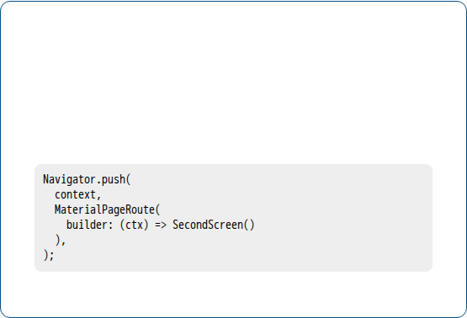
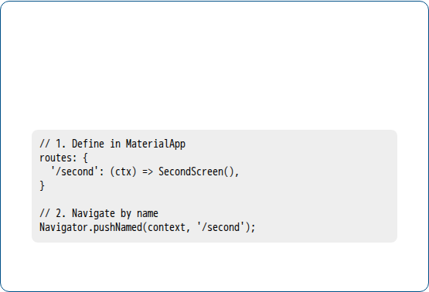
Navigator 1.0: The (Old) Imperative Way
Anonymous Routes
Named Routes
The most basic form. You "push" a MaterialPageRoute that builds your widget. This is simple but leads to duplicated code.
Cleaner. You define a map of string names to widgets in MaterialApp. However, this is no longer recommended.

Slide 17
Limitations of Navigator 1.0
The official Flutter docs warn against using named routes. Why?
Inflexible Deep Linking: Poorly handles external links (e.g., from a notification) trying to open a specific screen.
Difficult Stack Management: You can only push/pop from the top. Replacing the entire stack (e.g., after login) is complex.
Poor Web Support: Doesn't map to browser URLs. The back/forward buttons and URL bar don't work correctly.

Slide 18
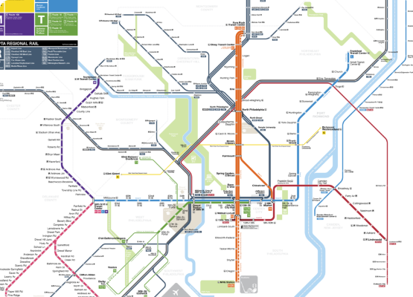
The Solution: go_router
go_router is the official, Flutter-team-endorsed package that implements the powerful, declarative Navigator 2.0 API for you.
Declarative: "Stack = f(State)"
You no longer say "go here." You define your app's navigation state, and the router builds the stack.
URL-Based API
It provides a simple, URL-based API (e.g., context.go('/users/123')) that solves deep linking, stack management, and web support.

Slide 19
go_router: Passing Parameters
Method | Path Definition | Navigation Example | Use Case
Path Parameter | '/users/:id' | context.go('/users/123') | Bookmarkable. Required IDs.
Query Parameter | '/search' | context.go('/search?q=flutter') | Bookmarkable. Optional filters.
Extra Parameter | (None) | context.go('...', extra: myObject) | NOT Bookmarkable. For transient state.

Slide 20
go_router Best Practice
Pass IDs in your routes, not complex objects. Use the ID in the destination screen to look up the data from a central state manager (e.g., Riverpod, Bloc).
"
"
— This ensures your app is fully deep-linkable, bookmarkable, and restorable.

Slide 21
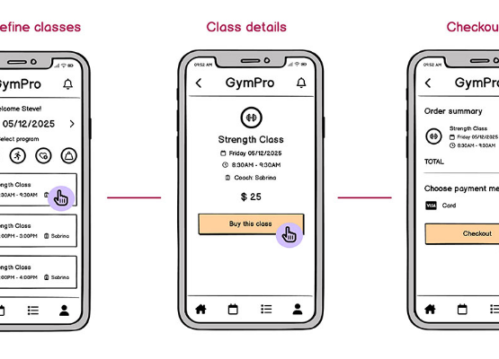
Nested Nav: ShellRoute
go_router's elegant solution to a classic problem: a persistent BottomNavigationBar.
How it Works
ShellRoute creates a nested Navigator. This means your main Scaffold (with the BottomNavBar) never rebuilds. Only the "shell" body changes.
State Preservation
StatefulShellRoute preserves the navigation state of each tab. If you navigate deep in Tab A, switch to Tab B, and return to Tab A, your stack is restored.

Slide 22






Synthesis: "Flutter MapChat" Flow
1. Permissions
2. Routing
3. WebSockets
User taps "Nearby." App checks and requests Permission.location, showing a rationale first.
User taps a friend. App calls context.go('/chat/alice_id'). go_router builds the chat screen.
ChatScreen connects to WebSocketManager to send/receive messages in real-time.

