Slide 1


Building Intelligent Flutter Apps
From On-Device ML (ML Kit) to Cloud-Native Agents (Firebase AI & Genkit)

Slide 2



The New Mandate: "AI-First"
The Paradigm Shift
What is "Flutter AI"?
The "mobile-first" approach is no longer the benchmark. Users now expect applications that are predictive, responsive, and intuitive. The global AI market is projected to surpass $826 billion by 2030.
It's an architectural philosophy: the fusion of Flutter's unparalleled UI capabilities with the power of ML, NLP, and intelligent automation. The goal is to build apps where AI is the core, and Flutter delivers that intelligence to any screen.

Slide 3






The Core Architectural Decision
1. On-Device AI
2. Cloud AI
3. Hybrid AI
The ML model runs entirely on the user's device. Characterized by high speed, strong data privacy, and offline functionality. (e.g., Google ML Kit)
The model resides on a server. Provides access to near-unlimited computational power for massive, complex models. (e.g., Firebase AI Logic)
A sophisticated architecture that balances both. A lightweight on-device model can trigger a more powerful cloud-based API for heavy lifting.

Slide 4
On-Device Intelligence: Google ML Kit
On-device AI, or "edge inference," performs all processing locally. No data is sent to a remote server. This provides three powerful advantages:
Speed: Processing happens locally, eliminating network latency. This is essential for real-time use cases like processing a live camera feed.
Privacy: The greatest strength. Sensitive user data (images, messages) never leaves the device, simplifying data privacy compliance.
Offline Functionality: Core features work without an internet connection, a critical requirement for apps in low-connectivity areas.

Slide 5
ML Kit: Production Considerations
Community Maintained: The Flutter plugins (e.g., `google_mlkit_face_detection`) are high-quality, community-driven wrappers, not officially Google-sponsored.
Platform Channels: Plugins use Flutter's Platform Channel mechanism to call native Google ML Kit APIs on iOS and Android.
Mobile Only: ML Kit is designed exclusively for mobile (iOS and Android). It does *not* support web.
Dependency: Do NOT use the `google_ml_kit` umbrella package. Add only the specific plugins you need (e.g., `google_mlkit_barcode_scanning`) to avoid bloating your app.

Slide 6
The New Wave: Gemini Nano
On-Device Generative AI
On-device AI is evolving beyond classic ML (detection, classification) and into generative AI. Google is now providing access to Gemini Nano, its smallest and most efficient model, for on-device execution.
This is exposed through new ML Kit GenAI APIs for tasks like summarization, proofreading, and rewriting.
Limitation: This is bleeding-edge technology, only available on a limited set of high-end devices (e.g., Pixel 8 Pro, Samsung S24 series) as of mid-2024.

Slide 7
Architectural Crossroads: On-Device vs. Cloud
Feature | On-Device AI | Cloud AI
Privacy | High (data stays on device) | Lower (data is sent to servers)
Computational Power | Limited to device capabilities | Near-unlimited cloud resources
Internet Dependence | Works offline | Requires stable connection
Model Updates | Must be pushed to devices (app update) | Can be instantly deployed to cloud

Slide 8
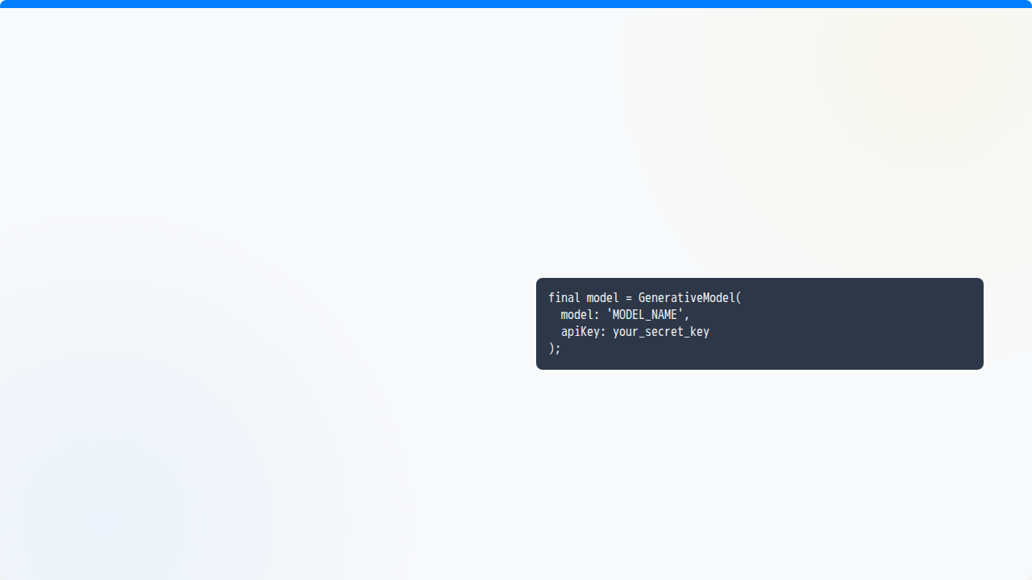

Cloud AI: The "Prototyping Trap"
The Trap
Using the `generative_ai` package and embedding your API key directly in the client-side code.
Security Vulnerability
The Risk
A malicious actor can decompile your app, extract this key, and use it on your behalf, resulting in catastrophic billing.

Slide 9
The Solution: Firebase AI Logic
The secure, production-ready solution. Firebase AI Logic is a serverless gateway that mediates all requests from your client app.
No API Key in Client: The Flutter app never includes a secret API key. The API signature conspicuously omits it.
App Check Integration: Verifies that requests are from a legitimate, untampered instance of *your* application, blocking bots.
Standard Firebase SDKs: The client interacts with the service using the standard, client-side Firebase SDKs you already trust.

Slide 10


Beyond Chat: What is an Agent?
A "Brain in a Jar"
Giving it "Arms and Legs"
An LLM, by itself, is trained on a static, finite dataset. It doesn't know the current weather, it can't access your private database, and it can't change your app's theme.
Tool Calling (or Function Calling) solves this. You provide the LLM a *description* of your Dart functions. The LLM then "pauses" and *requests* to run a function with specific arguments. Your app executes its own code, sends the result back, and the LLM synthesizes the final answer.

Slide 11
Advanced Orchestration: AI Logic vs. Genkit
Feature | Firebase AI Logic | Firebase Genkit
What it is | Client-side SDK (in Dart) | Server-side Framework (Node.js/Go)
Core Use Case | Simple, direct LLM calls from Flutter | Complex, multi-step "Flows"
Model Providers | Google-only (Gemini) | Multi-provider (Google, OpenAI, Anthropic...)
Advanced Logic | Basic (Tool Calling) | Advanced (RAG, Caching, custom logic)
Flutter Dev | All in Dart | Flutter calls a backend (e.g., Cloud Function)

Slide 12





The Future: Agentic Flutter Apps
Hyper-Personalization
Truly Multi-Modal
AI-Assisted Development
AI will move beyond discrete features to personalizing the entire user journey, proactively offering suggestions and dynamically re-ranking UI elements.
A seamless blend of voice, vision, and text. Users will interact in the most natural way possible, and the app will be expected to understand and synthesize these inputs.
AI will not only power the apps; it will help build them. AI-powered pipelines will auto-generate Flutter and Firebase code from a high-level idea.

