Slide 1

Mobile and Embedded Computing
Lecture 5. GraphQL & REST, Observability for Mobile applications (Events, Crashlytics, Performance Monitoring)

Slide 2
Section 1
Mobile API Communication

Slide 3
Why APIs are Critical
Data Source: Apps are often containers; the data lives on remote servers.
Functionality: Enable complex features like login, payments, and social feeds.
Synchronization: Keep user data consistent across multiple devices (phone, tablet, web).
Separation of Concerns: Decouples the client (app) from the backend (server).

Slide 4


REST API Fundamentals
Architecture
Core Concepts
REpresentational State Transfer. A stateless, client-server architectural style.
Uses standard HTTP methods to act on "Resources" identified by URLs.
It is not a protocol, but a set of constraints.
GET /users/123 POST /users PUT /users/123 DELETE /users/123

Slide 5




REST in Mobile: Pros & Cons
Pros
Cons
Simplicity: Easy to understand, built on standard HTTP.
Over-fetching: Getting more data than the screen needs.
Caching: Standard HTTP caching is effective.
Under-fetching: Needing multiple API calls for one screen (e.g., user + posts).
Mature: Decades of tooling and support.

Slide 6
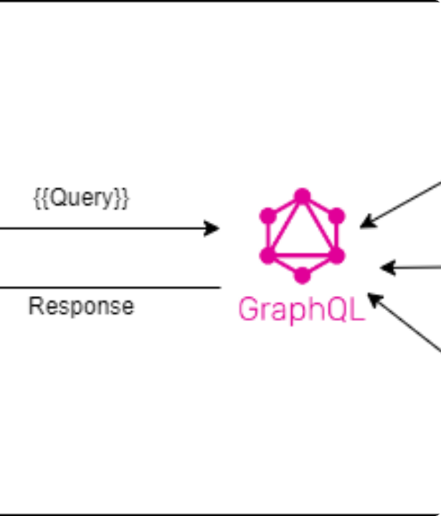
Introduction to GraphQL
A query language for your API, not an architecture. Developed by Facebook to solve mobile data-fetching issues.
Allows the client to ask for exactly what it needs and get exactly that in a single request.

Slide 7






GraphQL Core Concepts
Schema
Query
Mutation
The "contract." A strongly-typed definition of all data available on the API (types, fields, relationships).
A read-only operation to fetch data. The query's shape mirrors the JSON response's shape.
A write operation to modify data (create, update, delete). Defined in the schema just like queries.

Slide 8
GraphQL vs. REST: Head-to-Head
Feature | REST | GraphQL
Endpoint | Multiple endpoints (/users, /posts) | Single endpoint (e.g., /graphql)
Data Fetching | Fixed data structure (defined by server) | Flexible data shape (defined by client)
Data Shape | Prone to over/under-fetching | Precise data in one request
Schema | Loosely defined (e.g., OpenAPI) | Strongly typed (Schema Definition Language)
Protocol | Uses all HTTP verbs (GET, POST, PUT...) | Typically uses POST for all operations

Slide 9


When to Use...
Use REST when...
Use GraphQL when...
...simplicity is key.
...you have complex data relationships (e.g., social feeds).
...you have simple, well-defined resources.
...mobile bandwidth is a major concern (reduces payload).
...caching is a top priority (HTTP caching works perfectly).
...your app needs to fetch data from multiple sources.
...you are integrating with many 3rd-party APIs.
...you have multiple clients (iOS, Android, Web) with different data needs.

Slide 10
Section 2
Mobile App Observability

Slide 11
What is Mobile Observability?
More than monitoring: Monitoring tells you *if* something is broken. Observability helps you understand *why*.
Three Pillars: Traditionally Logs, Metrics, and Traces.
For Mobile: We adapt this to our "Big 3": 1. Events (User Behavior) 2. Crashes (Stability) 3. Performance (Speed)

Slide 12
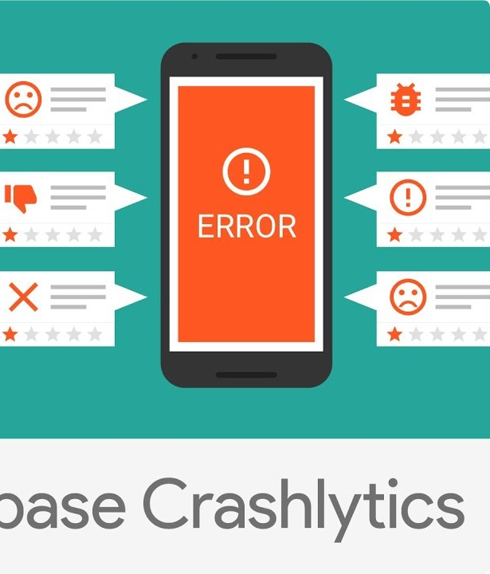
The Firebase Toolkit
Google's mobile platform that provides a suite of tools for building, releasing, and monitoring apps.
We focus on its observability products, which work together to give a complete picture of app health.

Slide 13
1. Firebase Analytics (Events)
What it is: Tracks user behavior and app usage by logging "Events".
Automatic Events: Captures screen_view, app_remove, first_open automatically.
Custom Events: You log events that matter to your app (e.g., purchase_complete, share_image).
The "Why": Understand user funnels, feature adoption, and engagement.

Slide 14
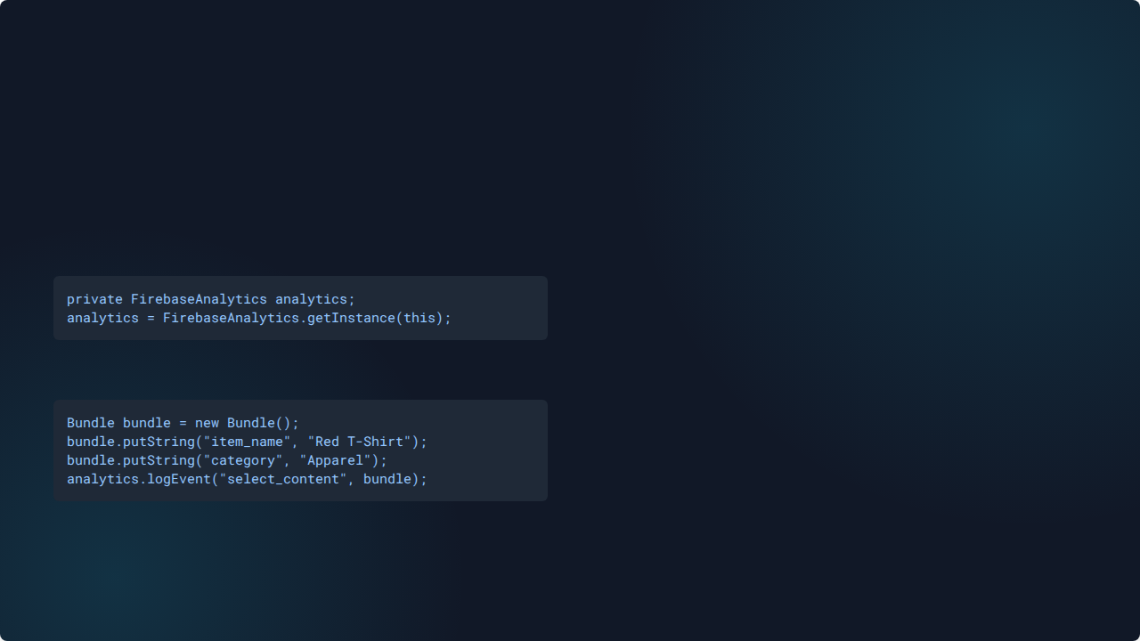

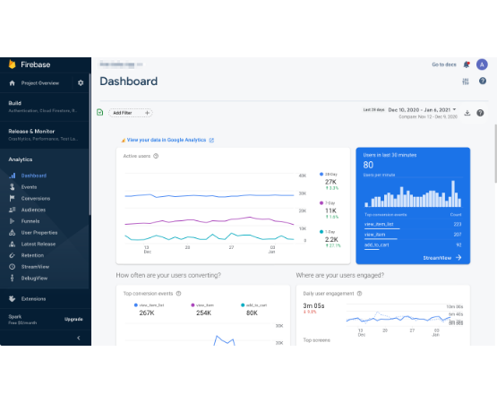
Implementing Firebase Events
1. Get the FirebaseAnalytics instance:
2. Log your custom event with a Bundle:

Slide 15
2. Firebase Crashlytics
99.9%
Find, Fix, and Prioritize Crashes
Real-time crash reporting that automatically captures and groups crashes (Java/Kotlin & NDK).
Goal: Crash-Free Users
Provides actionable insights: stack traces, device info, and OS version.

Slide 16
Setting Up Crashlytics
Integration: Add the Gradle dependency. It works out-of-the-box.
Custom Logs: Add "breadcrumb" context to reports. Crashlytics.log("User at checkout screen");
Custom Keys: Set user state (e.g., premium/free). Crashlytics.setCustomKey("user_tier", "premium");
Test Crash: Verify your setup. throw new RuntimeException("Test Crash");

Slide 17



3. Firebase Performance
App Startup
Network Requests
Custom Traces
Measures "cold," "warm," and "hot" app start times. A critical first impression.
Automatically monitors HTTP/S requests. Tracks success rate, payload size, and response time.
Manually trace specific code blocks (e.g., "image_processing") to find bottlenecks.

Slide 18
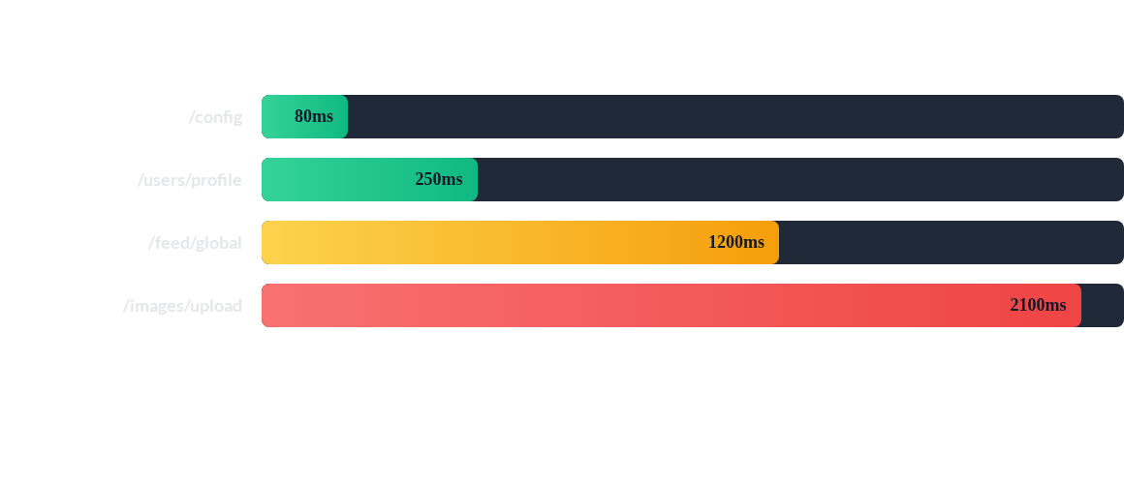
Performance Deep Dive: Network
The /feed/global and /images/upload endpoints are clear bottlenecks that need investigation.

Slide 19


Real life example
1. Event
2. Performance
3. Crash
User clicks "Buy". (Analytics logs begin_checkout).
checkout_trace starts. Network call to /payment is slow (5.2s). (Performance alerts).
App crashes due to an unexpected null response from the slow /payment API. (Crashlytics reports).

Slide 20
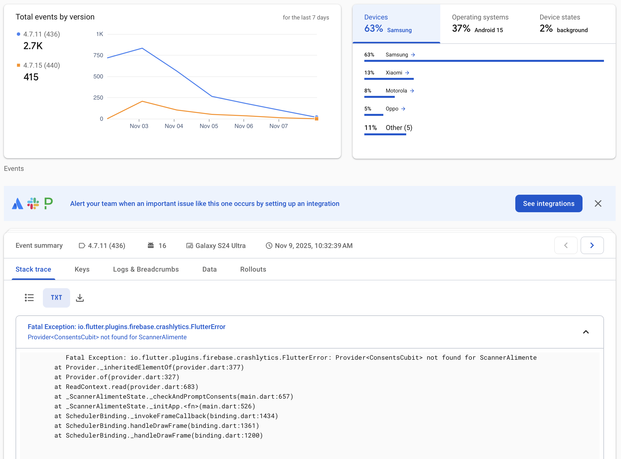

Slide 21
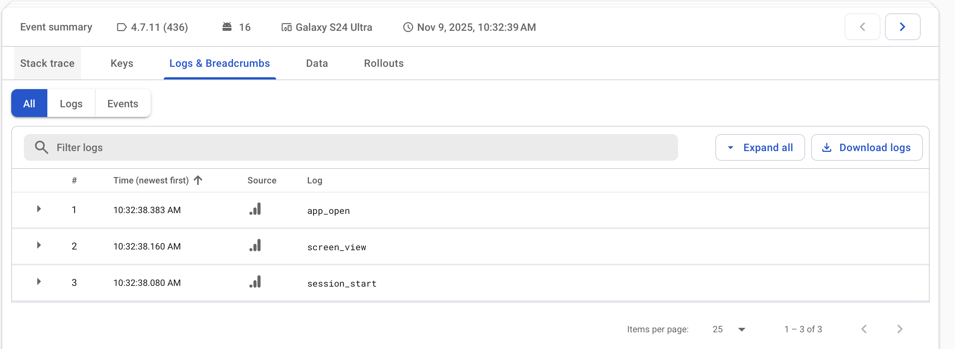

Slide 22
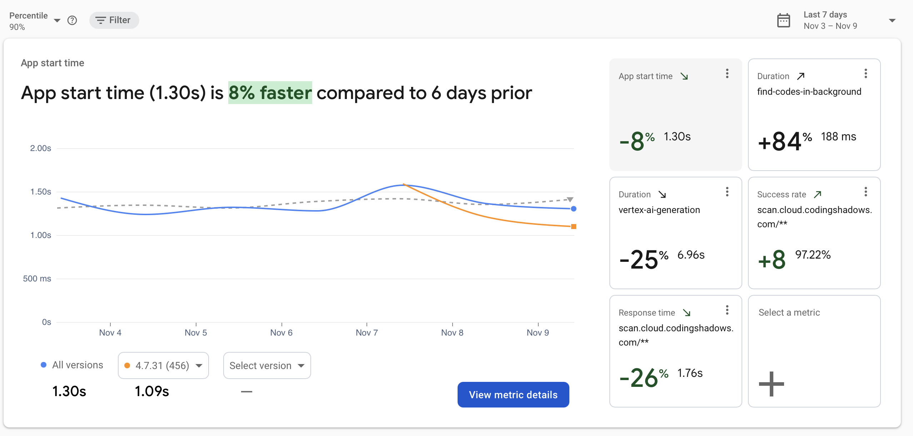

Slide 23
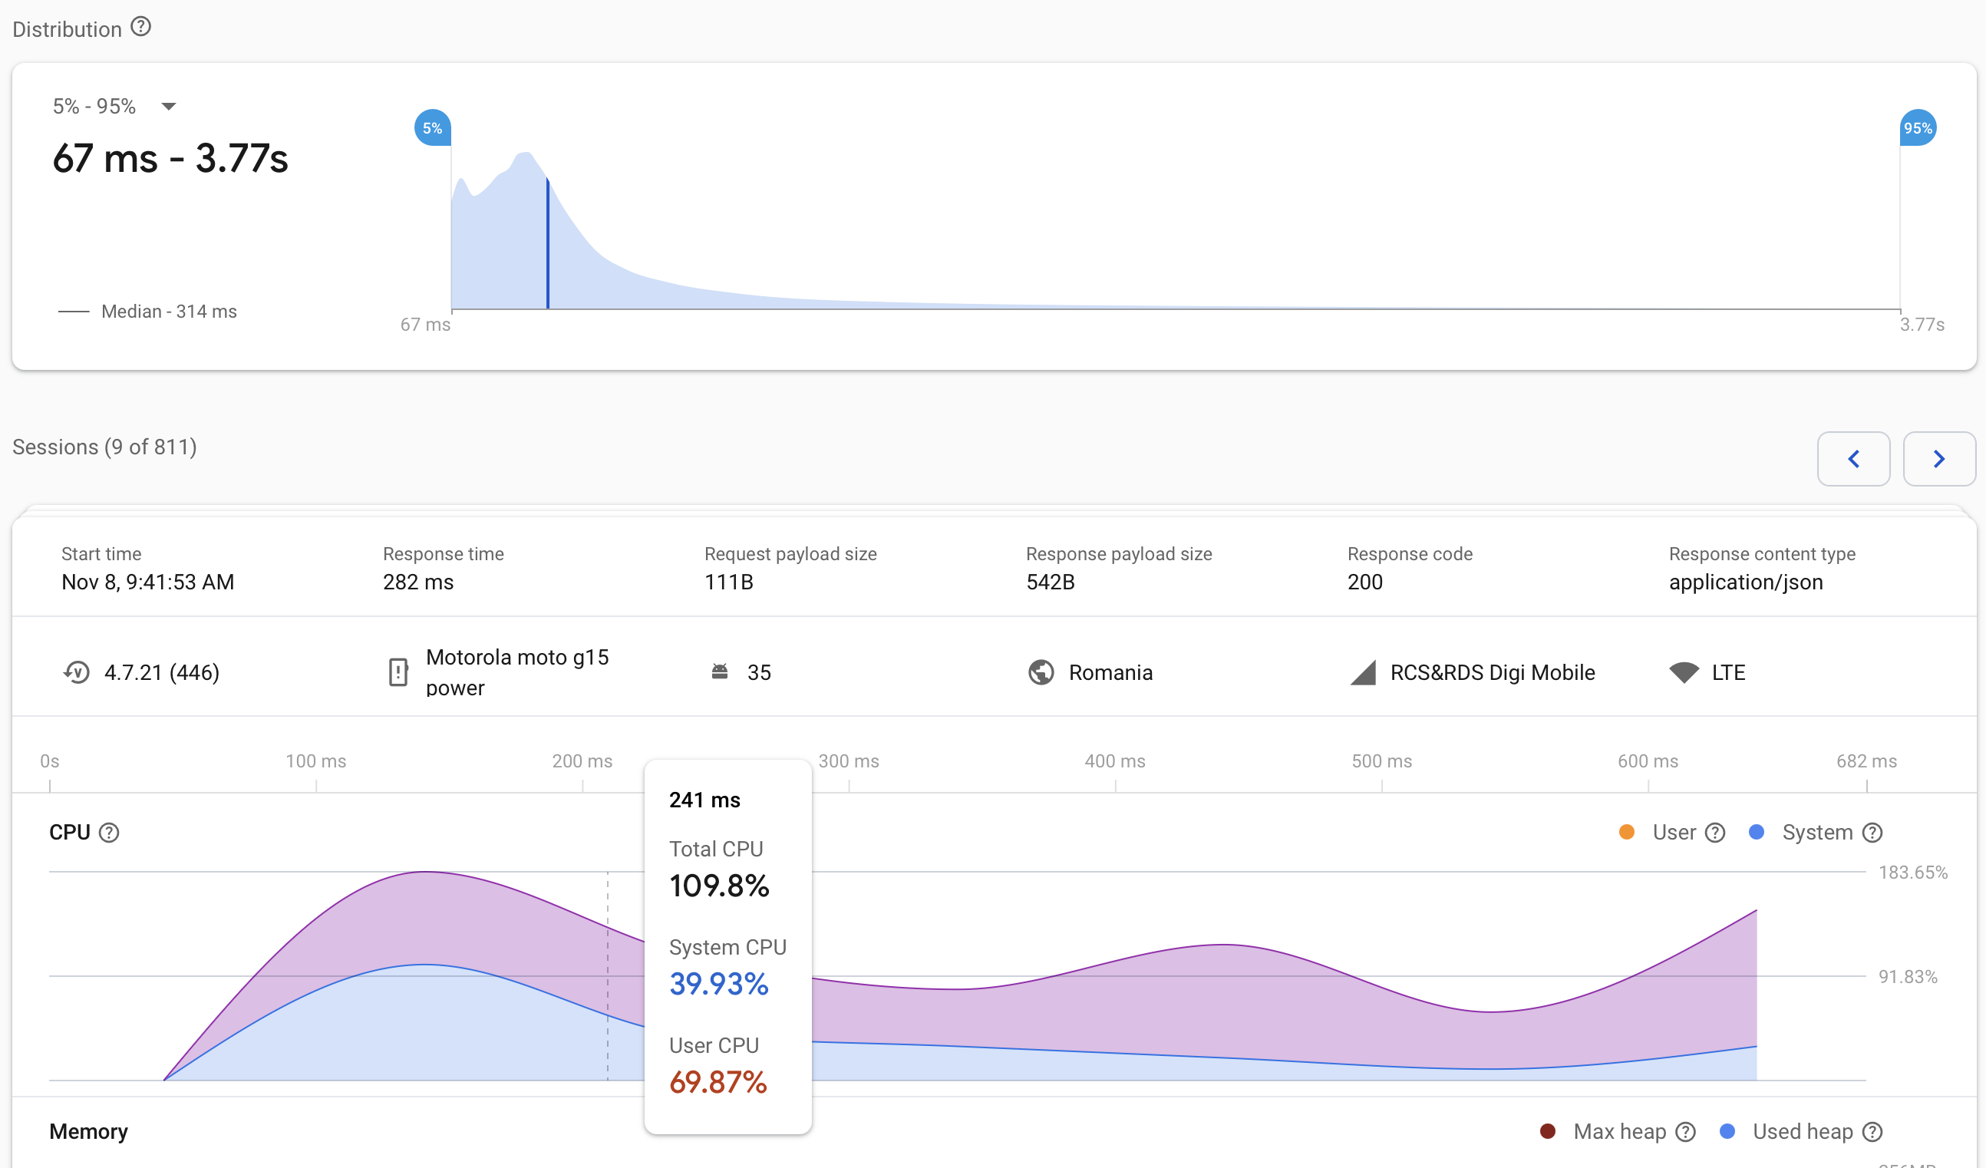

Slide 24
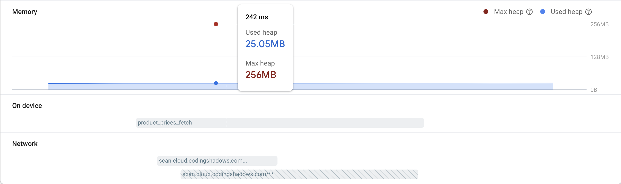

Slide 25
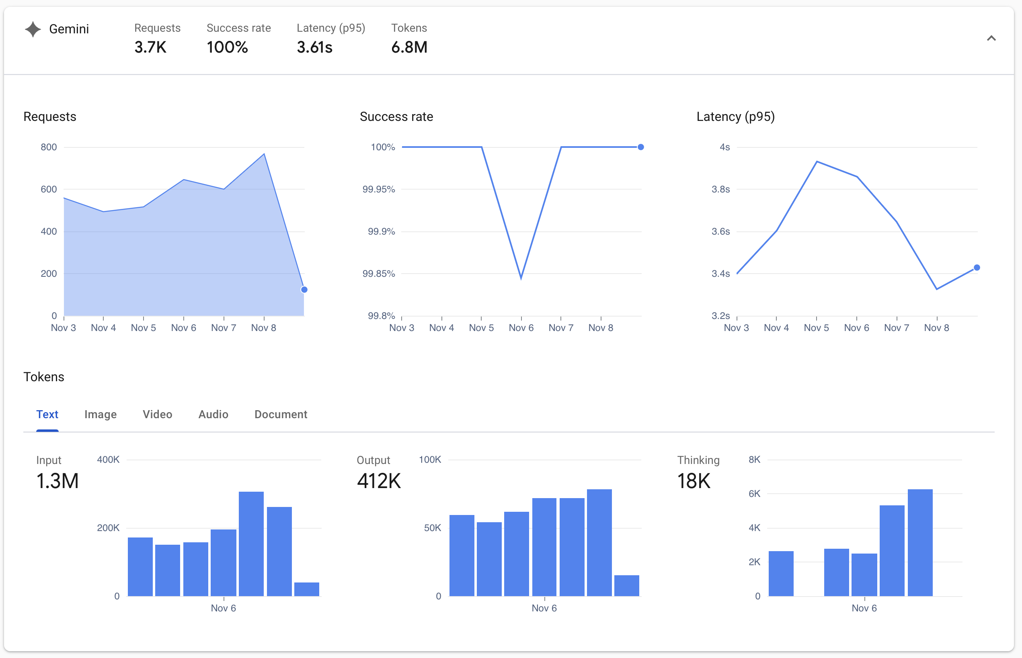

Slide 26
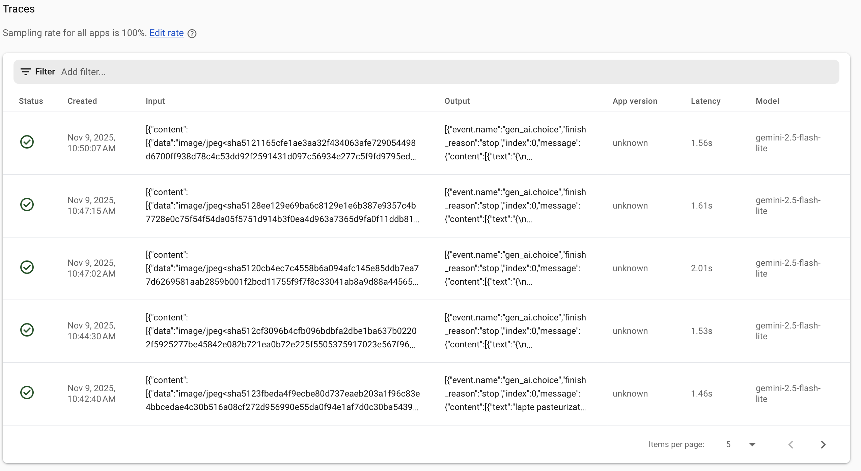

Slide 27
