Slide 1
Retrieval Augmented Generation (RAG)

Slide 2
Vector Embeddings
Embeddings are high-dimensional dense vectors (arrays of floating-point numbers) that represent data.
In this vector space, objects with similar meanings are positioned closer together.
[0.12, -0.45, 0.88, ... 0.05]
Example: The vector for "King" minus "Man" plus "Woman" results in a vector closest to "Queen".

Slide 3
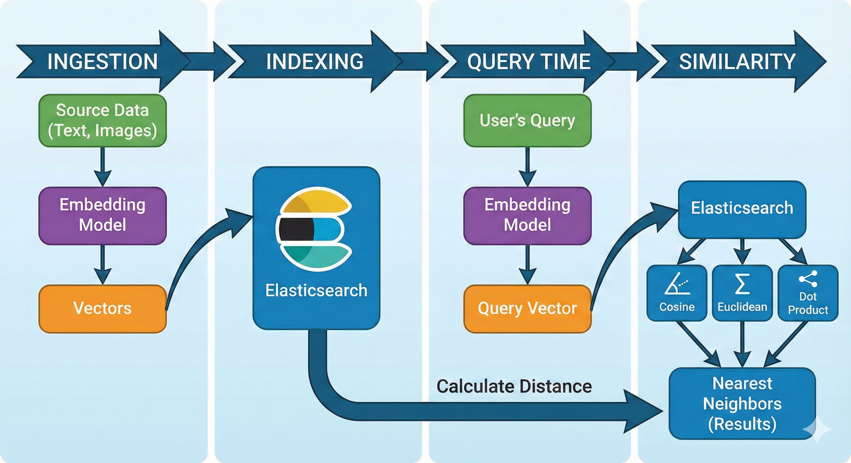
How Vector Search Works
1. Ingestion: Source data (text, images) is passed through an Embedding Model to generate vectors.
2. Indexing: Vectors are stored in Elasticsearch.
3. Query Time: The user's query is vectorized using the same model.
4. Similarity: Elasticsearch calculates the distance (Cosine, Euclidean, Dot Product) to find the nearest neighbors.

Slide 4
Distance Metrics
Cosine Similarity: Measures orientation. The default for NLP. Ranges from -1 to 1.
Dot Product: Faster. Identical to Cosine if vectors are normalized to unit length.
L2 Norm: Euclidean distance. Sensitive to magnitude; less common for text.

Slide 5
Search Methods: Exact vs. Approximate
Feature | Approximate kNN (kNN Search) | Exact kNN (Script Score)
Algorithm | HNSW (Graph-based) | Brute-force scan
Speed | Extremely Fast (Scales to millions) | Slow (Linear with document count)
Accuracy | High (Top-k is approximate) | 100% Perfect
Best For | Large datasets, production search | Small datasets, re-ranking top-N
Cost | Higher RAM usage | High CPU usage

Slide 6
Hybrid Search: Best of Both Worlds
Reciprocal Rank Fusion (RRF)
Hybrid Search runs both queries in parallel:
Standard BM25 Match
kNN Vector Search
RRF normalizes and combines the scores to rank the final results, ensuring the most relevant documents appear at the top.

Slide 7
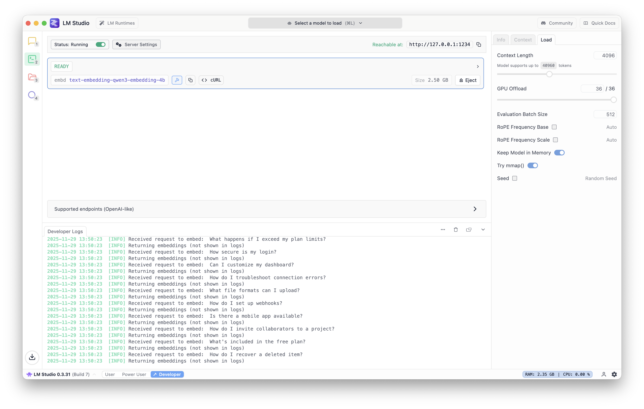
LMStudio
Desktop application for Windows, macOS, and Linux that allows users to discover, download, and run large language models (LLMs) locally

Slide 8
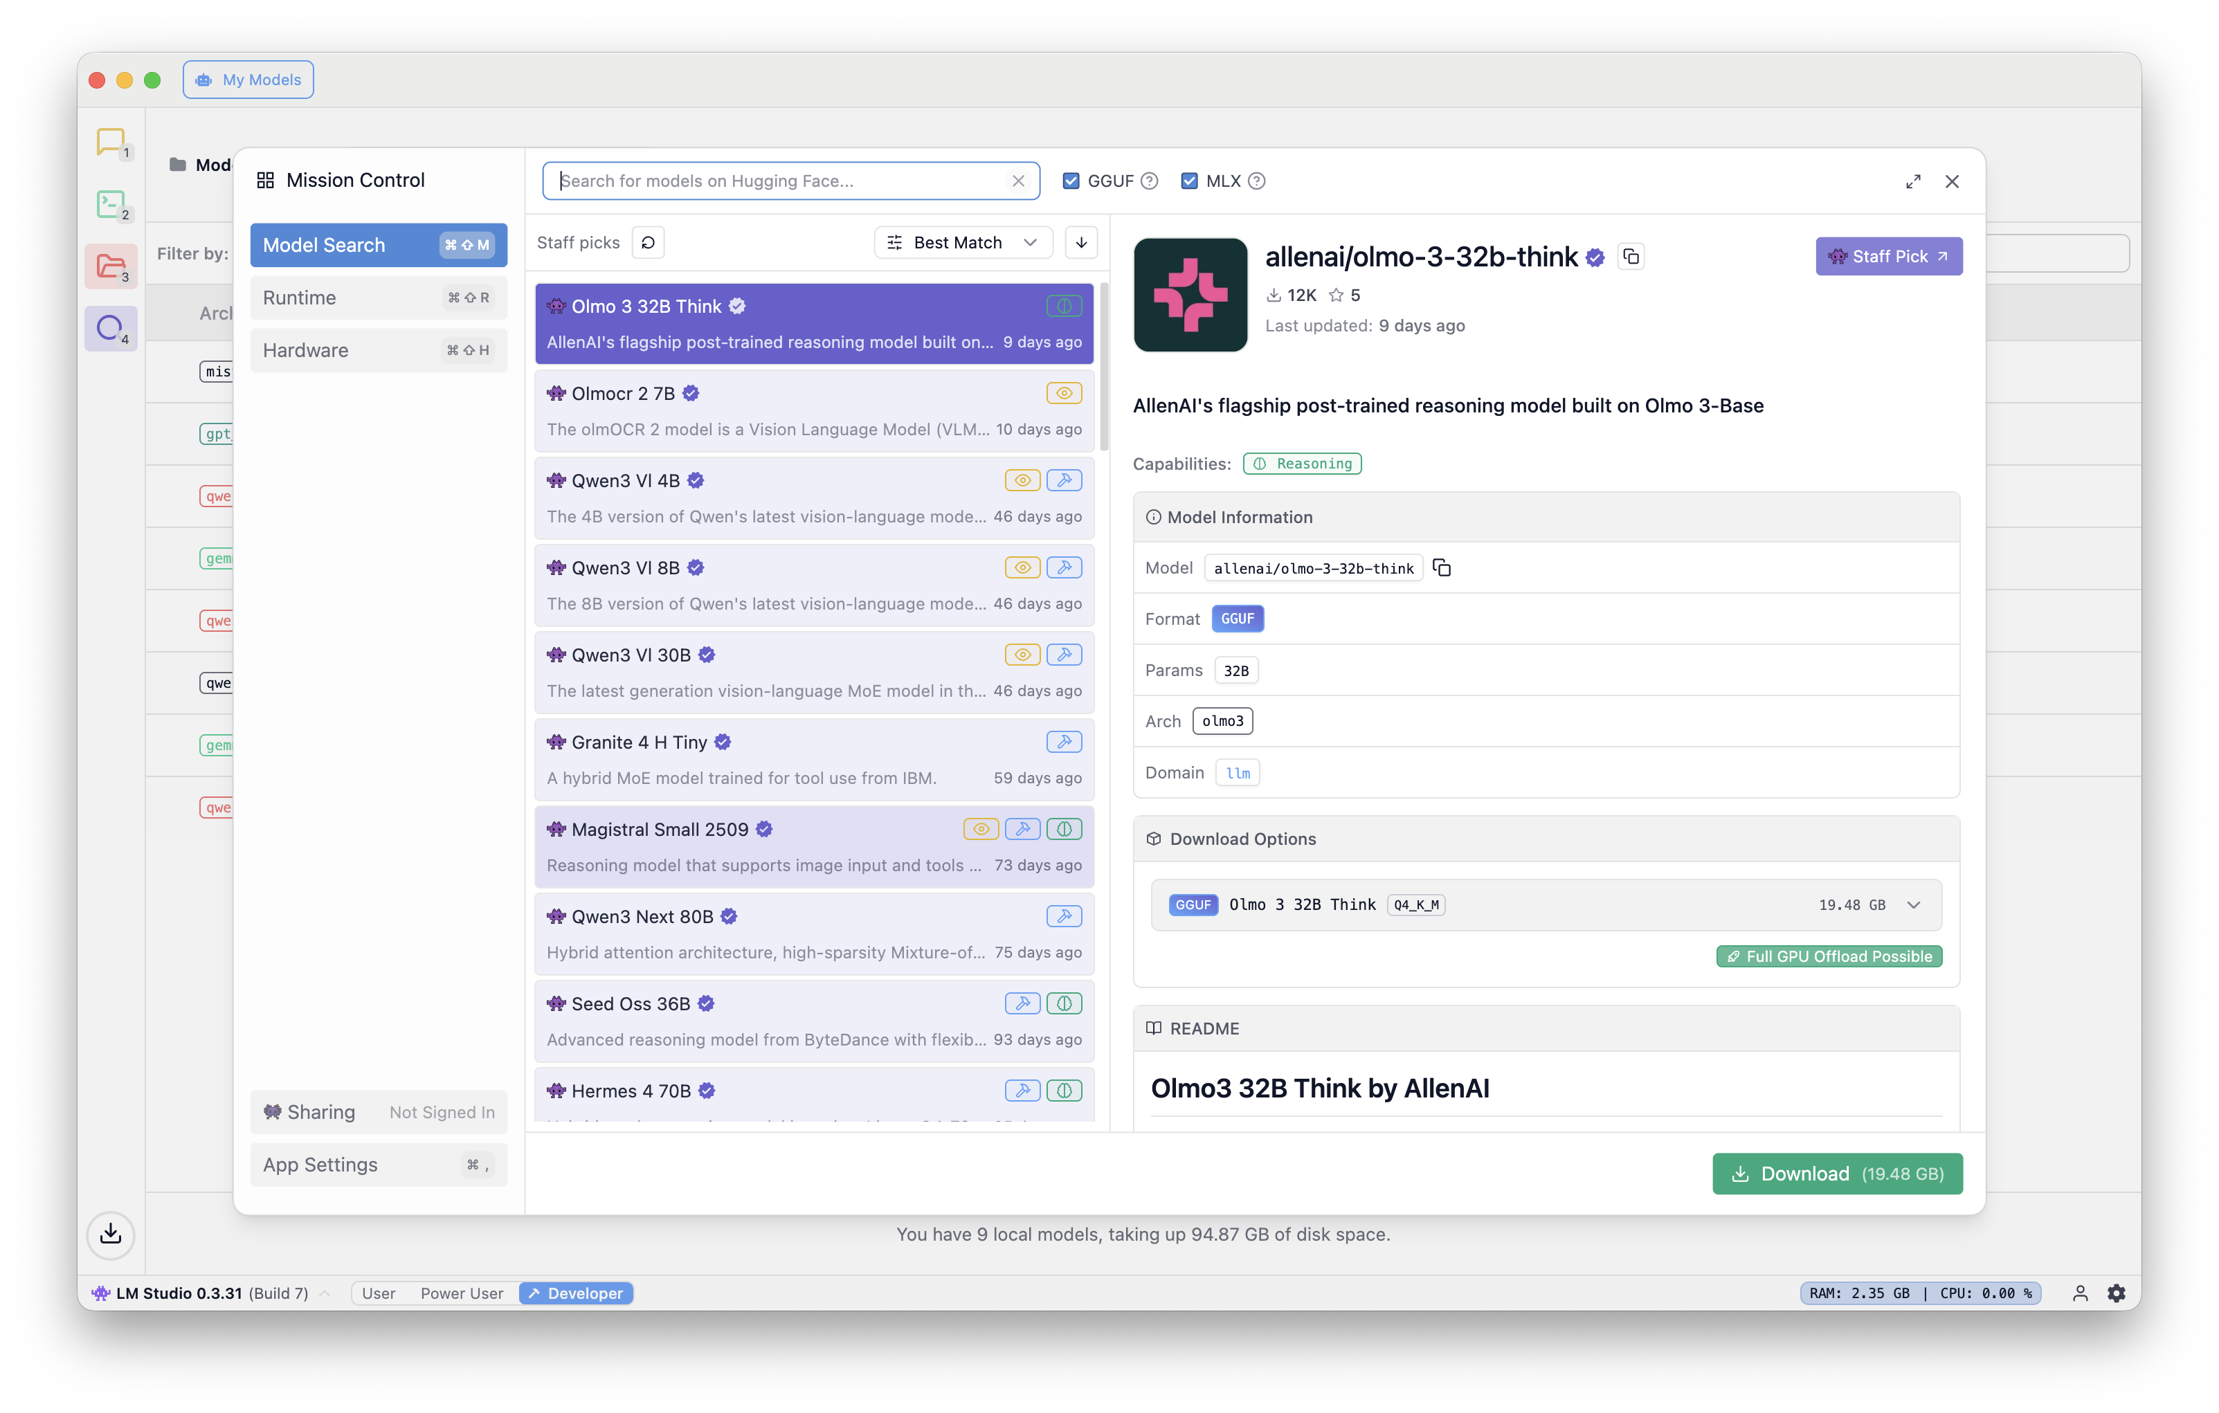
LMStudio – Downloading a model

Slide 9


LMStudio – Starting the server

Slide 10
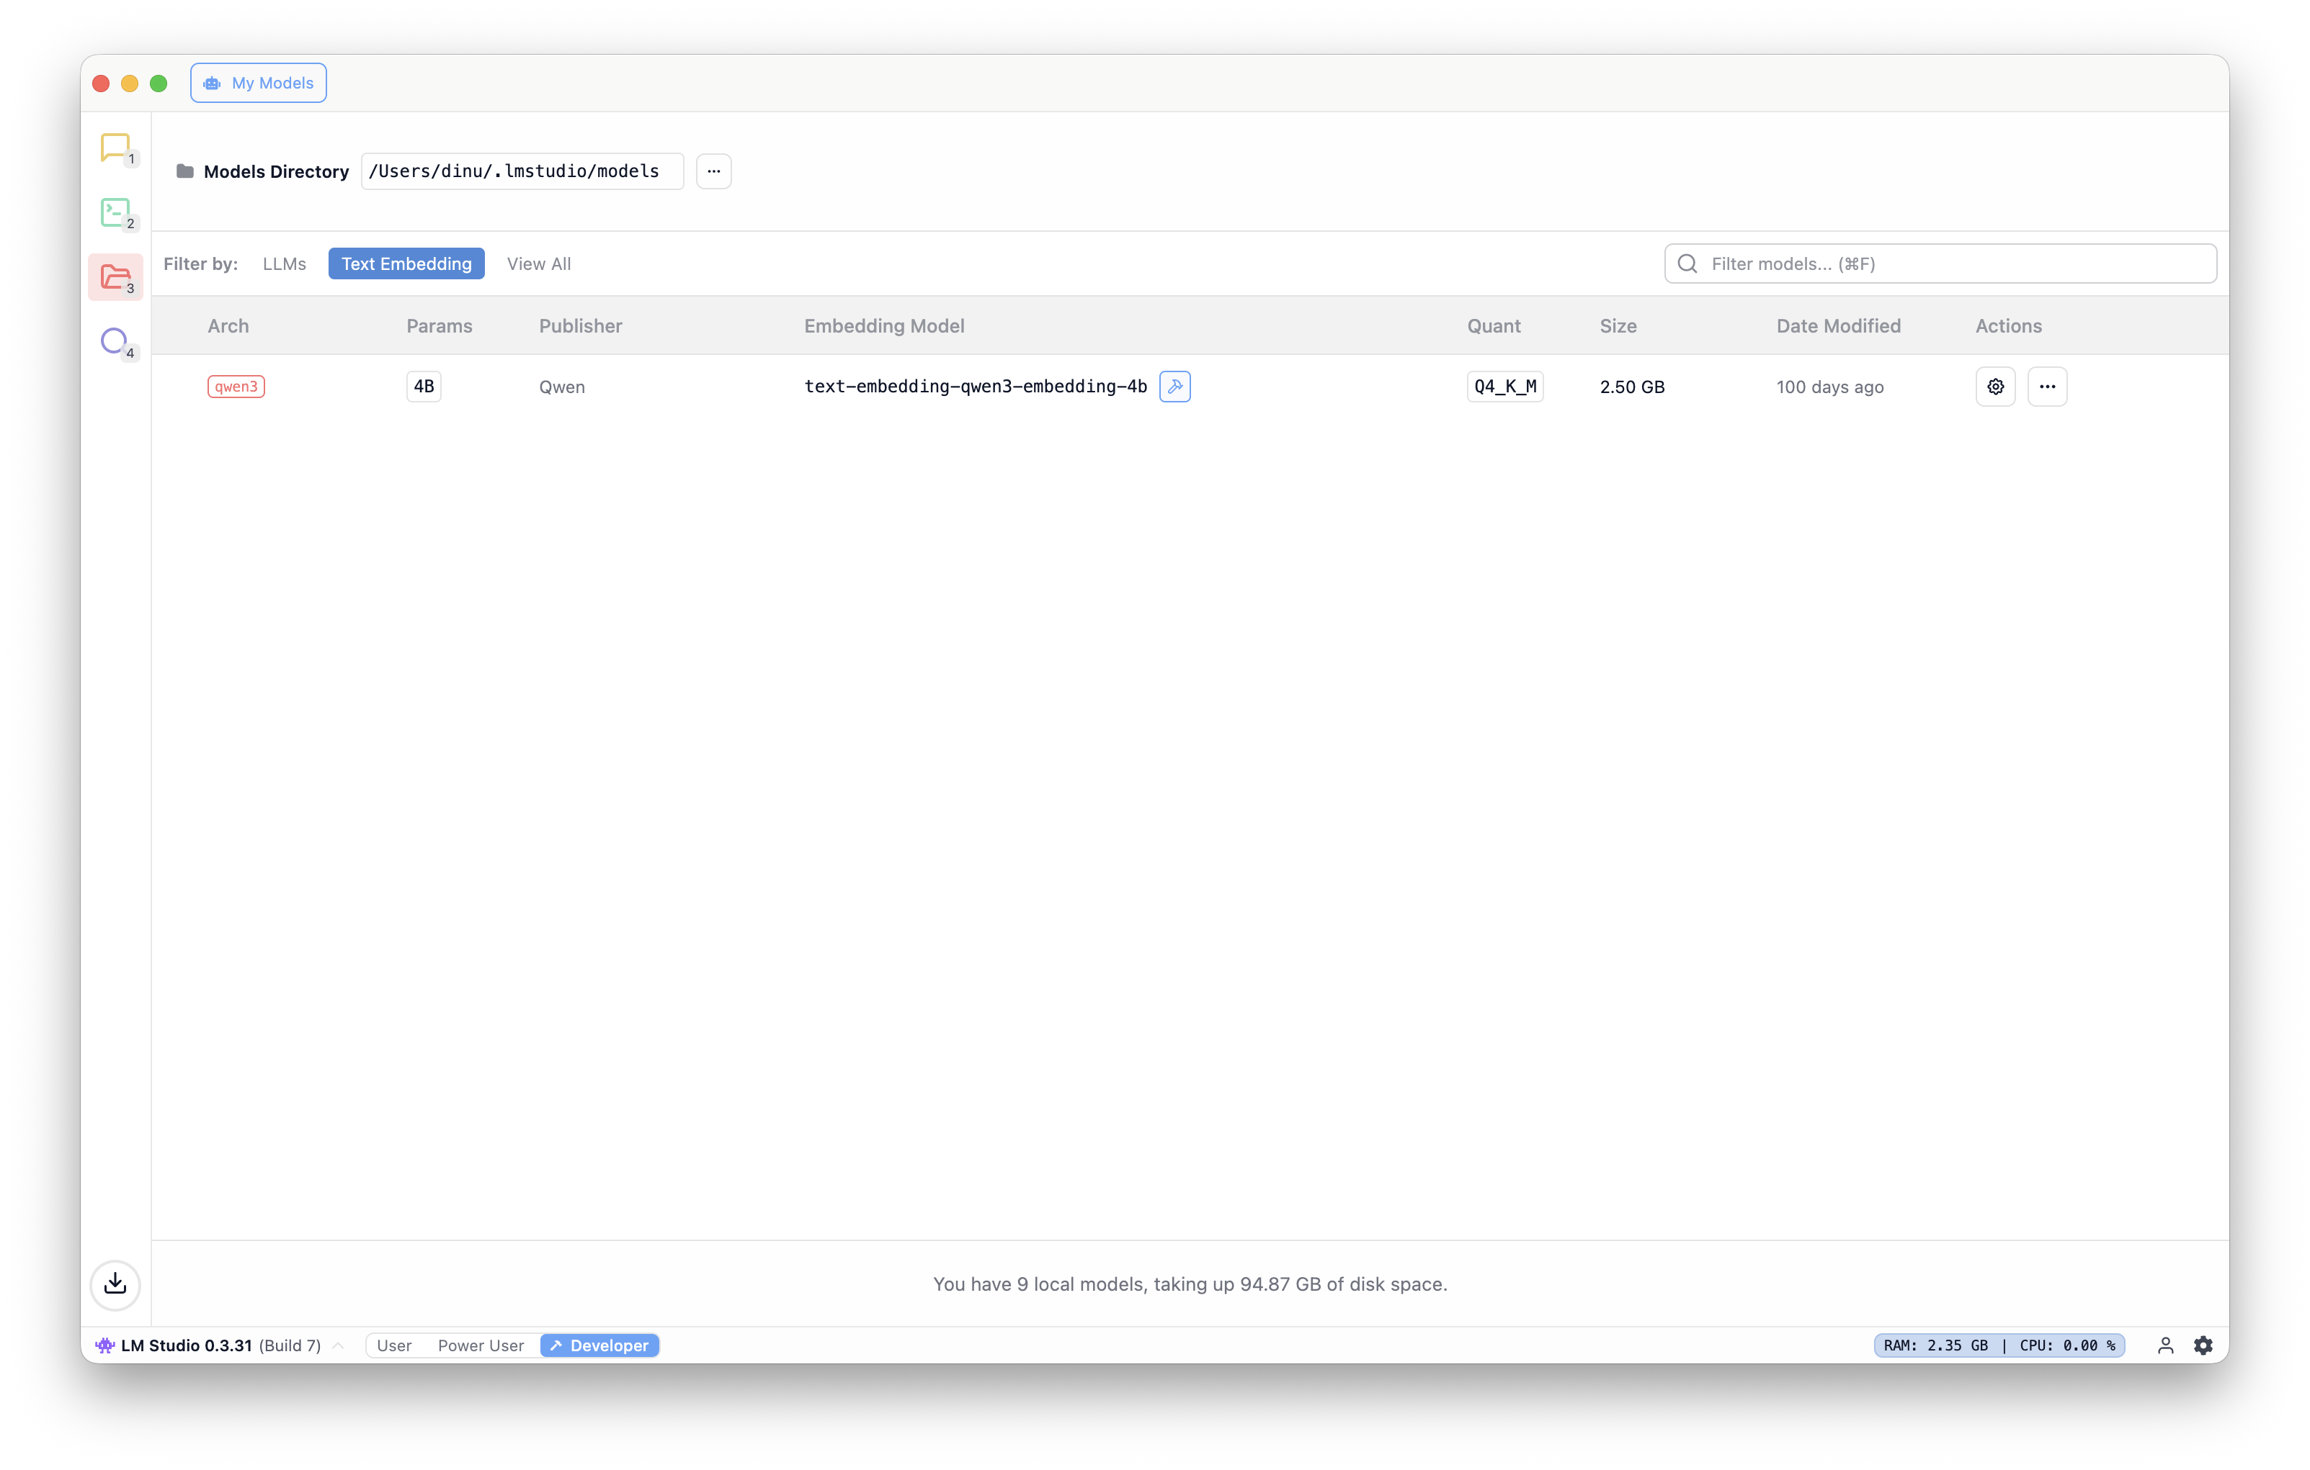
LMStudio – Selecting embedding models

Slide 11
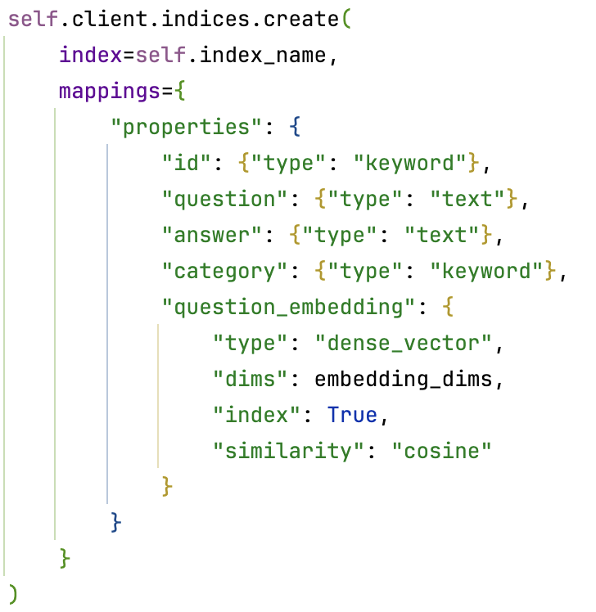
Creating an index

Slide 12
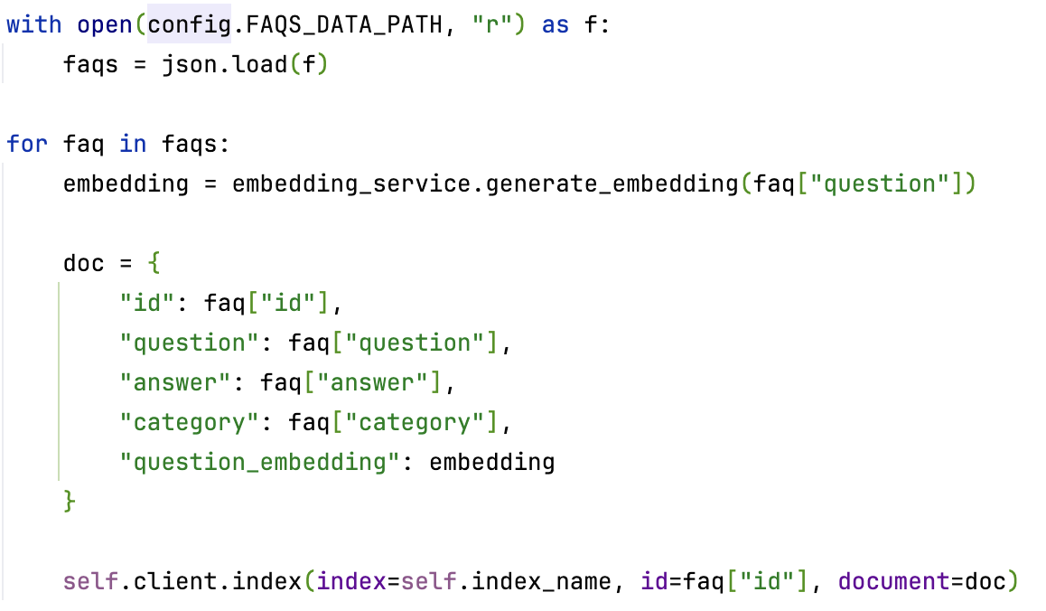
Indexing documents

Slide 13
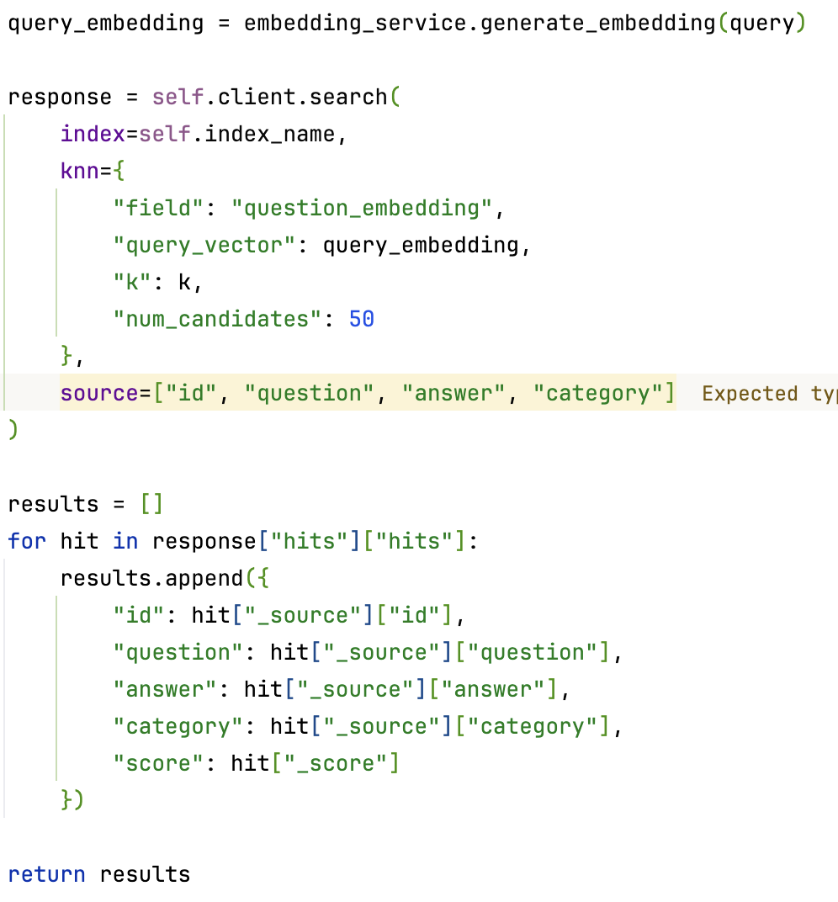
Searching text

Slide 14
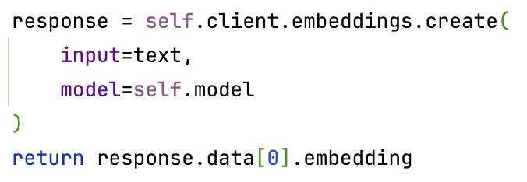
Generating embeddings

Slide 15

Libraries used
The openai library is used to generate vector embeddings from text. It connects to an OpenAI-compatible API (likely a local one, such as LMStudio) to create these embeddings.
The elasticsearch library is used to store and search these vector embeddings. It acts as a vector database, allowing the application to perform semantic searches to find the most relevant documents for a given query.

Slide 16
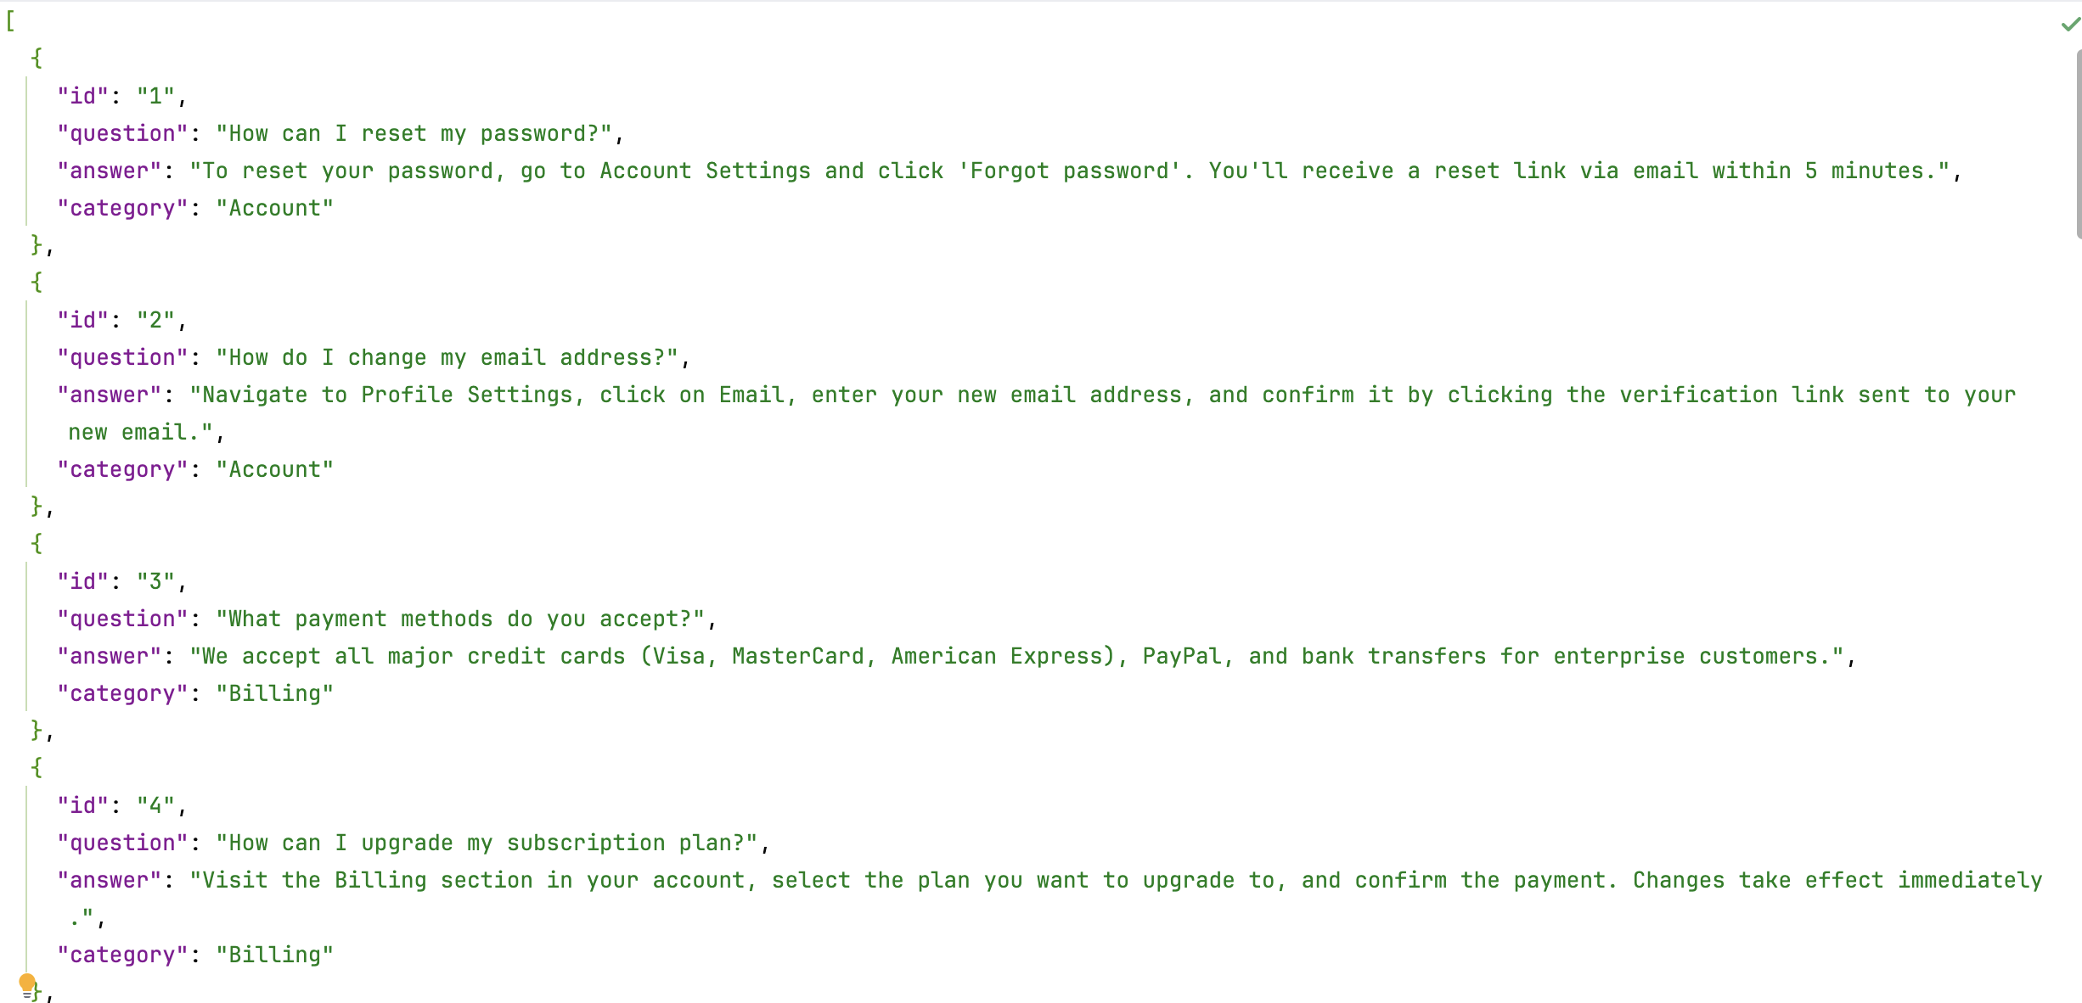
Initial dataset

Slide 17
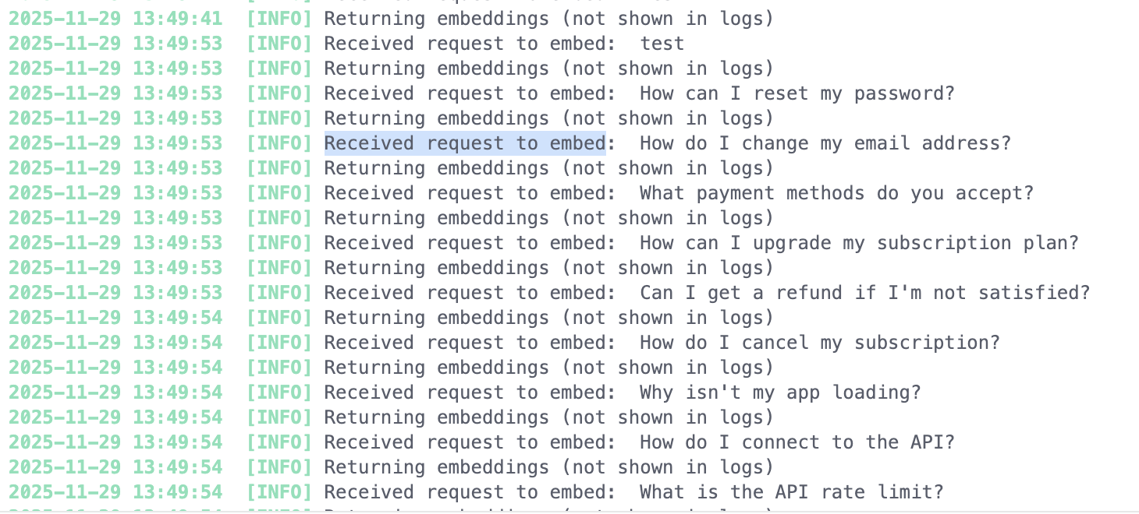
Embedding dataset

Slide 18
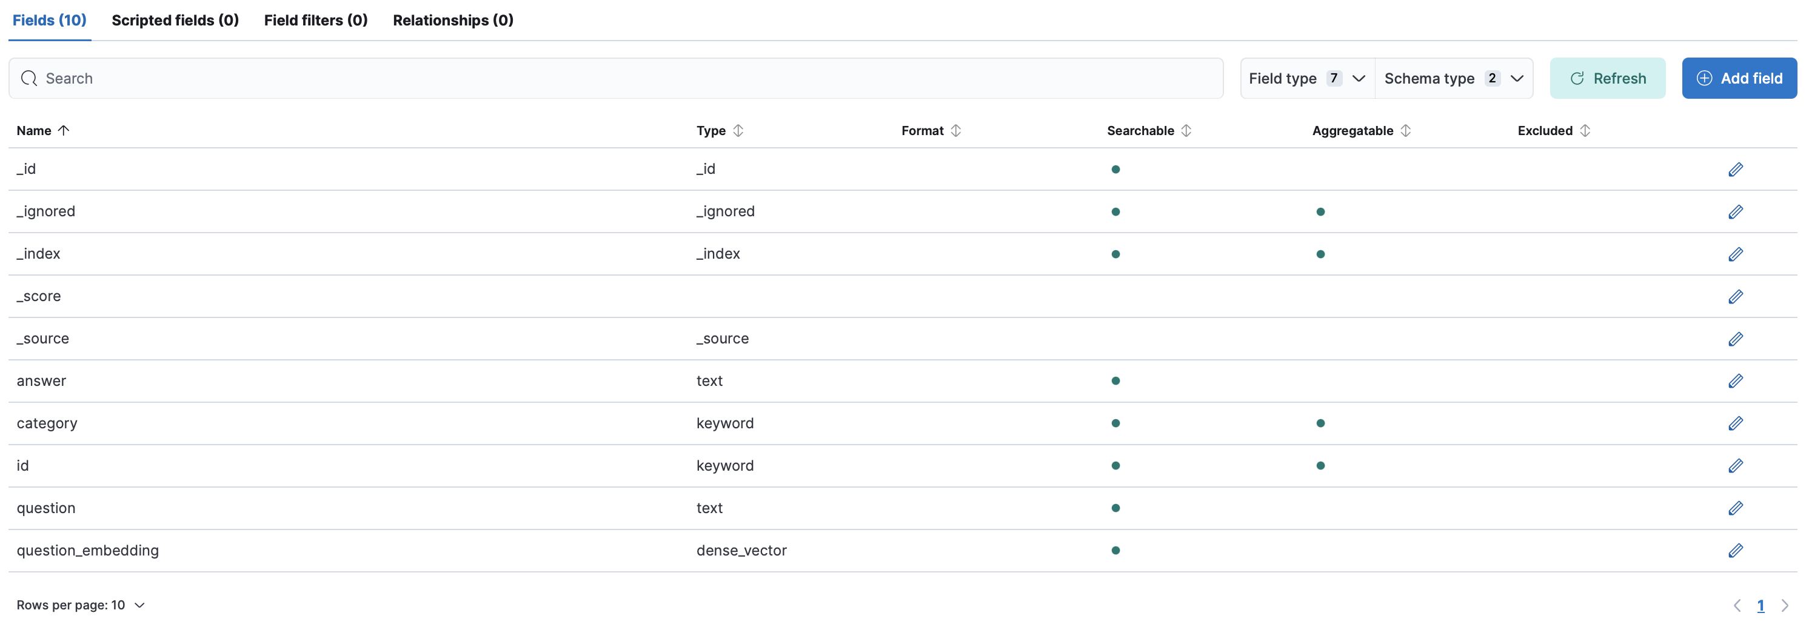
Elasticsearch Model

Slide 19
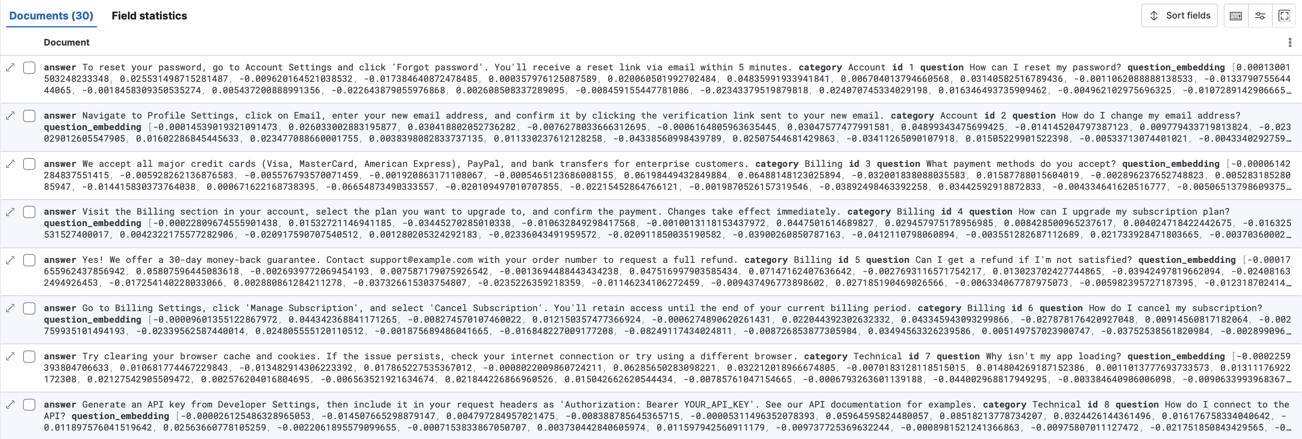
Index visualization

Slide 20
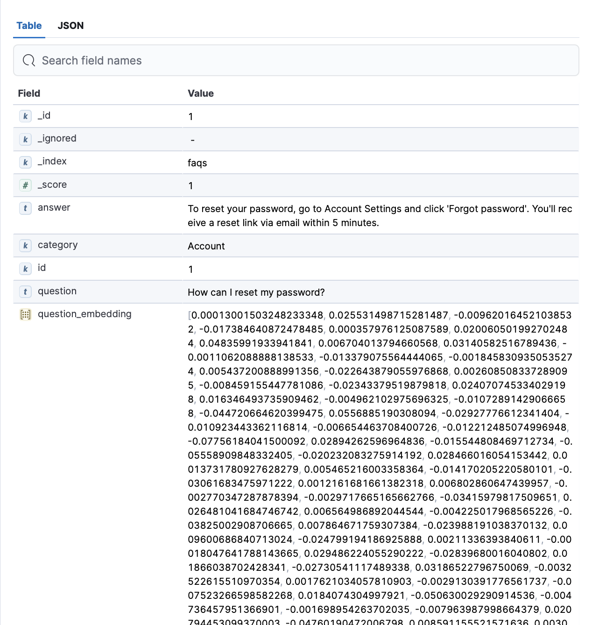
One document’s values

Slide 21
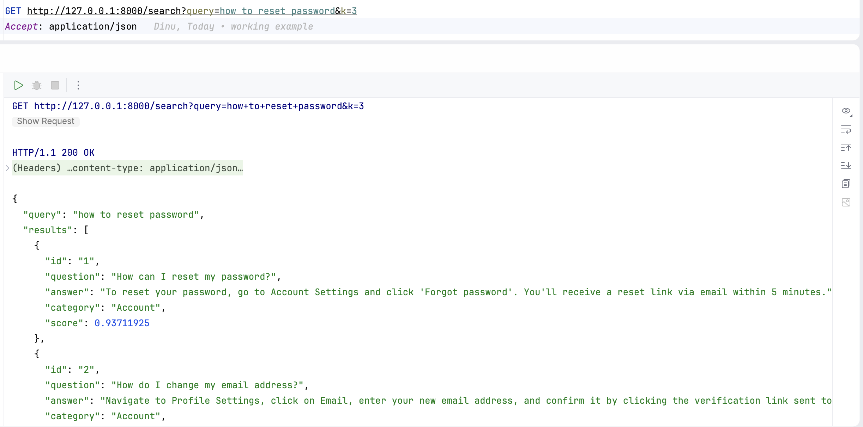
Querying the embeddings

Slide 22
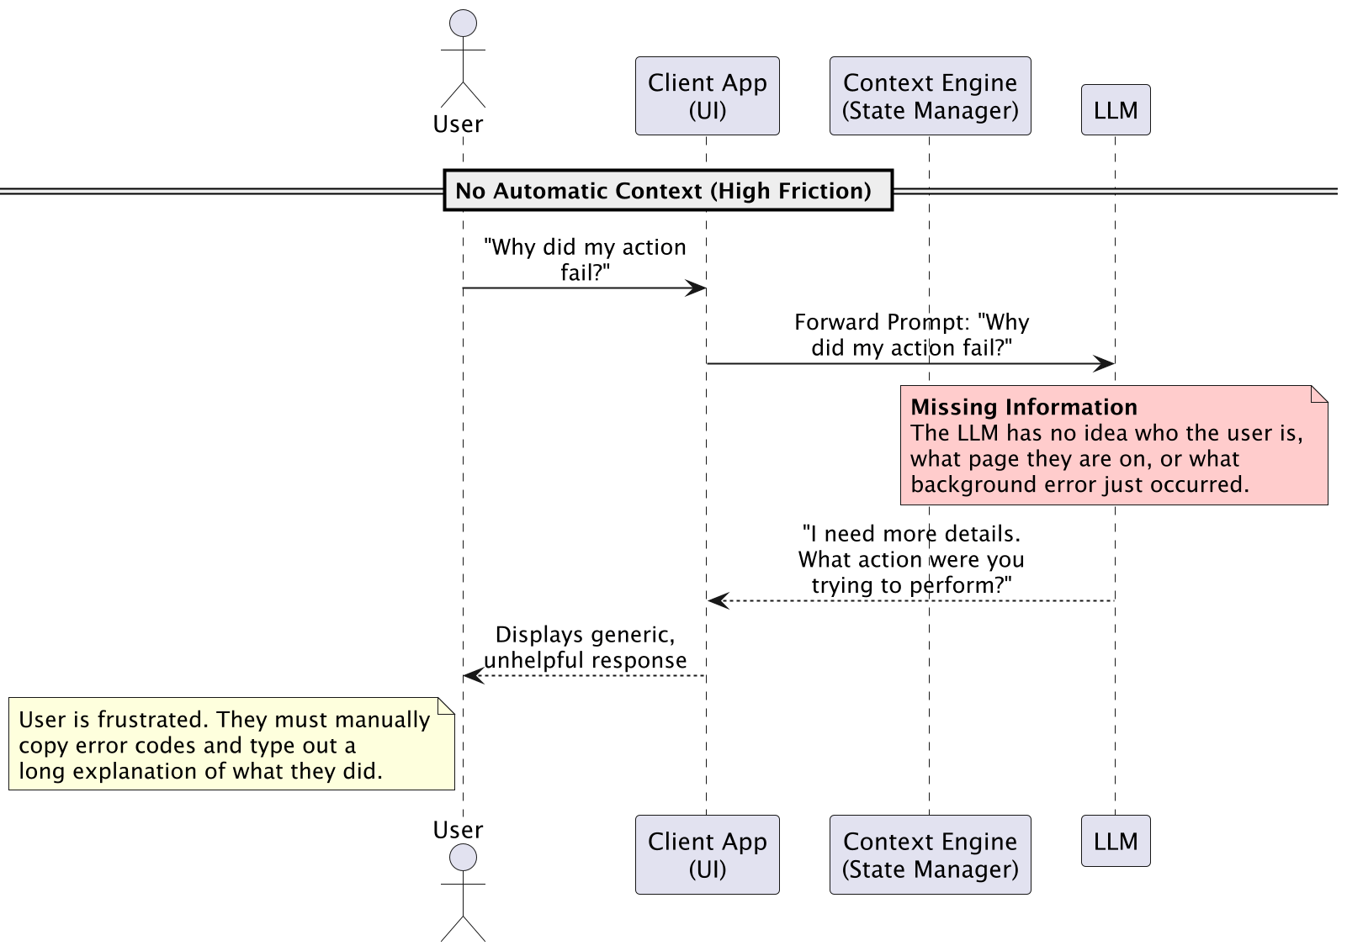
Diagrams

Slide 23
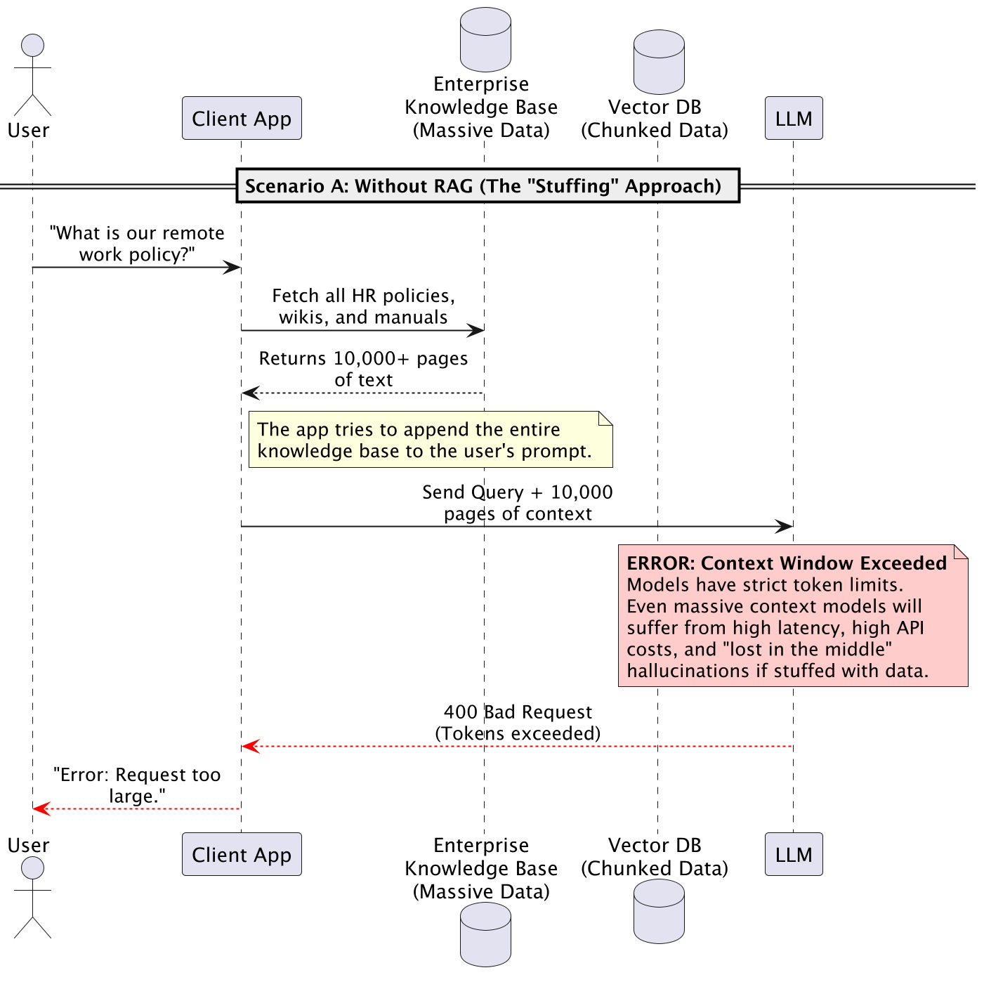

Slide 24
