Slide 1
Mobile and Embedded Computing
Lecture 4. Debugging & Tools, State management techniques

Slide 2
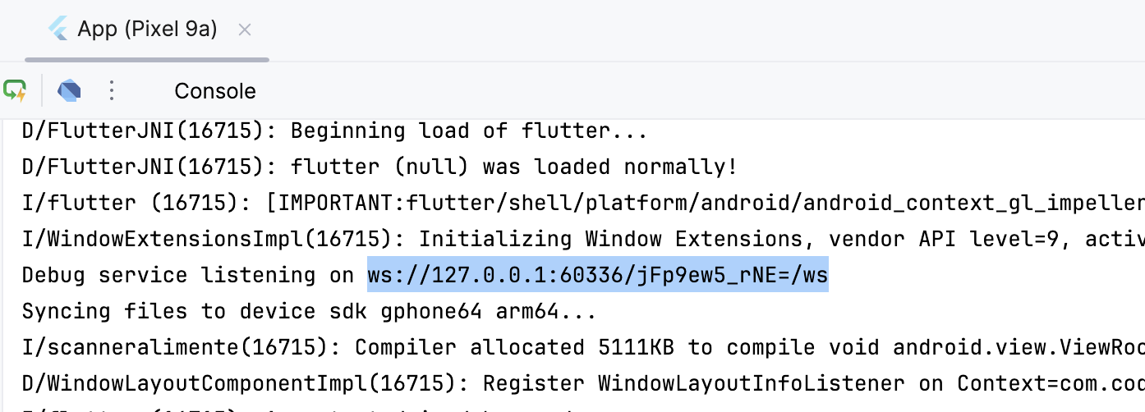
Flutter Dev Tools
Usually on http://127.0.0.1:9100/home
You will need this URL that is printed in the console:

Slide 3
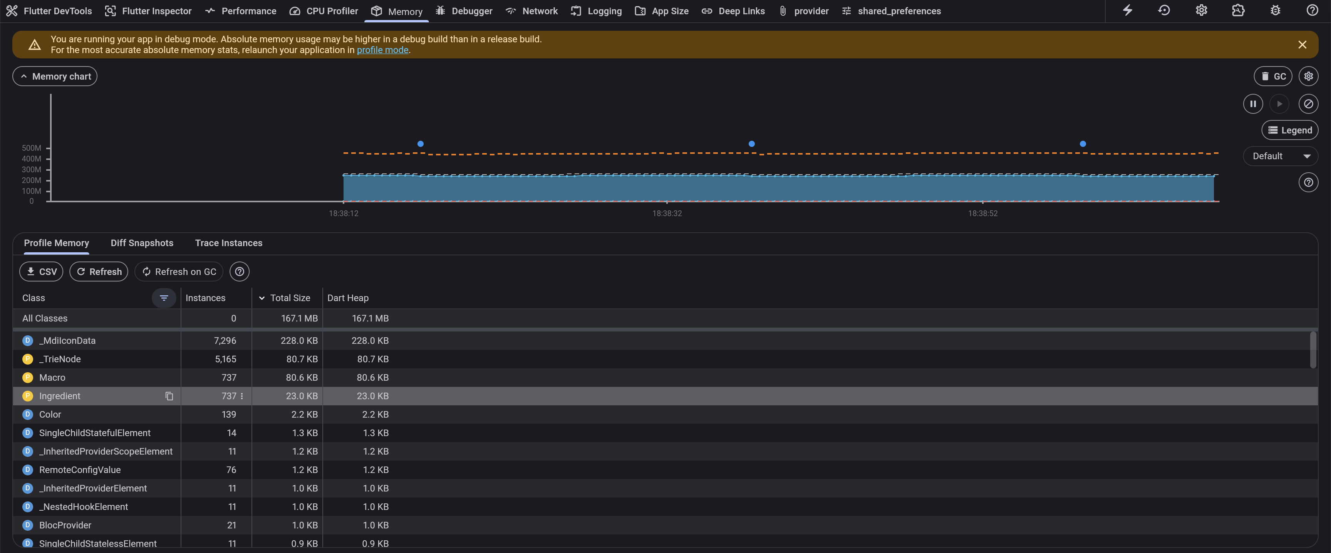
Flutter Dev Tools

Slide 4
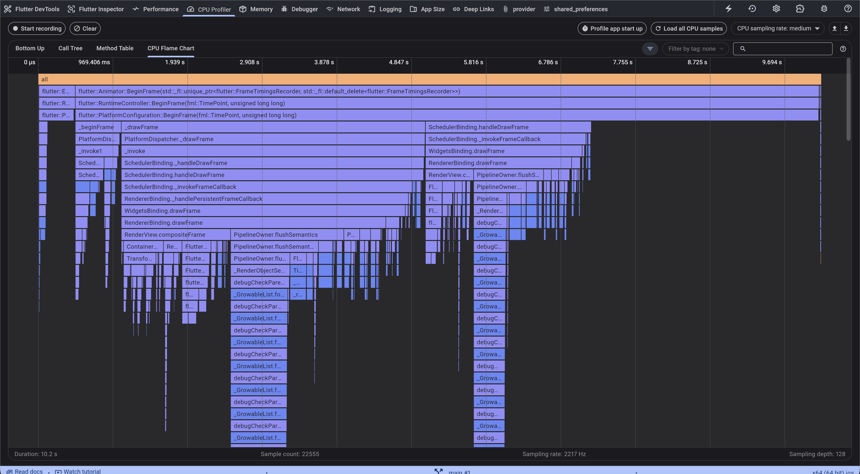
Flutter Dev Tools

Slide 5
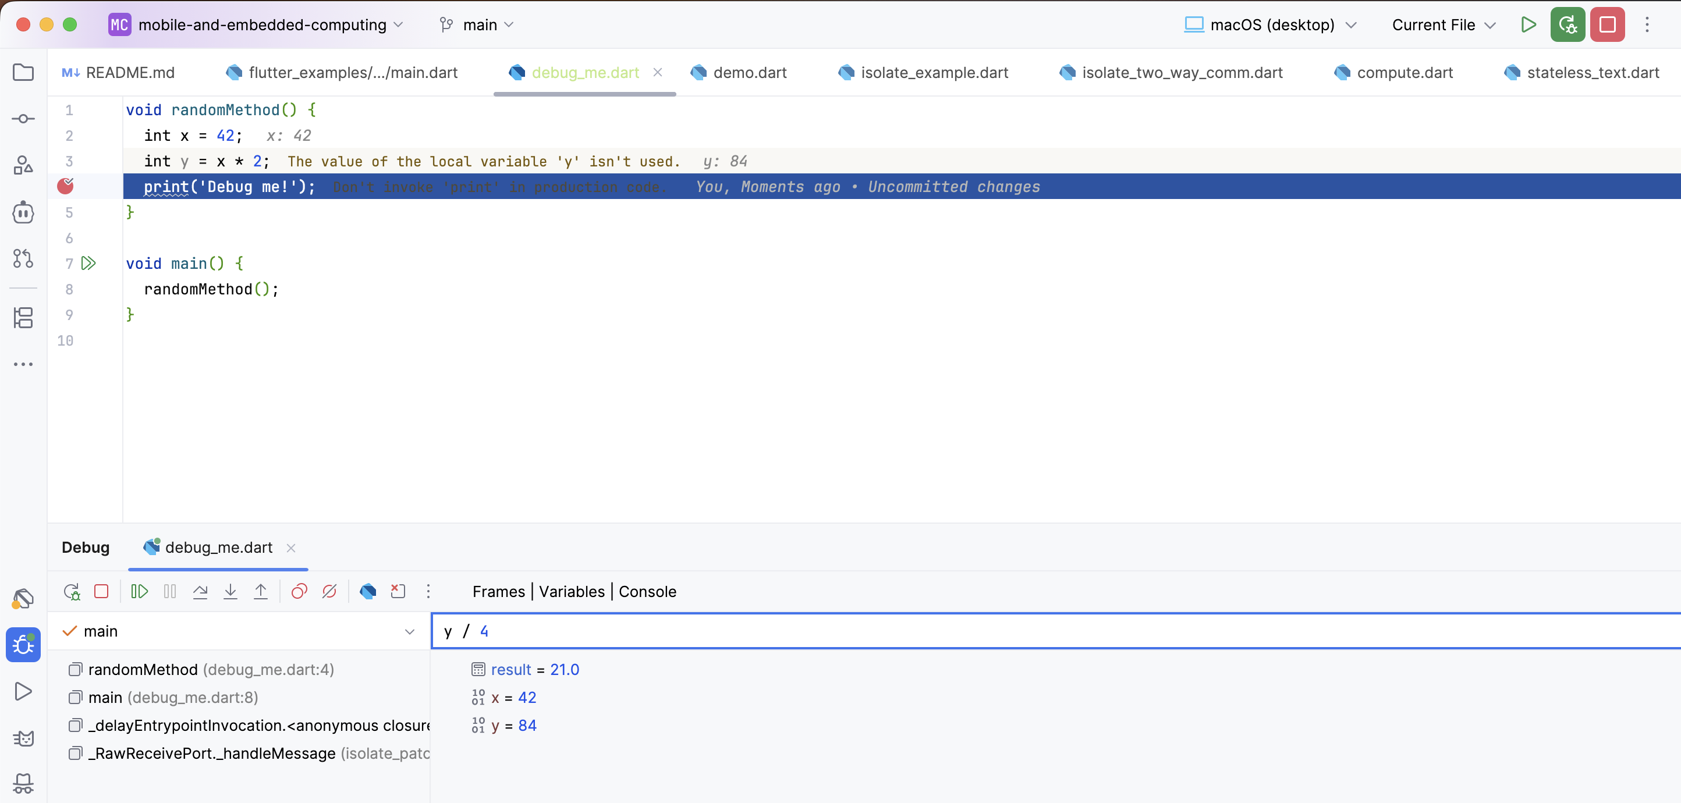
Using a debugger

Slide 6
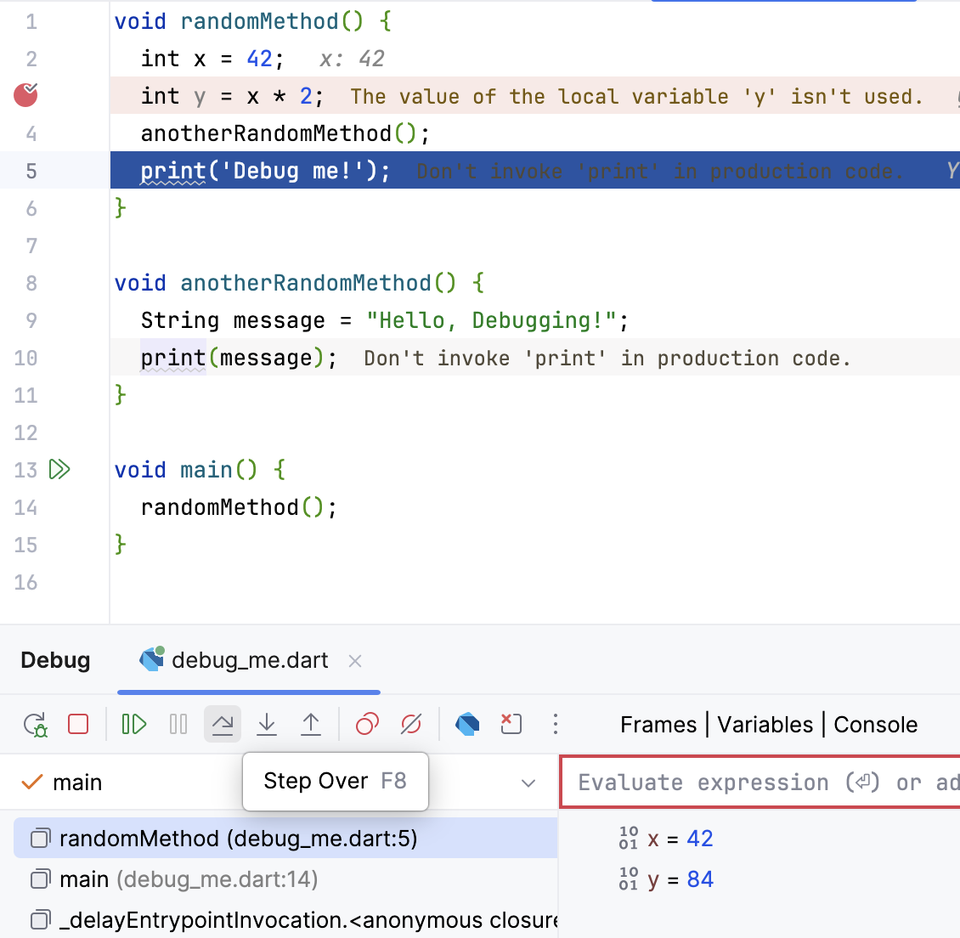
Step Over – Moves line by line without entering in any method

Slide 7
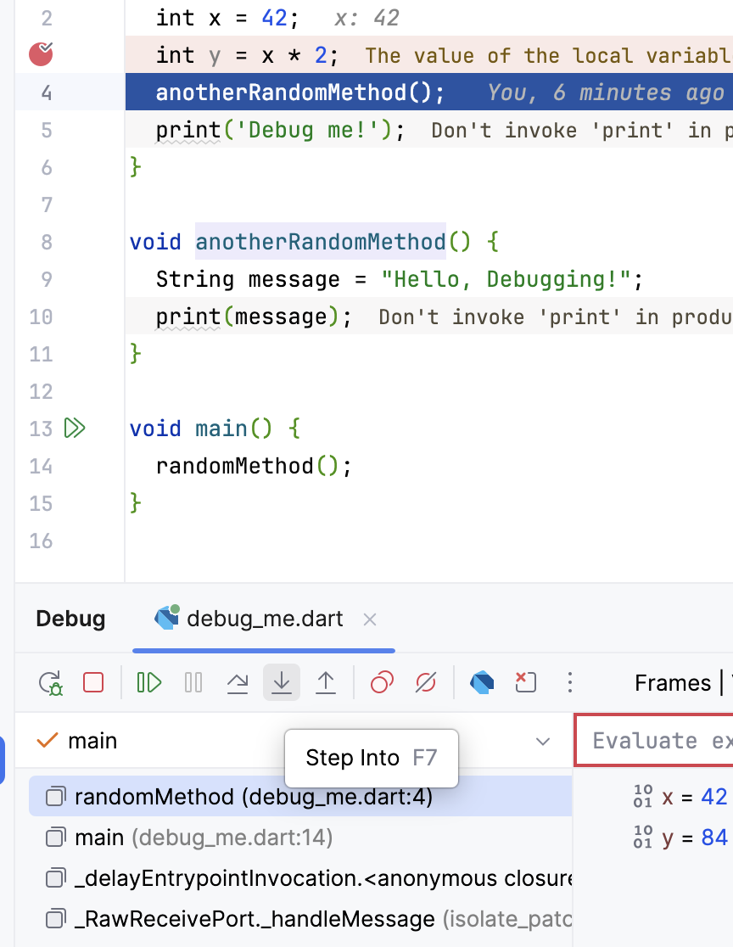
Step Into – If applied on a method, the debugger will move into that method

Slide 8
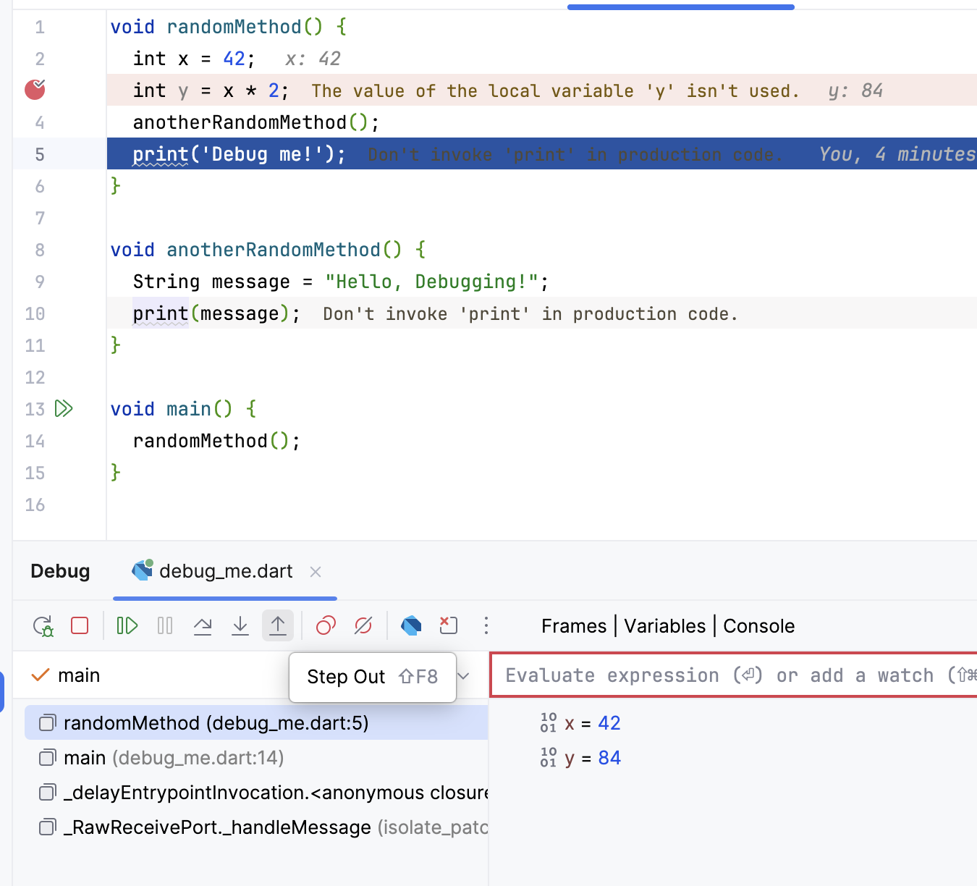
Step Out – Goes out of a method back to the previous one

