Slide 1






Mobile and Embedded Computing
Lecture 1 — Course orientation · Platforms & the device landscape
Dinu-Ștefan Rusu

Slide 2








ORIENTATION
Who's teaching this course
45+
400k
Dinu-Ștefan Rusu
dinu_stefan.rusu@upb.ro
Microsoft Teams — course channel
rusudinu.com
Flutter apps shipped
installs across them
Appeared in, spoken at & partnered with
2

Slide 3
ORIENTATION
The 12 lectures
01
The mobile & embedded landscape; native vs cross-platform; Git & GitHub Today
07
WebSockets; permissions & routing
02
Compiled vs interpreted languages; null safety; Dart & Kotlin; Flutter intro
08
State management techniques; the BLoC pattern
03
Agent-assisted coding; async vs threads (isolates vs goroutines); widgets
09
Authentication; OAuth providers; Firebase App Check
04
Stateless vs Stateful; introduction to state management
10
AI on-device & connecting to LLMs
05
Server vs client-side execution; serverless vs VPS; Go backends & Firebase
11
Deploy to stores & CI/CD; Kotlin Multiplatform
06
GraphQL & REST; observability for mobile (events, Crashlytics)
12
Performance & energy; embedded with TinyGo (sensors → MQTT → your app)
3

Slide 4
ORIENTATION
Grading
3 p
3 p
1.5 p
1.5 p
1 p
Final exam
Laboratory + assignments
Lab test
Project
Concept presentation
in the exam session
individual
individual
teams of max 3
teams of max 3
You pass with a total of ≥ 5 out of 10.
4

Slide 5
ORIENTATION
Concept presentations
Pick a topic from the shared Excel table — first come, first served
Prepare slides that cover ~20 minutes of presentation
If it fits the topic, include a demo — inside the same 20 minutes
Every team member presents their part
Upload all materials to Moodle in the designated space
You present from your own laptop, at the projector
Teams of at most 3 students
Speaking time
20 min ÷ team size
team of 2 → ~10 min each
team of 3 → ~7 min each
5

Slide 6




TODAY
What you should leave with
The device spectrum
The range of devices this course targets — and how their constraints differ by orders of magnitude
Four build strategies
The four ways to build a mobile app, and the trade-offs of each
Why Flutter
Why this course uses Flutter — and what that choice costs
A working Git setup
A GitHub account, and the branch → PR → review workflow the project grades
6

Slide 7

GIT & GITHUB
Git — and the services that host it
Git is a version control system — it tracks every change ever made to your source code
It lets multiple developers work on the same codebase without overwriting each other
Git is a tool on your machine. GitHub, GitLab and Bitbucket are services that host Git repositories and add collaboration on top — reviews, issues, CI
This course uses GitHub
one Git
GitHub · GitLab · Bitbucket
many hosting services
7

Slide 8

GIT & GITHUB
Create a GitHub account — it's mandatory
Sign up, free: github.com/signup
Your commits are part of your grade — labs, assignments and the team project
Every resource for this course lives in one repository:
github.com/rusudinu/mobile-and-embedded-computing
8

Slide 9
GIT & GITHUB
Repositories and branches
A repository holds all the files of your project — and every revision they've ever had
It always has at least one branch (main)
A repository is a Git concept, not a GitHub one — GitHub just hosts it
Branches let you build features, fix bugs and experiment without stepping on your teammates' work
A branch is always created from an existing branch
main → feature/…
9

Slide 10
GIT & GITHUB
The workflow you'll actually use
git clone <repo-url> # once
git checkout -b feature/login-screen
git add .
git commit -m "Add login screen"
git push -u origin feature/login-screen
# open a Pull Request → review → merge
git checkout main && git pull
This loop is your grade.
The project is graded on exactly this:
one branch per feature
pull requests with peer review
commits from every team member
10
Notes:
Live demo opportunity: run this loop once in front of the class. Emphasize that the graders look at the repo history — branches, PRs, reviews, and per-student commit distribution.

Slide 11
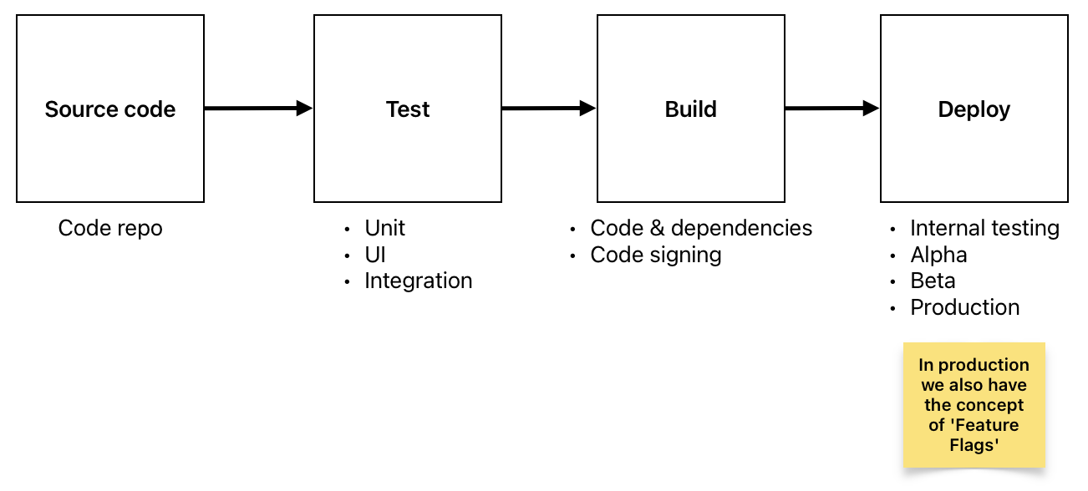
GIT & GITHUB
Pull requests — and what happens after merge
A pull request starts the process of merging your branch into the main branch
A peer reviews the changes and approves — or requests changes
Until the author receives all required approvals, the PR stays open
After merge, a CI pipeline takes over: test → build → deploy
The CI pipeline — we come back to this in Lecture 11, deploy & CI/CD
11

Slide 12
THE DEVICE LANDSCAPE
What is “mobile and embedded” computing?
The device landscape — and why it changes how you write software

Slide 13






THE DEVICE LANDSCAPE
One spectrum: from the cloud to a microcontroller
 | Cloud | Laptop | Phone | Wearable | SBC | MCU
RAM | 100s of GB | 16–32 GB | 8–16 GB | 1–2 GB | 1–8 GB | ~0.5 MB
Storage | TB – PB | ~1 TB | 128–512 GB | ~32 GB | SD card | ~4 MB flash
Power | grid, kW | ~60 W | ~5 W, battery | ~1 W, battery | ~5 W | milliwatts
OS | Linux | macOS / Win | Android / iOS | watchOS / Wear | Linux | RTOS / none
This course lives on the right half of this table — where resources are scarce and the power cable is gone.
13
Notes:
Orders of magnitude are the point, not exact numbers. A phone has ~10,000x less RAM headroom than a cloud box; an MCU has ~10,000x less than the phone. Numbers are 2026-typical: flagship phones 8–16 GB RAM; ESP32-class MCU: 520 KB SRAM, 4 MB flash, milliwatt budgets.

Slide 14





THE DEVICE LANDSCAPE
What changes when you leave the desktop
Battery is a first-class resource
Thermal limits
Intermittent connectivity
Every CPU cycle and radio wake-up costs energy — we measure this in Lecture 12
Sustained load throttles the SoC — you can't just “use more CPU”
Offline is a normal state, not an error — apps must be designed for it
You don't control deployment
Sensors & radios
ARM everywhere
App-store review, staged rollouts, and users who never update
GPS, accelerometer, camera, BLE — capabilities desktops don't have
From flagship phones down to microcontrollers — a different ISA than most servers
14

Slide 15




THE DEVICE LANDSCAPE
What every app negotiates for
CPU
RAM
Storage
GPU
Battery
compute
working memory
NAND flash
graphics & ML
mobile-only: a finite budget
On a desktop, the first four are effectively elastic. On mobile, all five are hard budgets — and the battery is the one you can't refill from code.
Next: one concrete resource negotiation, start to finish.
15

Slide 16
THE DEVICE LANDSCAPE
Resource allocation in action: loading an LLM
App asks the OS to load an LLM
Enough free VRAM?
yes
Weights load into VRAM → GPU-fast
Unified memory
no
Macs and phones share one memory pool between CPU and GPU — much more effective “VRAM” for LLMs than a PC with a discrete GPU.
Enough free RAM?
yes
Weights load into RAM → runs, slower
no
Model fails to load
On-device AI is a resource-allocation problem. Keep this slide in mind for Lecture 10, AI on-device.
16

Slide 17
STRATEGIES
Four ways to build a mobile app
Web · Native · Cross-platform, two flavors — and how to choose

Slide 18


STRATEGIES
The baseline — native apps
Platform-specific: built for one OS, with that OS's own SDK and tools
Best possible performance, full access to every platform capability
Native UI components — the platform's own look and behavior
Works fully offline; distributed through Google Play / the App Store
iOS
Swift / SwiftUI — Xcode
Android
Kotlin / Jetpack Compose — Android Studio
Everything on the next slides is ultimately built on top of these two platform SDKs.
18

Slide 19
STRATEGIES
Strategy 1 — the web: web apps & PWAs
What you get
What you give up
+ Opens from a URL — no installation, no store review
+ Updates reach every user instantly
+ One codebase, every platform with a browser
+ PWAs: installable, offline-capable, HTTPS-only
− Limited sensor & hardware access — BLE, NFC, background GPS
− No reliable background execution, especially on iOS
− Browser performance ceiling — and WebKit-only on iOS
− No store presence — a different discoverability model
Web apps have an architecture zoo of their own — SSR, SSG, CSR — that's a web-course topic. Here we only care how the web option compares to the next three.
19

Slide 20

STRATEGIES
Strategy 2 — cross-platform: two architectures
React Native — drive native widgets
Flutter — draw every pixel
Your JavaScript / TypeScript code
Your Dart code — AOT-compiled to native
JSI + Fabric — no serialized bridge since RN 0.76
Impeller renderer — draws the entire UI
Real native widgets on each OS
Identical UI on every platform
UI is genuinely native — per-platform look & feel
JS can update over the air (Expo EAS Update)
Every interaction crosses the JS ↔ native boundary
One rendering pipeline — no per-platform differences
Talks to the OS via platform channels (→ Lecture 12)
Hot reload during development
20
Notes:
History for the curious: RN's old async 'bridge' serialized JSON between JS and native — retired with the new architecture (default since RN 0.76, Oct 2024). CodePush was the classic OTA service; Microsoft retired it in March 2025, Expo EAS Update is the mainstream successor. Flutter: Impeller replaced Skia; since Flutter 3.44 Skia is fully removed on iOS and Android 10+.

Slide 21
STRATEGIES
Strategy 3 — Kotlin Multiplatform: share the logic
Shared Kotlin module
business logic · networking · storage · models
Share as much — or as little — as you choose
Kotlin compiles natively per platform (Kotlin/Native for iOS)
Stable since Nov 2023; Compose Multiplatform for iOS stable since May 2025
In production at McDonald's, Netflix, Forbes
We build a shared KMP module in Lecture 11
Android app
Jetpack Compose UI
iOS app
SwiftUI — or Compose Multiplatform
expect / actual bridges the platform-specific parts
Flutter shares everything, including the pixels. KMP shares exactly as much as you choose — and keeps each platform's native UI.
21

Slide 22
STRATEGIES
How to choose — and why this course uses Flutter
If you…
Reach without installs, light hardware needs
Why Flutter, here
→ Web / PWA
One codebase — a team of 3 can build the whole semester project
Hot reload — fast iteration in the labs
One renderer — what you see in the emulator is what you ship
Your instructor ships Flutter for a living — 45+ apps, 400k installs
Team lives in JS/React, wants native UI feel
→ React Native
Existing native apps, want shared logic
→ Kotlin Multiplatform
The honest trade-offs
One team, pixel-identical UI, fast iteration
Bigger binaries than native apps
Platform-channel overhead when talking to the OS (→ Lecture 12)
Dart is knowledge you may not reuse outside Flutter
→ Flutter
22

Slide 23
EMBEDDED
And where does “embedded” fit in?
The same constraints, taken to the extreme: kilobytes of RAM, milliwatt power budgets, no OS to help you
The phone becomes the hub: nearby devices talk to your app over BLE or MQTT, and your app talks to the cloud
In Lecture 12: a TinyGo program on a microcontroller publishes sensor data — and your Flutter app consumes it live
Sensor + MCU
ESP32-C3 · TinyGo
Your Flutter app
the hub — via MQTT / BLE
Cloud
storage · dashboards · ML
Hardware note
TinyGo's happy path is the ESP32-C3 / S3 (Wi-Fi support since TinyGo 0.41) or the Raspberry Pi Pico — not the original ESP32, whose support is minimal.
23

Slide 24


ROADMAP
The semester, pinned onto the spectrum
cloud
microcontroller
Cloud & backend
The phone
Embedded
L5
Serverless, VPS & Go backends
L2
Dart, Kotlin & Flutter
L12
Performance & energy
L6
GraphQL, REST & observability
L3
Widgets & async
L12
TinyGo: sensors → MQTT → app
L7
WebSockets, permissions, routing
L4+8
State management & BLoC
L9
Auth, OAuth & App Check
L10
AI on-device & LLMs
L11
Stores, CI/CD & KMP
You'll see this map again at the start of every lecture — with a pin on where we are.
24

Slide 25



Before next week
Recap
This week
Read more
One spectrum, cloud → microcontroller — the right half is ours
Four strategies: web, native, cross-platform, KMP
We chose Flutter, with the trade-offs on the table
Create your GitHub account and open the course repo
Install the Flutter SDK — Lab 1 walks you through it
Start thinking about teammates and a project idea
flutter.dev/multi-platform
kotlinlang.org/multiplatform
tinygo.org
developer.android.com · developer.apple.com

