Slide 1
Hand Gesture Controlled Robot Car using ARDUINO Lilypad
SOFTWARE GROUP PROJECT
DOMAIN : IoT
SEMESTER : 4
DEPSTAR - CSE

Slide 2
CONTENTS
Literature Review and Problem Statement
Current System
Proposed System
Hardware and Software Requirements
Planning(Gantt Chart)
Future Scope
Conclusion

Slide 3


1. LITERATURE REVIEW
Different technologies have been implemented for hand based recognition system and few of them have shown good results. The ultimate goal is to control certain systems like smartphones, air conditioners using these techniques. One of the most common approach is data glove based approach. In this approach there are sensors attached to glove which acquire the gestures and the signals generated by sensors are processed and corresponding instructions are performed. One example of this is gesture to speech conversion in which hand gestures are converted into speech with the help of complex computational algorithms. Different technologies have been implemented for hand based recognition system and few of them have shown good results.

Slide 4
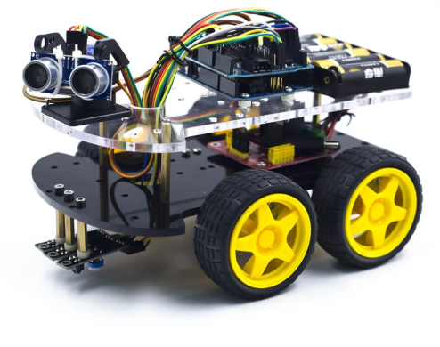
The ﬁrst is the transmitting section which includes the following components:
Arduino
Accelerometer
Comparator IC
Encoder IC
RF Transmitter
The second is the receiving end which
comprises of following main components:
RF Receiver Module
Decoder IC 9

Slide 5
PROBLEM STATEMENT
To build a Wireless Hand controlled Robot will function by a wearable hand glove from which the movements of the hand can be used as the input for the movement of the robot.

Slide 6
2. CURRENT SYSTEM
Through the use of gesture recognition, remote control with the wave of a hand of various devices is possible.
Gesture controlling is very helpful for handicapped and physically disabled people to achieve certain tasks, such as driving a vehicle.
Gestures is used to control interactions for entertainment purposes such as gaming to make the game player's experience more interactive or immersive.

Slide 7
3. PROPOSED SYSTEM
Gesture Controlled Robot car is a robot which can be controlled by simple gestures. The user just needs to wear a gesture device which includes a sensor. The sensor will record the movement of hand in a speciﬁc direction which will result in the movement of the robot in the respective direction. The robot and the Gesture device are connected wirelessly via radio waves. The wireless communication enables the user to interact with the robot in a more friendly way.

Slide 8
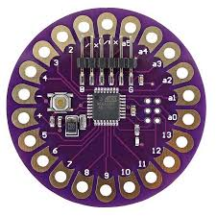
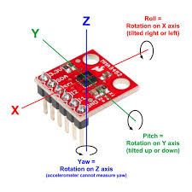
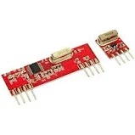
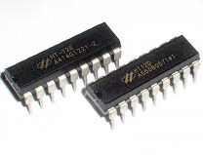
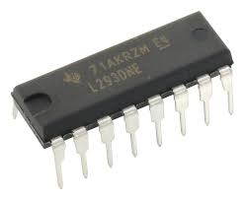
4. HARDWARE REQUIREMENTS
Arduino Lilypad
Accelerometer
RF 433 Module
HT12E and HT12D
Motor Driver L293DNE
BO Motor and Wheels
Prototyping Board
Battery and Jumper wires

Slide 9
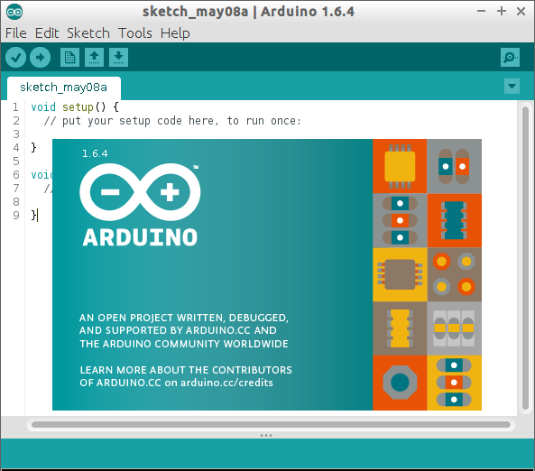
SOFTWARE REQUIREMENTS
Arduino IDE - 1.6.4

Slide 10
5. GANTT CHART
Gathering of components
50% Implementation
26/01/2020 | 20/02/2020 | 15/03/2020 | 8/04/2020
30% Implementation
100% Implementation

Slide 11
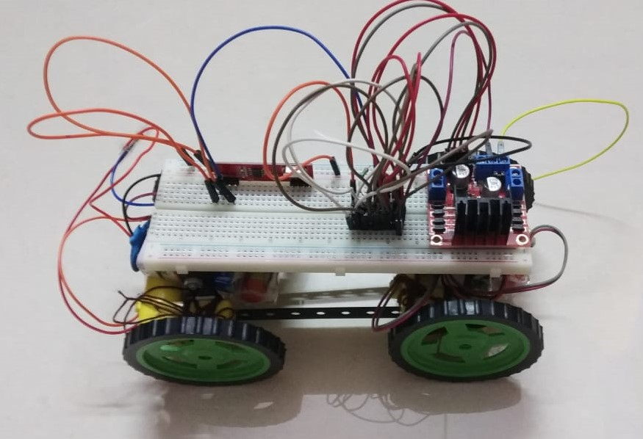
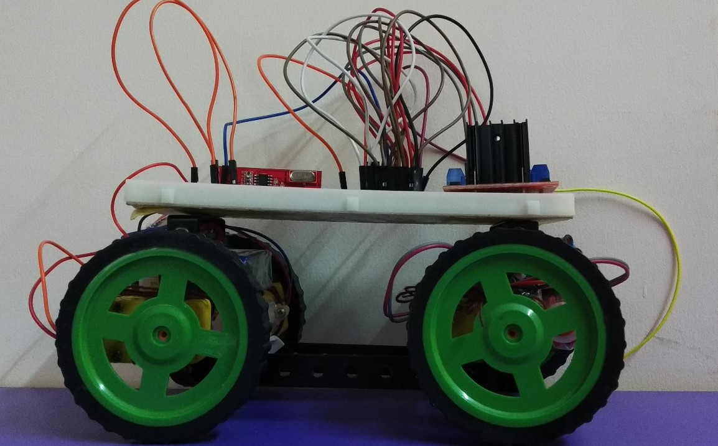
Snapshots of project

Slide 12
6. FUTURE SCOPE
Wireless controlled robots are very useful in many applications like remote surveillance, military etc.
Hand gesture controlled industrial grade robotic arms can be developed.
Automation systems – In homes, offices, transport vehicles and more, gesture recognition can be incorporated to greatly increase usability and reduce the resources necessary to create primary or secondary input systems like remote controls, car entertainment systems with buttons or similar.
An easier life for the disabled – Gesture recognition technology can eliminate a lot of manual labor and make life much easier for those who aren’t as fortunate as most of us are.
Gesture recognition technology is actually dominated by the videogame industry.

Slide 13
7. CONCLUSION
We have made a hand gesture controlled robot car using simple arduino UNO and lilypad. In our project we have designed a wearable Hand Glove which will contain the sensors mounted on it to capture the movement of the hand and convert the raw mechanical data into electrical form.

Slide 14
PREPARED BY:
KSHITIJ ANTANI
18DCS005
CSE1-A
RUTIKA MEHTA
18DCS045
CSE1-C
MANSI NAKRANI
18DCS053
CSE1-C
NIDHI PATEL
18DCS076
CSE2-A

Slide 15

THANK YOU

