Slide 1
Library System in C#
A Structured Approach to Managing Books, Magazines and DVDs
RM MUKABERO 5100944

Slide 2
Objective
Object-Oriented Programming used in types of library items
Use collection system for adding, removing and search items
Use robust exception handling for user-friendly interaction

Slide 3
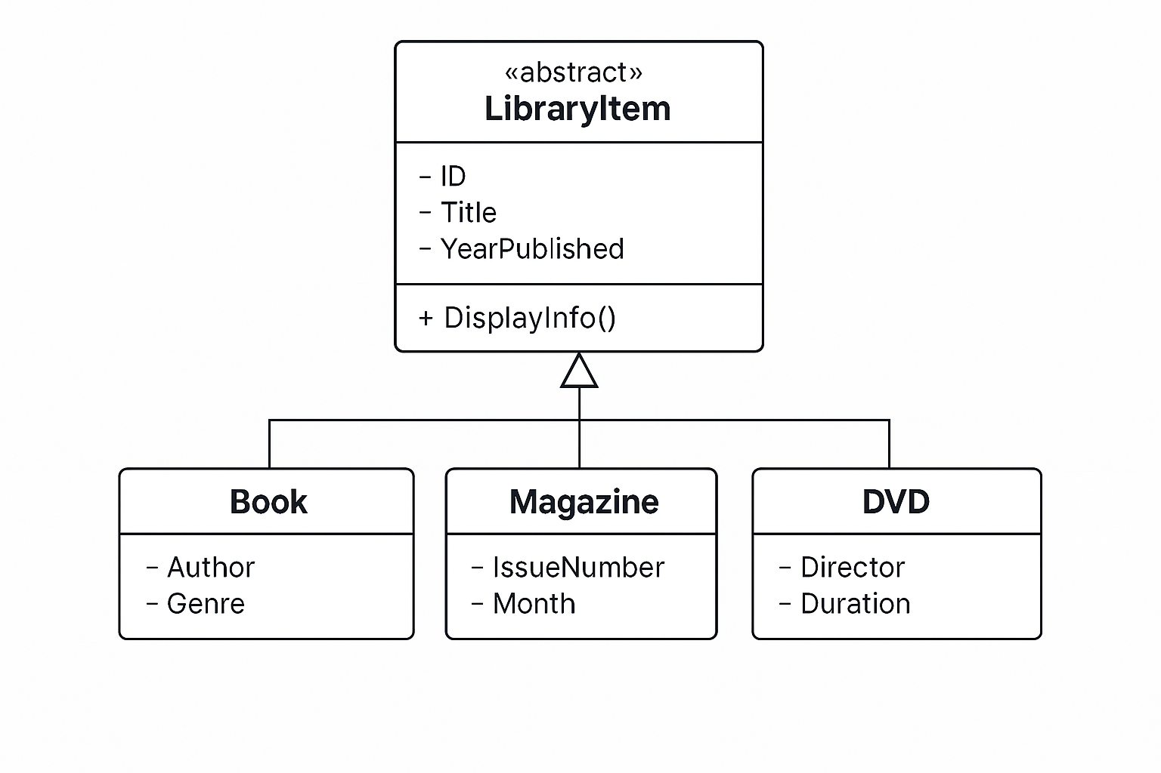
Class Structure

Slide 4
Library Collection
Library Class
-Manages Collection of LibraryItem objects.
-Methods: AddItem(), RemoveItem(),SerachItem(), DisplayAllItem().
Why This Approach?
-Use of List<T> for dynamic storage
-Provides scability for different item types
-Makes retrieval, deletion and display efficient

Slide 5
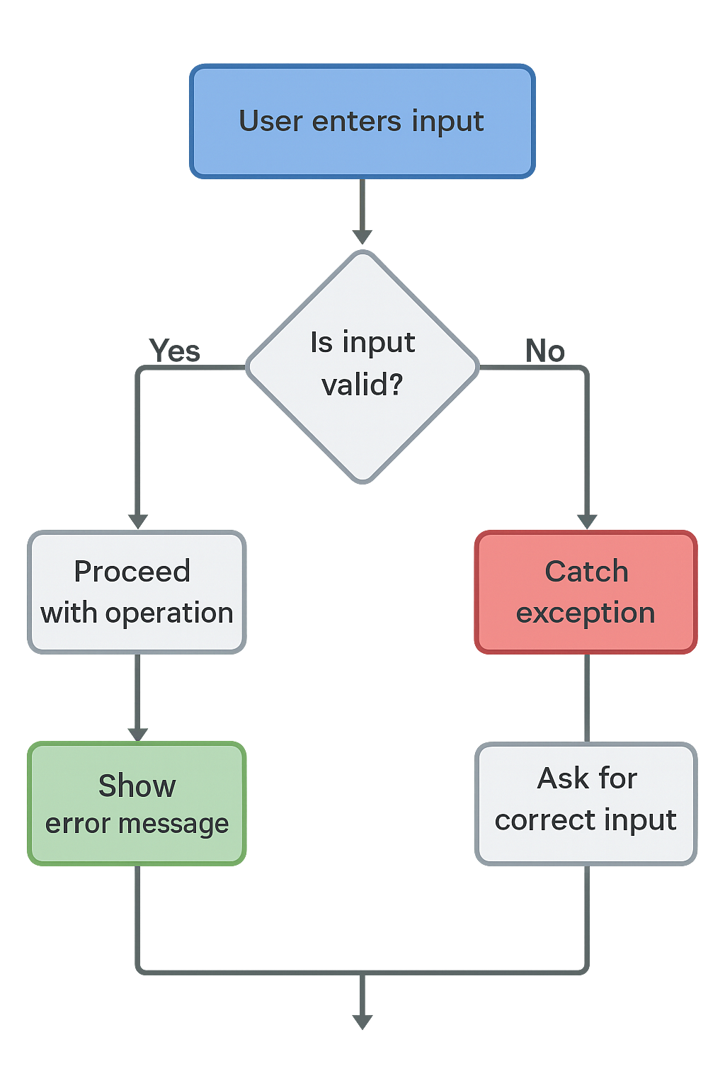
Exception handling

Slide 6
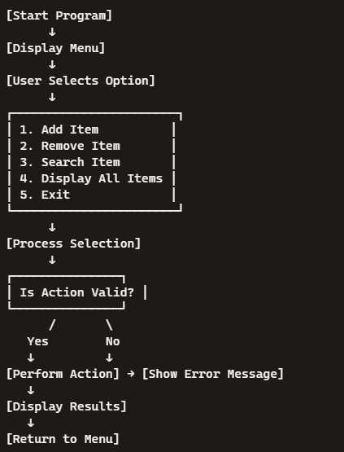
Program flow

Slide 7

Thank you

