Slide 1
Guide- Dr. G.Jegan
INTERDISCIPLINARY PROJECT
APRIL 2022
SCHOOL OF ELECTRICAL AND ELECTRONICS
SATHYABAMA INSTITUTE OF SCIENCE AND TECHNOLOGY

Slide 2
LIFE SAVING INTELLIGENT SAFETY HELMET WITH AUTO NOTIFICATIONS
BY:
RUTH BALAJI(39130382)
SUBHARAJA CHELLAM.A(39130443)
DEVADHARSHINI(39130108)

Slide 3
OVERVIEW
ABSTRACT
INTRODUCTION
BLOCK DIAGRAM
PROGRAMMING LANGUAGE
PROGRAMMING CODE
COMPONENTS
DESCRIPTION ABOUT EACH COMPONENT
WORKING
CONCLUSION
REFERENCES

Slide 4
ABSTRACT
An accident is a specific, unexpected, unusual and unintended external action which occurs in a particular time and place, with no apparent and deliberate cause but with marked effects. Carelessness of the driver is the major factor of such accidents. The traffic authorities give a lot of instructions to the vehicle operators. But many of them do not obey the rules. Nowadays most of the countries are forcing the motor riders to wear the helmet and not to use the vehicles when the person is in drunken condition. But still the rules are being violated by the users. In order to overcome this, in our Proposed System we wanted to incorporate efficient safety feature for Two-Wheeler drivers which will help them save their life with less time consumption-based help system. We have a dedicated Smart switch, so only upon wearing the helmet the driver will be able to start the bike that is the first condition, second condition the helmet will automatically detect for alcohol consumption if the driver detects positive for alcohol, he will not be in a position to start the bike. As a third level Safety Feature we have a fall detection sensor which helps to detect the accident , when talking about accidents there are 2 types light accident and Major Accident if the accident is light then we have an Emergency key in our bike , upon pressing it will stop all the auto-notifications which will help you immediately ignite the bike and can use it further and in case of an Major Accident we have an auto-notification system will will send notification to Ambulance , Family Member etc but till the time they come we cannot leave the driver to be in pain or leave un attended we add an alert system specifically for accident detection , upon hearing that sound nearby people can come in rescue of the person and save his life at the earliest.

Slide 5
INTRODUCTION
Existing System: In Existing System, there are very few safety features for bike drivers, But in Country like India the Majority of the People are dependent on Two- Wheelers and unfortunately because of Alcohol Consumption, Rash driving etc, there are lot of people who die in the accident and family members lose their member of their family because of less safety features in bike.
Proposed System: In our Proposed System we wanted to incorporate efficient safety feature for Two-Wheeler drivers which will help them save their life with less time consumption-based help system. We have a dedicated Smart switch, so only upon wearing the helmet the driver will be able to start the bike that is the first condition, second condition the helmet will automatically detect for alcohol consumption if the driver detects positive for alcohol, he will not be in a position to start the bike. As a third level Safety Feature we have a fall detection sensor which helps to detect the accident , when talking about accidents there are 2 types light accident and Major Accident if the accident is light then we have an Emergency key in our bike , upon pressing it will stop all the auto-notifications which will help you immediately ignite the bike and can use it further and in case of an Major Accident we have an auto-notification system will will send notification to Ambulance , Family Member etc but till the time they come we cannot leave the driver to be in pain or leave un attended we add an alert system specifically for accident detection , upon hearing that sound nearby people can come in rescue of the person and save his life at the earliest.

Slide 6
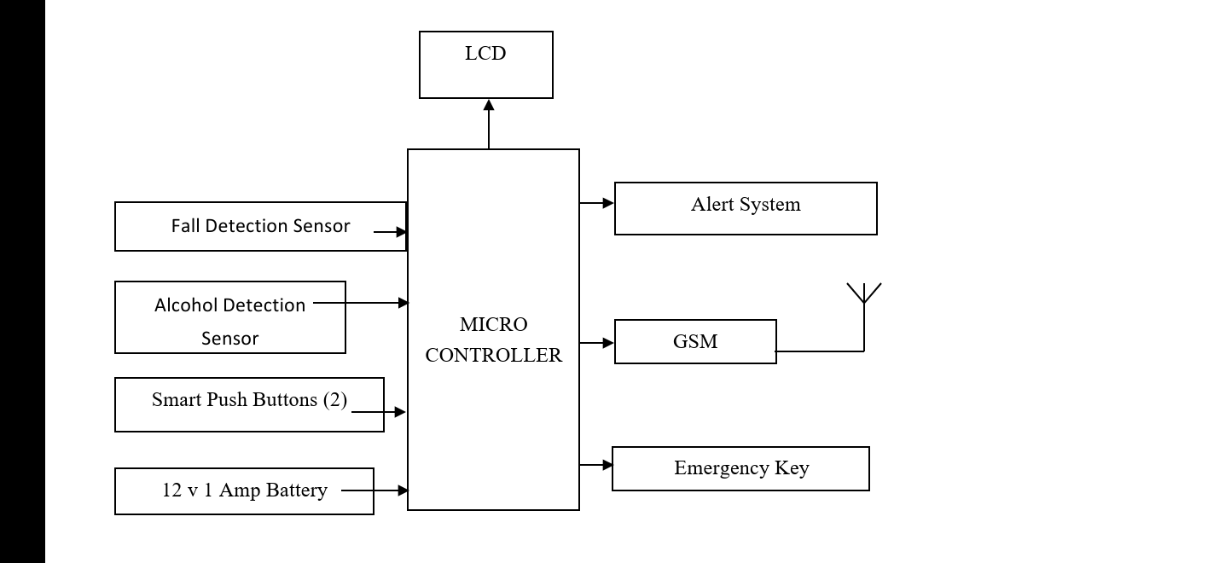
BLOCK DIAGRAM

Slide 7
PROGRAMMING LANGUAGE
EMBEDDED C- It is an extension to the traditional C programming language, that is used in embedded systems. The embedded C programming language uses the same syntax and semantics as the C programming language. The only extension in the Embedded C language from normal C Programming Language is the I/O Hardware Addressing, fixed-point arithmetic operations, accessing address spaces, etc. The C Programming Language, developed by Dennis Ritchie in the late 60’s and early 70’s, is the most popular and widely used programming language. The C Programming Language provided low level memory access using an uncomplicated compiler (a software that converts programs to machine code) and achieved efficient mapping to machine instructions. The C Programming Language became so popular that it is used in a wide range of applications ranging from Embedded Systems to Super Computers. Embedded C Programming Language, which is widely used in the development of Embedded Systems, is an extension of C Program Language. The Embedded C Programming Language uses the same syntax and semantics of the C Programming Language like main function, declaration of datatypes, defining variables, loops, functions, statements, etc. The extension in Embedded C from standard C Programming Language include I/O Hardware Addressing, fixed point arithmetic operations, accessing address spaces, etc.

Slide 8
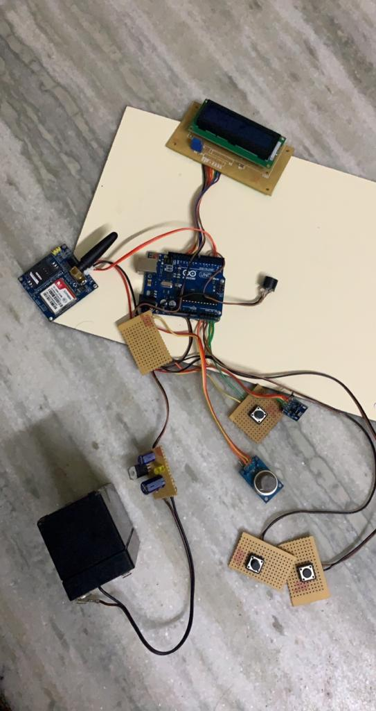

Slide 9
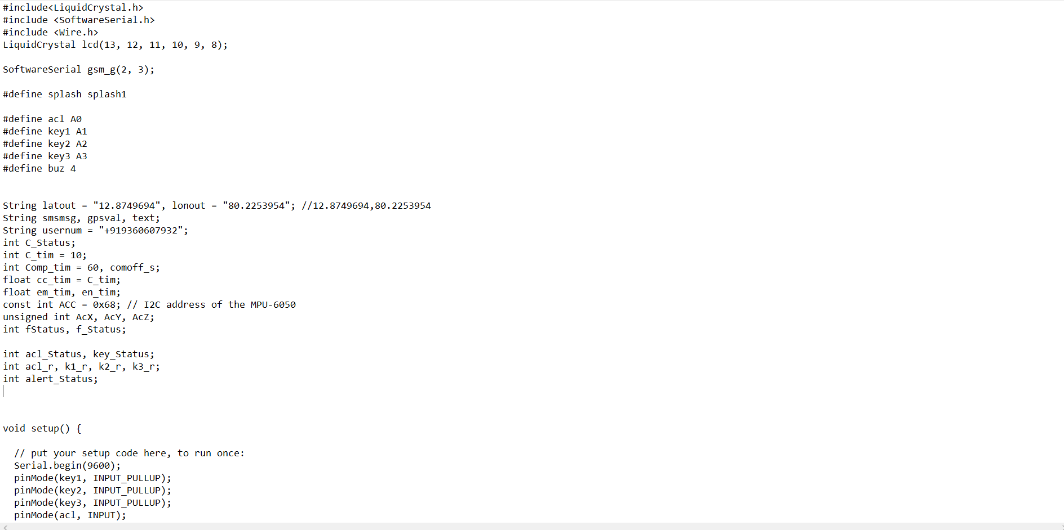
PROGRAMMING CODE

Slide 10
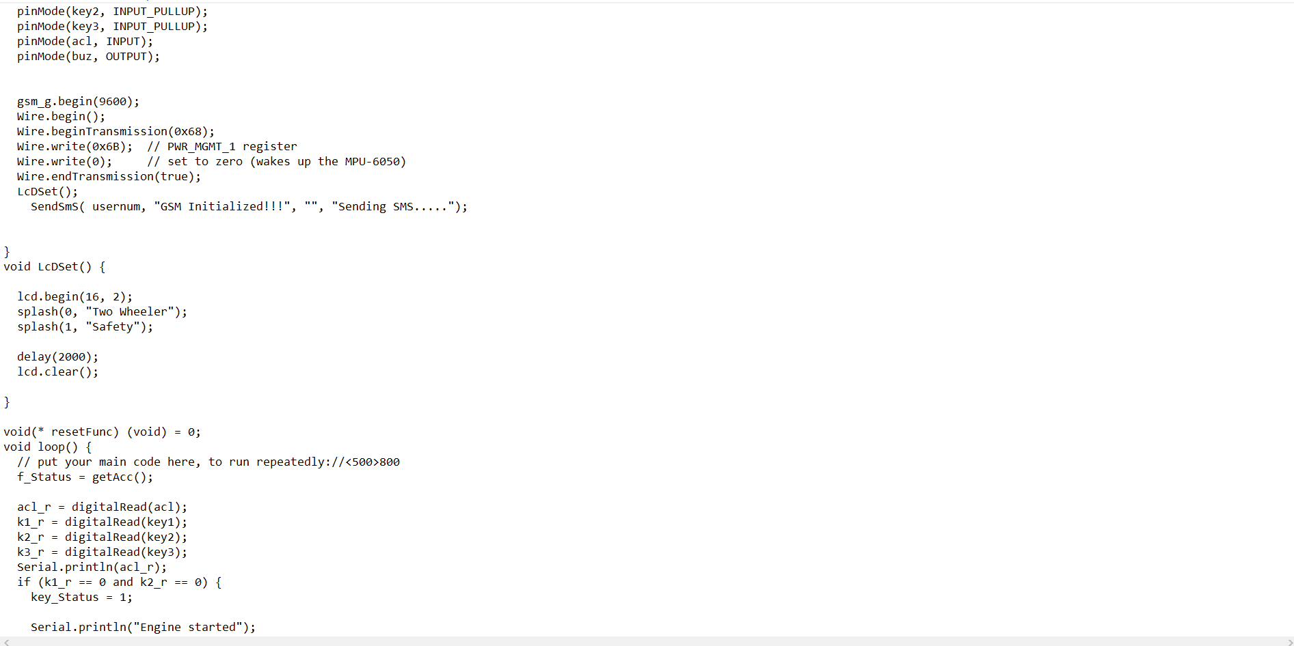

Slide 11
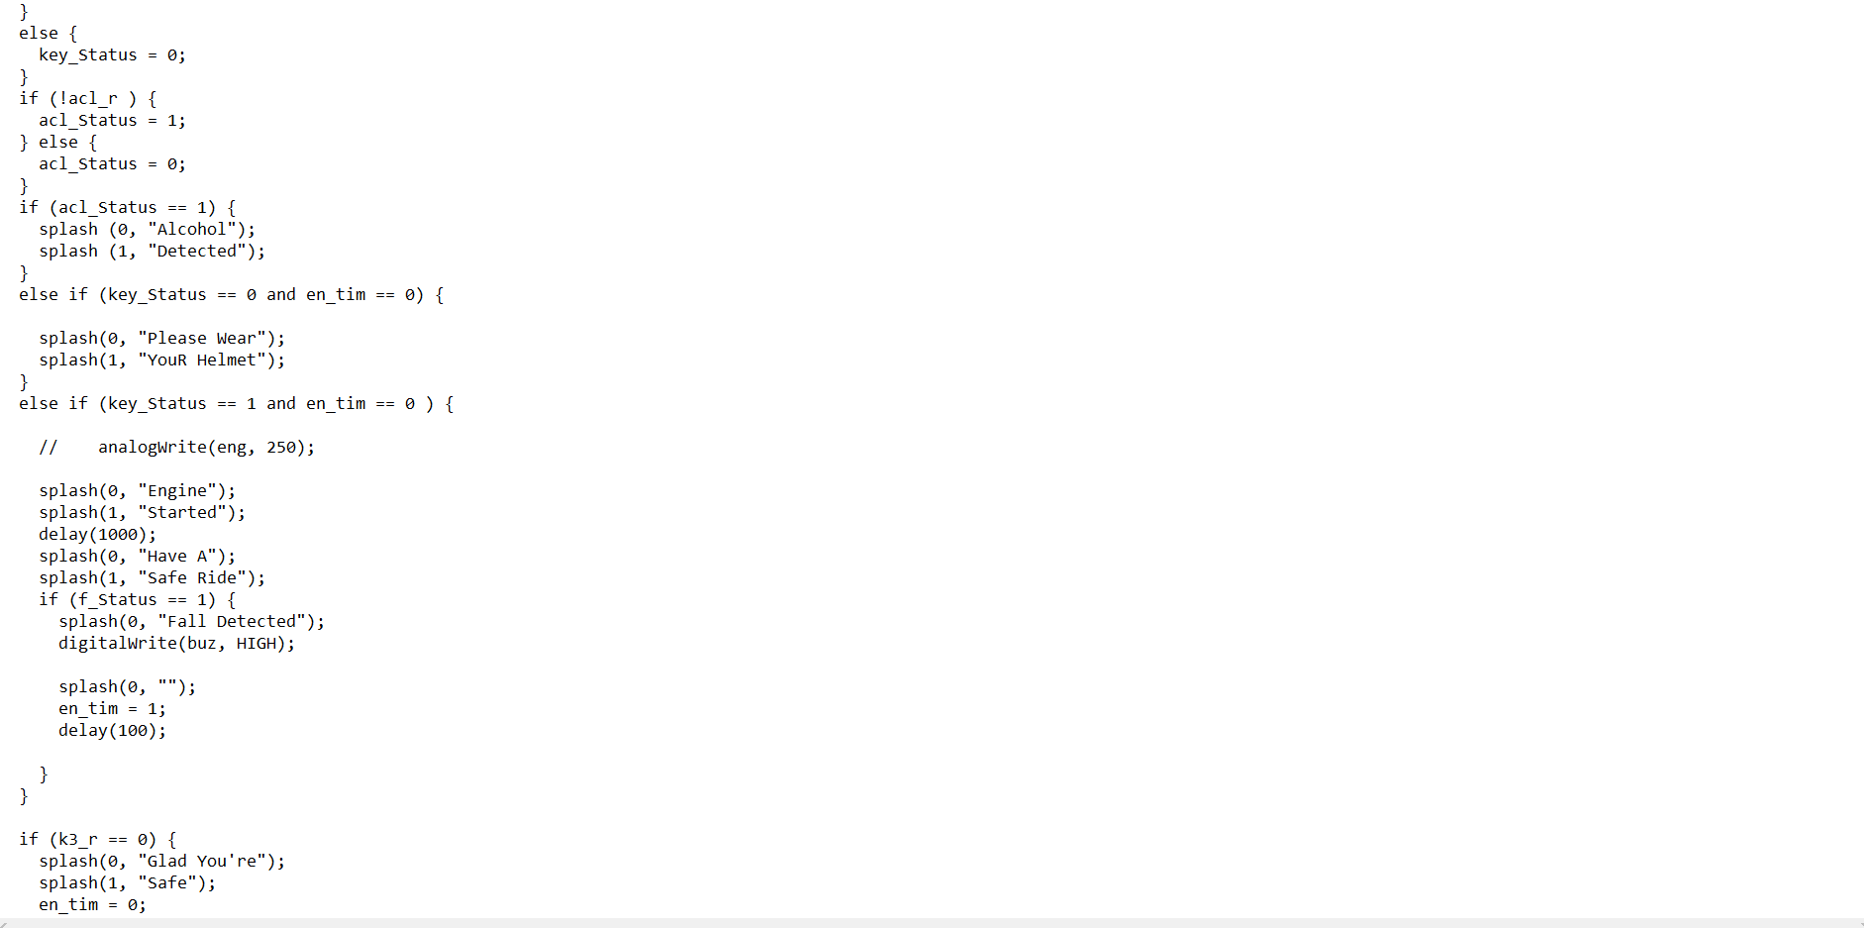

Slide 12
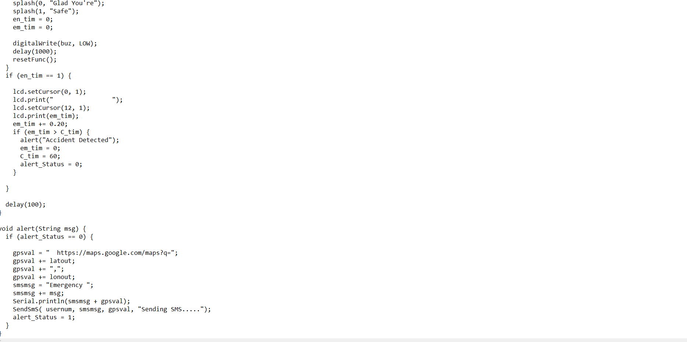

Slide 13
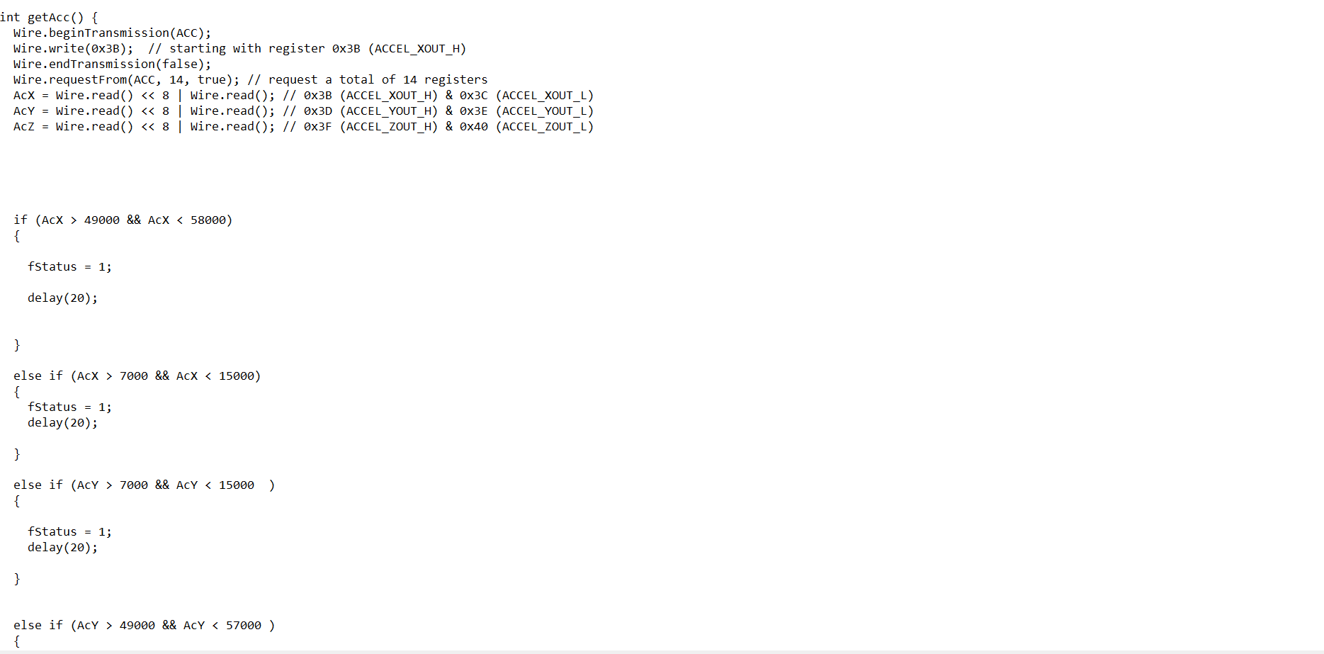

Slide 14
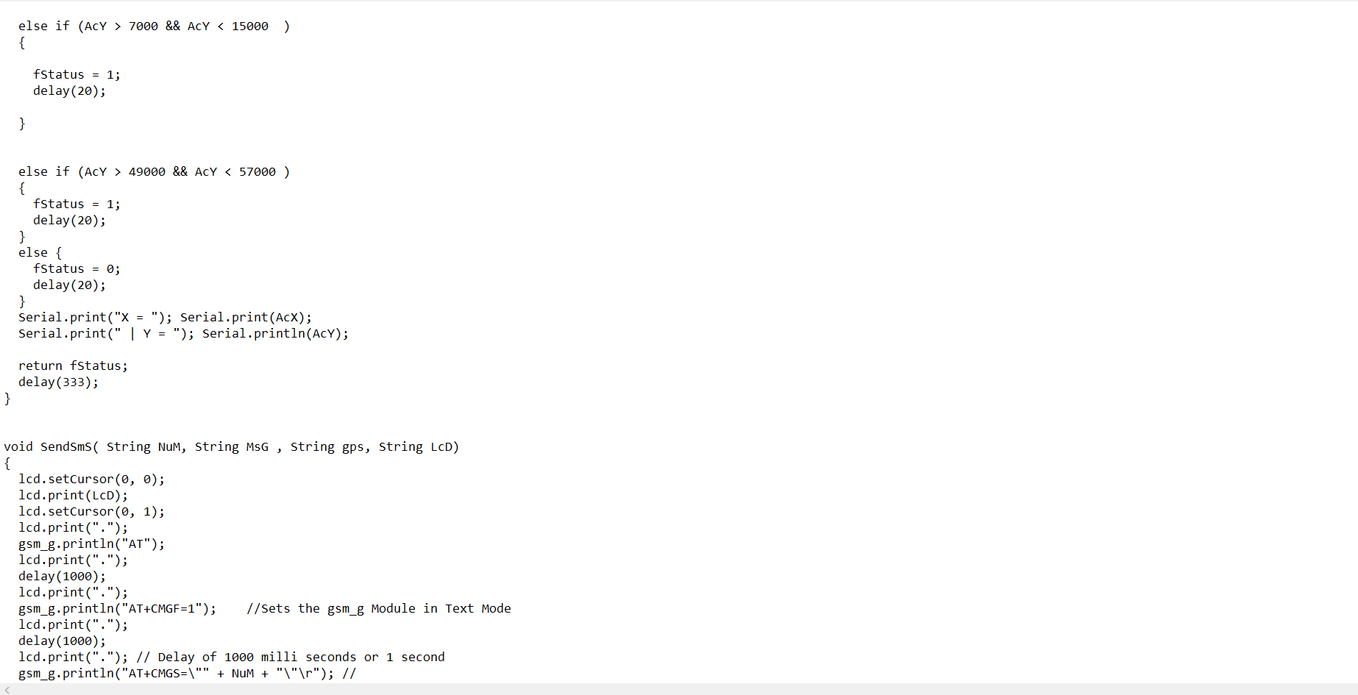

Slide 15
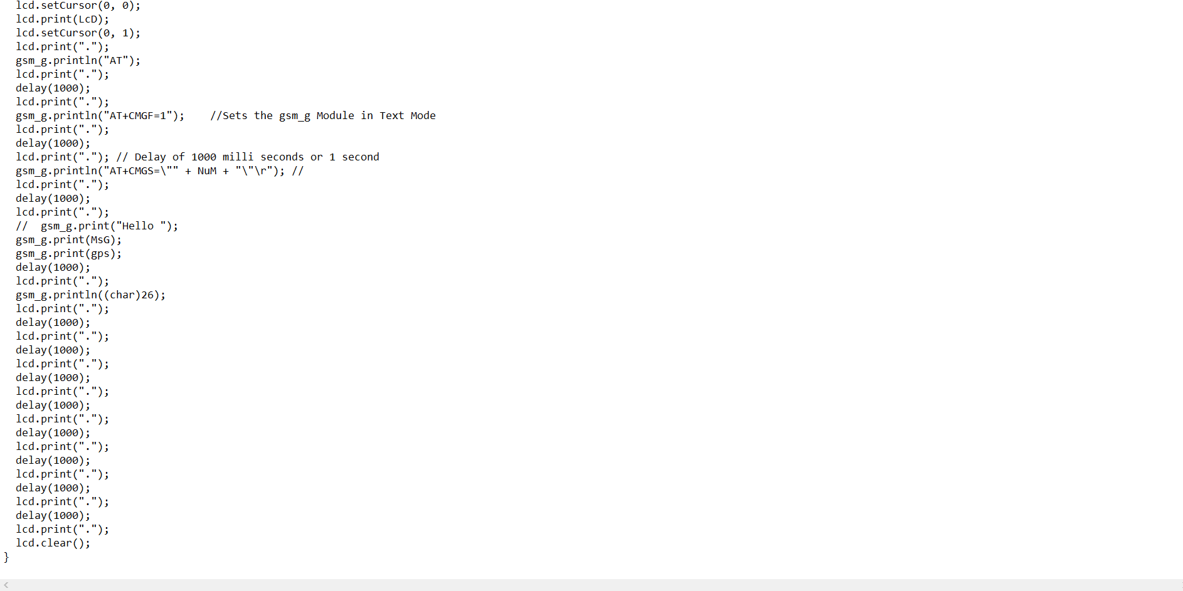

Slide 16
COMPONENTS
Hardware Requirements:
* Arduino Uno
*Lcd Display
*Lcd Base
*Accelerometer Sensor
*Push Buttons
*Gsm
*Buzzer
*Battery
Software Requirements:
*Arduino IDE

Slide 17
ARDUINO UNO
Arduino UNO is a low-cost, flexible, and easy-to-use programmable open-source microcontroller board that can be integrated into a variety of electronic projects.
This board can be interfaced with other Arduino boards, Arduino shields, Raspberry Pi boards and can control relays, LEDs, servos, and motors as an output.
Arduino is an open-source electronics platform based on easy-to-use hardware and software.
Arduino boards are able to read inputs - light on a sensor, a finger on a button, or a Twitter message - and turn it into an output - activating a motor, turning on an LED, publishing something online.
Arduino Uno is a microcontroller board based on the ATmega328P .
It has 14 digital input/output pins (of which 6 can be used as PWM outputs), 6 analog inputs, a 16 MHz ceramic resonator (CSTCE16M0V53-R0), a USB connection, a power jack, an ICSP header and a reset button.
It contains everything needed to support the microcontroller; simply connect it to a computer with a USB cable or power it with a AC-to-DC adapter or battery to get started.

Slide 18
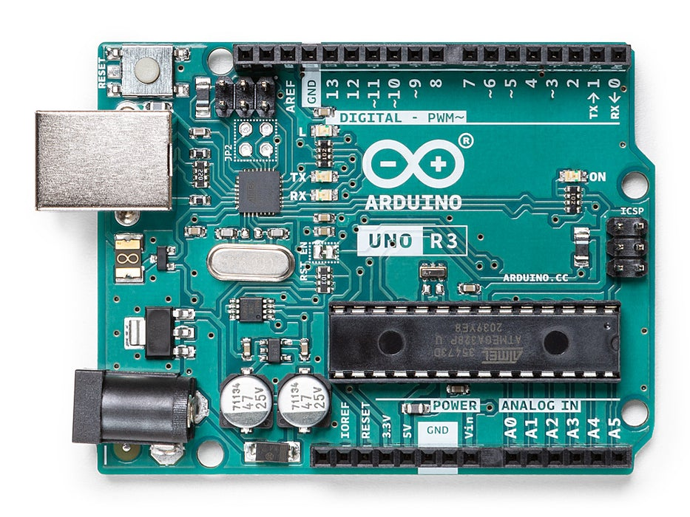

Slide 19
LIQUID CRYSTAL DISPLAY
A liquid-crystal display (LCD) is a flat-panel display or other electronically modulated optical device that uses the light-modulating properties of liquid crystals combined with polarizer's. Liquid crystals do not emit light directly, instead using a backlight or reflector to produce images in color or monochrome.
It has materials which combine the properties of both liquids and crystals. Rather than having a melting point, they have a temperature range within which the molecules are almost as mobile as they would be in a liquid, but are grouped together in an ordered form similar to a crystal.
An LCD consists of two glass panels, with the liquid crystal material sand witched in between them. The inner surface of the glass plates are coated with transparent electrodes which define the character, symbols or patterns to be displayed polymeric layers are present in between the electrodes and the liquid crystal, which makes the liquid crystal molecules to maintain a defined orientation angle.

Slide 20
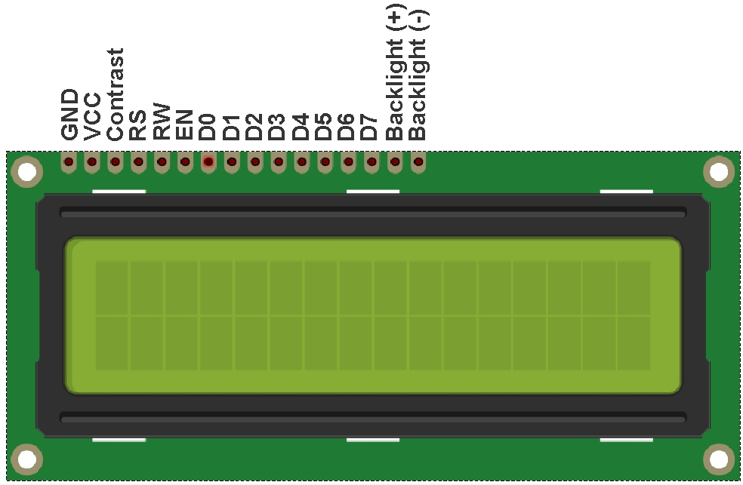

Slide 21
ACCELEROMETER SENSOR
An accelerometer is an electronic sensor that measures the acceleration forces acting on an object, in order to determine the object’s position in space and monitor the object’s movement. Acceleration, which is a vector quantity, is the rate of change of an object’s velocity .
There are three different types of accelerometers, and they are each designed to efficiently function in their intended environments. The three types are: piezoelectric, piezoresistance and capacitive.
A piezoelectric accelerometer utilizes the piezoelectric effect (piezoelectric materials produce electricity when put under physical stress) to sense change in acceleration. Piezoelectric accelerometers are most commonly used in vibration and shock measurement.
Piezoresistance accelerometers are much less sensitive than piezoelectric accelerometers, and they are better suited to vehicle crash testing. A piezoresistance accelerometer increases its resistance in proportion to the amount of pressure applied to it.
The third and most commonly used type of accelerometer is the capacitive accelerometer. Capacitive accelerometers use change in electrical capacitance to determine an object’s acceleration. When the sensor undergoes acceleration, the distance between its capacitor plates changes as the diaphragm of the sensor moves.

Slide 22
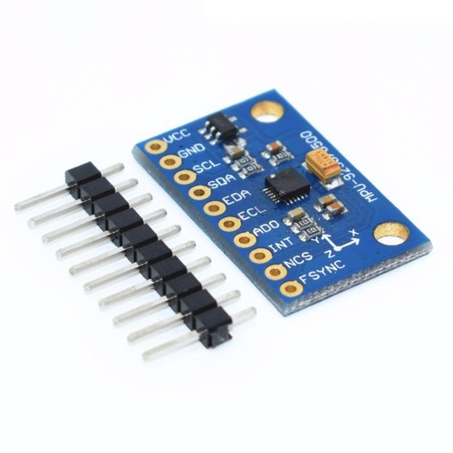

Slide 23
PUSH BUTTONS
A push-button (also spelled pushbutton) or simply button is a simple switch mechanism to control some aspect of a machine or a process.
Buttons are typically made out of hard material, usually plastic or metal.
A 'push to make' switch allows electricity to flow between its two contacts when held in.
When the button is released, the circuit is broken. This type of switch is also known as a Normally Open (NO) Switch.
Many Push switches are designed to function as both 'push to make' and 'push to break' switches. For these switches, the wiring of the switch determines whether the switch functions as a 'push to make' or as a 'push to break' switch.

Slide 24
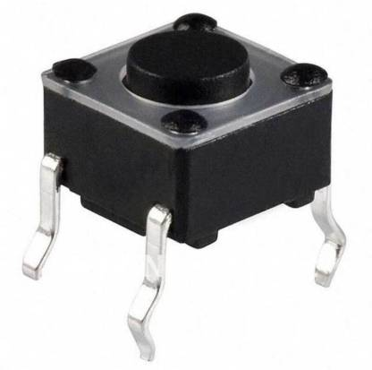

Slide 25
GSM
GSM (Global System for Mobile communication) is a digital mobile network that is widely used by mobile phone users in Europe and other parts of the world.
GSM uses a variation of time division multiple access (TDMA) and is the most widely used of the three digital wireless telephony technologies: TDMA, GSM and code-division multiple access (CDMA). GSM digitizes and compresses data, then sends it down a channel with two other streams of user data, each in its own time slot. It operates at either the 900 megahertz (MHz) or 1,800 MHz frequency band
GSM, together with other technologies, is part of the evolution of wireless mobile telecommunications that includes High-Speed Circuit-Switched Data (HSCSD), General Packet Radio Service (GPRS), Enhanced Data GSM Environment (EDGE) and Universal Mobile Telecommunications Service (UMTS).

Slide 26
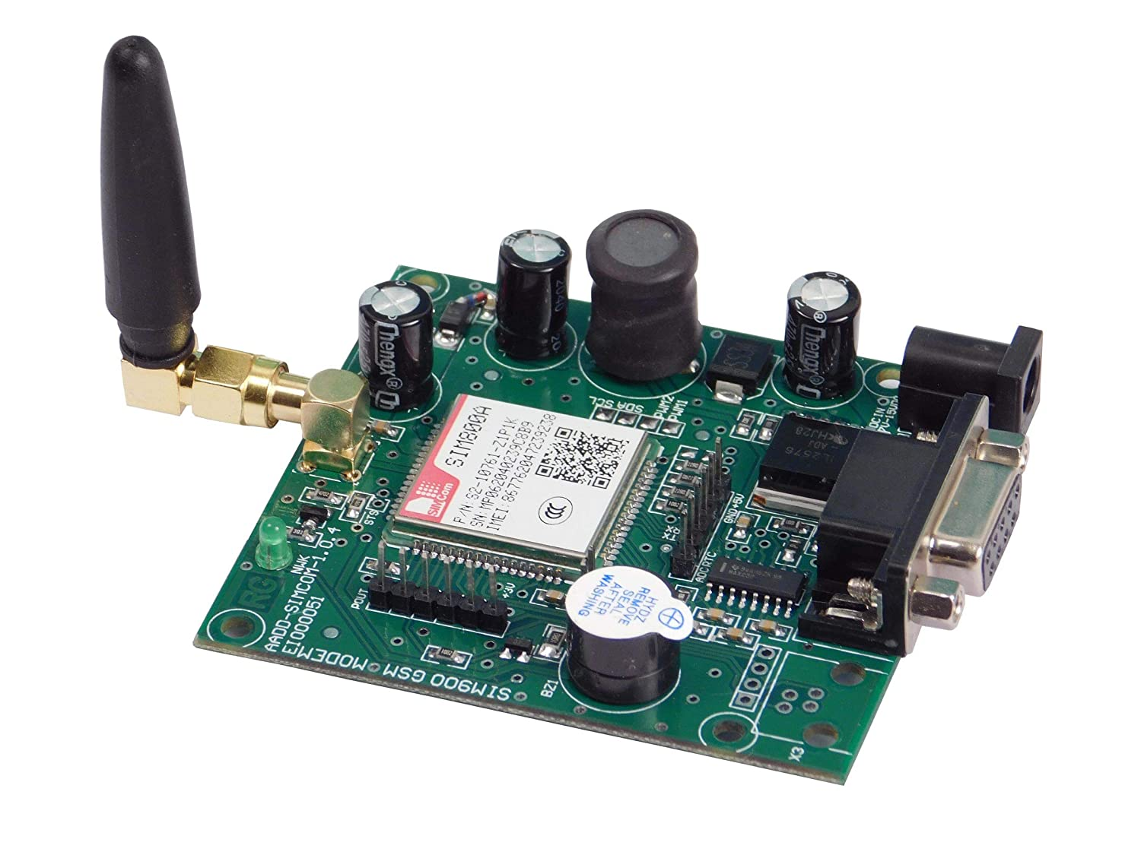

Slide 27
BUZZER
A buzzer or beeper is an audio signaling device which may be mechanical, electromechanical or piezoelectric.
Typical uses of buzzer or beeper include alarm device, timers and confirmation of user input such as a mouse click or keystroke.
Buzzer is an integrated structure of electronic transducers, DC power supply, widely used in computers, printers, copiers, alarms, electronic toys, automotive electronic equipment, telephone.
Active buzzer 5V rated power can be directly connected to a continuous sound.

Slide 28
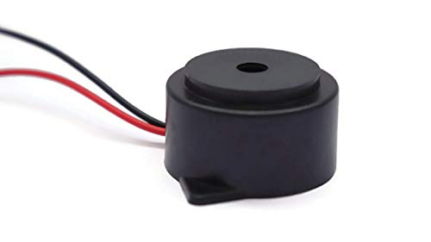

Slide 29
BATTERY
A battery can be defined as an electrochemical device (consisting of one or more electrochemical cells) which can be charged with an electric current and discharged whenever required.
Batteries are usually devices that are made up of multiple electrochemical cells that are connected to external inputs and outputs.
Batteries are widely employed in order to power small electric devices such as mobile phones, remotes, and flashlights.
Historically, the ‘term’ battery has always been used in order to refer to the combination of two or more electrochemical cells. However, the modern definition of the term ‘battery’ is believed to accommodate devices that only feature a single cell.

Slide 30
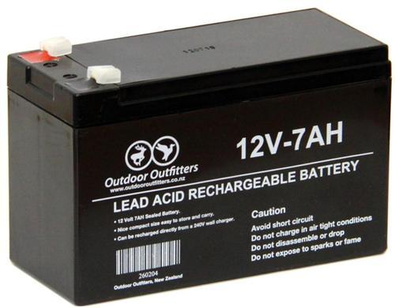

Slide 31
ARDUINO IDE
The Arduino Integrated Development Environment or Arduino Software (IDE) contains a text editor for writing code, a message area, a text console, a toolbar with buttons for common functions and a series of menus.
It connects to the Arduino hardware to upload programs and communicate with them.

Slide 32
WORKING
The Arduino UNO consists of 4 ports that are Analog, Digital, Transmitter & receiver and power supply port. The Analog port is connected to the Accelerometer sensor. The Digital port is connected to the LCD and buzzer. The Transmitter & Receiver port is connected to GSM because it transmits the information from the sim to the mobile number which we have fed. The power supply port is connected with all the wires that connects to the battery. The two switches which are connected with brown and black color wires are assumed as the switches set inside the helmet and are called as smart switch. There is another sensor used to detect if the person has consumed alcohol and the level of alcohol consumed. There is a button which is connected with yellow and green wire which is an emergency button used to stop the information from being transmitted from the sim to the numbers fed. In case the accident is not big then the person can press this emergency button within 1minute to stop the information from being transmitted from the GSM. We use a 12v battery which gets converted to 9V then 5V in the power supply board and finally 5V is supplied to the Arduino UNO. The accelerometer sensor detects if there is any accident taken place and then transmits the information to the GSM and the GSM transmits the information to the receiver stating the accident has taken place and the link of the location. The accelerometer will be able to identify if it is an accident or turning of the vehicle. The alcohol detection sensor detects if the person as consumed alcohol and does not allow the vehicle to move. If we wear the helmet only the motor will start or else it won’t start.

Slide 33
CONCLUSION
This project is very helpful for the ambulance or people to save life's of other people during an accident and being on time to the accident place.
This is also useful in order to make sure that people under alcohol do not ride there bikes and in order to avoid accidents due to alcohol consumption.

Slide 34
REFERENCES
[1] Prudhvi Raj R, Sri Krishna Kanth, BhargavAdityaBharath K, (2014), “Smart-tec Helmet” Electrical and Electronics Engineering, GITAM University,Rushikonda, Visakhapatnam, India. Advance in Electronic and Electric Engineering 4: 493-498.
[2] Behr, C.J., Kumar, A., Hancke, G.P “ A Smart Helmet for Air Quality and Hazardous Event Detection for the Mining Industry” Proceedings of the IEEE International Conference on Industrial Technology 2016- May,7475079, pp. 2026-2031
[3] Sreenithy Chandran, Sneha Chandrasekar, N Edna Elizabeth “Konnect: An Internet of Things(IoT) based smart helmet for accident detection and notification” 2016 IEEE Annual India Conference (INDICON)
[4] Rashmi Vashisth, Sanchit Gupta, Aditya Jain, Sarthak Gupta, Sahil, Prashant Rana “Implementation and analysis of smart helmet” 2017 4th International Conference on Signal Processing, Computing and Control (ISPCC)
[5] D. Selvathi, P. Pavithra, T. Preethi “Intelligent Transportation System for Accident Prevention and Detection” 2017 International Conference on Intelligent Computing and Control Systems (ICICCS)
[6] Archana D, Boomija G, Manisha J, Kalaiselvi V. K. G. “Mission On! Innovations in Bike Systems to Provide a Safe Ride Based on IOT ”2017 2nd International Conference on Computing and Communications Technologies (ICCCT)
[7] Sayan Tapadar, Shinjini Ray; Himadri, Nath Saha; Arnab, Kumar Saha,Robin Karlose “ Accident and alcohol detection in bluetooth enabled smart helmets for motorbikes” 2018 IEEE 8th Annual Computing and Communication Workshop and Conference

Slide 35
THANK YOU ☺

