Slide 1
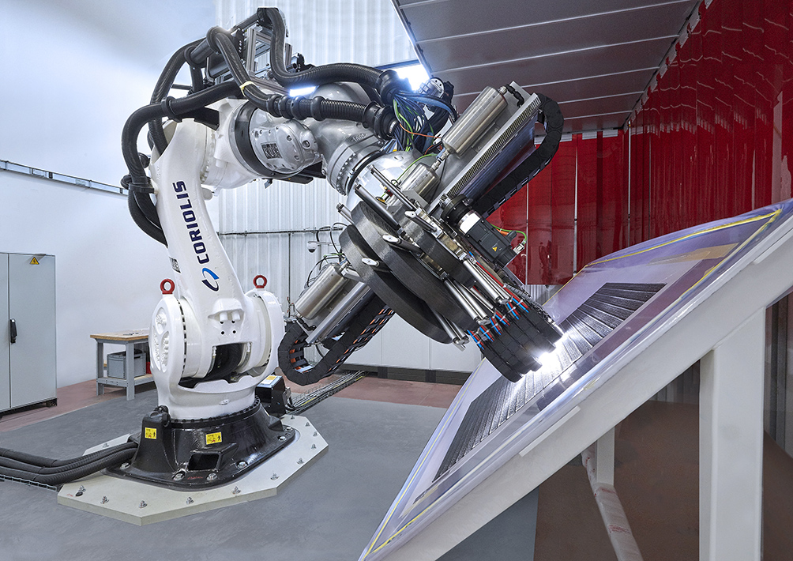
Improving the impact tolerance of CFRP laminates
Currently, composites manufactured using automated fiber/tape placement (AFP/ATL) are conventional layered angle-ply laminates
No fiber connectivity between layers
Susceptible to delamination at interfaces
Easily damaged by low velocity out-of-plane impacts
Does not make best use of AFP/ATL process flexibility and placement precision
[1] Coriolis Composites, “Coriolis C-5,” 2019. [Online]. Available: https://www.coriolis-composites.com/fiber-placement-machines/ [Accessed: 06-Dec-2019].

Slide 2

Interlaced composites
Macroscale woven-like composites
Pros:
Fiber connectivity between layers arrests the initiation and propagation of delamination
Retains stiffness of conventional angle ply laminates
Requires only a modification of AFP/ATL machine programming (no need for different equipment)
Cons:
Longer manufacturing time than conventional laminates (more passes to produce same thickness laminate) and by extension more expensive
More difficult to ensure consistent laminate quality (more voids, resin-rich areas etc.)

Slide 3
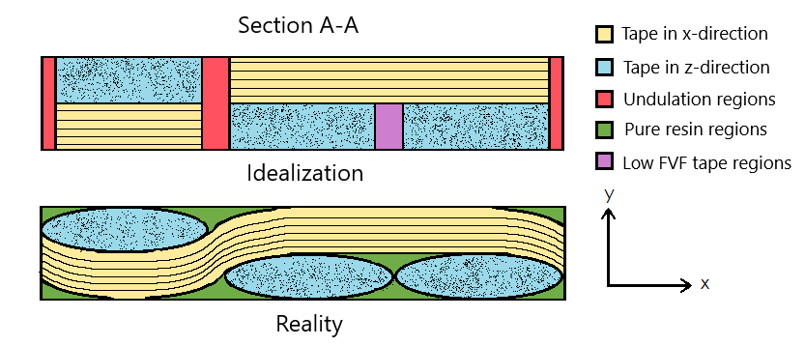
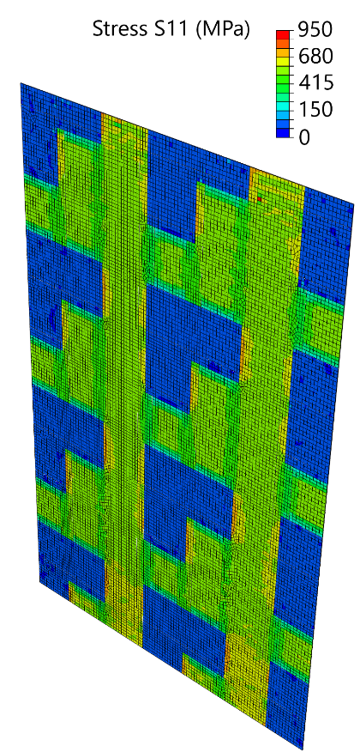
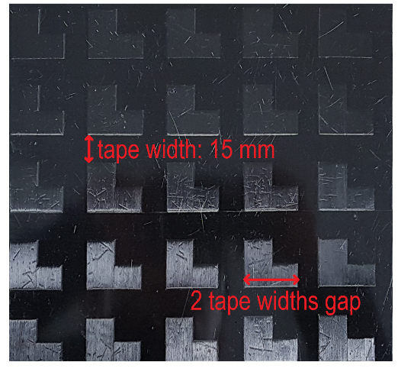
Virtual testing
Python and Abaqus based virtual testing framework
Tape geometry idealized to reduce solution time
Microscale models developed to understand behavior of tapes at undulations between layers
Future steps:
Impact and compression after impact testing (experimental and virtual)
Implementation of 3D failure criteria and continuum damage mechanics

