Slide 1
DELOITTE DIGITAL SOVEREIGNTY PLATFORM
SovScan
Digital sovereignty mapped — from scenario assessment to audit.
The complete user flow in eight steps, with screenshots from the live tool.
Deloitte Consulting Netherlands · Version 1.0 · July 2026

Slide 2
The flow at a glance
Two instruments, one platform — this deck follows the eight steps from the user manual.
01
02
03
04
Log in
Dashboard
Complete the assessment
Interpret the results
Browser-based, no installation
Assessments, audits & invitations
23 slider questions, live scores
Scores per scenario + KOs
05
06
07
08
Run the audit
Spider chart & benchmark
Invitations
Tips & FAQ
8 dimensions, scored 1–5
Radar vs. sector average
Shareable links, no account needed
Handling uncertainty & KOs
SovScan · Deloitte Digital Sovereignty Platform
2

Slide 3
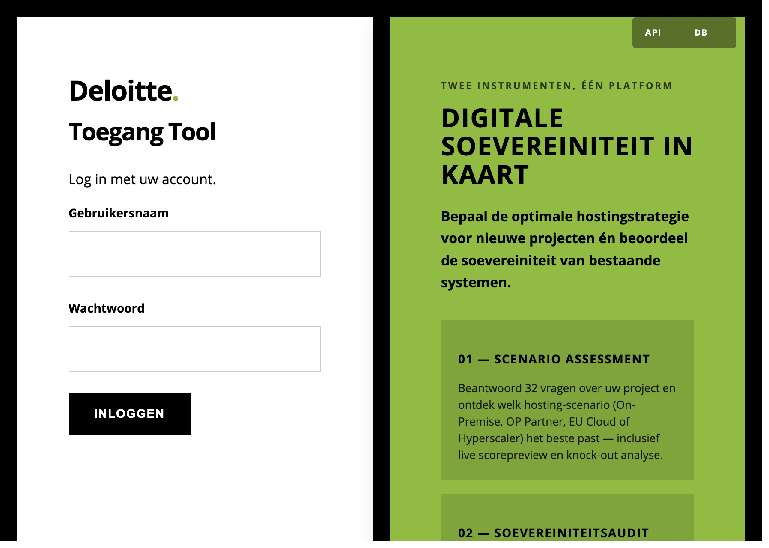
STEP 1
Log in
Open the tool in your browser — no installation required.
URL sovscan-frontend-1473.azurewebsites.net
Default credentials
Role | Username | Password
Consultant | admin | see manual
Administrator | sovadmin | see manual
Passwords are listed in the user manual (chapter 1).
💡 Tip Are you an administrator? Use the Admin Panel to create new users and manage permissions.
Login screen: two instruments, one platform (tool interface is in Dutch)
SovScan · Deloitte Digital Sovereignty Platform
3

Slide 4
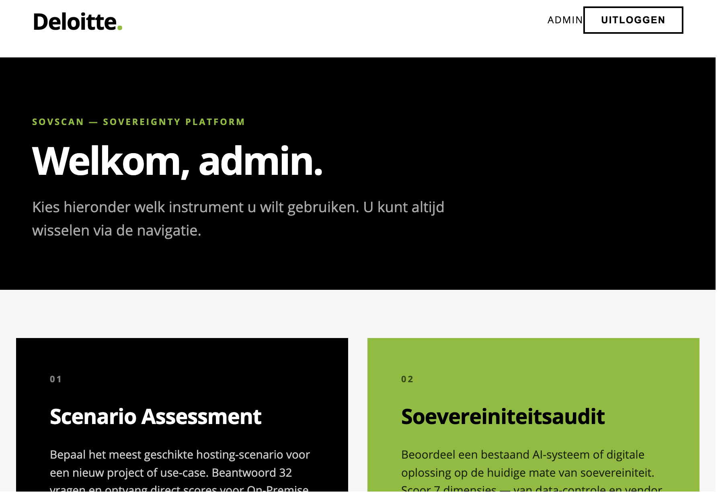
STEP 2
Dashboard
After logging in you see your personal dashboard — the starting point for both instruments.
▪ Your assessments — all previously completed scenario analyses
▪ Your audits — all previously performed sovereignty audits
▪ Manage invitations — shareable links for clients or colleagues
Start right away Click New Assessment or New Audit to begin immediately. You can always switch via the navigation.
Dashboard: choose Scenario Assessment (01) or Sovereignty Audit (02)
SovScan · Deloitte Digital Sovereignty Platform
4

Slide 5
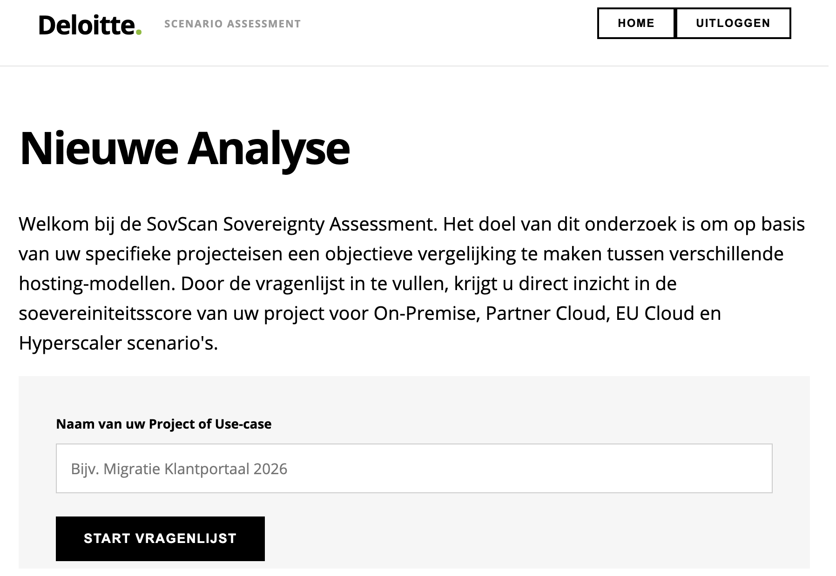
STEP 3
Tool 1 — Sovereignty Assessment
Determine in under 10 minutes which cloud scenario best fits your project or organisation.
▪ 23 slider questions — every question feeds into the sovereignty score
▪ Four scenarios side by side — On-Premise, On-Premise Partner, EU Cloud and Hyperscaler
▪ Live score preview — see the effect of every answer on all scenarios instantly
▪ Objective comparison — based on your specific project requirements
New analysis: enter a project name and start the questionnaire
SovScan · Deloitte Digital Sovereignty Platform
5

Slide 6
The slider & knock-out criteria
Answers are nuanced (0–100); hard legal boundaries eliminate a scenario instantly.
Score scale
Slider position | Meaning
0 – 25 | No (strong to slight)
25 – 50 | Neutral / slight no
50 – 75 | Neutral / slight yes
75 – 100 | Yes (slight to strong)
LIVE SCORE PREVIEW · EXAMPLE: CLASSIFIED DATA
On-Premise
88%
On-Premise Partner
74%
EU Cloud
KO
Hyperscaler
KO
💡 Not sure? Choose the neutral position (50). Neutral answers carry less weight than outspoken ones — the tool recognises uncertainty.
⚠ KO reason: commercial cloud is ruled out for classified (BBi+) data — EU Cloud and Hyperscaler are eliminated.
Knock-Out (KO) As soon as an answer exposes a legal or physical impossibility, the scenario is eliminated immediately — shown in red, with an explanation of why and what the alternative is.
SovScan · Deloitte Digital Sovereignty Platform
6

Slide 7
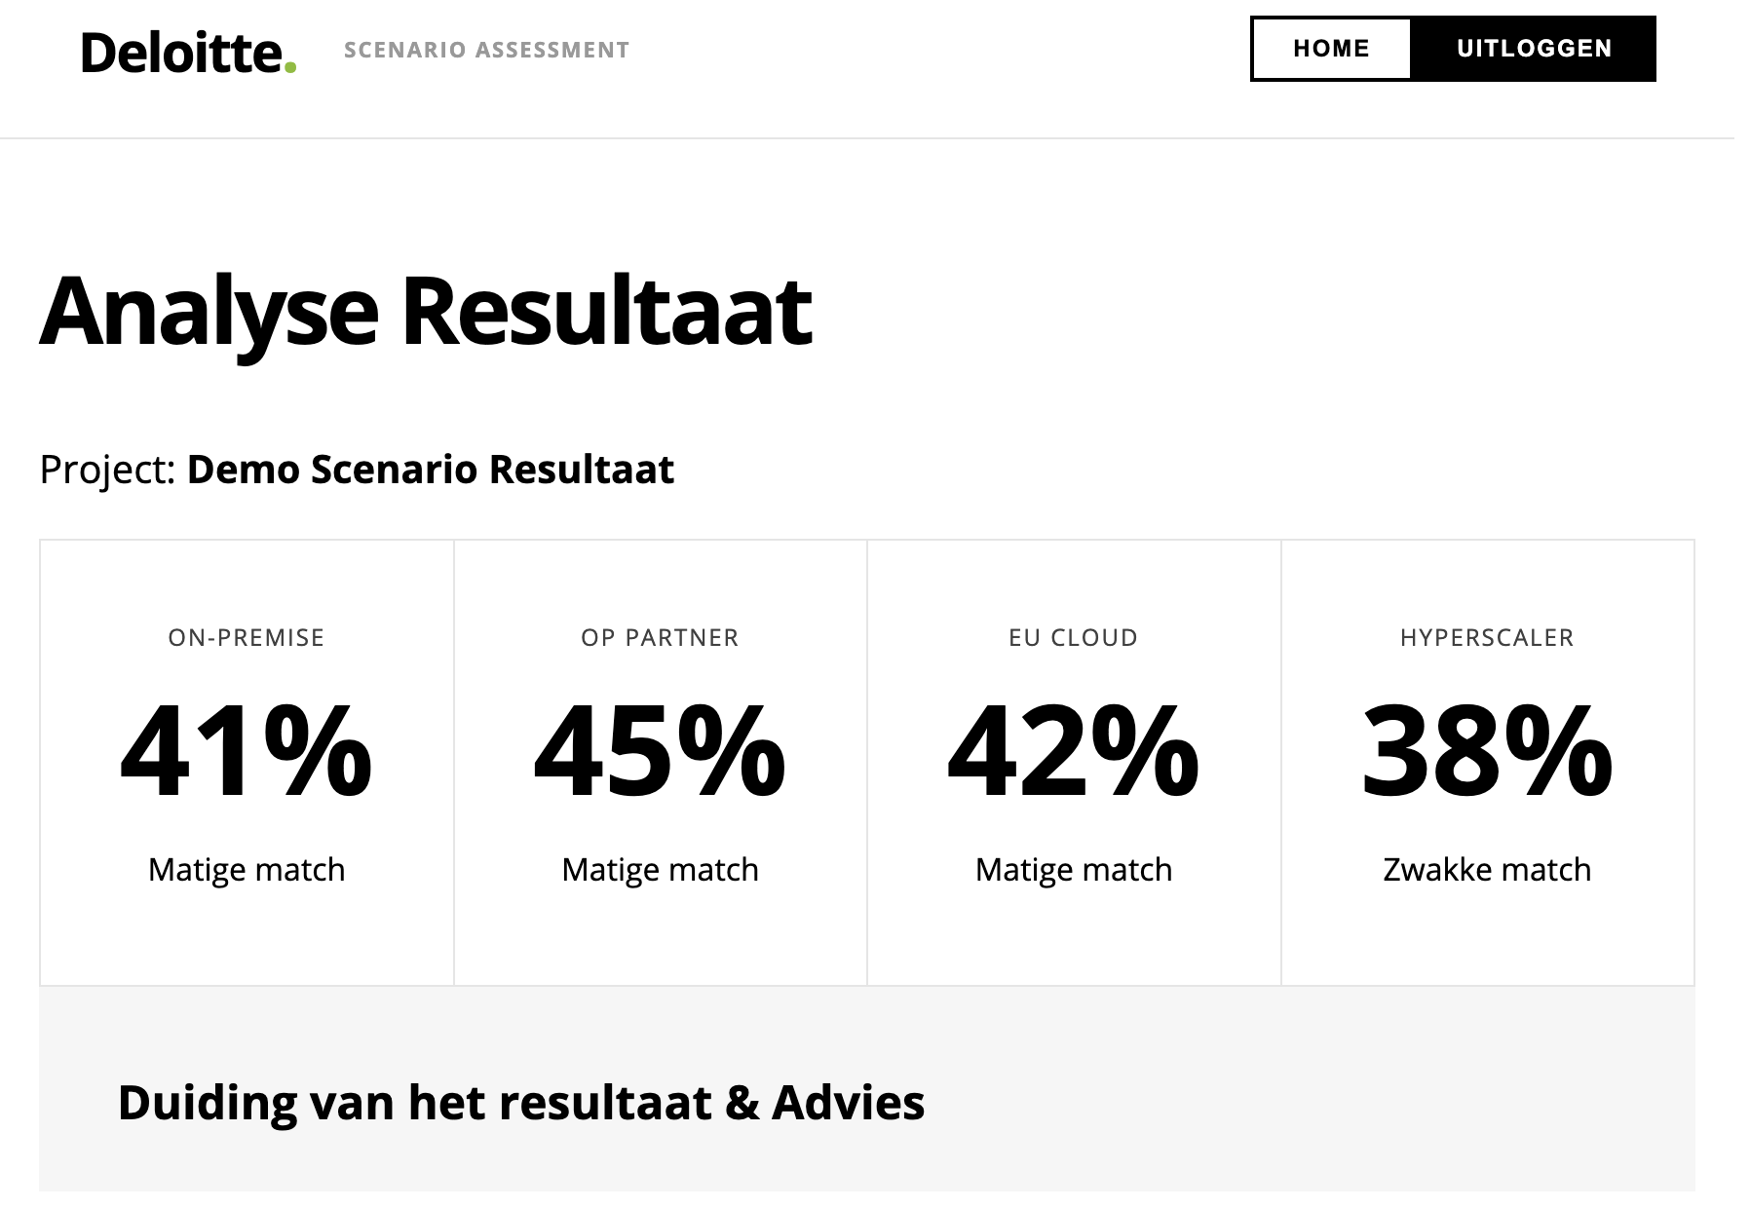
STEP 4
Interpreting the assessment result
After the last question, an overview page appears with scores per scenario.
▪ Highest score without a KO — that is the recommended direction
▪ Interpretation & advice — the tool explains why a scenario fits
▪ Export report — save and share the result with a single click
Example Government project with classified (BBi) data: On-Premise Partner wins (74%); EU Cloud and Hyperscaler are eliminated by KO.
Analysis result: match score per scenario, with interpretation and advice
SovScan · Deloitte Digital Sovereignty Platform
7

Slide 8
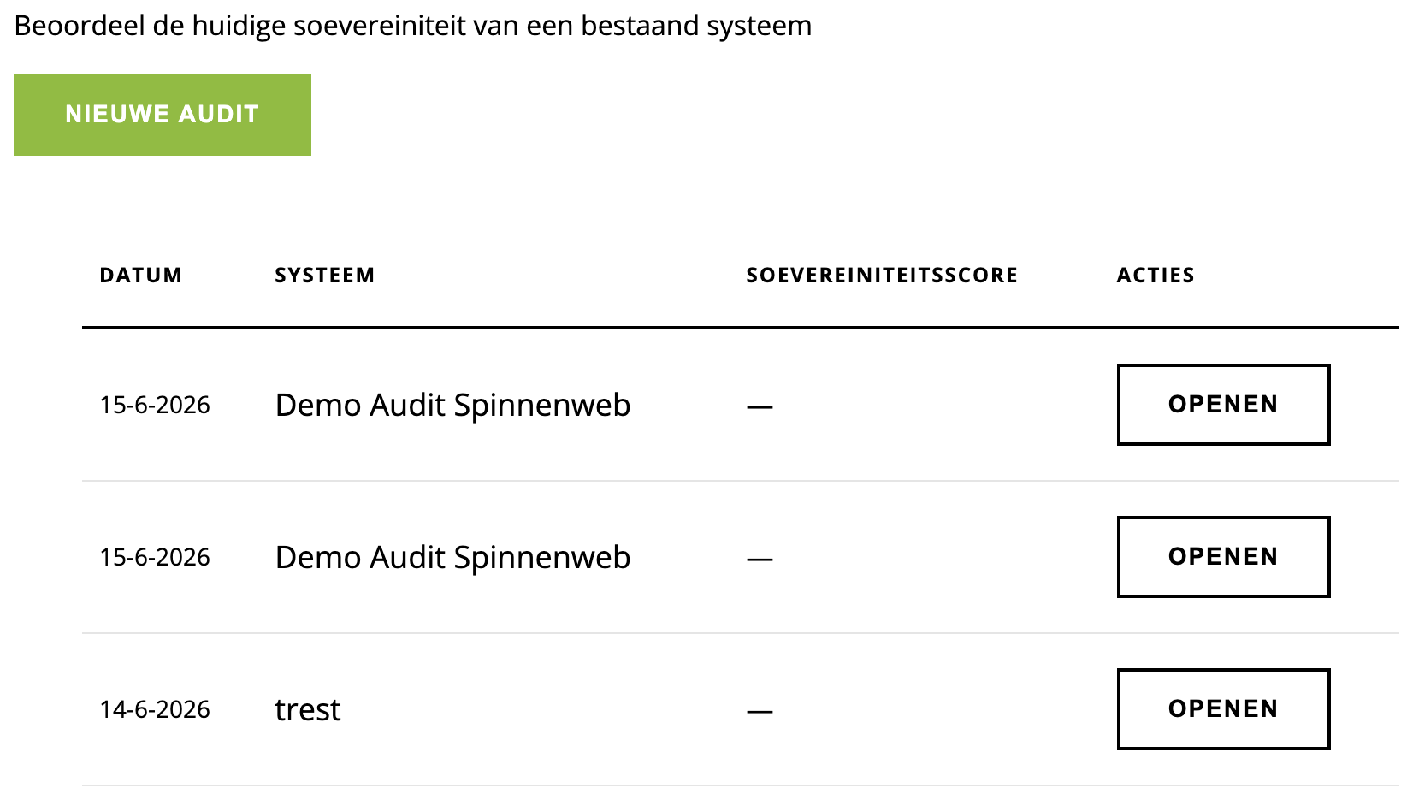
STEP 5
Tool 2 — Sovereignty Audit
Not a scenario comparison, but an in-depth view of your current sovereignty level.
▪ Eight dimensions — from data sovereignty to price/TCO
▪ Score 1 to 5 per dimension — you rate today's reality
▪ Sector benchmark — Government, Financial sector, Healthcare or Commercial
Score | Label
1 | Not sovereign
2 | Limited sovereignty
3 | Partially sovereign
4 | Largely sovereign
5 | Fully sovereign
Audit overview: open earlier audits or start a new one
SovScan · Deloitte Digital Sovereignty Platform
8

Slide 9
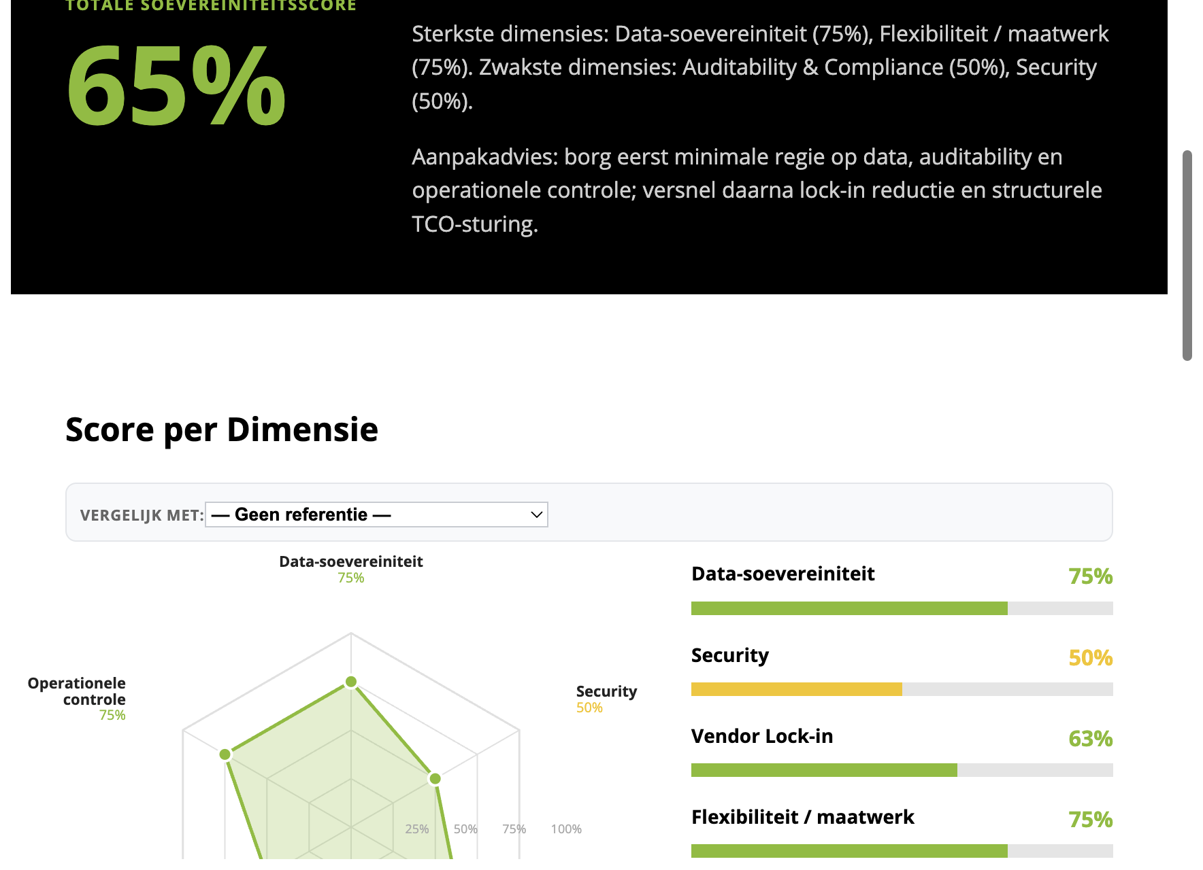
STEP 6
Audit result — the spider chart
Green area = your score per dimension; blue dashed line = the sector average.
▪ Total sovereignty score — a single percentage as a management summary
▪ Strongest & weakest dimensions — identified automatically, with action advice
▪ Below the benchmark? — then that is a priority area for the roadmap
What each colour means
≥ 80% Fully sovereign
60–79% Largely
40–59% Partially
20–39% Limited
< 20% Not sovereign
Radar chart with total score, score per dimension and action advice
SovScan · Deloitte Digital Sovereignty Platform
9

Slide 10
STEP 7
Sending invitations
Let clients or colleagues complete an assessment or audit — without needing an account.
1
2
3
4
Click Invitations
›
Configure the link
›
Share the link
›
Result appears
in the dashboard
project name, type (Assessment or Audit) and expiry date
copy and send via e-mail or Teams
automatically in your dashboard once the recipient is done
Please note The invitation link is valid until the expiry date you set; after that it can no longer be used. You can manage multiple invitations at once.
SovScan · Deloitte Digital Sovereignty Platform
10

Slide 11
STEP 8
Tips & frequently asked questions
How do I save a result?
Can I redo an assessment?
Automatically, after completing an assessment or audit. Everything is available in your dashboard.
Yes — start a new assessment from the dashboard. Earlier versions are kept.
What if I don't know the answer?
What exactly are KO criteria?
Set the slider to 50 (neutral). The tool recognises uncertainty and gives the answer less weight.
Hard legal or technical requirements that make a scenario impossible. The scenario is eliminated, with an explanation and mitigation advice.
How do I interpret the gap with the benchmark?
Dimensions significantly below the benchmark are priority areas — input for the roadmap conversation with your Deloitte advisor.
SovScan · Deloitte Digital Sovereignty Platform
11

Slide 12
MAKE COMPLIANCE TANGIBLE
Use SovScan as a conversation starter.
Fill in the questions together with your client and discuss the scores and KO criteria live — turning an abstract compliance discussion into something tangible.
▶ sovscan-frontend-1473.azurewebsites.net
SovScan · Deloitte Consulting Netherlands · © 2026

