Slide 1

Minerva

Slide 2


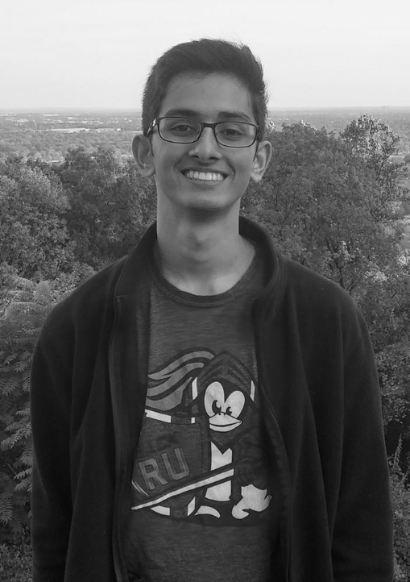
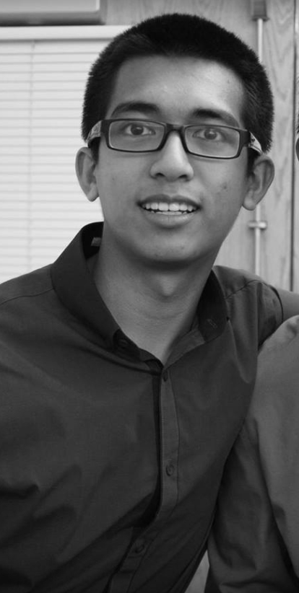

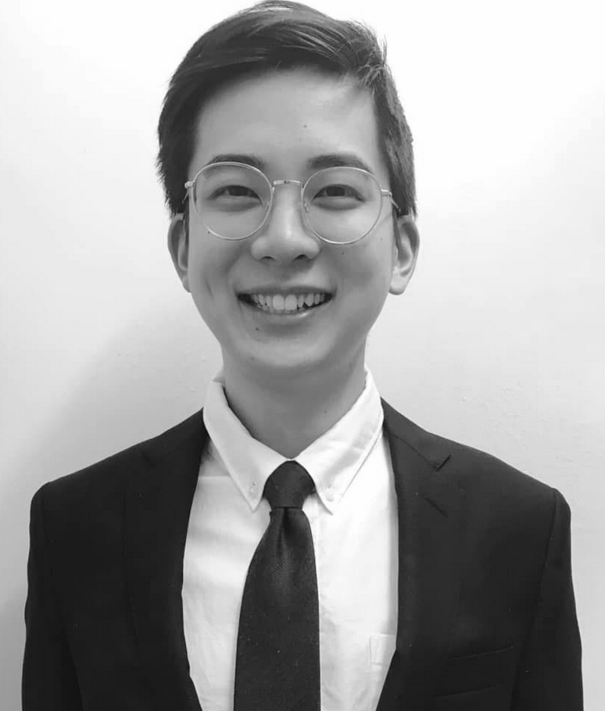
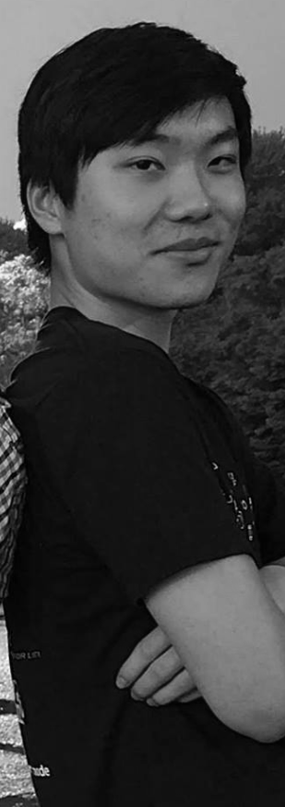
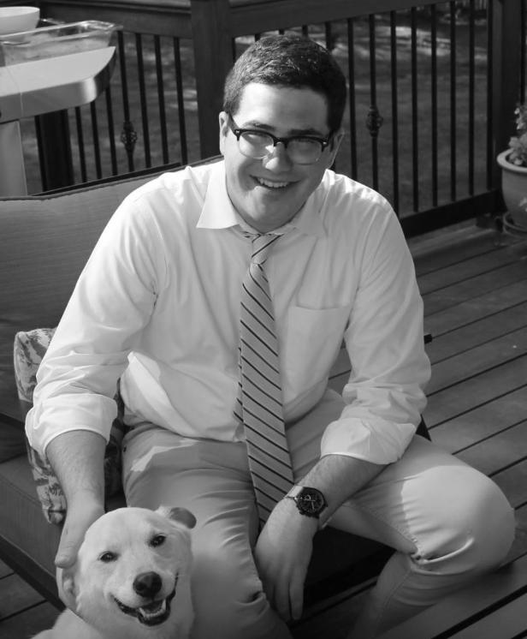
The Team:
Phuru
Justin
Salman
Josh
Skyler
Jon
Brian
Jacob
Mobile App
Teacher Web App
Student Web App
DB/Other

Slide 3
Why Minerva? (Problem Statement)
Students feel that it’s hard to have a voice, while professors feel that it’s hard to keep students engaged
This lack of communication hurts both sides
Meaningful discussion disrupts lecture
Sakai, Canvas, Piazza are inadequate and not integrated

Slide 4
What is Minerva? (Our Solution)
Web & mobile based educational software suite
Incorporates useful features of several different applications into one convenient service
Features
Web App
Announcements, Forum, Quizzes
Mobile App
Live Feedback, Attendance, Polls

Slide 5
Demo

Slide 6
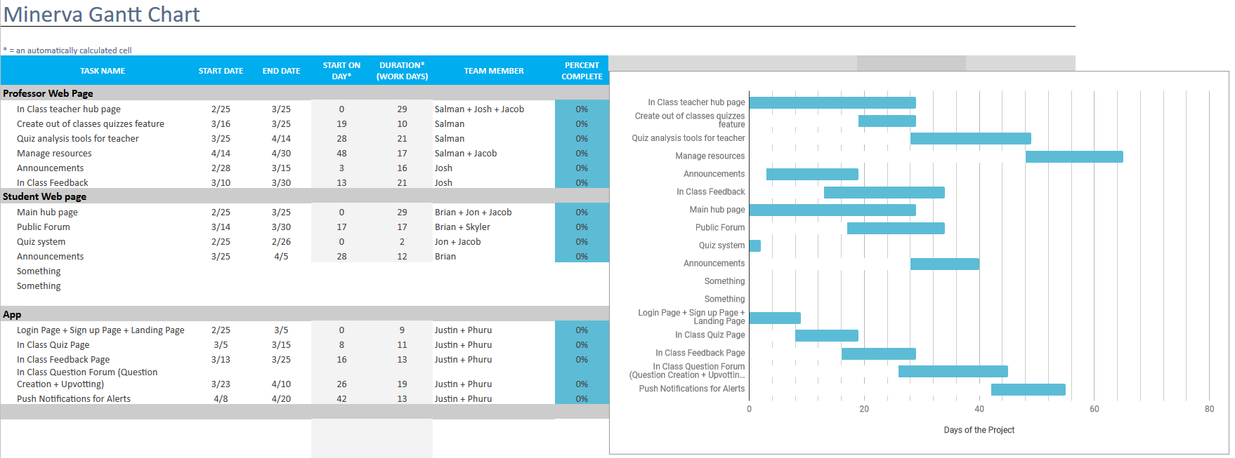
Plan of Work

