Slide 1
Creating a bespoke CMS in Java
Ruth Mills
Java Lead Developer
Connect Group

Slide 2
Overview
CMS specifically designed for salon websites
Began in March 2009 (when wife was in hospital in Yorkshire for several days), although mostly done November 2009 – August 2010 (gap between IT contracts)
Opportunity to learn new skills/technologies and expand on technologies used in work
Opportunity to experiment and try out new architectures and designs with a lot more freedom than would normally have in work

Slide 3
Some things I've learned/expanded on with this project
Spring Framework, Struts 2, Spring Security
Hibernate and JDBC
eXist-db / XQuery / XSLT
PostgreSQL
Jenkins, SVN and Git
Javascript, jQuery and CSS
JBoss, GlassFish, Jetty and Tomcat
Linux and Apache (including load balancing)

Slide 4
Why I chose Open Source libraries
Free to download and use
Source code available if required
Able to take part and give back to the community (even though I haven't Open Sourced any of the work I've done for this particular project)!

Slide 5
Main requirements
Easy to use so that salon owners can update content themselves with minimal support
Ability to support multiple accounts & websites within single web-app deployment
Ability to customise to support individual client requirements (e.g. via “custom fields” and overriding default functionality on a per-account basis).
Tie-in with client database/online appointment booking (which was never finished)!

Slide 6
Summary part 1
Uses Spring Framework, Spring Security, Struts 2, eXist-db, Hibernate, PostgreSQL
Deployed to GlassFish on CentOS Linux
Uses Spring custom scopes to pull account name off URL. Each account has its own XML database collection, and optional unique PostgreSQL instance/Hibernate instance.
Uses both an XML database (eXist-db) and optional SQL database (PostgreSQL) with Hibernate, plus caching on local filesystem.

Slide 7
Summary part 2
Uses XQuery and XSLT to generate web page content
Changes made include performance optimisations (e.g. caching web pages on the local filesystem once generated via XQuery, load balancing 3 x GlassFish server instances), and adding new functionality (e.g. replacing the TinyMCE text editor with Redactor, which allows easy uploads of images, documents, etc).

Slide 8
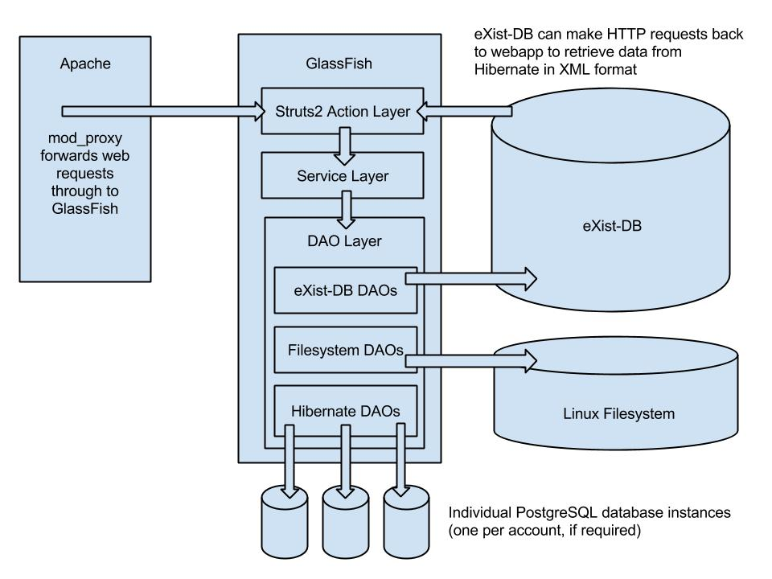
High Level Architecture

Slide 9
What I've learned
How to install, configure and maintain a Linux server running CentOS
How to configure Apache, inc. load balancing
How to run and maintain Java applications on a variety of different app servers
How to run my own SVN & Git repositories
Problem-solving skills – e.g. how to use Google to research bugs and problems online, how to use VisualVM to diagnose memory/performance issues

Slide 10
Why this isn't my career now
During the time between contracts (November 2009 to August 2010), I spent too much time on creating websites using the CMS and not enough time on finishing the online appointment booking, and ran out of money so took another IT contract.
I didn't know Agile back then, so didn't plan effectively (e.g. now, I would have created a product backlog and split work into sprints)
Connect are so awesome that when I was offered a permanent job last year, I said yes!

Slide 11
DEMO!!!

