Slide 1
Java Performance Testing and Diagnostics using JMeter, VisualVM and
Eclipse Memory Analyser Tool
Ruth Mills
Java Lead Developer
Connect Group

Slide 2


Slide 3
Why we need performance testing
To be able to test an application under heavy load, where it would not otherwise be possible to do this manually
To track down bugs and issues which only occur when an application is under heavy load
To determine at which point an application starts to fail when under stress
To test that an application fails gracefully when placed under excessive load
To benchmark performance before and after making changes to an application

Slide 4


Slide 5
JMeter
jmeter.apache.org
Open Source load/performance testing tool
Written in Java
Ideal for load testing Web applications (as well as other types of applications)
Very comprehensive and configurable
Great for firing up lots of concurrent threads to totally max out an application

Slide 6
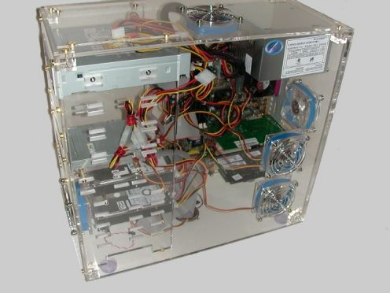

Slide 7
VisualVM
visualvm.java.net
JVM monitoring tool
Supports local and remote JVM connections
Real-time monitoring of CPU usage, memory, classes and threads
Sampling and profiling to work out which code is taking the most CPU and memory
Thread dump, heap dump and snapshot generation and analysis

Slide 8
Connecting to a remote JVM
Set up a SOCKS proxy via SSH, e.g.
ssh -D 9696 user@hostname
Configure VisualVM to use the SOCKS proxy (via the Network tab under the Preferences menu) – set the SOCKS Proxy to localhost and the port to 9696.
Set up JMX by adding the following to the JVM parameters for the JVM you want to monitor: -Dcom.sun.management.jmxremote -Dcom.sun.management.jmxremote.port=1099 -Dcom.sun.management.jmxremote.ssl=false -Dcom.sun.management.jmxremote.authenticate=false

Slide 9


Slide 10
Eclipse Memory Analyser Tool
eclipse.org/mat
Tool to analyse JVM heap dumps
Open Source
Very useful for tracking down memory leaks
Beware opening large heap dumps (e.g. several GB) unless you have shed loads of RAM – it may take ages to perform analysis or fail with an out of memory error

Slide 11
How to get a heap dump
Add the following command line option:
-XX:+HeapDumpOnOutOfMemoryError
this will then cause a heap dump upon the JVM running out of memory
Run jmap on the command line to trigger a heap dump (needs the PID of the JVM), e.g.
jmap -dump:file=heap.hprof {pid of the JVM}
Trigger a heap dump from within VisualVM, by right clicking on the JVM you are monitoring, and choosing “Heap Dump”.

Slide 12


