Slide 1

Microsoft Studio movie analysis
Author: Ruth Kitasi
Summary
As a data analyst for Microsoft's new movie studio, my role is crucial in shaping the company's entry into the cinematic market.
Insights gained from analysis of selected data sets dictate that Microsoft stakeholders should use marketing and production strategies used by top movie studios.

Slide 2

Business problem.
Competition in the movie industry against popular movie studios.
Profitability in terms of Cost of production compared to the returns.
- Original language associated with movies to be produced

Slide 3

Data
Raw data from the csv files, merged for qualitative analysis to save time on quantitative data cleaning.
tmdb.movie- This dataset provides insights into the film’s popularity, original language, and data of different films.
- bom.movie_gross-This dataset helps identify top-performing studios.
- m.movie_budget-This dataset gives details on costs such as production, domestic and foreign which facilitates on the analysis of the return of investments on the particular film

Slide 4
Methods
Preparation and data analysis.
Merging of files.
Checking and removal of duplicates.
Renaming of columns.
Dropping unnecessary columns.
Introducing new variables.
Visualization.
For this analysis, I have employed three different graphs to show my analysis in graphical representation.
This includes column graphs, bar graphs, and pie charts.

Slide 5
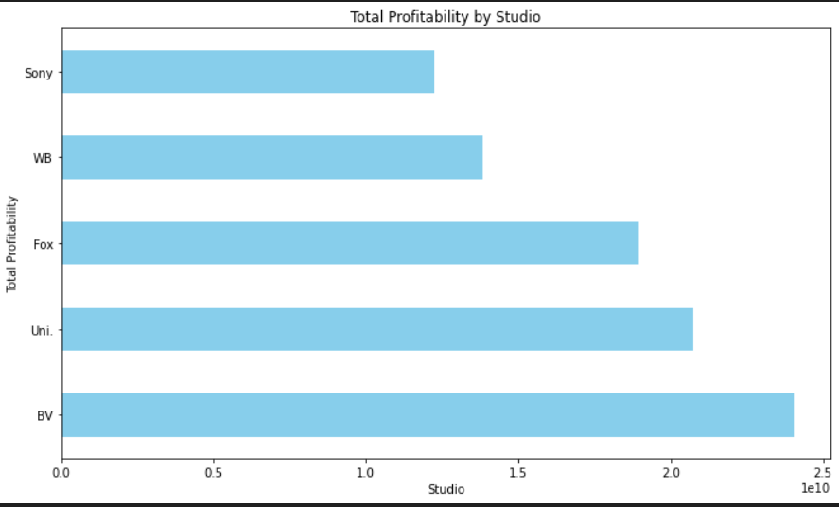
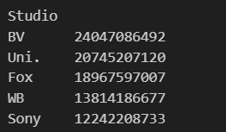
Competitor share on profitability.
BV studio shows to have made the most profits from the movies analyzed followed by Uni.

Slide 6
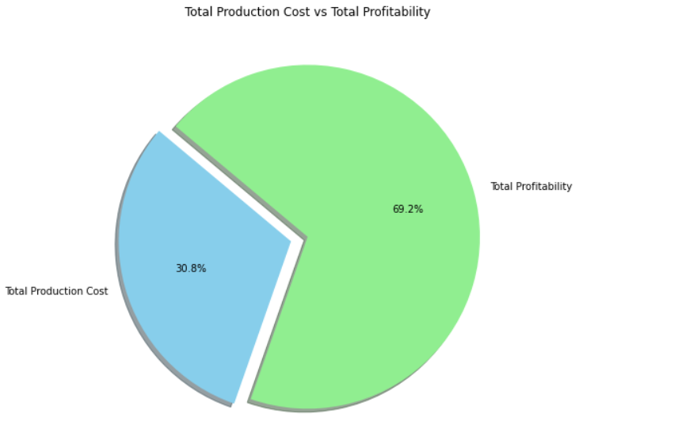
Production vs profitability.
The total profits made were more than the production budget by nearly half the cost.

Slide 7
Conclusion and recommendations
- Benchmark on studios making the most profits from movie production.
- Maximize producing movies in English as the original language as the top profitable moves are in English.
- Invest in the production cost to maximize profits associated with particular movies.

