Slide 1
ZALANDO EUROPE
E-Commerce Product
Performance Analysis
Product performance • market dynamics • pricing • inventory • customer experience
Duru Ruth
Data / Product Analyst
Business Analytics Portfolio

Slide 2
Business Context & Analytical Approach
BUSINESS NEED
APPROACH
• Product performance varies across categories, markets, seller models and fulfilment models.
• The business needs to understand what drives sales, profitability and customer experience.
• The analysis identifies practical opportunities to improve product and operational performance.
01
02
Data cleaning
& preparation
Comparative
analysis
03
04
Relationship
analysis
Power BI
visualization
Tool: Microsoft Power BI
Zalando Europe Product Performance Analysis
3

Slide 3
Research Questions
01
How are the products performing ?
What factors are associated with their performance?
02
How does pricing & discounts influence product performance ?
2.1
03
How can product performance be improved?
How does demand affect sales, profitability & inventory ?
2.2
How does customer ratings and seller/fulfillment models relate to performance ?
2.3
2.4
How do returns and delivery affect performance?
Zalando Europe Product Performance Analysis
3

Slide 4
Executive Overview
A portfolio performing strongly overall, with clear opportunities in inventory, returns and market execution.
NET SALES
GROSS PROFIT
UNITS SOLD
RETURNS
€1.17M
€487.62K
247K
22%
Overall portfolio
41.87% average margin
30-day sales volume
Average return rate
• Performance is concentrated in Women, Footwear and Men.
• Germany contributes 27.22% of net sales; España records the lowest sales.
• Rising-demand products represent the largest share of the portfolio.
• Declining-demand products hold the highest inventory, creating a potential demand–stock mismatch.
• Returns and stockouts remain important operational and customer-experience risks.
Zalando Europe Product Performance Analysis
2

Slide 5
RQ1 — How Are the Products Performing?
NET SALES
GROSS MARGIN
AVG. RATING
STOCKOUTS
€1.17M
41.87%
4.19 / 5
710
4 average stockout days
• Women, Footwear and Men are the strongest-performing categories; Footwear generates the highest gross profit among the leading categories.
• Mass-tier products contribute the largest share of gross profit (46%), while Premium records the highest brand-tier margin (48%).
• Germany is the strongest market at 27.22% of net sales; España records the lowest sales.
• The portfolio is supported by strong sales and demand, but inventory and return pressures create clear areas for improvement.
Zalando Europe Product Performance Analysis
4

Slide 6
RQ2.1 — How Does Pricing & Discounts Influence Product Performance
AVERAGE DISCOUNT
SELLING PRICE
CONVERSION
MARGIN RANGE
17%
€131.90
2.8%
38–43%
• Moderate discount levels can support sales and conversion, particularly across product categories.
• Most regional discounts fall within 7–25%, with gross margins generally between 38–43%.
• Deep discounting should be used selectively because higher discounts do not automatically translate into higher profitability.
Zalando Europe Product Performance Analysis
5

Slide 7
RQ2.2 — How Does Demand Affect Profitability & Inventory
RISING DEMAND
STABLE GROSS MARGIN
DECLINING DISCOUNT
48%
43%
18%
Largest portfolio share
Highest by demand group
Highest average discount
• Rising-demand products represent the largest share of the portfolio and dominate some categories.
• Declining-demand products hold the highest inventory despite receiving the highest average discounts.
• The pattern indicates a need to better align stock levels and discount strategies with demand.
Zalando Europe Product Performance Analysis
6

Slide 8
RQ2.3 — How Does Customer Ratings & Seller/Fulfilment Model Relate To Performance
AVG. RATING
SALES RELATIONSHIP
SELLER MODEL
RETURNS
4.19 / 5
Not significant
Wholesale
↑ with age
Ratings vs sales
Stronger performance
Older products
• Seller and fulfilment models show clearer performance differences than customer ratings.
• Wholesale and Platform Fulfilled record stronger performance, while Private Label records lower sales.
• Older products show higher return rates.
• Footwear and Premium record the highest complaint rates, highlighting customer-experience priorities.
Zalando Europe Product Performance Analysis
7

Slide 9
RQ2.4 — Hoe Does Returns & Delivery Affect Performance
AVERAGE RETURN RATE
RETURNED UNITS
AVG. DELIVERY
TOP RETURN AREAS
22%
≈4K
3.1 days
Women + Footwear
Customer-experience pressure
Portfolio total
• Women and Footwear record the highest return volumes despite being strong sales categories.
• Size/Fit, Change of Mind and Not as Described are the leading return reasons.
• Footwear and Premium have the highest complaint rates.
• Older products also record higher return rates, highlighting the need for stronger product information, lifecycle management and fulfilment experience.
Zalando Europe Product Performance Analysis
8

Slide 10
RQ3 — How Can Product Performance Be Improved?
01
Optimize Product Assortment
02
Align inventory with demand:
Prioritize high-performing, rising-demand products in Women, Footwear and Men, while reducing slow-moving and declining-demand products with excess inventory.
Increase stock for high-demand products and reduce excess stock for declining-demand products to minimize stockouts and slow-moving inventory.
03
Optimize Market-Specific Pricing
04
Strengthen seller & fulfilment strategy:
Use moderate discounts for strong-demand products and deeper discounts to clear slow-moving or excess stock while protecting profit margins.
Expand effective seller and fulfilment practices while improving weaker markets and sellers to boost sales, conversion, and profit margins.
05
Reduce Returns & Customer Complaints
Improve size/fit information, product descriptions, and quality—especially for Footwear and Women—to reduce returns and complaints.
Zalando Europe Product Performance Analysis
9

Slide 11
Recommendation/ Conclusion
01
Prioritize high-performing products
02
Align inventory with demand
Maintain availability across Women, Footwear and Men; review low-performing Beauty and Sports products.
Increase stock for rising demand and reduce excess stock in declining demand.
03
Adopt market-specific strategies
04
Apply strategic discounting
Use Germany's stronger performance to identify practices adaptable to weaker markets.
Use moderate discounts for strong demand and deeper markdowns for declining or excess stock.
05
Strengthen seller & fulfilment strategy
06
Reduce returns & complaints
Scale Wholesale and Platform Fulfilled practices into weaker-performing areas.
Improve fit information, descriptions and quality, especially in Footwear and Women.
07
Protect Premium profitability
08
Review product lifecycle
Maintain availability and avoid unnecessary discounting where Premium demand is strong.
Reassess older products with rising returns; update, reposition, discount or replace where appropriate.
Zalando Europe Product Performance Analysis
9

Slide 12
CORE TAKEAWAY
Zalando's product portfolio demonstrates strong overall sales, profitability and demand, but performance is uneven across markets, products and operating models.
• Focus inventory and assortment decisions on actual demand.
• Use pricing and discounts selectively to balance conversion and margin.
• Transfer successful seller and fulfilment practices to weaker-performing areas.
• Address returns, complaints and ageing products to strengthen customer experience.
• Continuously monitor sales, margins, demand, inventory, returns and fulfilment.
Duru Ruth | Data / Product Analyst
Zalando Europe Product Performance Analysis
10

Slide 13
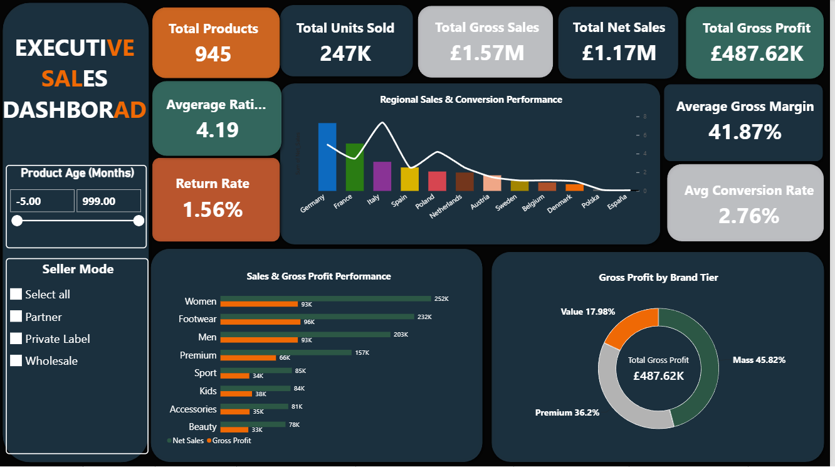

Slide 14
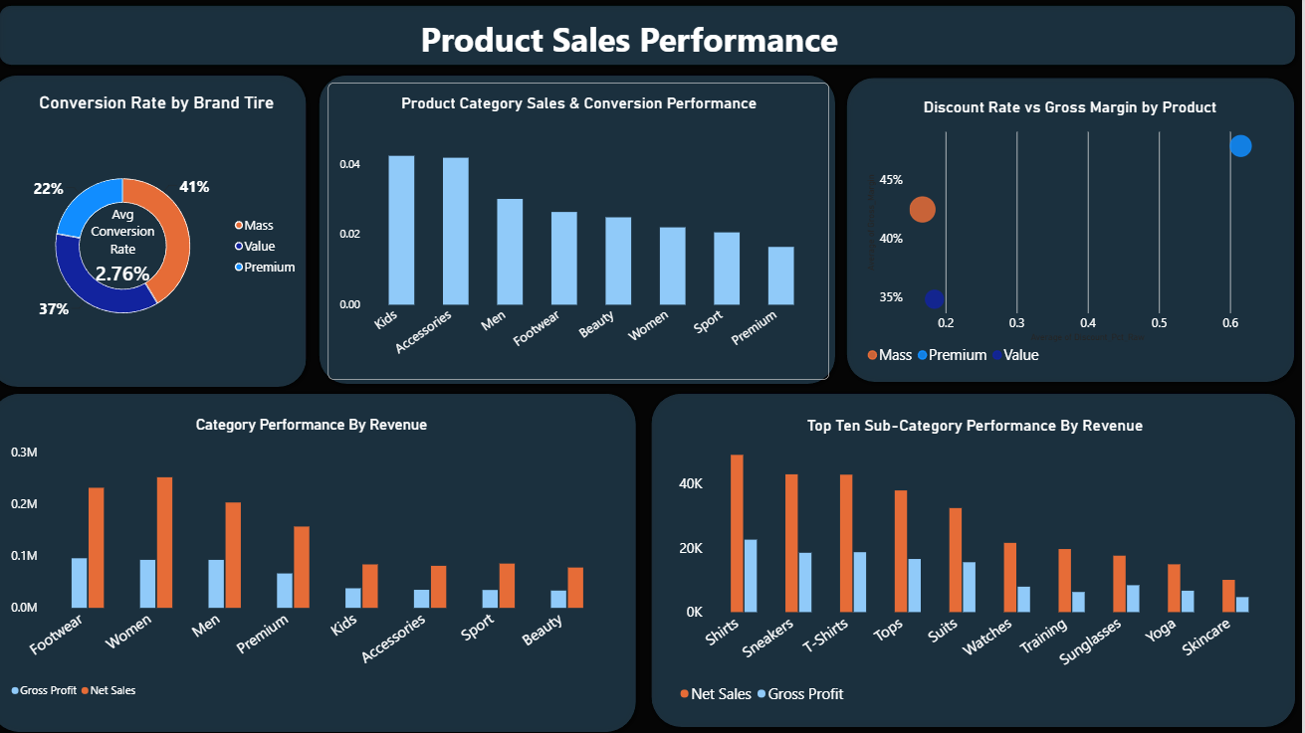

Slide 15
