Slide 1
WELCOME
.

Slide 2
Project Report Template
The Tragedy of Flight: A Comprehensive Crash Analysis
Servite Arts and Science College for Women ,
T. Idaiyapatti, Thogamalai, Karur.
FACULTY MENTOR: Dr. A. THANGA PANDI.,M.Sc.,M.Phil.,BE.d.,Ph.D.,
Project done by
A. RUTH PRINCY – Team Leader
L. NANCY KANIKKAI MARY – Team Member
A. JEYAMALI NI – Team Member

Slide 3
INTRODUCTION
An airplane crash analysis is a detailed investigation into the causes of an aviation accident . The goal of an airplane crash analysis is to identify any factors that contributed to the accident, with the ultimate goal of improving safety and preventing future accidents. The process of conducting an airplane crash analysis wide range of data, including information about the aircraft and its systems, the operators, and any other relevant factors.
This data is typically collected from Kaggle. Once the data has been collected, it is analysed through tableau, to identify any potential causes of the accident. The results of an airplane crash analysis are typically published in a report, which may include recommendations for improving safety and preventing similar accidents in the future. These recommendations may be implemented by the relevant authorities or industry organizations.

Slide 4
PURPOSE:
The goal of a airplane crash analysis is to identify any factors that contributed to the accident, with the ultimate goal of improving safety and preventing from accident.

Slide 5
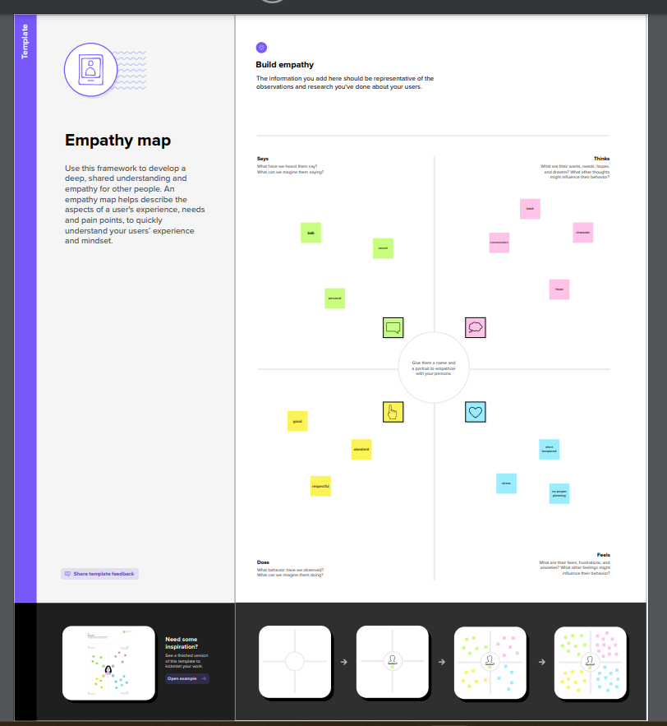

Slide 6
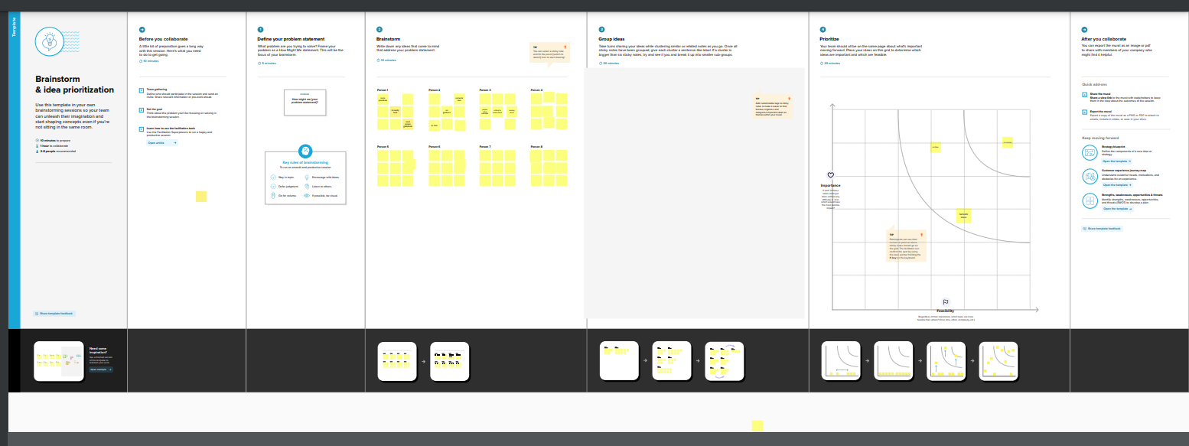

Slide 7
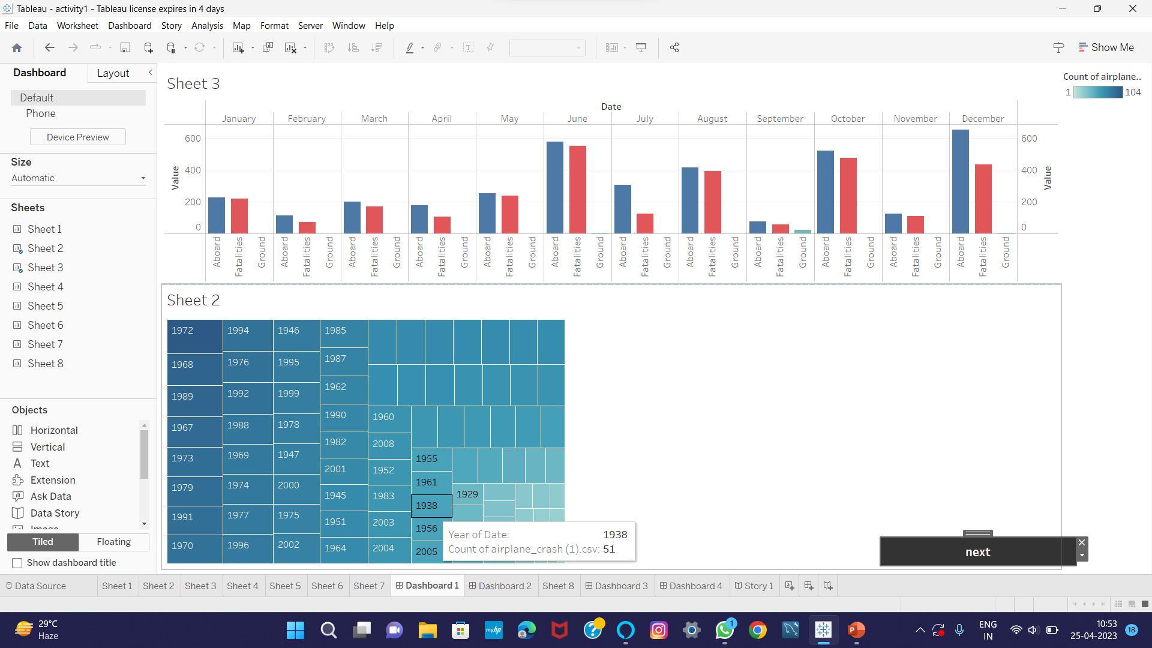

Slide 8
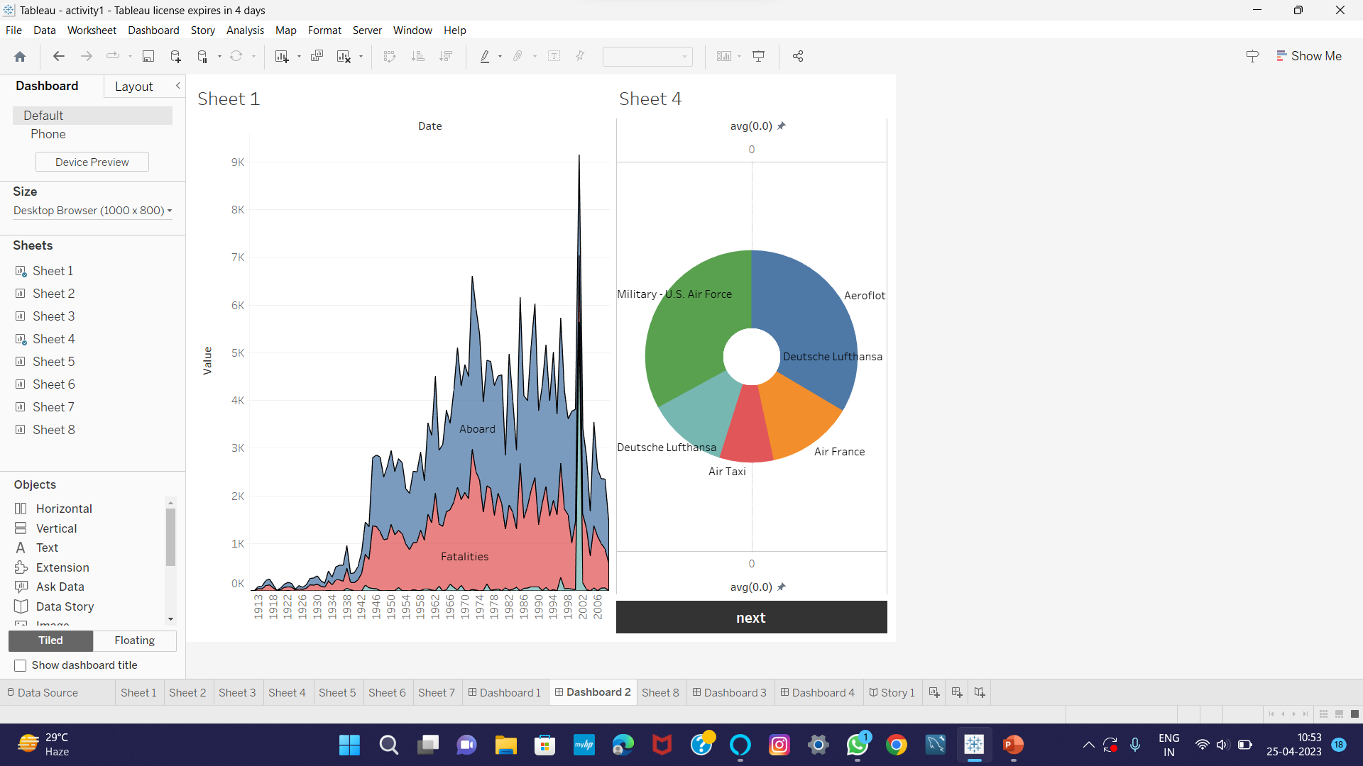

Slide 9
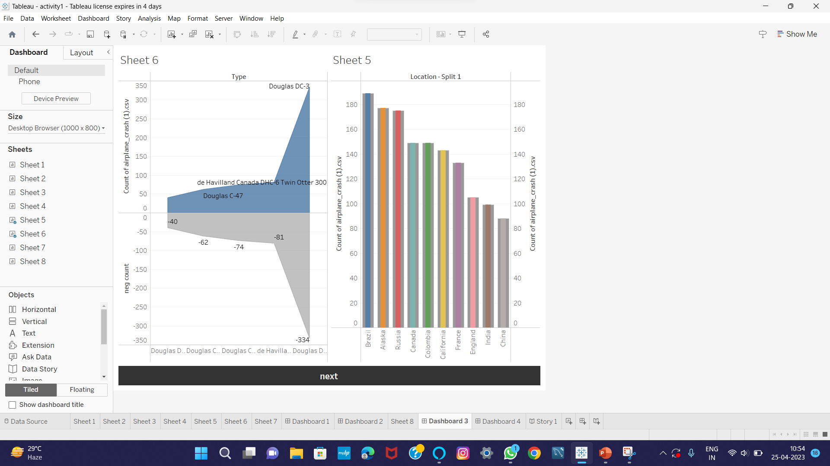

Slide 10
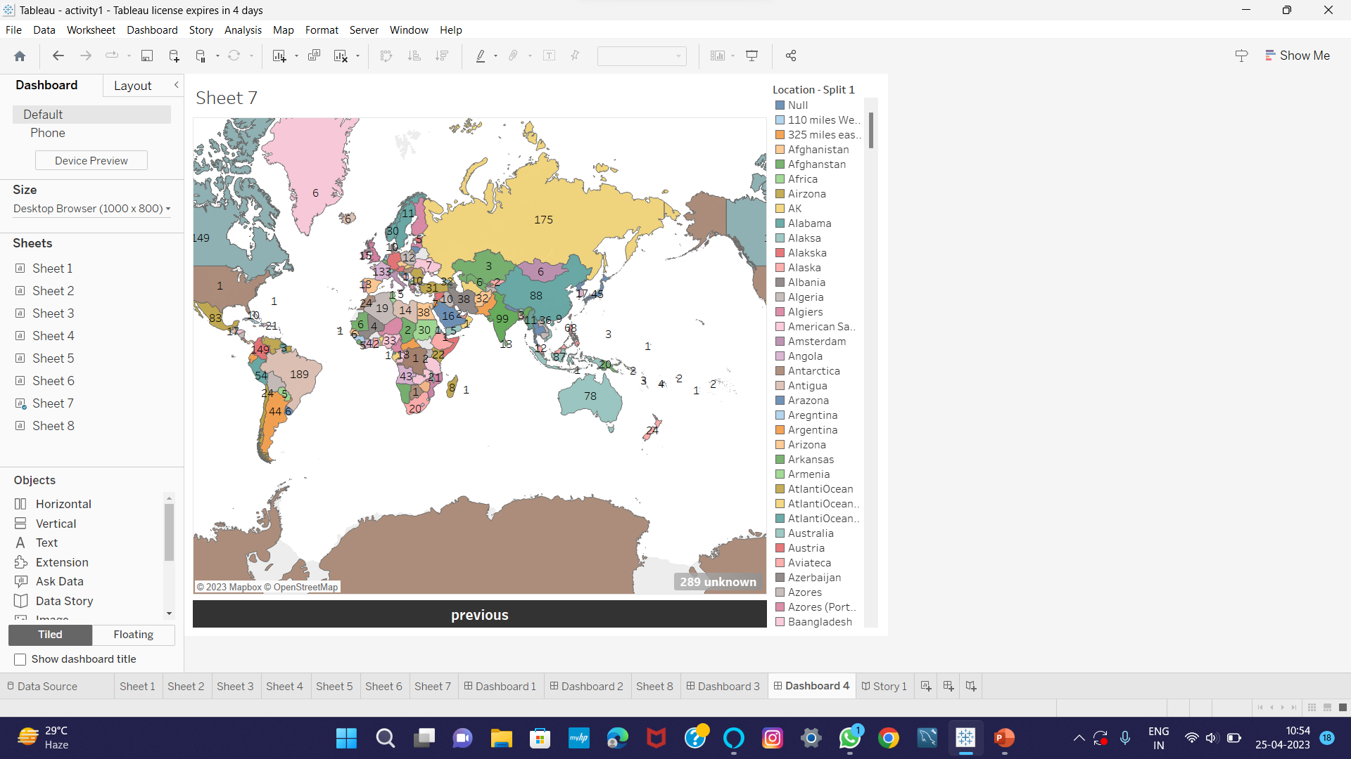

Slide 11
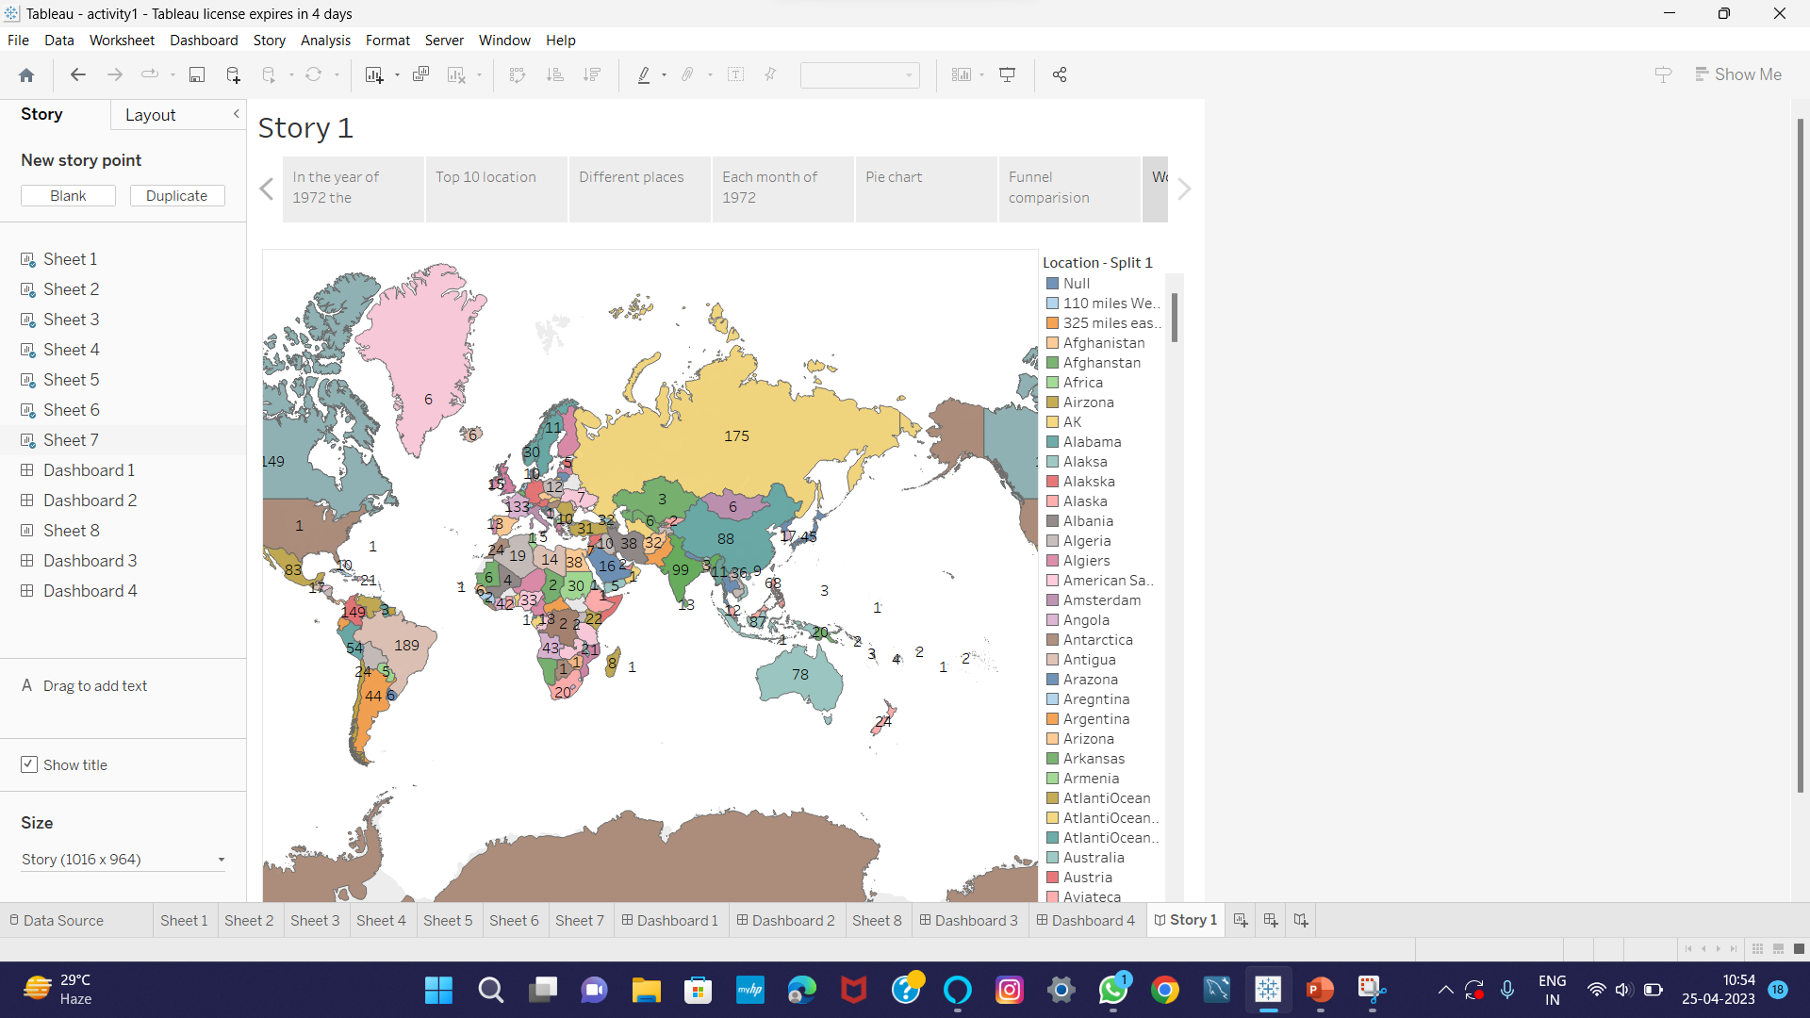

Slide 12
ADVANTAGES:
Fastest type of travel.
Good facilities at most airports; refreshments / meals en route.
Minimal check – in time for most domestic flights.
Most popular method of transport.
DISADVANTAGES:
Expensive.
Airports can often be several miles from city centre.
Long check – in time required for some flights abroad.
Bad weather can mean delays, rerouting or cancellation.

Slide 13
SOME CAUSES FOR FLIGHT TRAGEDY:
Aviation accidents can be traced to a variety of causes , including pilot error, air traffic controller error, design and manufacturer defects, maintenance failures, sabotage, or inclement weather.

Slide 14
CONCLUSION:
The constant maintenance and repair of aircraft may seem like a trivial job but they can prove to fatal if not done properly.
A missing screw can jeopardize the whole aircraft.
Lack of lubrication costed 88 lives, these are lessons the aviation industry learnt the hard way.

Slide 15
FUTURE SCOPE:
In the modern aviation industry, it is also used to analyse a database of past accidents in order to prevent an accident from happening. Many models have been used not only for the accident investigation but also for educational purpose.

Slide 16
THANKING YOU

