Slide 1

ROCKBUSTER STEALTH LLC
Entering into the online video rental market
Data Analytics Team
Ruth Agnew

Slide 2
Overview and Objectives
Rockbuster Stealth is a global movie rental company looking to increase their competitive edge by entering into the online video rental market.
We have been tasked with looking at Rockbuster’s existing customer and inventory data to understand and answer some key questions put forward by the Management Board:
How many customers do we have and where are they based?
Which movies contributed the most or least to revenue gain?
What was the average rental duration for all the videos?
Where are customers with a high lifetime value based?
Do sales figures vary between geographic regions?

Slide 3
Where is Rockbuster now?
Rockbuster collects data on things such as transaction and payment information, customer intel, current inventory and stock, film details, and employee and store information. When looking at data captured between February and May 2007, we can see the following:
109 countries
599 customers
1000 movies
Total revenue generated
$61,312.04
Number of rentals
14,596

Slide 4
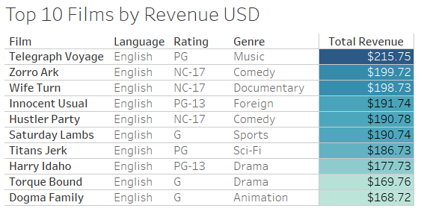
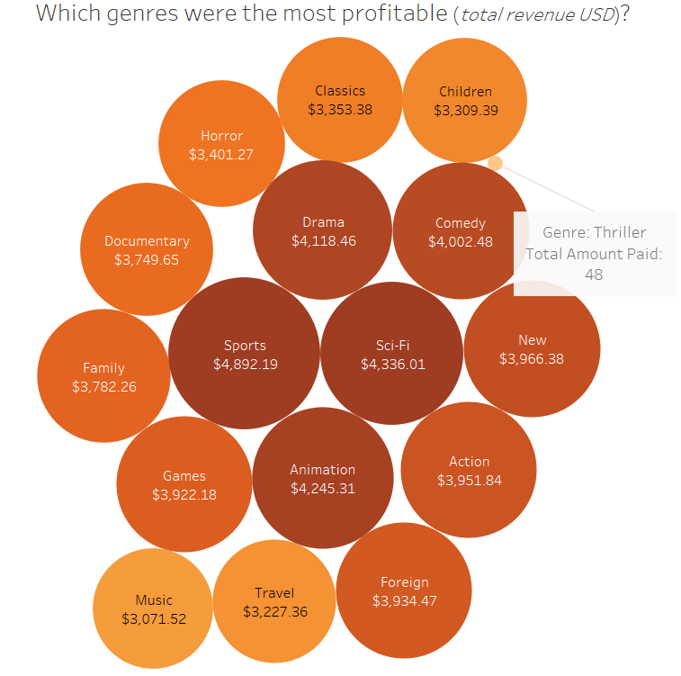
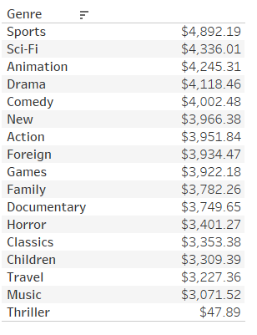
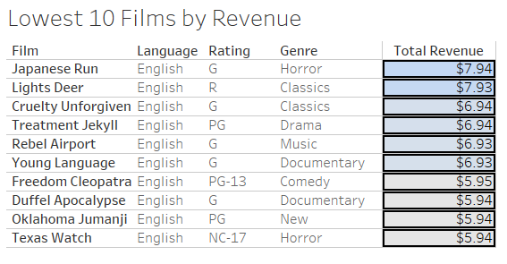
What are Rockbuster’s most popular films?
All genres generate significant revenue, except for Thriller

Slide 5
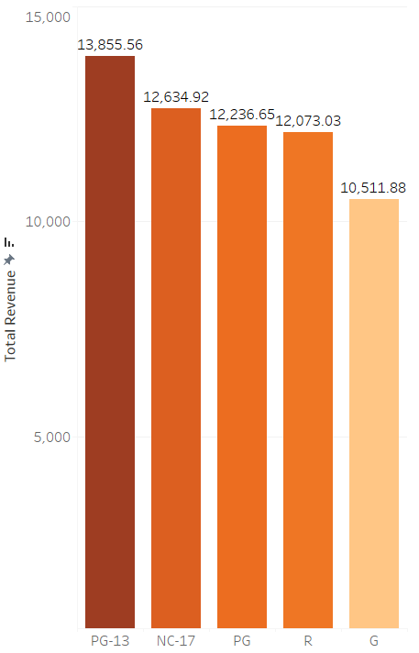
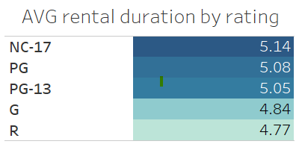
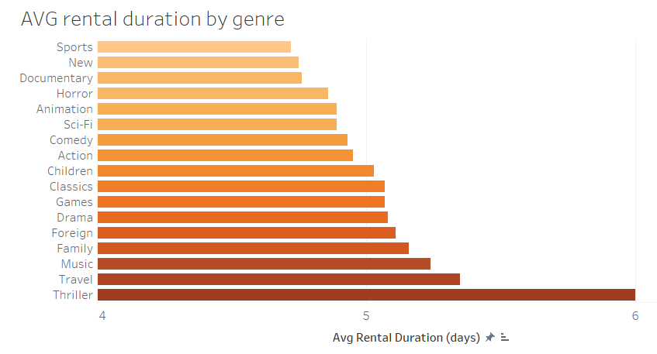
How are customers renting films?
PG-13 films are the most popular to rent
Minimum: 3 days
Maximum: 7 days
Average: 5 days
Genre and rating have some impact on rental duration, but not hugely significant.
It’s important to note that Thriller films were only rented 11 times in the time period, compared to Sports’ 1081 or New’s 864 (see Appendix).

Slide 6
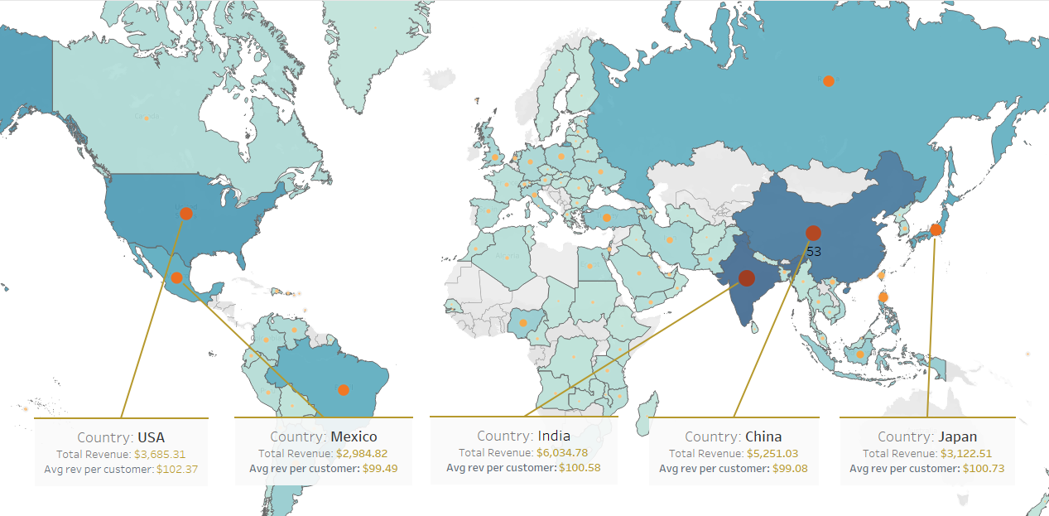
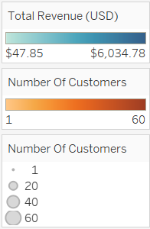
Where is Rockbuster most profitable?
Top 10 Countries by revenue
India
China
USA
Japan
Mexico
Brazil
Russia
Philippines
Turkey
Indonesia
The countries with the most customers also generate the most revenue.

Slide 7
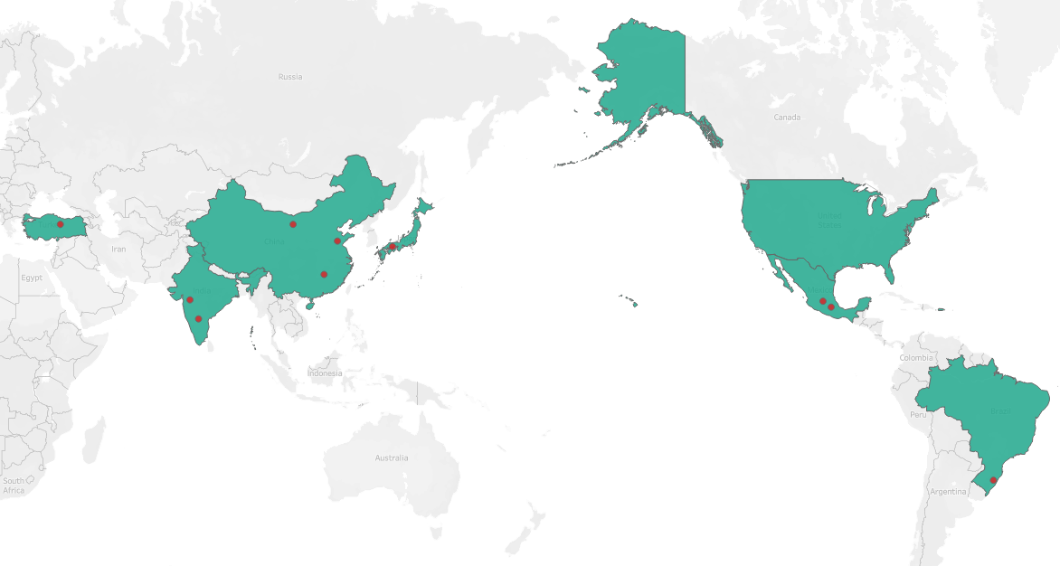
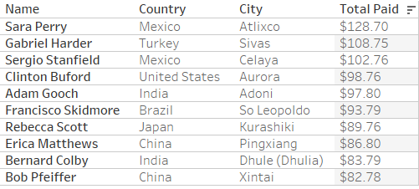
Where are our Top 10 customers?

Slide 8
Conclusions and Recommendations
Leverage your geographic strengths
Rockbuster has 599 customers in 109 countries. The top five countries in terms of revenue and customer numbers are India, China, USA, Japan, and Mexico. Rockbuster should prioritise these countries in the roll out of the online video rental strategy; perhaps even using these countries in an initial roll out before expanding globally.
Only one country in the top 10 is based in Europe – Turkey – so I would suggest deprioritising that market in favour of Asia, LATAM, and North America.
Your top 10 customers are based all across the globe. Consider introducing a loyalty or reward scheme to highly valued customers, and ensure they keep returning to Rockbuster.

Slide 9
Conclusions and Recommendations
Expanding your inventory
All films from the analysis were released in 2006. I would consider widening your inventory to include films made in other years as this could broaden your appeal and customer market.
All films which were rented during the analysed period were English-language. I would suggest investigating whether foreign language films could be included. This is especially important given that only one country in the top 10 has English as it’s main official language.
The most popular genres were sports, sci-fi, and animation, but most genres generated revenue. The exception was Thriller which was only rented 11 times, making a revenue of $48. Since there is currently only one film categorised as Thriller, we should first investigate whether this has been incorrectly categorised. Secondly, since tentative data shows that thriller films are rented for longer than average (6 compared to 5), we should investigate whether more thriller films could be added to the inventory as this could potentially generate more revenue.

Slide 10
Resources and Contact Information
You can find all visuals on Tableau Public
Please feel free to contact me for any additional resources or follow up questions on ragnew@rockbuster.com.
Thank you for your time.

Slide 11
Appendix
Film genres by number of rentals and total revenue
Genre | Number of rentals | Total revenue (USD)
Sports | 1081 | 4892.19
Sci-Fi | 998 | 4336.01
Animation | 1065 | 4245.31
Drama | 953 | 4118.46
Comedy | 851 | 4002.48
New | 864 | 3966.38
Action | 1013 | 3951.84
Foreign | 953 | 3934.47
Games | 884 | 3922.18
Family | 977 | 3782.26
Documentary | 937 | 3749.65
Horror | 773 | 3401.27
Classics | 860 | 3353.38
Children | 861 | 3309.39
Travel | 765 | 3227.36
Music | 750 | 3071.52
Thriller | 11 | 47.89

