Slide 1
CacheBandit
A Framework Towards Improving Shared Tightly-Coupled-Memory ($) Efficiency in Embedded SIMT Architectures.

Slide 2
Introduction
Multiple contemporary Scientific Computing / Industrial (HPC) applications involve Sparse-Matrix (SpM) solvers, such as in FEM, CFD, Structural-Modeling, Graph Processing, and AI Edge-Inference [1 - 5].
SpM streaming kernels such as SpMV are memory-bound rather than compute-bound. Largely limited by the available bandwidth between compute units and off-chip memory, through the memory hierarchy.

Slide 3
Introduction
Multiple contemporary Scientific Computing / Industrial (HPC) applications involve Sparse-Matrix (SpM) solvers [1 - 5].
SpM streaming kernels tend to be memory-bound rather than compute-bound [6].
Hence benefiting from Near-Data-Processing (NDP) architectures.

Slide 4
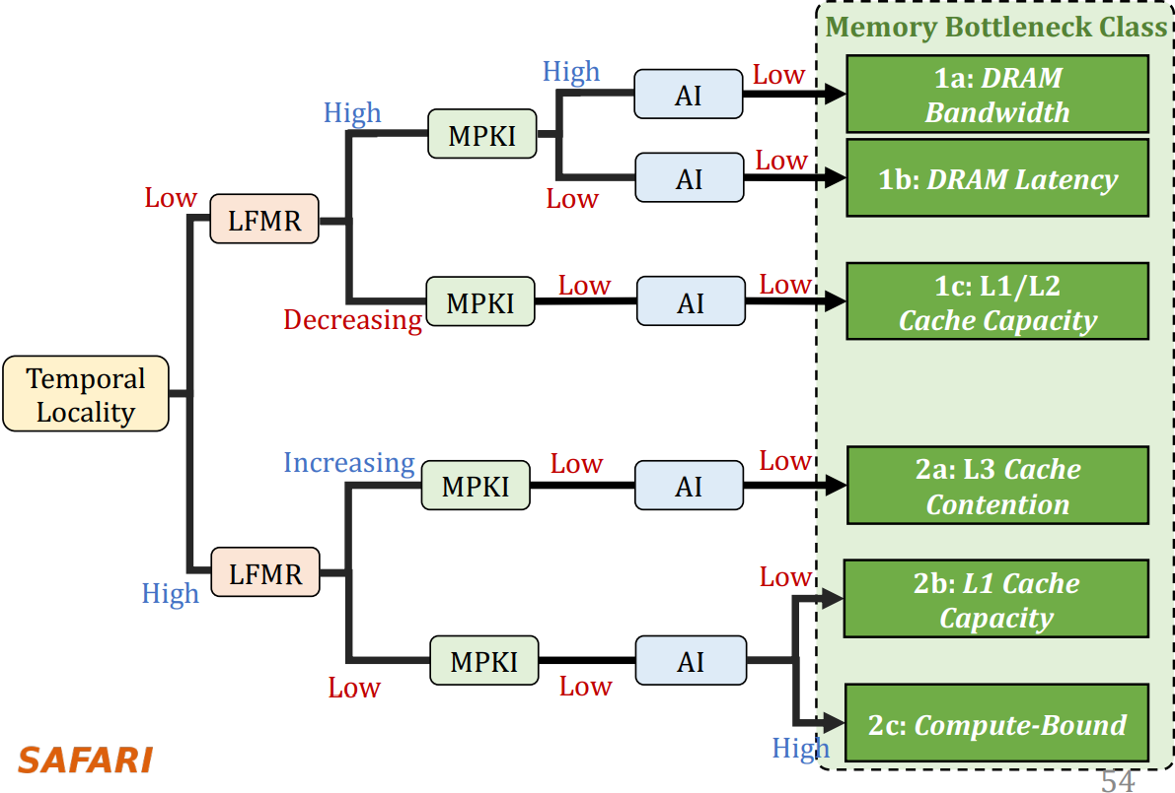
Introduction: Memory Bottleneck Classes
* [6]

Slide 5
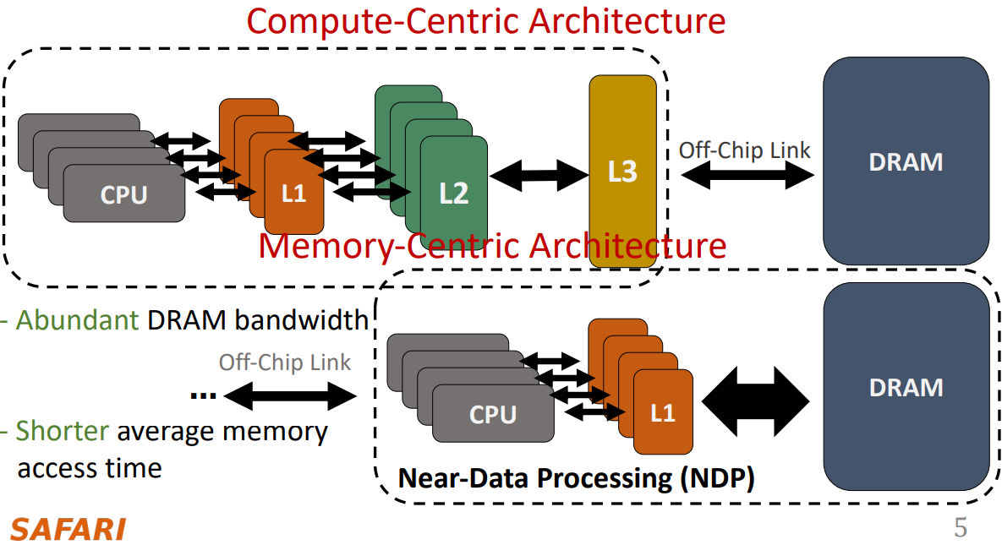
Introduction: Near Data Processing (NDP)
* [6]

Slide 6
Case Study: SpMV
SpMV is ubiquitous in HPC and is chosen for NDP cache enhancement study due to high LFMR and high MPKI.
SpMV kernels are currently run on GPGPUs [8, 9] with compute-centric architectures.
SIMT architecture maximum throughput achieved by scheduling workloads across threads to hide latencies [10].
SpMV streams on SIMT exhibit poor temporal locality. Resulting in exacerbated cache line (thrashing) conflicts [11].

Slide 7
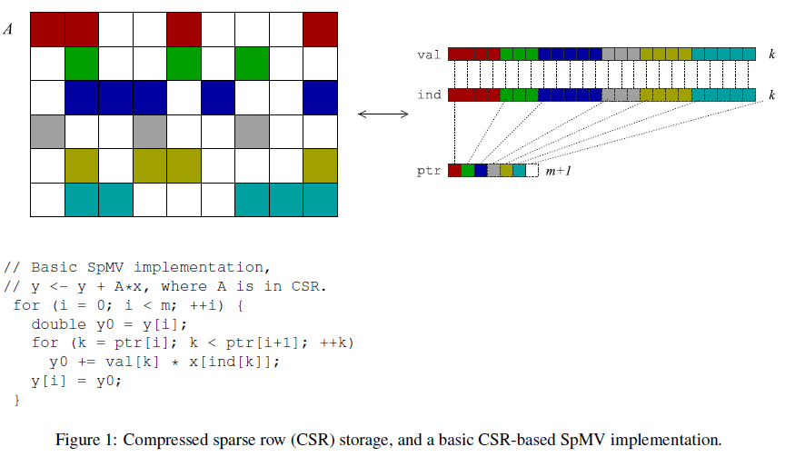
SpMV: Representation
* [12]

Slide 8
Problem: Cache Resource Contention
Thrashing of a ‘Set-Associative’ (SA) TCM$ (L1D) due to multiple physical addresses mapping to the same block/line/frame.
-> Barrier = Hardware implementing Associativity (Field-of-View).
Results in increased DRAM memory traffic due unnecessary evictions in TCM$.
-> Barrier = Cache contention (SA mapping).
Thus, requiring larger DRAM bandwidth, leading to:
(1) Slower execution time -> Tspmv_lower_bound ∝ No. of DRAM access.
(2) Higher energy consumption -> Espmv_lower_bound ∝ No. of DRAM access.
(3) Lower Cache Efficiency -> Bloating of DRAM access beyond necessary.

Slide 9
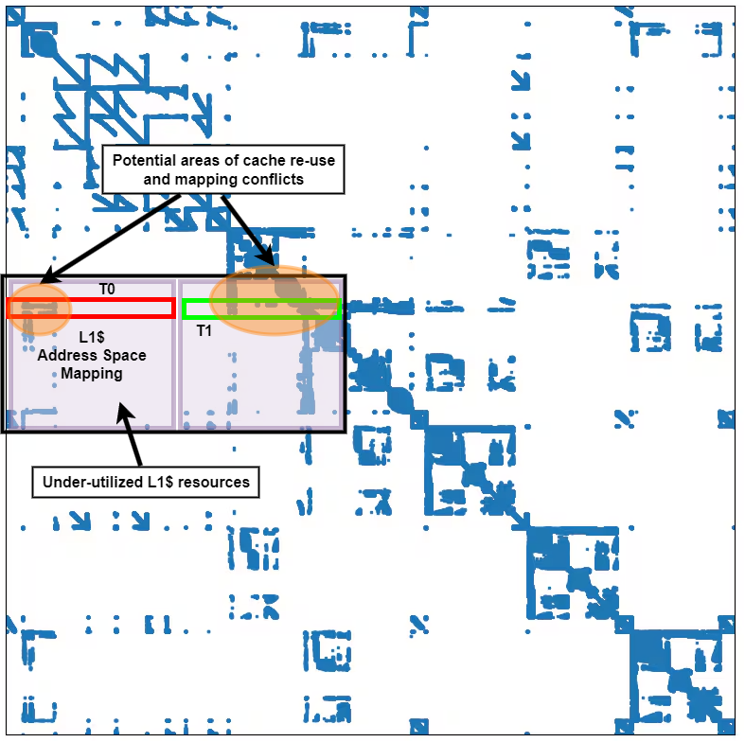
Problem:
*https://gpuopen.com/learn/amd-lab-notes/amd-lab-notes-spmv-docs-spmv_part1/

Slide 10
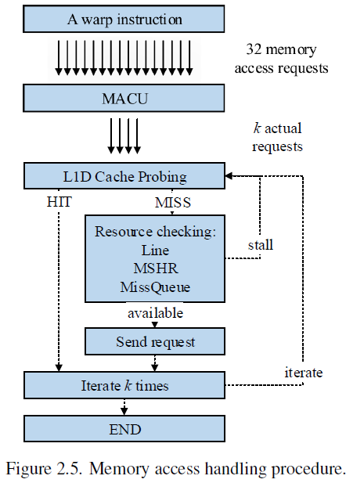
Problem:
* [11]

Slide 11
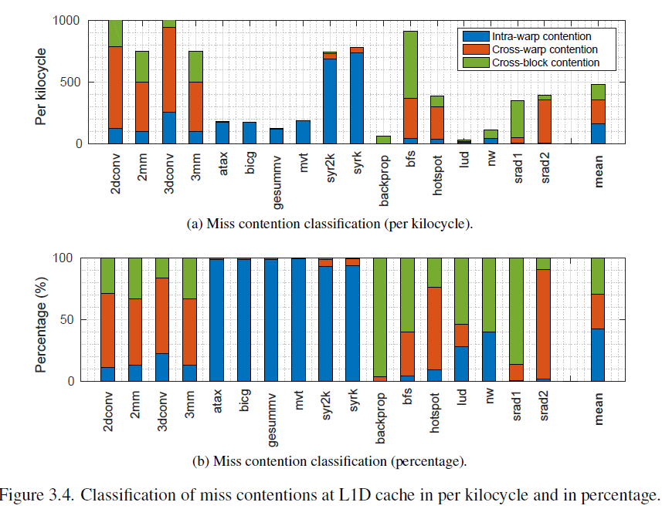
Problem:
* [11]

Slide 12
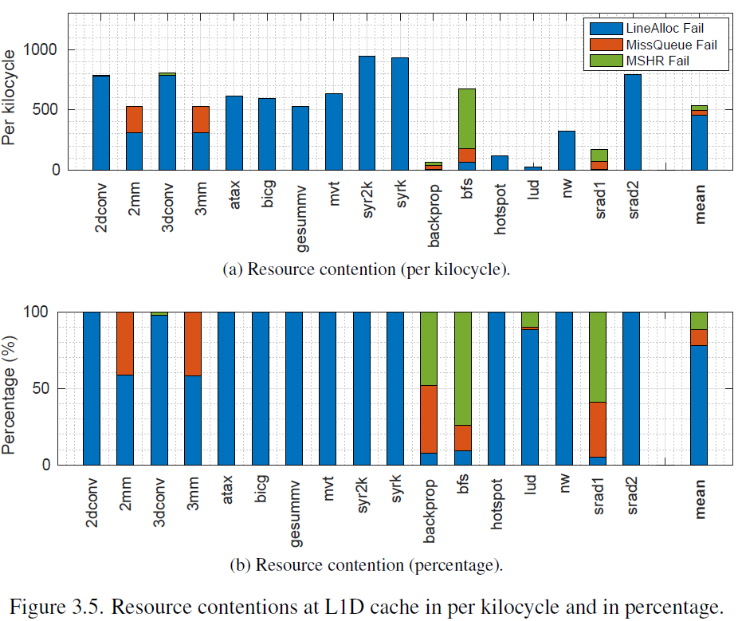
Problem
* [11]

Slide 13
Problem: Embedded Platform
SpMV on deep-cache-hierarchy architectures (GPGPU/CPU) can suffer from additional latency introduced by the hierarchy, due to their low arithmetic intensity.
Hence the FPGAs prototype-ability is used to study the effect of NDP cache enhancements on embedded SpMV accelerators.
High-Level-Synthesis (HLS) reduces the effort to port C/C++ SpMV algorithms to FPGA accelerators [12].

Slide 14
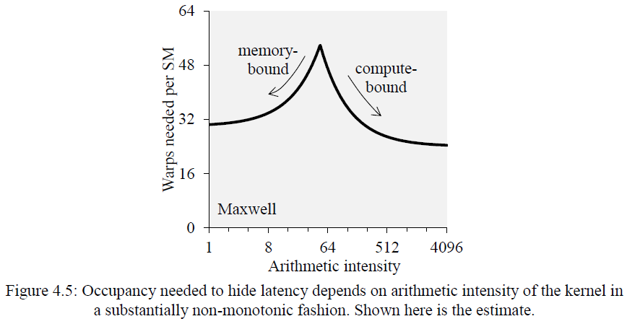
Problem:
* [10]

Slide 15
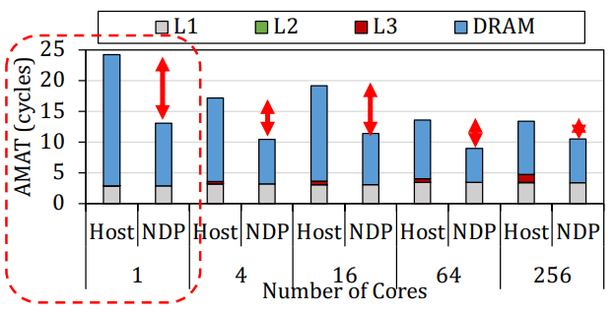
Problem:
* [6]

Slide 16
Solution Space Exploration:
Many approaches exist to reduce cache conflict. Some [13 - 15] involve cache/thread/load-aware scheduling and pre-processing techniques (Access-Pattern-Manipulation) to improve L1D$ utilization.
Other approaches [16 - 20] involve hardware enhancements (Access-Pattern Adaptation) to remedy cache resource conflicts.
In practice, effort on both APM and APA fronts are necessary to maximize $ utilization in irregular memory access patterns.
This work (CacheBandit) falls under the second category of APM enhancement, for NDP SIMT architectures.

Slide 17
CacheBandit: Goals
Major goals:
(1) Reduce cache contention (FA + larger FOV) and maximize TCM$ efficiency.
(2) Support concurrent (TDM) Multi-Context access.
(3) Tile-able (structurally) / Scalable (Frequency) (Little’s Law).
Target TCM/L1D$ which is present in both compute/memory centric architectures.

Slide 18
CacheBandit: Hypothesis
If cache contention (FOV) is the bottleneck and not the cache size, as in the case with streaming applications such as SpMV.
Solution is to use ‘Fully-Associative’ (FA) cache.
But realizing FA cache resources across threads sharing TCM$ is expensive.
Hence, employ a hybrid solution. The TCM$ is FA from a physical memory perspective, but is virtually SA with respect to each individual thread.

Slide 19
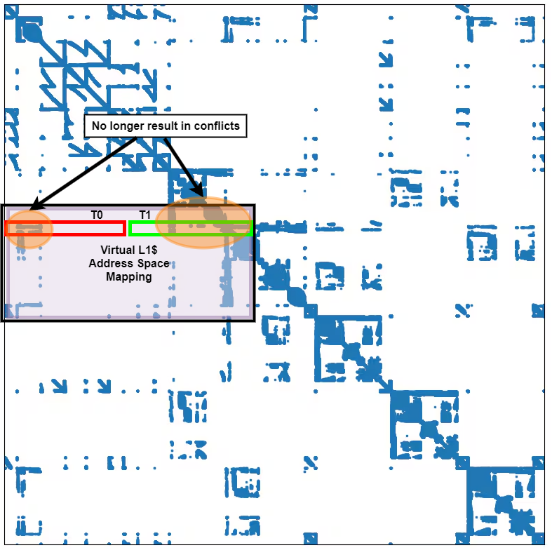
CacheBandit:

Slide 20
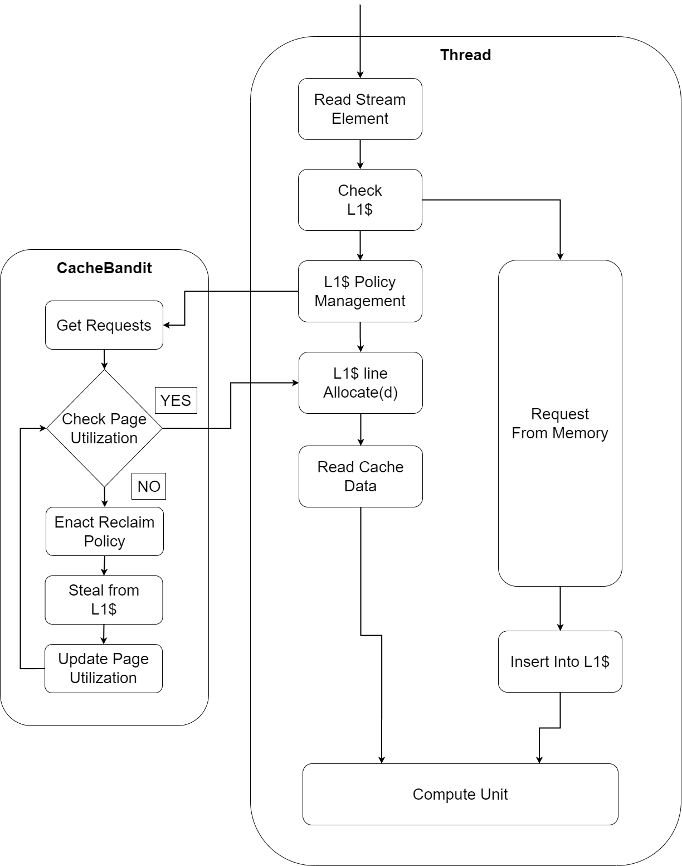
CacheBandit: Flow

Slide 21
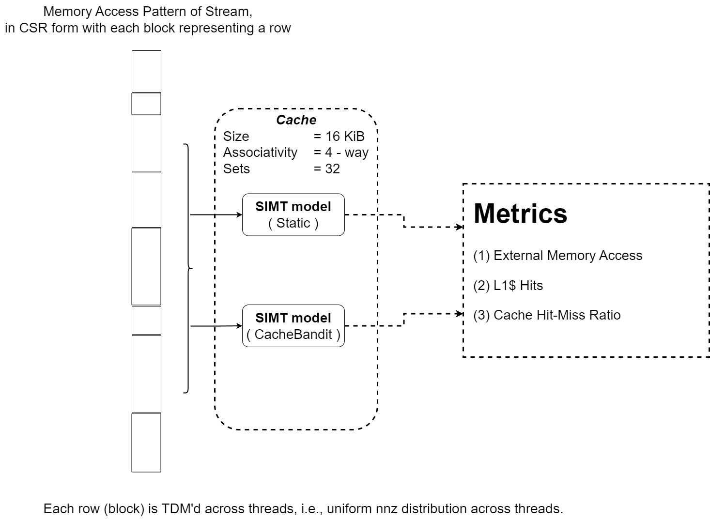
CacheBandit: Single Warp Simulation

Slide 22
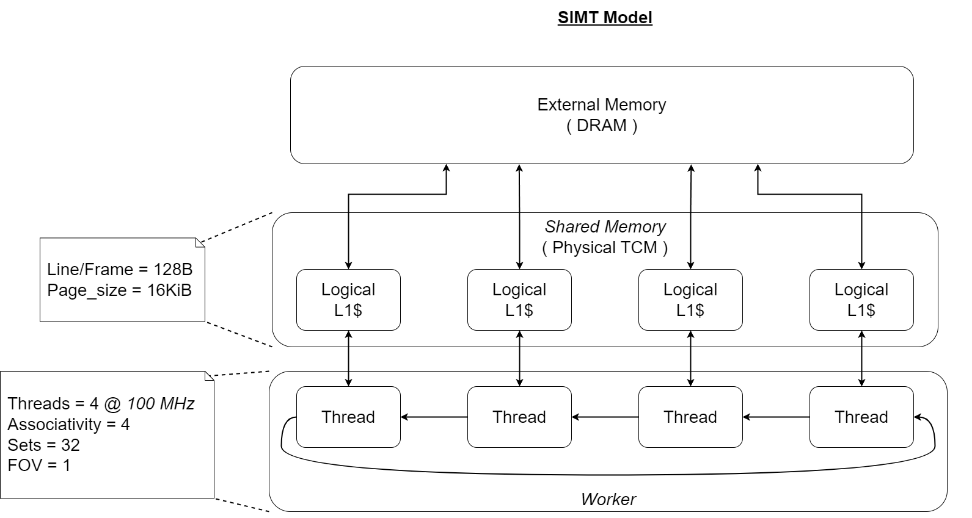
CacheBandit:

Slide 23
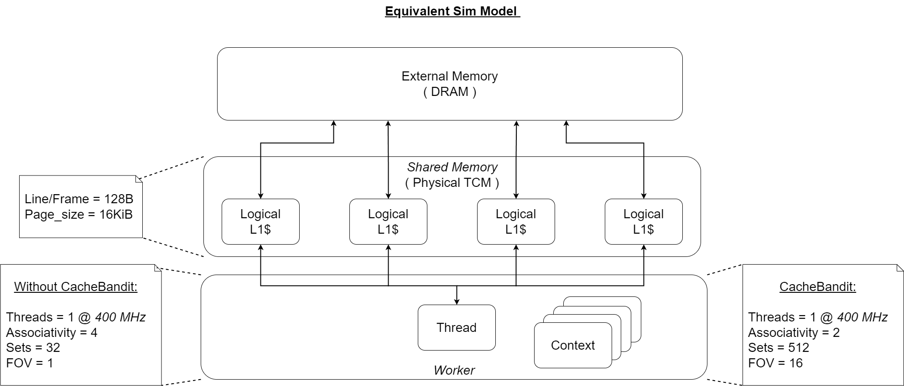
CacheBandit:

Slide 24
CacheBandit: Performance Metrics

Slide 25
CacheBandit:

Slide 26
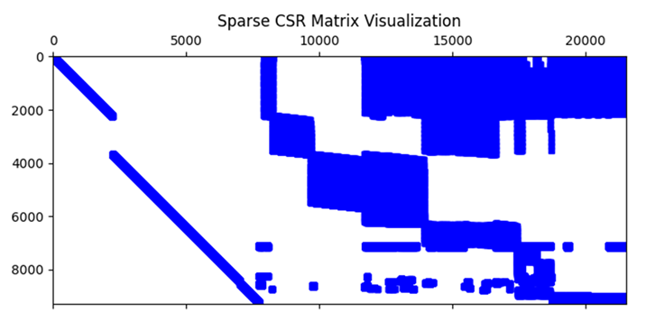
CacheBandit:
Problem: Name = cq9, Group = Meszaros, Kind = linear programming problem.
K = 9278, M = 21534 ; Density = 4.83% ; NNZ = 96653 ; Unique Frames Visited = 1346

Slide 27
CacheBandit: Dynamic Virtual Sets

Slide 28
CacheBandit:

Slide 29
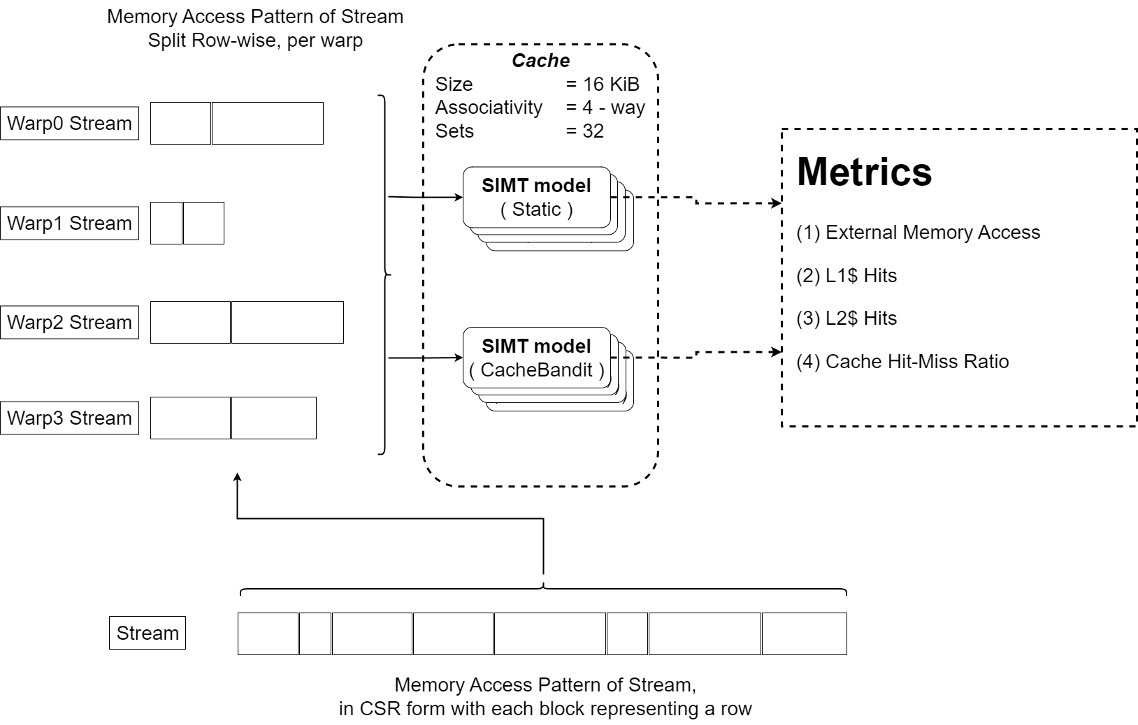
CacheBandit: Multi Warp Simulation

Slide 30
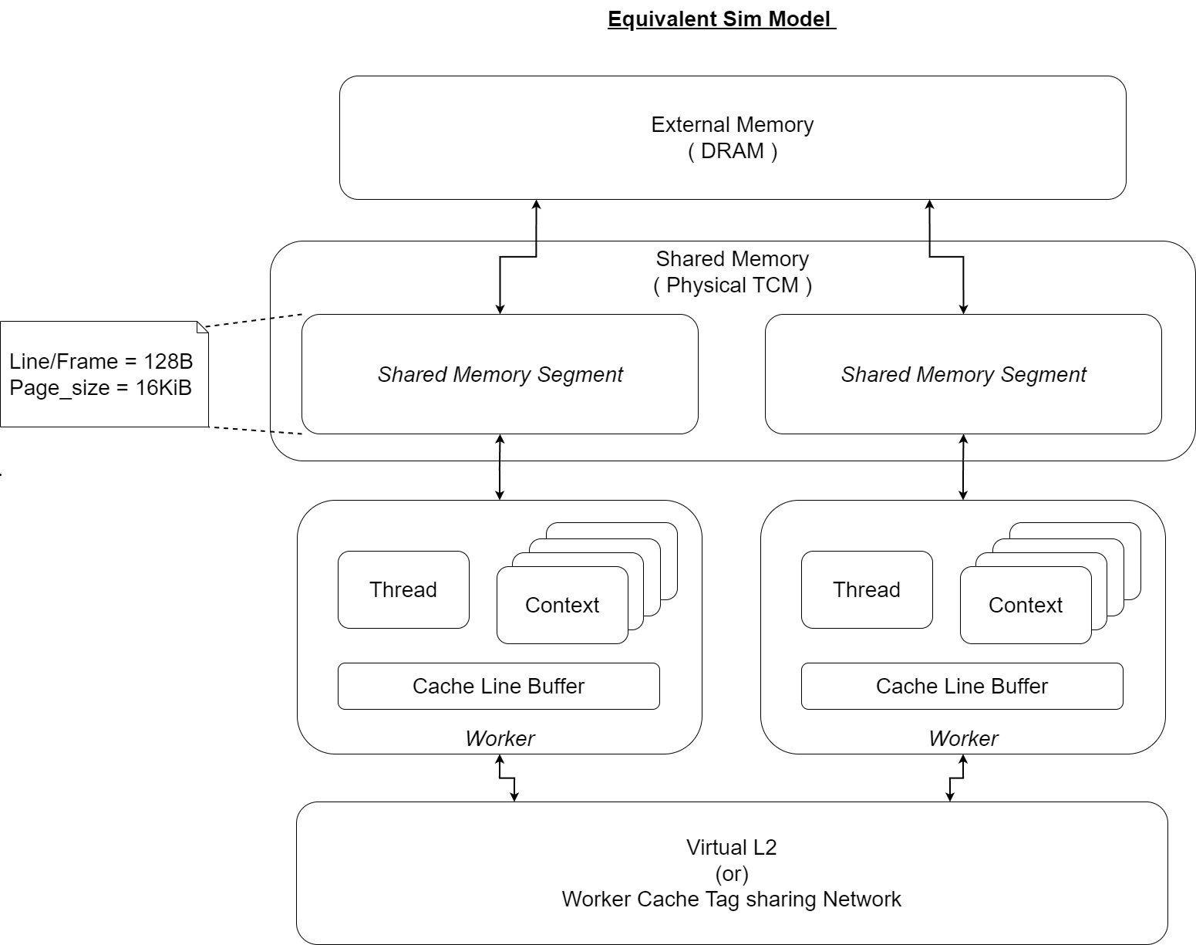
CacheBandit: Multi Warp

Slide 31
CacheBandit: Multi Warp Metrics

Slide 32
CacheBandit: Multi Warp

Slide 33
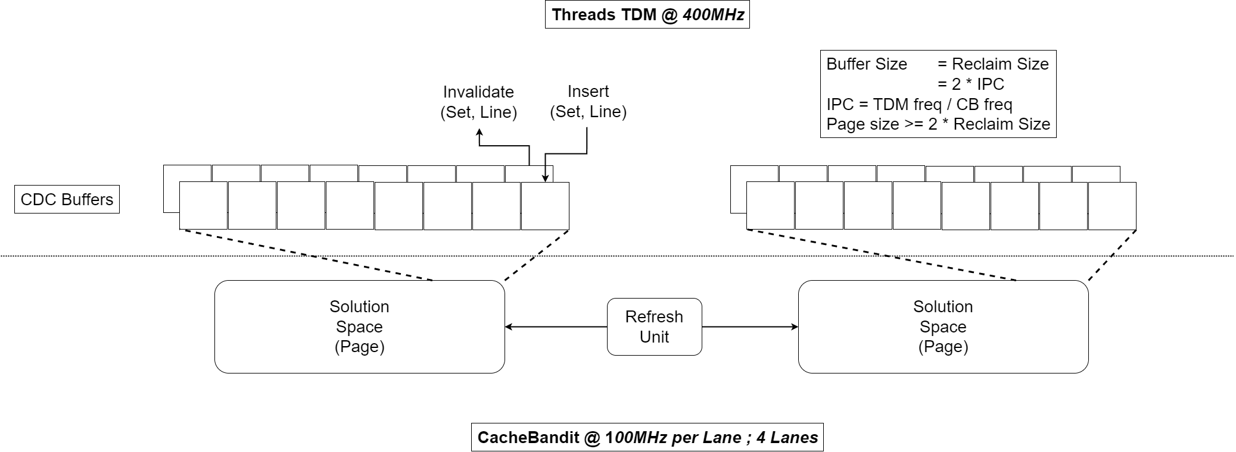
CacheBandit: Single Warp Template

Slide 34
CacheBandit: Implementation Roadmap
Parts:
(1) Allocator: Provide solution to thread upon cache line request.
(2) Virtual L1: Tag store, comparator hardware.
(2) Deallocator: Reclaim cache lines upon hitting utilization threshold.
(4) Memory Controller: DMA with DRAM memory.
Sub-modules allocator and deallocator are ported from QuickPage(Lite).
MCU and Virtual L1 tag array still need to be worked out.

Slide 35
CacheBandit: Advantages
Eliminates conflict-miss within a SIMT core.
Template design reduces design overhead.
Scalable in terms of both:
Managed Cache capacity.
Core frequency.

Slide 36
CacheBandit: Tradeoffs
Implementation cost grows with core frequency and managed page size (solution space).
Still very dependent on memory access pattern.
Not a standalone solution, and requires pre-processing such as access pattern profiling to set dynamic sets.

Slide 37
CacheBandit: QPL Resource Dependency

Slide 38
Bibliography
[1] Efficient Computation of Sparse Matrix Functions for Large-Scale Electronic Structure Calculations: The CheSS Library, Stephan Mohr, et.al.
[2] Multi-level μ-Finite Element Analysis for Human Bone Structures, Peter Arbenz, et.al.
[3] Sparse Matrix Algebra for Quantum Modeling of Large Systems, Emanuel H. Rubensson, et.al.
[4] SparseGPT: Massive Language Models Can be Accurately Pruned in One-Shot, Elias Frantar, Dan Alistarh.
[5] Sparse Linear Algebra Toolkit for Computational Aerodynamics, Stephen L. Wood, et.al.
[6] DAMOV: A New Methodology and Benchmark Suite for Evaluating Data Movement Bottlenecks, Geraldo F. Oliveira, et.al.
[8] NVIDIA AMPERE GA102 GPU ARCHITECTURE (white paper)
[9] CUDA Programming A Developer’s Guide to Parallel Computing with GPUs, Shane Cook (book)
[10] Understanding Latency Hiding on GPUs, Vasily Volkov (PhD)
[11] Reducing Cache Contention On GPUs, Kyoshin Choo (PhD)
[12] Optimization of sparse matrix–vector multiplication on emerging multicore platforms, Samuel Williams, et.al.
[13] A Streaming Dataflow Engine for Sparse Matrix-Vector Multiplication using High-Level Synthesis, Mohammad Hosseinabady, and Jose Luis Nunez-Yanez
[14] Efficient Algorithm Design of Optimizing SpMV on GPU, Genshen Chu, et.al.
[15] Locality-Aware CTA Clustering for Modern GPUs, Ang Li, et.al. (includes Prof. Akash Kumar)
[16] OWL: Cooperative Thread Array Aware Scheduling Techniques for Improving GPGPU Performance, Adwait Jog, et.al. (includes Prof. Onur Mutlu)
[17] Locality-Based Cache Management and Warp Scheduling for Reducing Cache Contention in GPU, Juan Fang, et.al.
[18] Warp Scheduling for Fine-Grained Synchronization, Ahmed ElTantawy, Tor M. Aamodt
[19] An Efficient GPU Cache Architecture for Applications with Irregular Memory Access Patterns, Bingchao Li, et.al.
[20] ATA-Cache: Contention Mitigation for GPU Shared L1 Cache with Aggregated Tag Array, Xiangrong Xu, et.al.
[21] Dynamically linked MSHRs for adaptive miss handling in GPUs, Yongbin Gu, Lizhong Chen

Slide 39
Thank You!

