Slide 1
Chapter Seven
Organizational Change Management

Slide 2

“Change or die”

Slide 3
Forces of change
Nature of the workforce
More cultural diversity
Aging population
Increased immigration and outsourcing
Technology
Faster, cheaper, and more mobile computers and handheld devices
Emergence and growth of social networking sites
Economic shocks
Rise and fall of global housing market
Financial sector collapse
Global recession
Competition
Global competitors
Mergers and consolidations
Increased government regulation of commerce
Social trends
Increased environmental awareness
More multitasking and connectivity
World politics
Rising health care costs
Negative social attitudes toward business and executives
Opening of new markets worldwide

Slide 4
Planned Change Vs. Emergent Change
What are the goals of planned change?
1. it seeks to improve the ability of the organization to adapt to changes in its environment.
2. it seeks to change employee behavior.
Who in organizations is responsible for managing change activities? change agents.
They see a future for the organization others have not identified, and they are able to motivate, invent, and implement this vision.
Change agents can be managers or non-managers, current or new employees, or outside consultants.
Some change agents look to transform old industries to meet new capabilities and demands.
Finding true change agents in long-established organizations can pose unique challenges.

Slide 5
Resistance to Change
The reluctance of people to adapt to change. Employees can be overt or covert about their unwillingness to adapt to organizational changes.
Resistance to change doesn’t just come from lower levels of the organization.
Resistance doesn’t necessarily surface in standardized ways. It can be overt, implicit, immediate, or deferred.
It’s easiest for management to deal with overt and immediate resistance such as complaints, a work slowdown, or a strike threat.
The greater challenge is managing resistance that is implicit or deferred because these responses—loss of loyalty or motivation, increased errors or absenteeism—are more subtle and more difficult to recognize for what they are.
Deferred actions also cloud the link between the change and the reaction to it, sometimes surfacing weeks, months, or even years later.

Slide 6
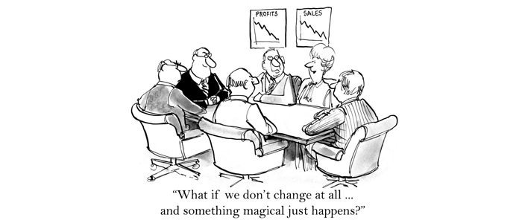
Overcoming resistance to change
Eight tactics
Communication
Changes are most effective when a company communicates a rationale that balances the interests of various stakeholders
Formal information sessions decreased employees’ anxiety about the change, while providing high-quality information about the change increased their commitment to it.
2. Participation:- It’s difficult to resist a change decision in which we’ve participated.
their involvement can reduce resistance, obtain commitment, and increase the quality of the change decision.
However, against these advantages are the negatives: the potential for a poor solution and a great consumption of time.

Slide 7

Overcoming resistance cont.
3. Building Support and Commitment
When managers or employees have low emotional commitment to change, they resist it and favor the status quo.
Employees are also more accepting of changes when they are committed to the organization as a whole.
When employees’ fear and anxiety are high, counseling and therapy, new-skills training, or a short paid leave of absence may facilitate adjustment to change.
4. Develop positive relationships:- People are more willing to accept changes if they trust the managers implementing
Those who had a more positive relationship with their supervisor, and who felt that the work environment supported development, were much more positive about the change process.
research suggests that if managers are able to facilitate positive relationships, they may be able to overcome resistance to change even among those who ordinarily don’t like changes.

Slide 8
Overcoming resistance cont.
5. Implementing changes fairly:- One way organizations can minimize negative impact is to make sure change is implemented fairly.
procedural fairness is especially important when employees perceive an outcome as negative, so it’s crucial that employees see the reason for the change and perceive its implementation as consistent and fair.
6. manipulation and Cooptation
Manipulation refers to covert influence attempts. Twisting facts to make them more attractive, withholding information, and creating false rumors to get employees to accept change are all examples of manipulation.
Cooptation, on the other hand, combines manipulation and participation. It seeks to buy off the leaders of a resistance group by giving them a key role, seeking their advice not to find a better solution but to get their endorsement.
Both manipulation and cooptation are relatively inexpensive ways to gain the support of adversaries, but they can backfire if the targets become aware they are being tricked or used. Once that’s discovered, the change agent’s credibility may drop to zero.

Slide 9
Overcoming resistance cont.
7. Selecting people Who accept Change
Research suggests the ability to easily accept and adapt to change is related to personality—some people simply have more positive attitudes.
Individuals who are open to experience, take a positive attitude toward change, are willing to take risks, and are flexible in their behavior are prime candidates.
an impressive body of evidence shows organizations can facilitate change by selecting people predisposed to accept it.
Besides selecting individuals who are willing to accept changes, it is also possible to select teams that are more adaptable.

Slide 10

Overcoming resistance cont.
8. Coercion
the application of direct threats or force on the resisters.
Other examples include threatening employees with transfers, blocked promotions, negative performance evaluations, and poor letters of recommendation.
Coercion is most effective when some force or pressure is enacted on at least some resisters—for instance, if an employee is publicly refused a transfer request, the threat of blocked promotions will become a real possibility in the minds of other employees.
The advantages and drawbacks of coercion are approximately the same as for manipulation and cooptation.

Slide 11

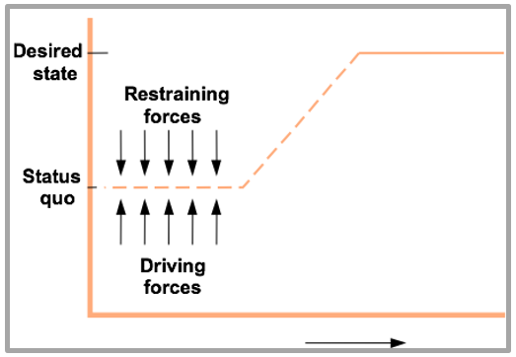
Approaches to Managing Change
Lewin’s three-Step model
successful change in organizations should follow three steps: unfreezing the status quo, movement to a desired end state, and refreezing the new change to make it permanent.
By definition, status quo is an equilibrium state. To move from equilibrium— to overcome the pressures of both individual resistance and group conformity— unfreezing must happen in one of three ways
For one, the driving forces, which direct behavior away from the status quo, can be increased. For another, the restraining forces, which hinder movement away from equilibrium, can be decreased. A third alternative is to combine the first two approaches.

Slide 12
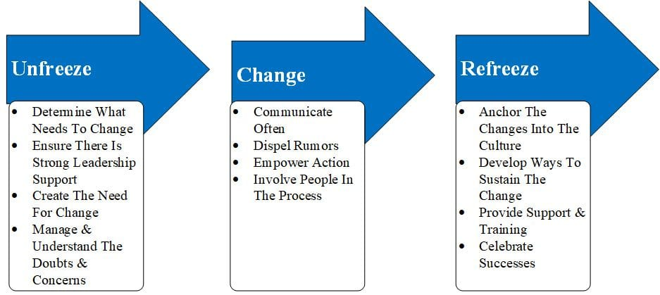
Approaches to Managing Change

Slide 13
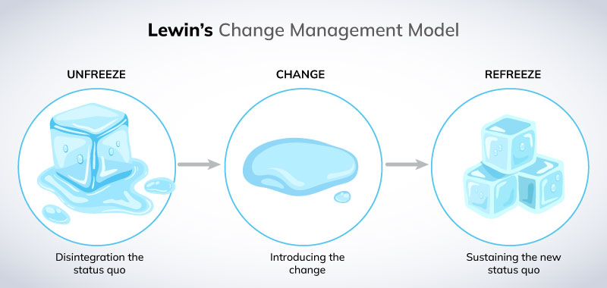
Approaches to Managing Change

Slide 14
Approach to change cont..
Kotter’s eight-Step plan
John Kotter of Harvard Business School built on Lewin’s three-step model to create a more detailed approach for implementing change.
Kotter began by listing common mistakes managers make when trying to initiate change.
They may fail to create a sense of urgency about the need for change, a coalition for managing the change process, a vision for change and effectively communicate it, and/or to anchor the changes into the organization’s culture.
They also may fail to remove obstacles that could impede the vision’s achievement and/or provide short-term and achievable goals. Finally, they may declare victory too soon.
Kotter established eight sequential steps to overcome these problems.

Slide 15
Approaches cont.
Kotter’s eight-Step plan for implementing Change
1. Establish a sense of urgency by creating a compelling reason for why change is needed.
2. Form a coalition with enough power to lead the change.
3. Create a new vision to direct the change and strategies for achieving the vision.
4. Communicate the vision throughout the organization.
5. Empower others to act on the vision by removing barriers to change and encouraging risk taking and creative problem solving.
6. Plan for, create, and reward short-term “wins” that move the organization toward the new vision.
7. Consolidate improvements, reassess changes, and make necessary adjustments in the new programs.
8. Reinforce the changes by demonstrating the relationship between new behaviors and organizational success.

Slide 16
Action research
Is A change process based on the systematic collection of data and selection of a change action based on what the analyzed data indicate.
It provides a scientific methodology for managing planned change.
Action research consists of five steps : diagnosis, analysis, feedback, action, and evaluation.
1st diagnosis gathering information about problems, concerns, and needed changes from members of the organization. The change agent asks questions, reviews records, and interviews employees, actively listening to their concerns.
2nd analysis. What problems do people key in on? What patterns do these problems seem to take? The change agent synthesizes this information into primary concerns, problem areas, and possible actions.
3rd step—feedback—requires sharing with employees what has been found from the first and second steps.
4th the employees, with the help of the change agent, develop action plans for bringing about needed change.
The final step, evaluation of the action plan’s effectiveness, using the initial data gathered as a benchmark.

Slide 17
Organizational Development
A collection of change methods that try to improve organizational effectiveness and employee well-being.
OD methods value human and organizational growth, collaborative and participative processes, and a spirit of inquiry.
Contemporary OD borrows heavily from postmodern philosophy in placing heavy emphasis on the subjective ways people see and make sense of their work environment. The change agent may
take the lead in OD, but there is a strong emphasis on collaboration.
Here are the six OD techniques or interventions for bringing about change

Slide 18
OD cont..
Sensitivity training:- refer to an early method of changing behavior through unstructured group interaction.
Current organizational interventions such as diversity training, executive coaching, and team-building exercises are descendants of this early OD intervention technique
Survey feedback:- tool for assessing the attitudes of organizational members, identifying discrepancies among member perceptions, and solving differences
Process consultation:- is for an outside consultant to assist a client, usually a manager, “to perceive, understand, and act upon process events” with which the manager must deal.
These events might include workflow, informal relationships among unit members, and formal communication channels.

Slide 19

OD cont..
Team building
uses high-interaction group activities to increase trust and openness among team members, improve coordinative efforts, and increase team performance.
Emphasize the intragroup level, meaning within organizational families (command groups) as well as committees, project teams, self-managed teams, and task groups.
Intergroup development
seeks to change groups’ attitudes, stereotypes, and perceptions about each other.
Here, training sessions closely resemble diversity training, except rather than focusing on demographic differences, they focus on differences among occupations, departments, or divisions within an organization.

Slide 20
OD cont.
Appreciative inquiry:- Most OD approaches are problem-centered.
They identify a problem or set of problems, then look for a solution. Appreciative inquiry (AI) instead accentuates the positive.
Rather than looking for problems to fix, it seeks to identify the unique qualities and special strengths of an organization, which members can build on to improve performance
Creating a Culture for Change

Slide 21
End of chapter seven
?

