Slide 1
Algorithm Substitution Attacks
Ruth Ng
(INFO/IS/ISL)

Slide 2
Overview
Motivation
Security Model:
SURV, DETECT [BPR]
KR, SDETECT [BJK]
Attacks:
IV-substitution attack [BPR]
Biased ciphertext attack [BPR]
Generic stateless attack [BJK]
Defense against ASAs [BPR, BJK]

Slide 3
Motivation
Consider the following scenario:
Alice is Bob’s super-jealous girlfriend
Alice
Bob

Slide 4
Motivation
Consider the following scenario:
Alice is not pleased that Bob is talking to all these other girls on Facebook
Facebook “friends”
Alice
Bob

Slide 5
Motivation
Consider the following scenario:
However, Alice is a computer expert and decides she wants to read Bob’s Internet traffic. (what a healthy relationship!)
Wireshark
Facebook “friends”
Alice
Bob

Slide 6
Motivation
Consider the following scenario:
However, Bob is equally devious, and encrypts his Internet traffic with a symmetric encryption scheme
?
Wireshark
?
?
Facebook “friends”
?
?
Symmetric Encryption
Alice
Bob

Slide 7
Motivation
Consider the following scenario:
Because this is a clearly toxic relationship, Alice installs some malware on Bob’s computer.
Wireshark
Facebook “friends”
“Symmetric Encryption”
Alice
Bob

Slide 8
Motivation
Consider the following scenario:
Her goal is to now be able to understand the traffic, given Bob is using the subverted algorithm
Wireshark
Facebook “friends”
“Symmetric Encryption”
Alice
Bob

Slide 9
Motivation
Consider the following scenario:
She cares that Bob doesn’t realize what is happening, and also that she gets meaningful information
Wireshark
Nothing wrong here!
Facebook “friends”
“Symmetric Encryption”
Alice
Heeheehee
Bob

Slide 10
Security Model
Let’s formalize this:
Alice replaces Bob’s symmetric encryption scheme with a subverted one
Bob talks to Carol, using that symmetric encryption scheme
Alice (without knowing Bob and Carol’s session key), attempts to gain information about their conversation
Bob attempts to differentiate subverted algorithm from real algorithm

Slide 11
Security Model
Notions of Security, and other preliminaries.

Slide 12
Security Notions
Bob uses encryption scheme: Π=(K,E,D)
Here, K is a non-zero set of session keys.
E is an encryption scheme, and E(K,M)=$ C, for K in K, M a plaintext string and C a ciphertext string (we write =$ to denote that there is randomness in the function)
D is a decryption scheme, and D(K,C)=M

Slide 13
Security Notions
Alice subverts the encryption scheme using subversion scheme: Σ=(K’,E’,A)
When Bob uses the subverted scheme, he will still use K,D from the original scheme.
K’ is a non-zero set of keys for use by Alice
E’ is an encryption scheme, where E’(K,K’,M)=$ C, where K’ is in K’ and the other variables are as before
A is a function that Alice defines as she wishes, to retrieve whatever “useful information” she can get from plaintexts encrypted under E’.

Slide 14
Security Notions
We say that the encryption scheme is coin-injective if E can be expressed as a deterministic function, taking an additional argument r (much like an IV), such that for any fixed K,M, the mapping
r → E(K,M,r) is injective

Slide 15
Security Notions
We say that the symmetric encryption scheme satisfies the correctness condition if:
Pr[D(K,E(K,M))=M] = 1
We assume all Π satisfy the correctness condition for the rest of the presentation.
We say that the subversion satisfies the decryptability condition if:
Pr[D(K,E’(K’,K,M))=M] = 1

Slide 16
Notes
For the purposes of this presentation, I simplified the topic to ignore:
Associated Data (AD)
Variable message/ block lengths
Non-uniform distribution of plaintexts
The authors extend the security notions to Asymmetric Encryption as well, which we will not cover in this talk.
I will not be covering any proofs, but am happy to discuss it another time if you’d like ☺

Slide 17
Also, recall…
We also assume the existence of:
PRF-secure functions (pseudorandom functions)
Keyed functions whose output is indistinguishable from a true random source
Secure symmetric encryption schemes:
PRIV or IND-CPA/CCA secure
Secure block ciphers
Behaves like a PRF

Slide 18
Recall that…
Alice’s goal: When Bob uses encryption scheme Σ instead of Π, she can compromise the privacy of his conversation with Carol.
Bob’s goal: To be able to detect when Alice has replaced Π with Σ.
We call Alice’s role here surveillance and Bob’s role detection

Slide 19
Surveillance [BPR]
In surveillance, Alice first chooses a key from K’, namely K’.
e.g. This could be hard-coded into her subverted algorithm
When Bob and Carol start their conversation, they establish a session key, namely K_{i}, but Alice does not know it.
e.g. Using Diffie-Hellman

Slide 20
Surveillance [BPR]
We said Alice wants to “compromise privacy” of Bob, meaning she wants to gain some useful information about the conversation he is having.
The most basic form of “information” is to be able to tell when Bob is using a subverted algorithm, and when he isn’t. We conservatively form our notion of security from this.

Slide 21
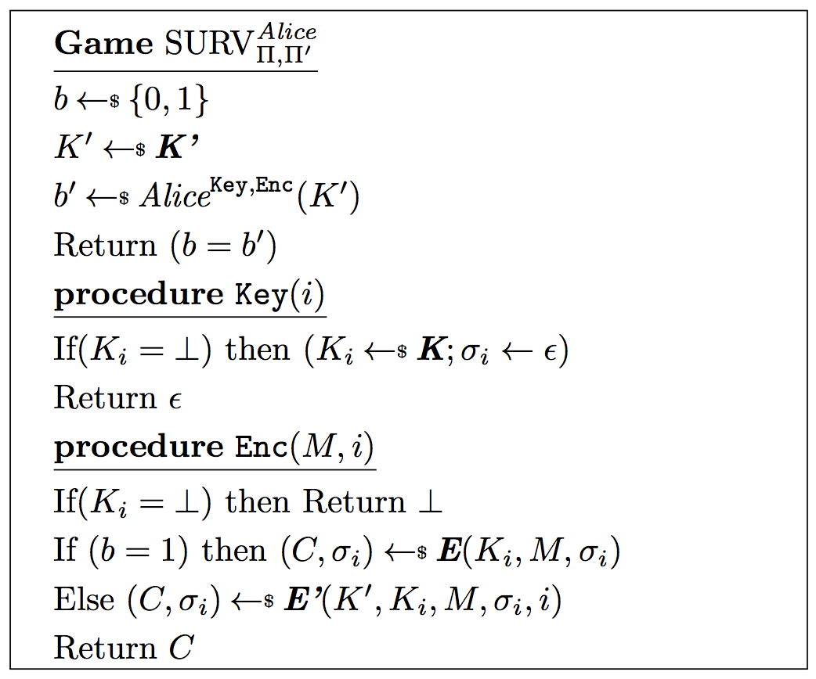

Slide 22
Breaking it down…
A bit b is chosen at random
Alice, the surveillance adversary, is trying to guess the value of b. Her guess is b’.
The game returns 1 (Alice wins) if her guess of b’ is consistent with the value of b.

Slide 23
Breaking it down…
Alice’s key is chosen prior to her starting her analysis
Alice knows her key and is given two oracles to use, Key and Enc
Key will initialize each session’s key for Bob and Carol, if it hasn’t already been initialized, simulating how systems, after subversion, can still generate session keys. Alice does not get the session key since nothing (i.e. ε) is returned.

Slide 24
Breaking it down…
Each σ_{i} is a state, this allows each session to maintain a state. (e.g. a counter)
Enc allows Alice to encrypt any message of her choice under any of the session keys.
If b=1 the original algorithm is used in Enc
If b=0 the subverted algorithm is used in Enc

Slide 25
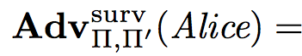

Surveillance advantage [BPR]

Slide 26
Detection [BPR]
Recall that Bob wants to detect when Alice is subverting his system, and when she isn’t.
We can note that this goal is not too different from Alice, except Bob does not know K’, but knows K_{i}.

Slide 27
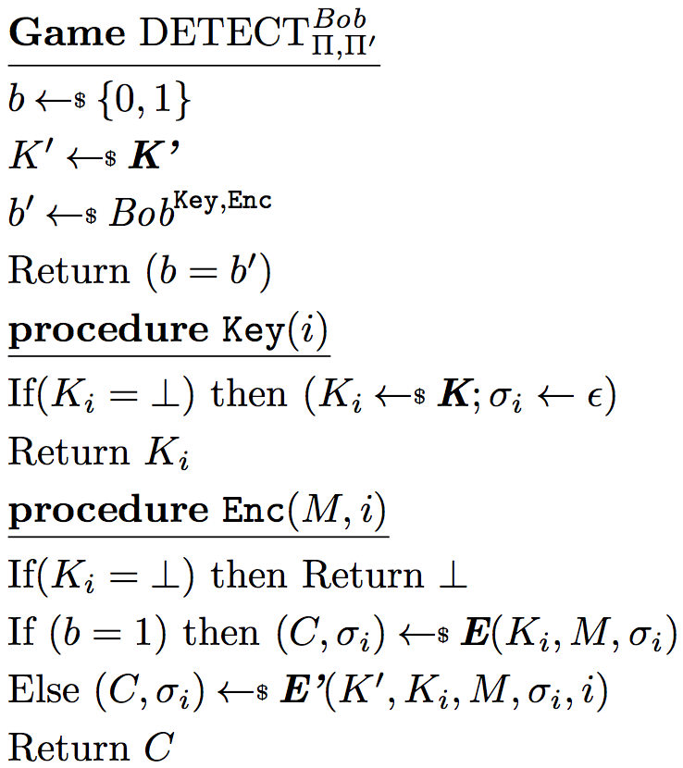
Compare and Contrast [BPR]

Slide 28
Detection Advantage [BPR]

Slide 29
Key Recovery [BJK]
After the work of [BPR] was published, [BJK] doubted if [BPR]’s interpretation of a “surveillance advantage” was true to the goals of a real-world adversary.
Where an attacker is concerned, just distinguishing when the subverted algorithm is being used is insufficient.
Instead, the adversary’s goal might be key recovery.

Slide 30
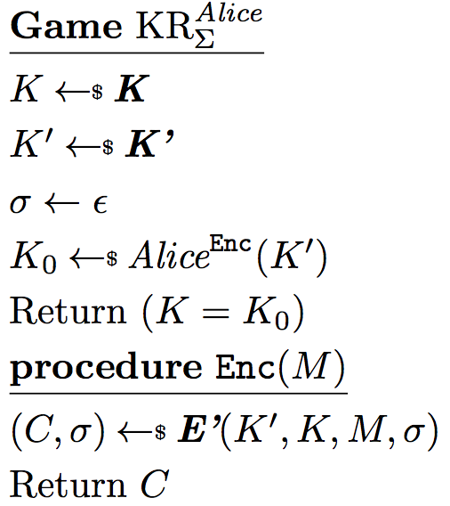

Key Recovery [BJK]

Slide 31
Key Recovery [BJK]
Alice’s goal is to recover the key that is being used
Alice’s does not get to inspect the state, only the ciphertexts

Slide 32
Strong Undetectability [BJK]
[BJK] also questioned if [BPR]’s model of detectability fully encapsulated all the Bob might do to detect if subversion had occurred.
Of course, no subversion is fully undetectable (i.e. the code must be different!), however, Bob might be able to look at register values, or open temporary files logging the encryption process…

Slide 33
Strong Undetectability [BJK]
[BJK] therefore proposes that the state of the encryption (e.g. the counter in AES-CTR, or the state in Sponge construction) should be available to Bob when he is trying to detect subversion.
In this way, the subversion scheme cannot use any non-static memory.
In addition, Bob can choose the key he wants to use in the encryption oracle.

Slide 34
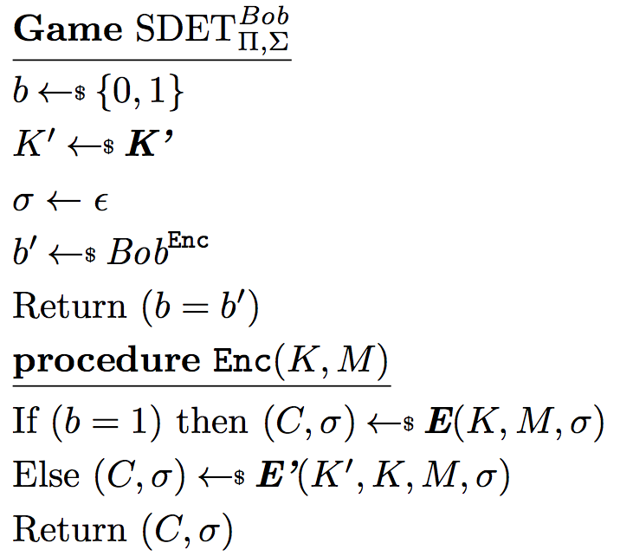
Strong Undetectability [BJK]

Slide 35
Strong Undetectability [BJK]
Bob’s goal is still to differentiate between Π and Σ
Bob is given access to the state of the encryption, so the subversion cannot make use of non-static memory in a different way from the original encryption scheme.

Slide 36
Attacks

Slide 37
Attacks
We will be presenting a number of attacks:
IV-substitution attack [BPR]
Biased ciphertext attack [BPR]
Generic stateless attack [BJK]

Slide 38
IV-substitution [BPR]
This is applicable for schemes with an IV that will be written in clear in the ciphertext.
E.g. AES-CBC$ or AES-CTR with a random starting point
Recall that we defined E(K,M)=$ C
Suppose that E, can be expressed as E*(K,M,IV)=C (deterministic, with a random IV)

Slide 39
IV-substitution [BPR]
For simplicity, assume that |IV|=|C| (though this easily extends to a scheme where multiple passes are used for when |C|>|IV|)
Assume also that we have block cipher B(K,M)=C, where |M|=|C|= |IV|=n
Let X(C)=IV, a function that extracts the IV from the ciphertext.

Slide 40
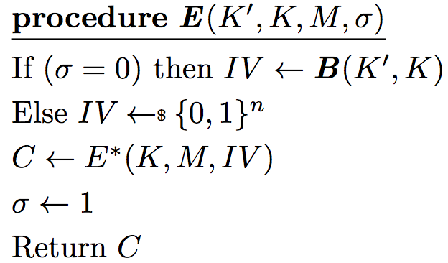
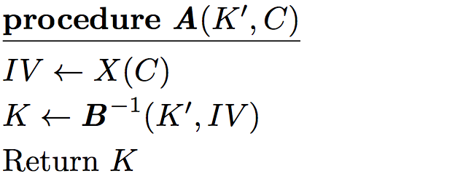
IV-substitution [BPR]
On the first message (and no other), encrypt the key K using block cipher B and Alice’s key, K’
Use this IV value in the encryption
Extract the IV
Retrieve and return K, Bob’s session key.

Slide 41

Security Proofs [BPR]
By the correctness of the block cipher, the surveillance advantage is 1
i.e.

Slide 42
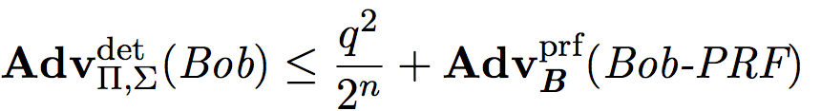
Security Proofs [BPR]
They also show that given any detection adversary Bob, we can construct an adversary Bob-PRF, where
Bob makes at most q queries to the Key oracle,
Π,Σsatisfy the decryptability condition
Bob-PRF takes the same time and number of queries to the Enc oracle as Bob
Then,

Slide 43
Security Proofs [BPR]
Then,
i.e. If Bob can detect the subversion, he either made many oracle queries, or the block cipher B was a poor PRF.

Slide 44
Stateless IV-substitution [BPR]
This can be easily converted to a stateless attack, using more blocks.
On expectation, the entire key will be sent in n• ln(n) blocks.
Here, we express the l digit representation of numbers 0,1,…(n-1) as <0>,<1>…<(n-1)>
We use || to denote concatenation, and K[x] refers to the x^{th} bit of K

Slide 45
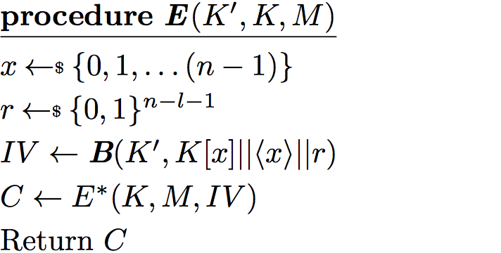
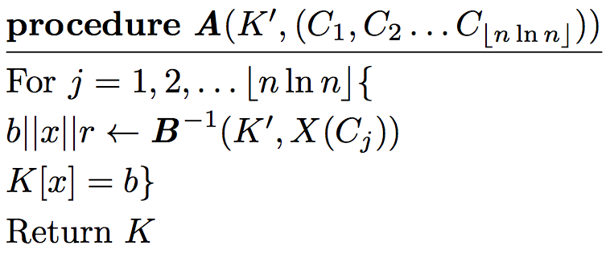
Stateless IV-substitution [BPR]
IV is now the encryption of a random bit of the key, the index of that bit, and a random string.
We use n• ln(n) ciphertexts, expecting to retrieve the entire key
Retrieve key one bit at a time

Slide 46
Security Proofs [BPR]
While not shown by the authors, Alice is a very powerful SURV-adversary
i.e. If the same bit of the key is sent twice and they don’t agree, she is sure that the algorithm is not subverted

Slide 47
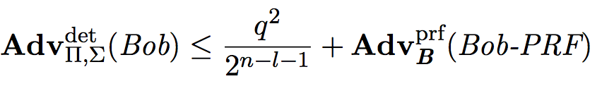
Security Proofs [BPR]
For the detection side, the authors do have a proof for a similar set up to the stateful one, where:

Slide 48
Biased Ciphertext Attack [BPR]
The biased ciphertext attack makes use of PRFs so that we don’t need to depend on an IV that is sent in the clear.
Therefore, this is a stateful attack on any coin-injective scheme with some non-trivial amount of randomness.
E.g. XCBC, IACBC, CBC2…
Makes use of a keyed PRF, F, such that F(K’,M)=1 or F(K’,M)=0 for all K’,M.

Slide 49
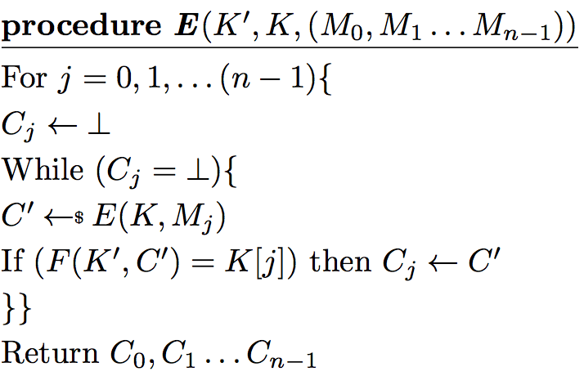
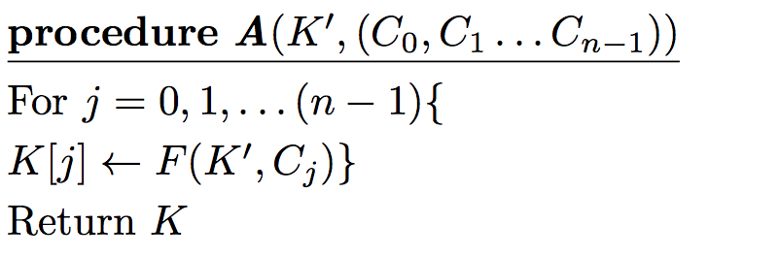
Biased Ciphertext Attack [BPR]
Since encryption is randomized, C’ should take a different value every loop
Choose C_{j} so that the value of the j^{th} bit of the key will be revealed given K’.
Reconstitute K over n messages, one bit at a time.

Slide 50
Security Proofs [BPR]
Again, the authors do not really cover the surveillance advantage of Alice here.
However, one can see that if the scheme has sufficient randomness, Alice should succeed every time there are sufficient queries to the Enc oracle.

Slide 51
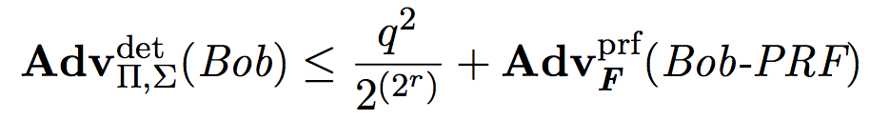
Security Proofs [BPR]
They also show that given any detection adversary Bob, we can construct an adversary Bob-PRF, where
Bob makes at most q queries to the Key oracle
Π is stateless
Π,Σsatisfy the decryptability condition
Π is coin-injective, and has r bits of randomness
Bob-PRF takes the same time and number of queries to the Enc oracle
Then,

Slide 52
Security Proofs [BPR]
Then,
i.e. If Bob can detect the subversion, he either made many oracle queries, or the PRF F was a poor PRF.

Slide 53
Generic Stateless Attack [BJK]
The generic stateless attack broadens the work of [BPR] by:
Using more stringent detection and surveillance primitives (i.e. strong undetectability and key recovery respectively
Proof is not restricted to schemes that are coin-injective or stateless
Attack is stateless
Attack always terminates

Slide 54
Generic Stateless Attack [BJK]
To extend this, the authors introduce the parameter s as the maximum number of encryptions performed on one plaintext
The encryption may fail but will always terminate.
They make use of a keyed PRF H, that takes key K’ and ciphertext C, returning a tuple (v,t), where v is an integer between 0 and (n-1), and t = 0 or t = 1.
Again, we expect to need to use n• ln(n) ciphertexts for key recovery.

Slide 55
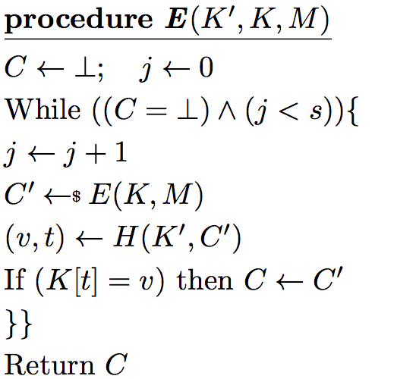
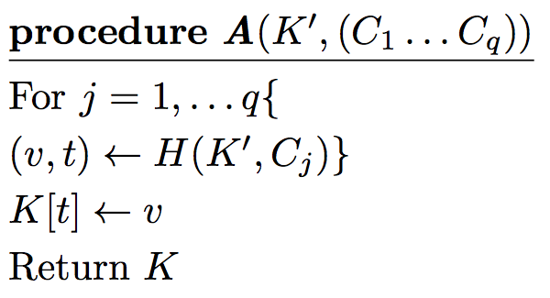
Generic Stateless Attack [BJK]
The attack will fail if more than s encryptions are made with any plaintext
We use keyed PRF, H, ensuring that K[t]=v for all (v,t)=H(K’,C).
This is a KR-adversary since we are able to retrieve the key with high probability.

Slide 56
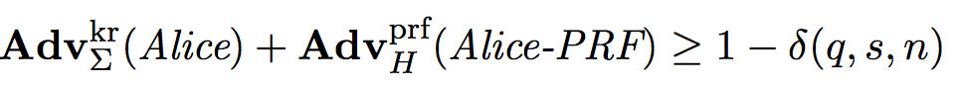

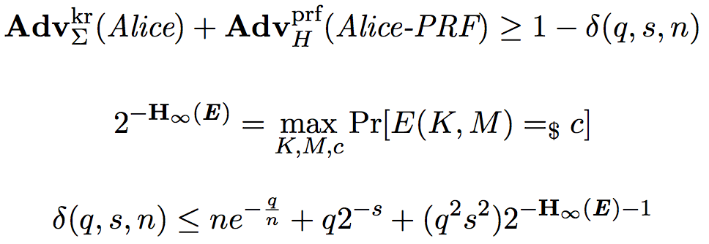
Security Proofs [BJK]
First, the authors show that with this construction, given adversary Alice, one can construct Alice-PRF, such that:
Where q is the number of ciphertexts needed to recover the key, s is the maximum number of encryptions done per plaintext, and n is the length of the key. Here we also have:

Slide 57
Security Proofs [BJK]
Informally, this means that:
Either Alice can recover the key efficiently
Or Alice can break the PRF-security of H,
Or s,q are too large to be feasible.

Slide 58
Security Proofs [BJK]
They are able to show that given any SDETECT-adversary Bob, making k queries to the Enc oracle, can be used to make PRF-adversary Bob-PRF, which runs in the same time, and makes ks oracle queries. Then:
Meaning that the subversion is strongly undetectable, if H is a secure PRF, against practical parameters k,n,s,q.

Slide 59
Defenses Against ASAs

Slide 60
Defenses against ASAs
Recall New Staff Training:
We all learnt that randomness is important to ensure security against replay attacks
More formally, it seems like randomness is needed for IND-CPA or PRIV security.
But now we know that any and all schemes with even a small amount of randomness are vulnerable to ASAs
Where does this leave us?

Slide 61

Defense against ASAs [BPR]
Let Y_{Π} (K,M,σ) = {C|D(K,C,σ)=M}
We say that Π is a unique-ciphertext scheme when|Y_{Π} (K,M,σ)|≤ 1 for all K,M,σ.
[BPR] show that for any unique-ciphertext scheme Π, any subversion Π’ satisfying the decryptability condition, and any surveillance adversary Alice:

Slide 62
Defense against ASAs [BPR]
[BPR] note that this works because a unique-ciphertext scheme is deterministic. However, not all deterministic schemes are unique-ciphertext schemes.
[BPR] also present an example of a unique-ciphertext scheme, based on the encode-then-encipher paradigm.

Slide 63
Defense against ASAs [BJK]
All the arguments of [BPR] continue to work extends to strong undetectability, however, one must continue to assume the decryptability condition (which is not assumed in all other parts of [BPR])
There is work that specifically critiques the decryptability condition and succeeded in adapting the proof for a security model without it to show that deterministic encryption is still secure.

Slide 64
Conclusions

Slide 65
Summary
Security Model: Alice wants to use ASAs to invade privacy, Bob wants to detect when she does so.
SURV [BPR] and KR [BJK] adversaries
DETECT [BPR] and SDET [BJK] adversaries
Attacks:
IV-substitution, stateful and stateless [BPR]
Biased Ciphertext Attack[BPR]
Generic Stateless Attack [BJK]
Defenses:
Unique Ciphertext Schemes [BPR,BJK]

Slide 66
Reflections: Security Model
Beyond jealous girlfriends like I described at the start, what are the applications of this?
Usable as a mass-surveillance tool
Securing our systems from ASAs, which are increasingly difficult to detect by inspection of the code/ software
In the US, the possibility of the NSA conducting mass surveillance through backdoored software worries many researchers, which inspired research in this area.

Slide 67
Reflections: Attacks
The attacks we saw ramped up in maliciousness very quickly:
IV-substitution: Only usable in systems with exposed IV
Biased Ciphertext: Stateful attack on stateless encryption. Usable in any system with randomness, provided the coin-injectivity and decryptability conditions are adhered to
Generic Stateless Attack: Stateless, and no restrictions except that there is some reasonable degree of randomness in the scheme

Slide 68
Reflections: Defenses
Achieving privacy and security, in the sense of formal notions like IND-CPA, or PRIV, requires protection against replay attacks.
There are only two ways that this is done now:
Randomness
Maintaining an internal state
This research shows that only the latter is secure against ASAs, and recommends it to a large degree.

Slide 69
Questions?
Thank you!

