Slide 1
FACE TRACKER · SYSTEM DIAGRAMS
Intelligent Face Tracker with auto-registration & unique visitor counting
YOLOv8 detection · ByteTrack · ArcFace + OSNet re-ID · PostgreSQL logging
D1
System architecture
D2
Main loop flowchart
D3
Track lifecycle state machine
D4
Identity decision: new or returning visitor?
D5
Database schema (ER)
D6
Runtime & deployment
D7
End-of-run consolidation
Notes:
Overview of the Intelligent Face Tracker: seven diagrams covering architecture, main loop, track lifecycle, identity decision, database schema, runtime and consolidation.

Slide 2
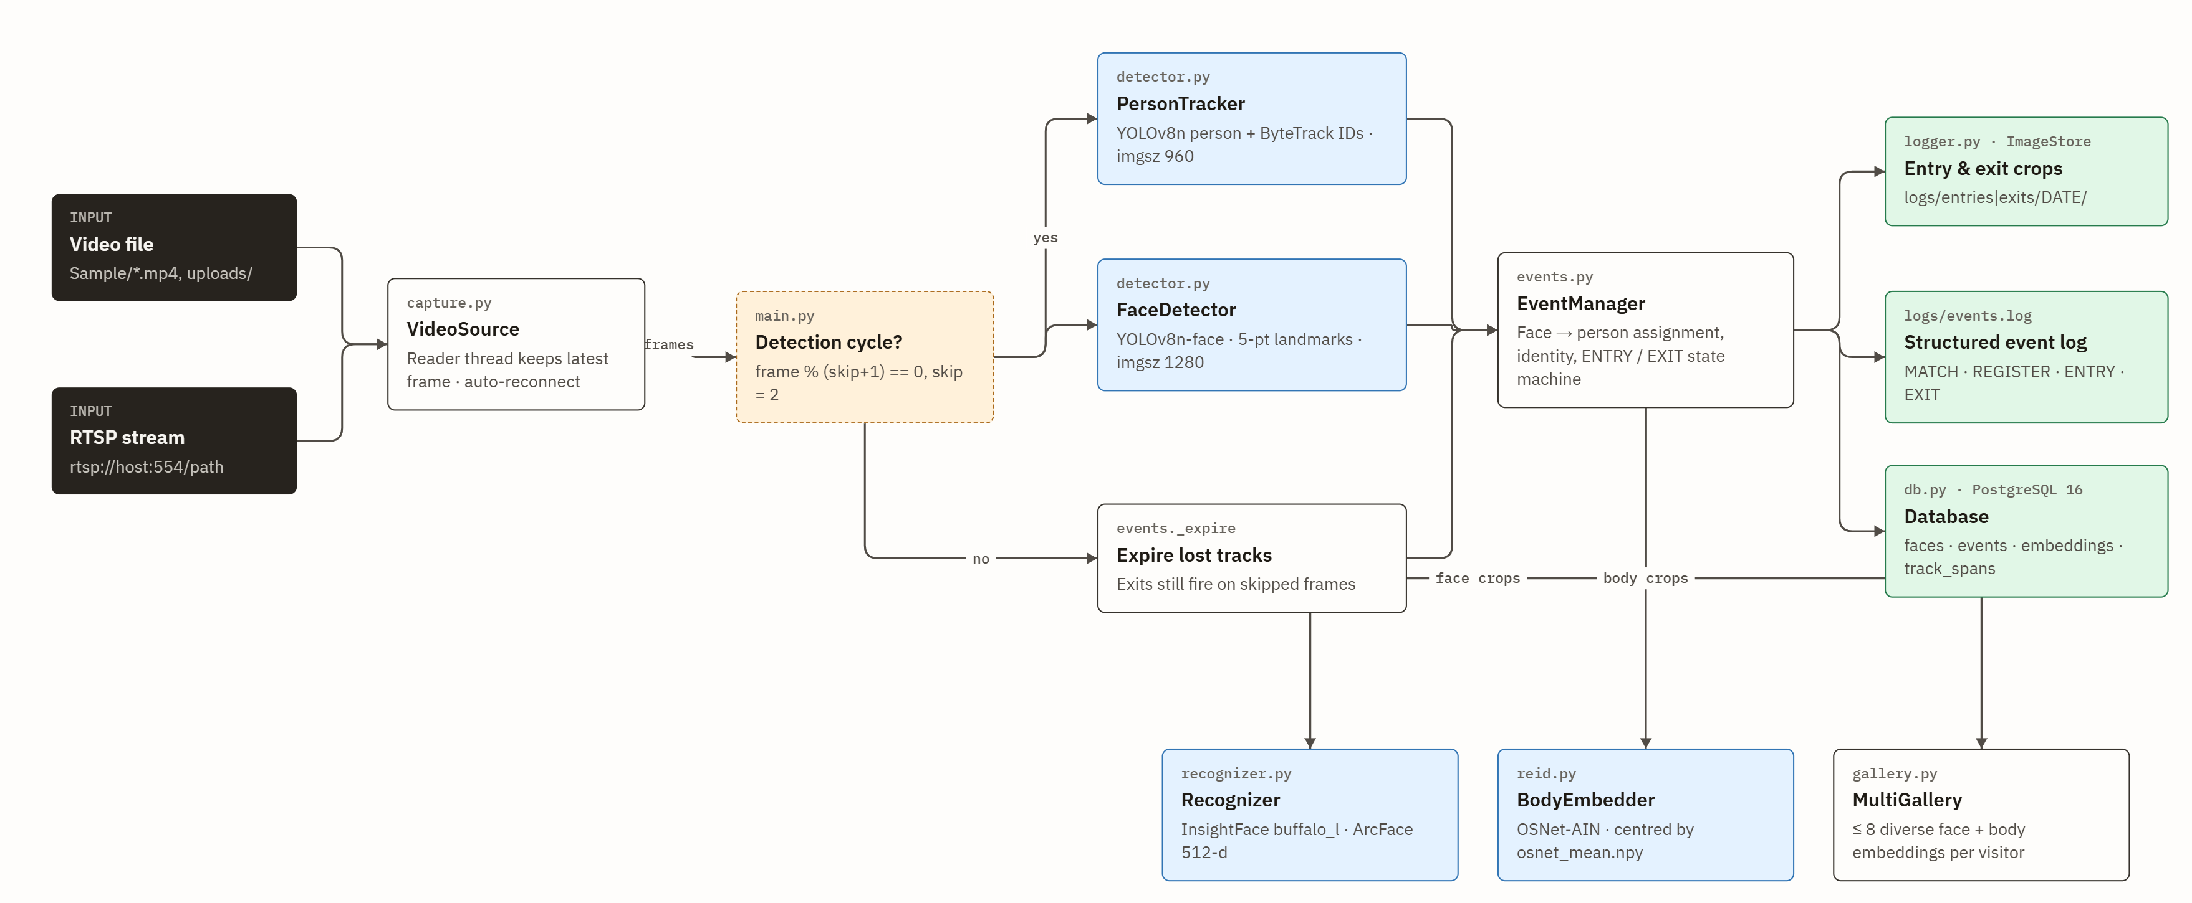
D1
System architecture
Data flow from video source to logs and database. Registry and galleries are reloaded from PostgreSQL on start.
Notes:
Data flow from video source to logs and database. Registry and galleries are reloaded from PostgreSQL on start.

Slide 3
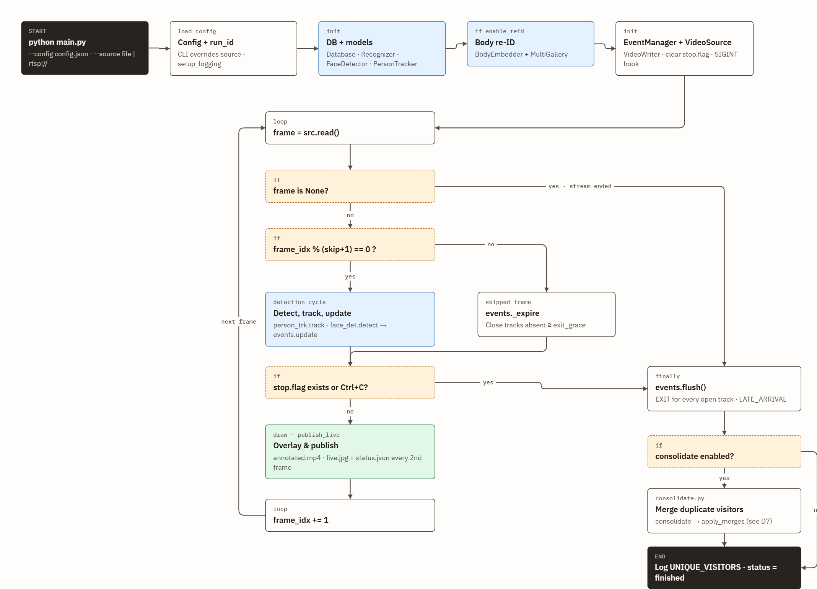
D2
Main loop flowchart
main.py: setup, per-frame loop, and the finally-block shutdown that guarantees no EXIT is lost.
Notes:
main.py: setup, per-frame loop, and the finally-block shutdown that guarantees no EXIT is lost.

Slide 4
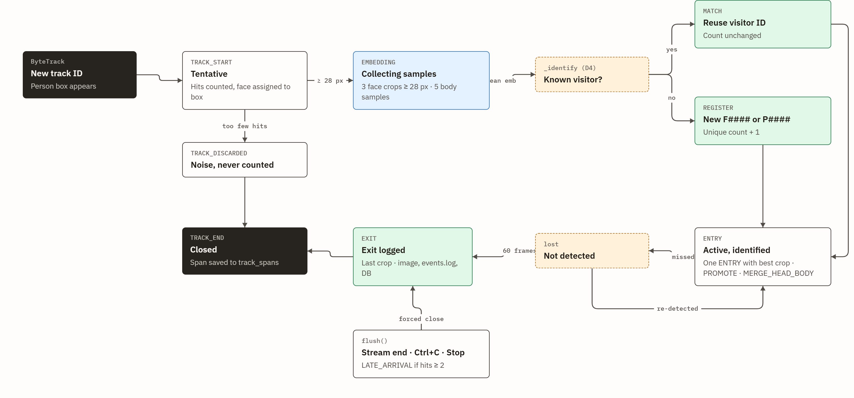
D3
Track lifecycle state machine
Each ByteTrack ID yields exactly one ENTRY and one EXIT. Labels in mono are the events.log tags.
Notes:
Each ByteTrack ID yields exactly one ENTRY and one EXIT. Labels in mono are the events.log tags.

Slide 5
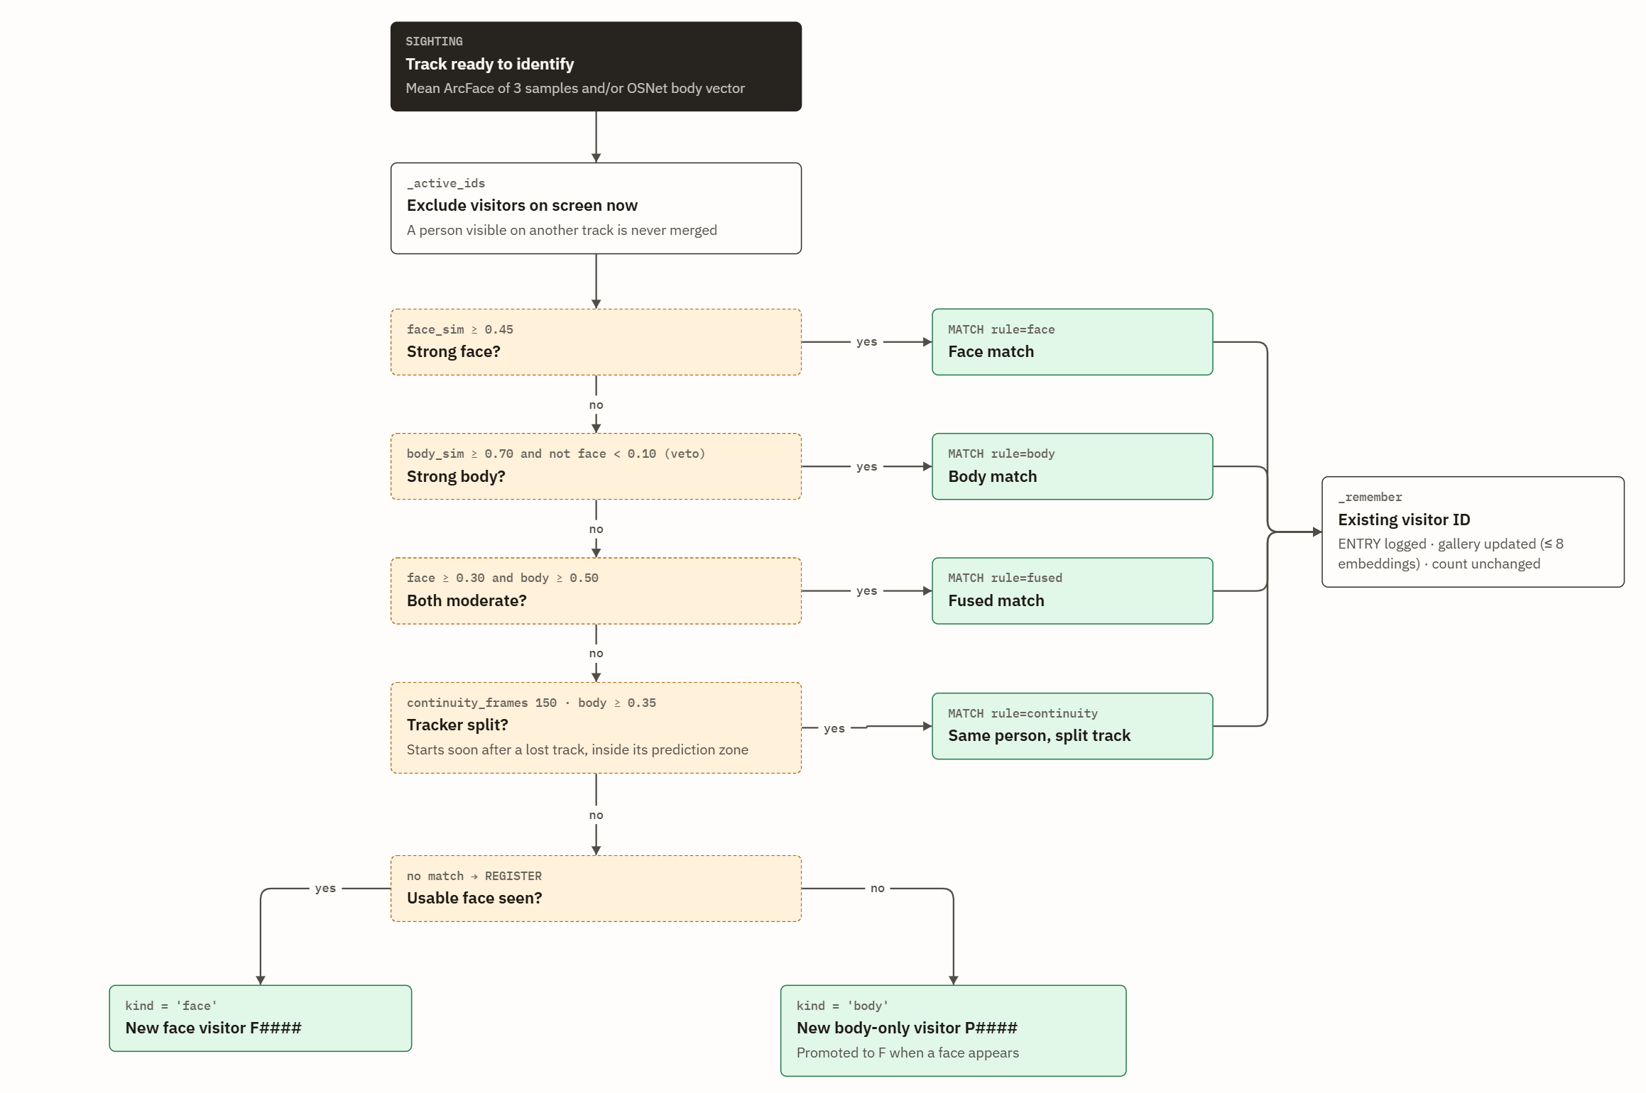
D4
Identity decision: new or returning visitor?
events._identify / _best_match. Every sighting is compared with all stored visitors using ArcFace (face) and OSNet (body) cosine similarity.
Notes:
events._identify / _best_match. Every sighting is compared with all stored visitors using ArcFace (face) and OSNet (body) cosine similarity.

Slide 6
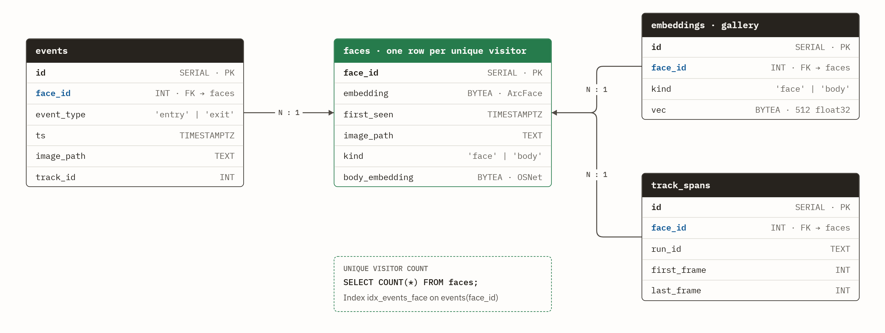
D5
Database schema (ER)
PostgreSQL 16, database facetracker. Created by db.py SCHEMA on start.
Notes:
PostgreSQL 16, database facetracker. Created by db.py SCHEMA on start.

Slide 7
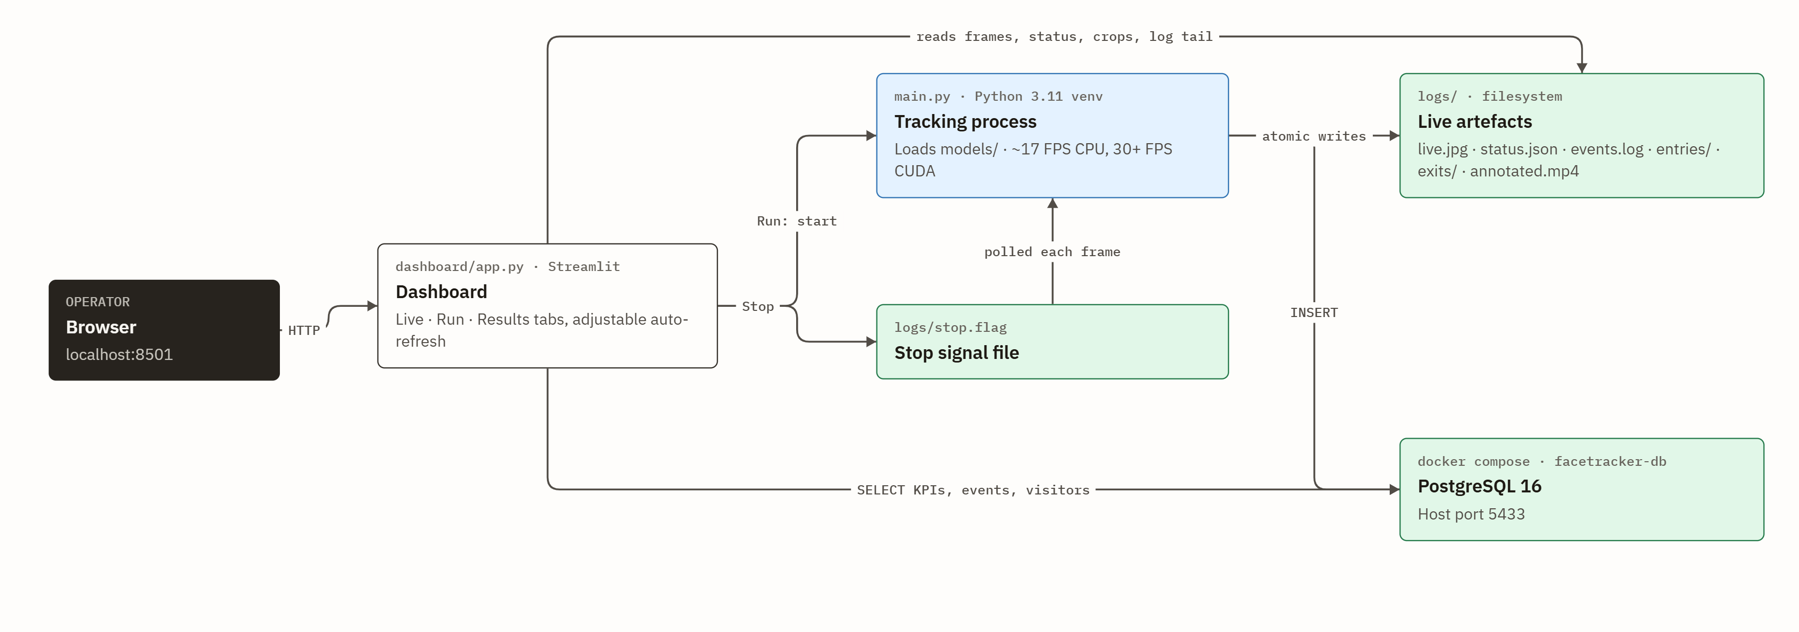
D6
Runtime & deployment
Dashboard and tracker share PostgreSQL and the logs/ folder; files are written atomically so the dashboard never reads half a frame.
Notes:
Dashboard and tracker share PostgreSQL and the logs/ folder; files are written atomically so the dashboard never reads half a frame.

Slide 8
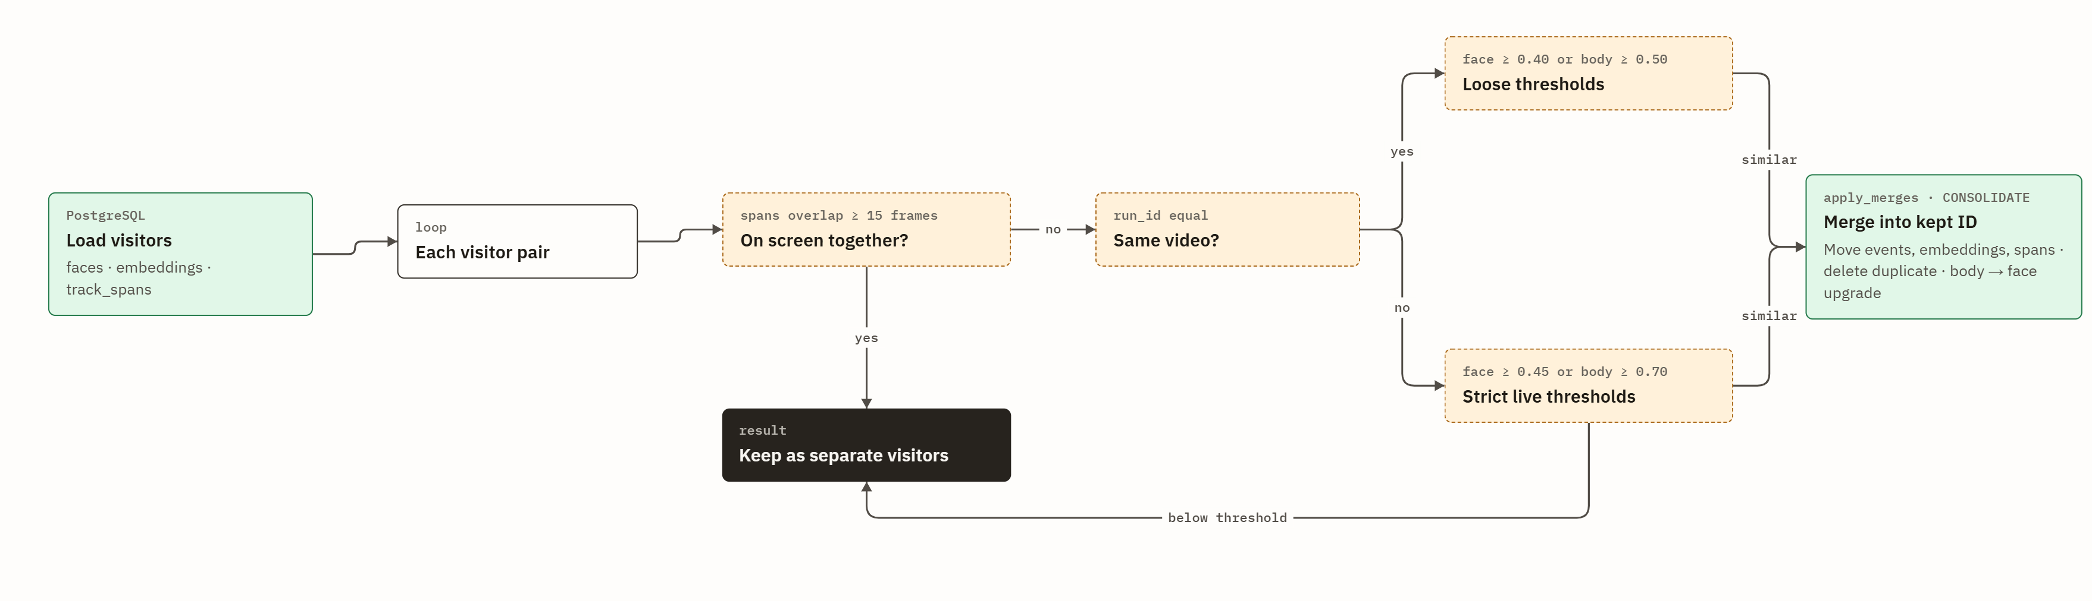
D7
End-of-run consolidation
consolidate.py merges duplicate visitors after the stream ends. Hard rule: people on screen together are never merged.
Notes:
consolidate.py merges duplicate visitors after the stream ends. Hard rule: people on screen together are never merged.

