Slide 1
Predicting Poverty Level
Submitted by:
Bigyan Bhandari
Tyler Stephens
Michael Bednar
Ruth Kanyinda
TEAM BPRT

Slide 2
Outline
Data Source
Data Cleaning and Preprocessing
Data Features + Exploratory Analysis
Labeling schools as Strict Poverty, High Poverty
Feature Selection
Modeling
Model Selection
Prediction + Findings

Slide 3
Data Source
Data collected from https://nces.ed.gov/ccd/
Data for 34 years - 1986 to 2020
Data for each year was separately downloaded using the table generator
There are different number of columns per year – but we kept uniform number of features for analysis and modeling
We dropped all rows with null values in free lunch and total student columns

Slide 4
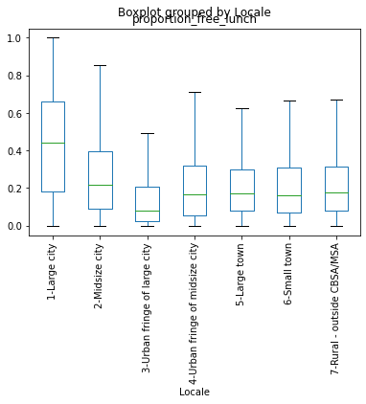
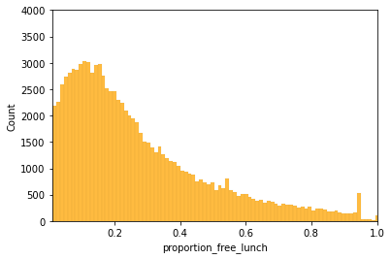
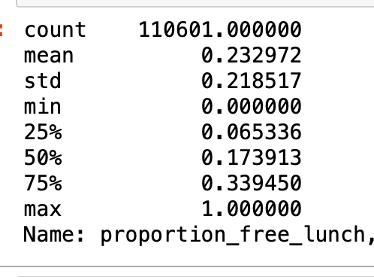
Data Features + Exploratory Analysis ( 1986-91)
23.3% students eligible for free lunch on average
US Poverty rate for years 1986-91 was between 13-15 %.
Proportion of students qualifying for free lunch is higher than the poverty rate.

Slide 5
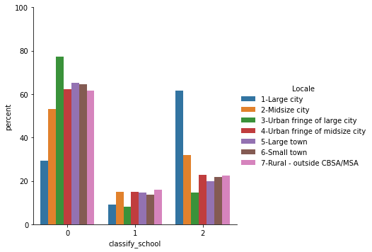
Creating label for High and Strict Poverty
We chose mean and 75% of free lunch eligibility % as threshold for High poverty and Strict poverty - as a result strict poverty is a subset of high poverty.
For modeling purposes, we have separate binary classification for High Poverty and Strict poverty.
0 – No poverty, 1 – High Poverty,
2 – Strict Poverty

Slide 6
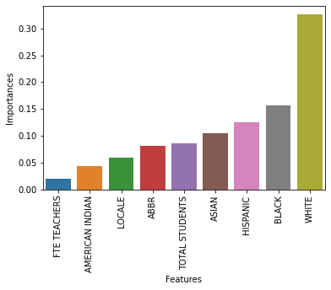
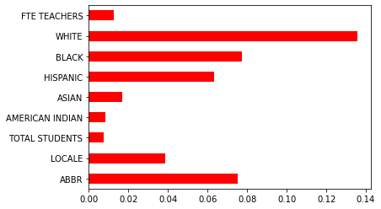
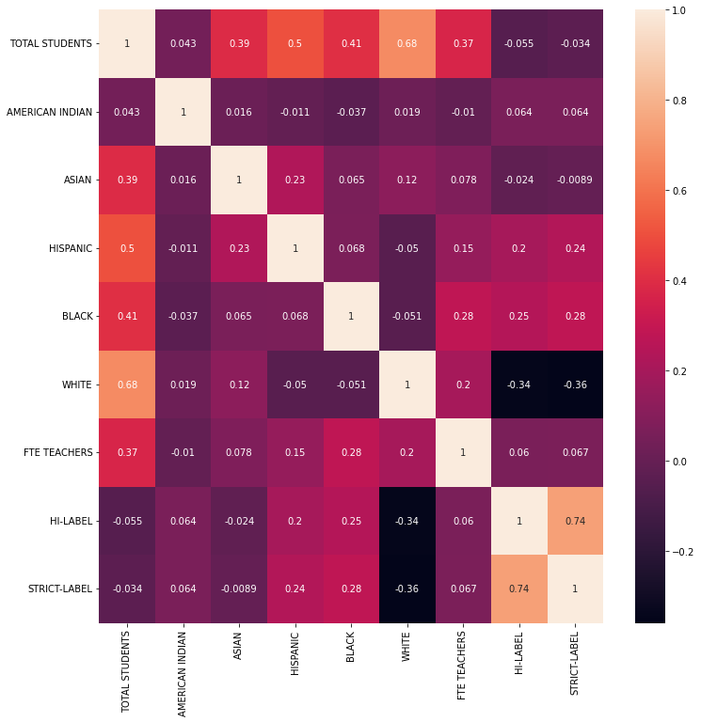
Feature Selection ( 1991-1997)
Random Forest Classifier (50 leaf, 1000 trees) Mutual Gain Info Heatmap
We also used Recursive Feature Elimination – It did not drop any features
LASSO regularization only dropped ‘American Indian’ student count column
We decided to drop Full-Time Teacher Equivalent and American-Indian student as features
These are for High Poverty labels. Strict-Poverty labels yield similar results.

Slide 7
Model Training ( 1998 – 2014)
We considered Logistic Regression, KNeighborsClassifier, RandomForestClassifier and Logistic Regression with SGD training and picked KneighborsClassifier for further tuning based on initial promise.
Encoded categorical features, StandardScaler for continuous variable.
 | Logistic Regression | KNN (50 neighbors) | RandomForest | Logistic Regreesion with SGD training
Training Accuracy ( High / Strict) | 74.5 / 73.7 | 84.0 / 83.5 | 83.7 / 83.2 | 73.8 / 72.7
Test Accuracy ( High / Strict) | 75.6 / 73.6 | 83.4 / 82. 7 | 82.7 / 82.1 | 73.7 / 72.6

Slide 8
KNeighbors with different parameters
Adding weights as a function of distance improved the training and testing accuracy of our model.
We tried GridSearchCV to find best parameters for our model – but our computation power was not strong enough to achieve that objective.
Currently our model is overfit, we are still looking to find that balance between overfit and underfit model
 | KNN (50 neighbors, Weight: Uniform Euclidean metric) | KNN (25 neighbors, Euclidean metric weight: uniform) | KNN ( 25 neighbors, Minkowski metric, Weight: distance) | KNN ( 25 neighbors, Euclidean metric, Weight: distance)
Test Accuracy ( High / Strict) | 84.0 / 83.5 | 85.6 / 85.1 | 86.10/85.66 | 86.09/ 85.65
Training Accuracy ( High / Strict) | ~ 90 | ~ 93 | ~93 | ~93

Slide 9
Model Testing on 2014-19 data
All KNN models performed similar, we decided to pick KNN with 25 neighbors and weight applied by distance.
We chose KNN as our model because we believe similar schools in terms of free lunch eligible student percentage would have similar population makeup and depending on locale would be clustered separately.
KNN’s prediction ability in comparison to linear regression tends to support our view.
RandomForest classifier could also have been a good choice but it performed similar to KNN in model selection process.
Prediction | KNN (50 neighbors, Weight: Uniform Euclidean metric) | KNN (25 neighbors, Euclidean metric weight: uniform) | KNN ( 25 neighbors, Minkowski metric, Weight: distance) | KNN ( 25 neighbors, Euclidean metric, Weight: distance)
High-Poverty | 84.4% | 84.6% | 84.5% | 84.6%
Strict Poverty | 80.0% | 80.5% | 80.4% | 80.5%

Slide 10
Prediction on 2019-20 data
Prediction | KNN, 25 neighbors, Metric: Euclidean, Weight : Distance
High Poverty | 84.5%
Strict Poverty | 80.0%

Slide 11
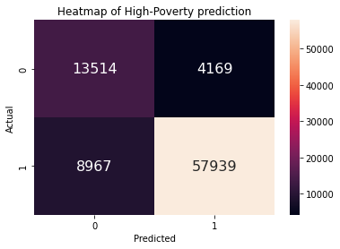
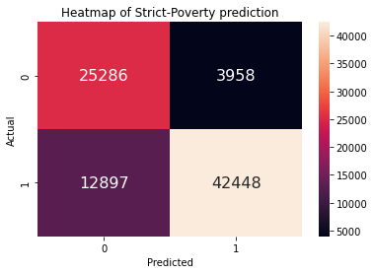
Analysis of Prediction
precision recall f1-score
1 0.93 0.87 0.90
0 0.60 0.76 0.67
precision recall f1-score
1 0.91 0.77 0.83
0 0.66 0.86 0.75

