Slide 2
Live Tweet, Tonight’s Slides and Examples
Twitter: @RuthlesssHelp @Apress
Slideshare: http://www.slideshare.net/ruthlesshelp
Github: http://github.com/ruthlesshelp

Slide 3
Overall – Challenges
Continuous Integration
No CI Server
No Code Analysis
Not Triggered by SCM

Slide 4
Overall – Challenges
Code Reviews
Not Conducted
Issues Not Tracked
Issues Dropped

Slide 5
Current – Challenges
Automated Builds and Deployments
Manual Deployment
No Automated Testing
No Code Analysis

Slide 6
Current – Challenges
Automated Unit Testing
Low Code Coverage
No Mocking Framework
Failing or Ignored Tests

Slide 7
Opportunities
Best Practices Matrix
Complexity
Value
Risk
Cost

Slide 8
Minimal, Essential
Source Control

Slide 9

TFS

Slide 10

SVN

Slide 11

Mercurial

Slide 12

Git

Slide 13

Level Metaphor

Slide 14
Go to Green
1
2
3
4
5
6
7
8
9

Slide 15
Level 1 – Goals
Build Script
Notes:
Week 1
Build Script
Write a build script using a common build scripting tool.
Rebuild All
The entire project solution
Soup-to-nuts rebuild
One command file calls one script

Slide 16

Level 1 – Starting Point
Manual Builds
Notes:
Manual Builds
Visual Studio is NOT a Build Tool
Danger Zone
Inconsistency
Hero Worship

Slide 17

MSBuild
Notes:
Helpful Change
Write a Build Script
Conventional Scripting Tool
MSBuild
Conventional
Part of .NET
Used by Visual Studio and TFS
Widely used, lots of examples
Part of .NET Fundamentals

Slide 18

NAnt
Notes:
Conventional Scripting Tool
NAnt
Free and open-source
Popular with .NET developers
Widely used, lots of examples
Based on the Java build tool, Ant
Obsolete

Slide 19


PowerShell
Notes:
Conventional Scripting Tool
PowerShell – the Microsoft shell tool
psake – a PowerShell based build system
Supports scripting
Can automate many administrative tasks on Windows Server and most Microsoft server applications
Part of Windows Fundamentals

Slide 20


Extensions
Notes:
Task Libraries
MSBuild Extension Pack
MSBuild Community Tasks
Automate, Automate, Automate
Assembly Info
XML Peek & Poke, Transform Config
Copy Files, Zip, Package
Documentation

Slide 21
Level 1 – Example
Example Build Script

Slide 22

Level 1 – Result
Build Script
One Script, Builds Everything
“Run the Runner”
Notes:
One Script, Builds Everything
Completely
Consistently
runner.msbuild
runner.bat
Virtuous Discipline
Runner Runs Every Build Step
Always “Run the Runner”
Avoid Integration Hell
Pull
Rebuild
Code
Rebuild
Push

Slide 23
Go to Green
1
2
3
4
5
6
7
8
9

Slide 24
Level 2 – Goals
Continuous Integration
Notes:
Week 2
Continuous Integration Server
Select one
Install it
Run Build Script
Rebuild Phase
Soup-to-Nuts

Slide 25
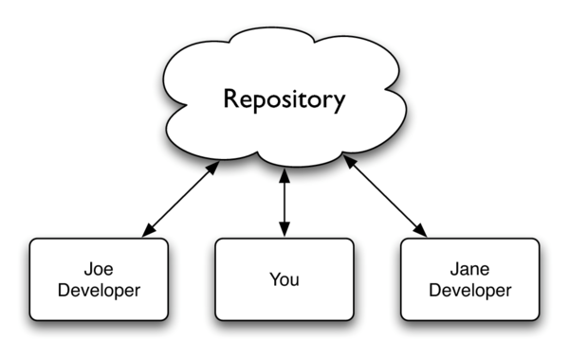
Level 2 – Starting Point
No CI Server
Notes:
No CI Server
Developers Push Code
Fire and Forget
SCM Repository
Holds Code Revisions
Unknown Condition
Danger Zone
Deferring the Build
Integration Hell
Lurking Quality Issues

Slide 26
Level 2 – To Do
Install CI Server
Triggered by Code Push
“Run the Runner”
Notes:
Install CI Server
SCM Trigger
Run runner.msbuild

Slide 27
TFS
Notes:
Commercial
Microsoft’s Team Foundation Server

Slide 28

CC.NET
Notes:
Free, Open Source
Cruise Control .NET

Slide 29

Jenkins
Notes:
Free, Open Source
Jenkins

Slide 30

TeamCity
Notes:
Commercial
JetBrains TeamCity

Slide 31
Level 2 – Example
CI Server Example

Slide 32

Level 2 – Result
Observe & Report
Notes:
Observe
Code Push
Build Success
Report
Build History
Visibility
Build Feedback
Improve Personal Process
Stakeholder Visibility

Slide 33
Go to Green
1
2
3
4
5
6
7
8
9

Slide 34
Level 3 – Goals
Code Analysis
Notes:
Week 3
Code Analysis
Run code analysis tool against the codebase
Understand the Inspections
Focus on the Minimum, Recommended
Find One Rule That’s Being Violated
Decide that on one that’s worth fixing
One that’s worth monitoring
Fix Every Violation of That One Inspection
Build Script
Code analysis running from within the build script
Running from within the CI server
Build breaks if that one inspection rule is violated

Slide 35

Level 3 – Starting Point
No Code Analysis
Notes:
No Code Analysis
Danger Zone
Critical Errors: these probably exist in the code, but you don’t know where
Bad Practices: you could be following a bad coding practices
Code Smells: you could be following new and better coding practices

Slide 36
Level 3 – To Do
Analysis Tool
Static Code Analysis
Run with CI Server
Notes:
Identify an Analysis Tool
Static Code Analysis
Run the Analysis Tool within the CI Server

Slide 37

FxCop
Notes:
FxCop
.NET Framework Guidelines

Slide 38

Gendarme
Notes:
Gendarme
Finds Common Problems

Slide 39

StyleCop
Notes:
StyleCop
Helps Enforce Coding Standards

Slide 40

NDepend
Notes:
NDepend
Go Deep: analysis in depth

Slide 41

Simian
Notes:
Simian
Duplicate Code Finder

Slide 42

Sonar
Notes:
Sonar 3
Dashboard
Rules, Alerts, Thresholds

Slide 43
Level 3 – Example
Analysis Tool Example
FxCop 10

Slide 44
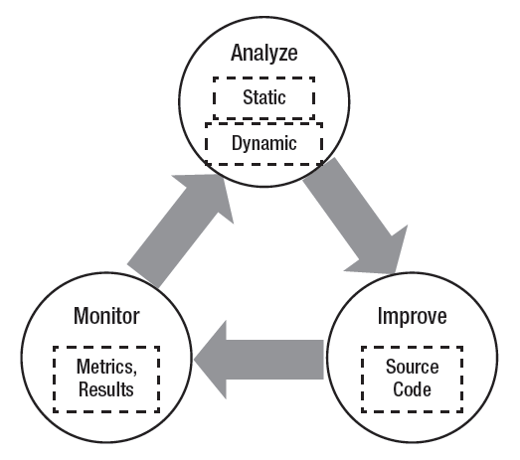
Level 3 – Result
Analyze, Improve, Monitor
Notes:
Add to runner.msbuild
Run Performant Analysis
Per-Commit Analysis
CI Server
Run Performant Analysis
Monitor
Violations Break the Build
Nightly Analysis
Run Complete Analysis
Analyze
Evaluate, Triage
Improve
Urgent, Important

Slide 45
Go to Green
1
2
3
4
5
6
7
8
9

Slide 46
Level 4 – Goals
Automate Testing
Notes:
Week 4
Write One Automated Unit Test
Build Script
Have the test run within the build script
Have the test run within the CI server
Code Analysis
Identify, fix and monitor 2 more inspections

Slide 47
Level 4 – Starting Point
No Tests
Notes:
No Automated Tests
Unit
Integration
What Defines “Automated Testing”?
Runs Everywhere
Every Developer’s Machine
No Manual …
Configuration
Intervention
Deterministic, Isolated, Repeatable

Slide 48
Level 4 – To Do
Testing Framework
Run with Runner
Run with CI Server
Notes:
Select a Testing Framework
Run the Tests with a Scripting Tool
Run the Tests within the CI Server

Slide 49

MSTest
Notes:
Testing Framework
MSTest

Slide 50

MBUnit
Notes:
Testing Framework
MbUnit

Slide 51

xUnit.net
Notes:
Testing Framework
xUnit.net

Slide 52

NUnit
Notes:
Testing Framework
NUnit

Slide 53
Level 4 – To Do
Mocking Framework
Isolation
Interaction Testing
Notes:
Select a Mocking Framework
Allows for Test Isolation
Enables Interaction Testing

Slide 54

Rhino Mocks
Notes:
Mocking Framework
RhinoMocks

Slide 55

Moq
Notes:
Mocking Framework
Moq

Slide 56
Level 4 – Example
Automate Testing Example

Slide 57

Level 4 – Results
Passing
Tests
Notes:
Add to runner.msbuild
Run All Unit Tests
Per-Commit Testing
CI Server
Run All Unit Tests
Monitor
Failing Unit Test, Breaks the Build
Nightly Testing
Run Automated Integration Tests

Slide 58
Go to Green
1
2
3
4
5
6
7
8
9

Slide 59
Level 5 – Goals
Code Coverage
+ More Tests
+ More Code Analysis
Notes:
Automated Unit Testing
One automated unit test assembly for each assembly/executable-under-test
One tests class for each class-under-test
Achieve 100% class coverage
Mocking Framework
Use a mocking framework
CI Server
Make sure all unit tests runs on the CI server
Code Analysis
Identify, fix and monitor 4 more code analysis violations.

Slide 60
Level 5 – To Do
Coverage Tool
Run in Visual Studio
Run with CI Server

Slide 61

NCover

Slide 62

OpenCover

Slide 63

dotCover

Slide 64
Level 5 – Example
Code Coverage Example

Slide 65
Level 5 – Results
100% Class Coverage
+ More Code Analysis
Notes:
Automated Unit Testing
One automated unit test assembly for each assembly/executable-under-test
One tests class for each class-under-test
Achieve 100% class coverage
Mocking Framework
Use a mocking framework
CI Server
Make sure all unit tests runs on the CI server
Code Analysis
Identify, fix and monitor 4 more code analysis violations.

Slide 66
Go to Green
1
2
3
4
5
6
7
8
9

Slide 67
Level 6 – Goals
Code Review
+ More Tests
+ More Code Analysis
Notes:
Code Review
Decide on the code review strategy
Perform a “model code review”, together with everyone on the team
Hash it out and define an approach that the team is willing to commit to
Automated Unit Testing
Write one unit test for each method in each class-under-test
Try to achieve 100% method coverage
Code Analysis
Identify, fix and monitor 8 more code analysis violations

Slide 68
Level 6 – To Do
Pick Approach
Share Opinions
Track Issues

Slide 69

Pairing

Slide 70

Group

Slide 71

Peer

Slide 72
Level 6 – Example
Code Review Example
Peer

Slide 73
Level 6 – Results
Reviewed Code
100% Method Coverage
+ More Code Analysis
Notes:
Code Review
Decide on the code review strategy
Perform a “model code review”, together with everyone on the team
Hash it out and define an approach that the team is willing to commit to
Automated Unit Testing
Write one unit test for each method in each class-under-test
Try to achieve 100% method coverage
Code Analysis
Identify, fix and monitor 8 more code analysis violations

Slide 74
Go to Green
1
2
3
4
5
6
7
8
9

Slide 75
Level 7 – Goals
Packaging
+ More Tests
+ More Coverage
+ More Code Analysis
Notes:
Packaging
Deployment
Code Review
Make sure code reviews happen
Automated Testing
Write more unit tests
Try to exceed 40% statement coverage
Code Analysis
Identify, fix and monitor 16 more code analysis violations

Slide 76

MSI

Slide 77
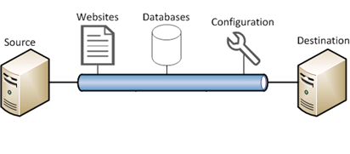
Web Deploy

Slide 78

Octopus

Slide 79

Zip Archive

Slide 80
Level 7 – Example
Packaging Example
Zip

Slide 81
Level 7 – Results
Packaged Deliverable
Code Reviews
40% Line Coverage
+ More Code Analysis
Notes:
Automated Deployment
Write a deployment/packaging script
Code Review
Make sure code reviews happen
Automated Testing
Write more unit tests
Try to exceed 40% statement coverage
Code Analysis
Identify, fix and monitor 16 more code analysis violations

Slide 82
Go to Green
1
2
3
4
5
6
7
8
9

Slide 83
Level 8 – Goals
Automated Deployments
+ More Tests
+ More Line Coverage
+ More Code Analysis
Notes:
Automated Deployment
Write a deployment/packaging script
Automated Deployment
Automate the deployment to an integration environment as part of the “per commit” pipeline
Code Reviews
Perform all code reviews
Automated Testing
Write more unit tests
Try to exceed 60% statement coverage
Code Analysis
Identify, fix and monitor 32 more code analysis violations

Slide 84

Script

Slide 85
Level 8 – Example
Automated Deployment Example
MSBuild

Slide 86
Level 8 – Results
Automated Deployments
+ Code Reviews
+ 60% Line Coverage
+ More Code Analysis
Notes:
Automated Deployment
Automate the deployment to Test
Automate the deployment to an integration environment as part of the “per commit” pipeline
Code Reviews
Perform all code reviews
Automated Testing
Write more unit tests
Try to exceed 60% statement coverage
Code Analysis
Identify, fix and monitor 32 more code analysis violations

Slide 87
Go to Green
1
2
3
4
5
6
7
8
9

Slide 88
Level 9 – Goals
Full Code Coverage
+ More Tests
+ More Coverage
+ More Code Analysis
Notes:
Automated Testing
Write more unit tests
Write more automated integration tests
Try to exceed 80% statement coverage

Slide 89
Testing

Slide 90
Level 9 – Example
Full Code Coverage Example

Slide 91
Level 9 – Results
> 80% Line Coverage
+ Code Reviews
Automated Deployments
+ More Code Analysis
Notes:
Automated Testing
Write more unit tests
Try to exceed 80% statement coverage
Code Reviews
Perform all code reviews
Automated Deployment
Working with QA, automate the deployment to Test environment.
Code Analysis
Identify all applicable code analysis rules
Fix and monitor all mandatory rules

Slide 92
Go to Green
1
2
3
4
5
6
7
8
9

Slide 93
Overall – Results
Continuous Integration
CI Server
Code Analysis
Triggered by SCM

Slide 94
Overall – Results
Code Reviews
Conducted Regularly
Issues Tracked
Issues Resolved

Slide 95
Overall – Results
Automated Builds and Deployments
Automated Deployment
Automated Testing
Code Analysis

Slide 96
Overall – Results
Automated Unit Testing
Code Coverage: > 80%
Mocking Framework
Passing Tests: Priority

Slide 97
Follow On – Goals
Retrospectives
Presentations
Notes:
Retrospective
Liked: What did we do right?
Learned: What did we learn?
Lacked: What held us back?
Longed for: What did we wish we had?
Presentation to Project Stakeholders
Gather metrics along the way
Gather success stories
Demonstrate the CI server
Present the results

Slide 98
Further Discussion
Any questions?
Any comments?

Slide 99
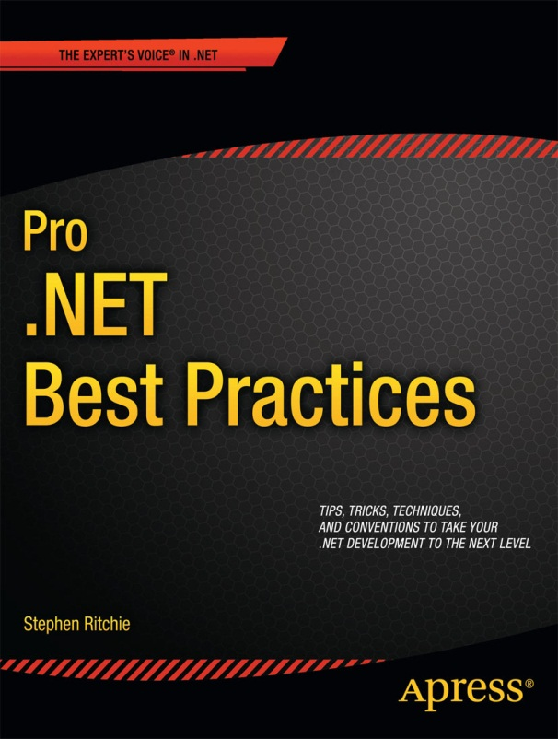
Shameless Self Promotion Time!
40% off eBook at apress.com
Use promo code:
PR0N3T
Offer ends 15-Dec-2012

Slide 100
Contact Me
Twitter: @ruthlesshelp
Email: stephen.ritchie@excella.com
Blog: http://ruthlesslyhelpful.net
LinkedIn: http://www.linkedin.com/in/sritchie

Slide 101
Slides and Examples
Slideshare: http://www.slideshare.net/ruthlesshelp
Github: http://github.com/ruthlesshelp

