Slide 2
Purpose
Useful
Automated Testing
Make Software Better

Slide 3
Agenda
1
Motivation
2
Principles
3
Obstacles

Slide 4
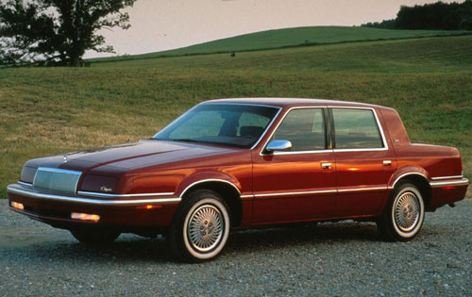
Chrysler New Yorker

Slide 5
First Topic: Motivation
Why Write Unit Tests?
Why Automate Testing?

Slide 6
Agenda
1
Motivation
2
Principles
3
Obstacles

Slide 7
Visibility & Insight
Problem Detection
Advance Warning

Slide 8
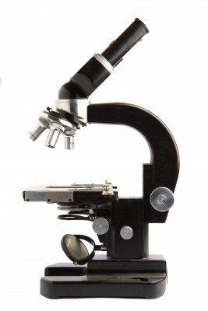
Microscope: Visibility and Insight

Slide 9
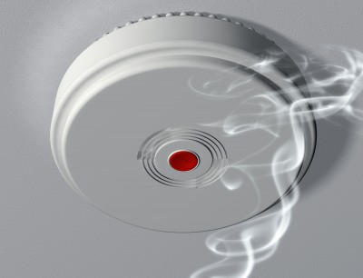
Smoke Detector: Problem Detection

Slide 10
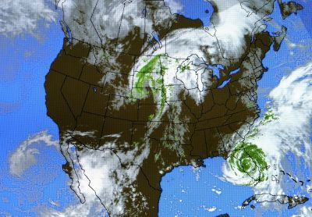
Weather Satellite: Advance Warning

Slide 11
Example
Perhaps
An Example
Would Be
Helpful

Slide 12
Automated Tests
Make Sure
Software Works
As Intended

Slide 13
Agenda
1
Motivation
2
Principles
3
Obstacles

Slide 14
Principles
Zero Configuration
Fast
Clear Result
Easy To Maintain

Slide 15
Automated Testing: Vocabulary
Test-Driven Development (TDD)
Write a Test, Watch the Test Fail
Write Code, Make the Test Pass
Write the Next Test
Behavior-Driven Development (BDD)
Given a Desired Behavior
Intention Checking
The Software Works, As Intended

Slide 16
Principles
Zero Configuration
I can run your tests,
You can run mine.

Slide 17
Principles
Fast
All the tests run in
just a few minutes

Slide 18
Principles
Clear Results
Pass/Fail
Focused Test

Slide 19
Principles
Easy to Maintain
Conventional
Brief

Slide 20
The Long-Term Goals
Automated Testing
Vigilantly Monitoring the Code
Readability
Have Mercy on Future Developers
Conventional
Short, Clear
Maintainability
Both a Sword and a Shield
Code Works as Intended
Protects Against Regression
Reliable
N+1 is Easy

Slide 21
Agenda
1
Motivation
2
Principles
3
Obstacles

Slide 22
One Primary Assert To Rule Them All
Obstacle 1
Over-Specifying

Slide 23
One Primary Assert To Rule Them All
Is your effort to refactor and improve code overwhelmed by the time it takes to maintain/update/rewrite all those failing unit tests?
Your test-code could be over specifying things.
Perhaps an example would be helpful …

Slide 24
One Primary Assert To Rule Them All
Debate: Only one assertion per test?
Test Method Tests One and Only One Scenario
1 Primary Assert Verifies and Validates the Scenario
Secondary Asserts
Support Arrangement and Preconditions
Support Post-Conditions
Avoid Asserts that Over Specify
Too Literal => Inhibited Refactoring
Imagined Benefit => Rigidity

Slide 25
Four Ways to Fake Time
Obstacle 2
Time Crunch

Slide 26
Four Ways to Fake Time
Are your test methods starting to fail because the code-under-test is coupled to the system clock?
Your code is too dependent on System.DateTime.Now
Perhaps an example would be helpful …

Slide 27
Four Ways to Fake Time
Things to Watch For
Thread Safety
public static class SystemDateTime
Making Your Privates Public
// Inject the class dependency on DateTime.Now
private DateTime? _now;
public DateTime Now
{
get { return _now ?? DateTime.Now; }
set { _now = value; }
}

Slide 28
Database Killed The Integration Test
Obstacle 3
Database

Slide 29
Database Killed The Integration Test
Are your automated integration tests failing because of the data in the testing database; the data keeps changing?
Perhaps an example would be helpful …

Slide 30
Database Killed The Integration Test
Automated Testing Persistence
NDbUnit
SQL Server Express
NHibernate
Surface Testing
Data Access Layer: API Surface
Liberates Refactoring

Slide 31
In Test Code, Do Repeat Yourself ... Do Repeat Yourself
Obstacle 4
Unhelpful …
Reuse
Repetition
Coupling

Slide 32
In Test Code, Do Repeat Yourself ... Do Repeat Yourself
Do you have an explosion of test methods, with the ratio of test code to code-under-test that’s way too high?
Your test-code is too DRY in some places and …
Not DRY enough in all the right places
Perhaps an example would be helpful …

Slide 33
In Test Code, Do Repeat Yourself ... Do Repeat Yourself
Data-Drive Test Cases
One Test Method
Many Test Scenarios
Repeat Code in a “TestsContext” Class
Sidecar Approach
Use Helper Classes
Extension methods
Composition
Keep Inheritance in Reserve
Overall Testing Framework

Slide 34
Agenda
1
Motivation
2
Principles
3
Obstacles

Slide 35

Of Course It’s Safe … After You

Slide 36
Further Discussion
Any questions?
Any comments?

Slide 37
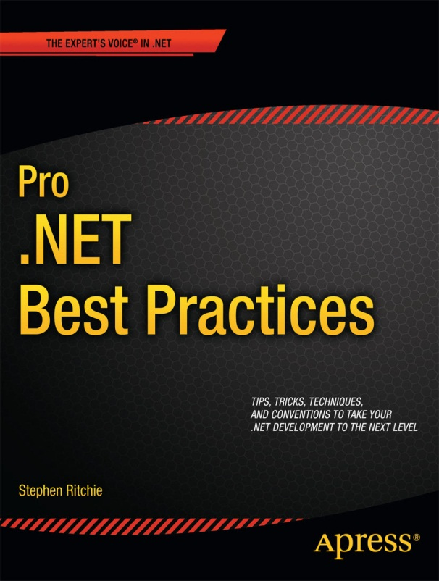
Shameless Self Promotion Time!
40% off eBook at apress.com
Use promo code:
LIN340
Offer ends 6-Oct-2012

Slide 38
Contact Me
Twitter: @ruthlesshelp
Email: stephen.ritchie@excella.com
Blog: http://ruthlesslyhelpful.net
LinkedIn: http://www.linkedin.com/in/sritchie

Slide 39
Slides and Examples
Slideshare: http://www.slideshare.net/ruthlesshelp
Github: http://github.com/ruthlesshelp

