Slide 1
Test Driven Development
Blueprint, Toolbox, and Master Craft
Stephen Ritchie
April 1, 2013

Slide 2
Live Tweet, Slides and Examples
Twitter: @RuthlessHelp @Apress
Slides: http://www.slideshare.net/ruthlesshelp
Code Samples: http://github.com/ruthlesshelp

Slide 3

Blueprint

Slide 4
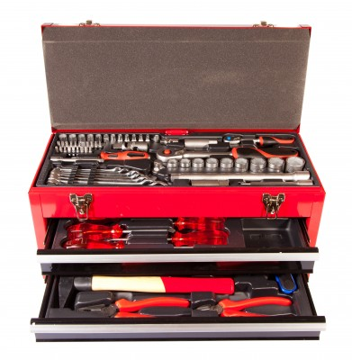
Toolbox

Slide 5
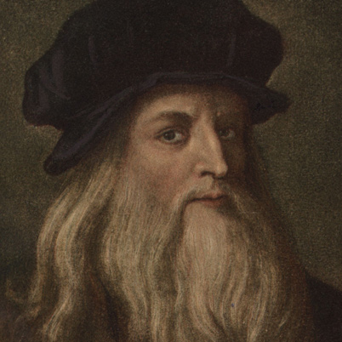
Master Craft

Slide 6
Motivation
Why test software?

Slide 7
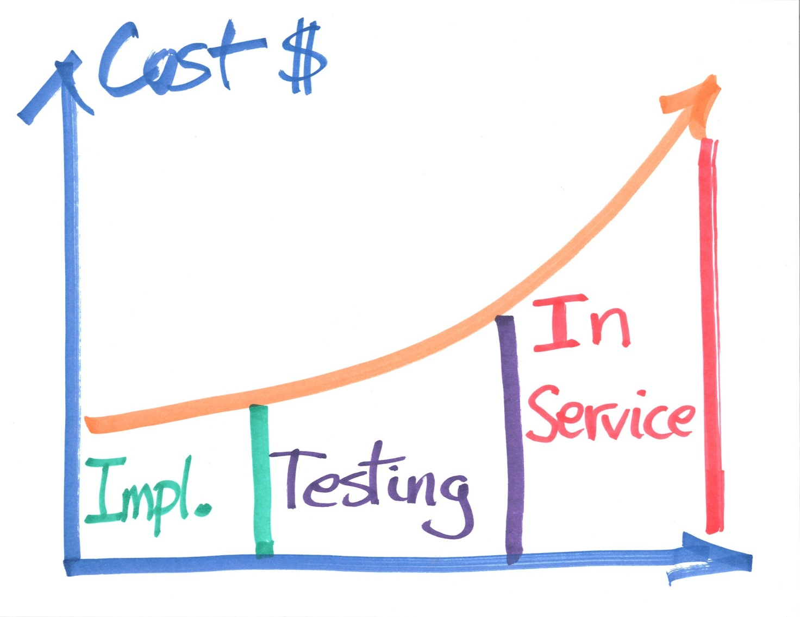
Motivation

Slide 8
Blueprint
Red
1
Refactor
Green
2
3

Slide 9
Blueprint
0. Think
1. Write Test Code
2. Write Production Code
3. Refactor
Repeat 12–40+ cycles/hr

Slide 10
Blueprint
0. Think
Specification (examples)
Consumers (API)
Users

Slide 11
Blueprint
1. Red
Write a very small amount of test code.

Slide 12
Blueprint
2. Green
Write a very small amount of production code.

Slide 13
Blueprint
3. Refactor
Improve the code.
Design
Readability
Testability

Slide 14
Blueprint
Repeat
Cycle
12 to 40+ times per hour
Keep it simple
Run all the tests, every time

Slide 15
Automated Tests
Make Sure
Software Works
As You Intended

Slide 16

But wait …

Slide 17
Temperature Conversion
Perhaps an example would be helpful.

Slide 18
Temperature Conversion
Specification By Example
Start Where You Start
Debug As You Go
Safely Refactor
Engaging (Fun?)

Slide 19
TDD Katas
Bowling Score
Roman Numerals
Tennis Score
Conway's Game of Life
Kata Sites: http://en.wikipedia.org/wiki/Kata_(programming)

Slide 20
But wait …
My Manager Wants Me Slinging Code

Slide 21
TDD: Quality, Visibility, Etc.
Focus on Requirements
Clear, Simple, & Testable
Documents Code’s Behavior
Suite of Regression Tests
Enables & Liberates Change
Visibility (KPI)
Number of Passing Tests
% Code Coverage
Problem Prevention

Slide 22
But wait …
What’s In It For Me?

Slide 23

TDD: Agility
http://amzn.to/172CrtT

Slide 24
TDD: Agility
Easier Debugging
Personal Process
Easy to Get Started
Easy to Keep Going
Detailed Design Do-Overs
What Was I Thinking?
What Was That Bozo Thinking?
Hey, Your API Doesn’t Work

Slide 25
But wait …
We Have a Boat-Load of Legacy Code

Slide 26

TDD: Legacy Code
http://amzn.to/YMpZhl

Slide 27
TDD: Legacy Code
Assembly Coverage
Class Coverage
Method Coverage
Branch Coverage
Boundary Analysis
100% Code Coverage

Slide 28
Toolbox
TDD Books

Slide 29

TDD: Big Picture
http://amzn.to/10YXE5a

Slide 30

TDD: The Art
http://amzn.to/XLOt4b
Second Edition:
http://bit.ly/XLOZz0

Slide 31
Toolbox
Testing Framework
Run Tests
Make Assertions

Slide 32

MSTest
Notes:
Testing Framework
MSTest

Slide 33

MBUnit
Notes:
Testing Framework
MbUnit

Slide 34

xUnit.net
Notes:
Testing Framework
xUnit.net

Slide 35

NUnit
http://www.nunit.org/
Notes:
Testing Framework
NUnit

Slide 36
Toolbox
Mocking Framework
Isolation
Interaction Testing

Slide 37

Rhino Mocks
Notes:
Mocking Framework
RhinoMocks

Slide 38

Moq
http://bit.ly/ZHjQQ0
Notes:
Mocking Framework
Moq

Slide 39
Unit Testing
Perhaps an example would be helpful.

Slide 40
The Master Craft
Continuous Integration
Automation
Monitoring

Slide 41




CI Servers

Slide 42

CI in .NET
http://amzn.to/10mXYIt

Slide 43
The Master Craft
Code Coverage
Find Missing Tests
Monitoring

Slide 44

Toolbox
dotCover
Metrics
http://www.jetbrains.com/dotcover/

Slide 45

Toolbox
Open Cover
Metrics
http://nuget.org/packages/OpenCover

Slide 46

The Master Craft
http://www.ncover.com/

Slide 47
The Master Craft
Inversion of Control
Dependency Injection
IoC Containers
MSDN Article: http://bit.ly/172KUxg

Slide 48

Toolbox
Autofac
http://code.google.com/p/autofac/

Slide 49

The Master Craft

Slide 50


Slide 51

Of Course It’s Safe … After You

Slide 52

Shameless Self Promotion Time!
“Best Practices” Initiative
Tips and Tricks
Generate Ideas
Quantifying Value
Biases & Aversions
Tools & Technologies
Avoid Making the Same Mistakes Once.
http://amzn.to/v8TD8E

Slide 53
Shameless Self Promotion Time!
40% off eBook at Apress.com http://www.apress.com/9781430240235
Use promo code: FWUG40
Offer expires 1-May-2013

Slide 54

Stephen’s Contact Info
Twitter: @RuthlessHelp
Email: stephen.ritchie@excella.com
Blog: http://ruthlesslyhelpful.net
LinkedIn: http://www.linkedin.com/in/sritchie

