Slide 1
Test Driven Development
Happy April Fools Day
Stephen Ritchie
April 1, 2013

Slide 2


Slide 3
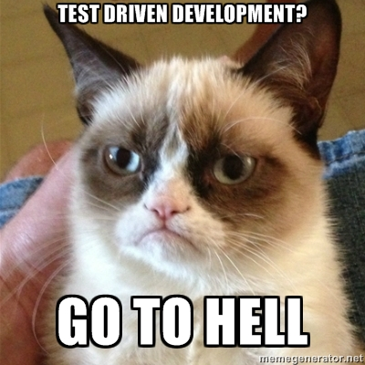

Slide 4
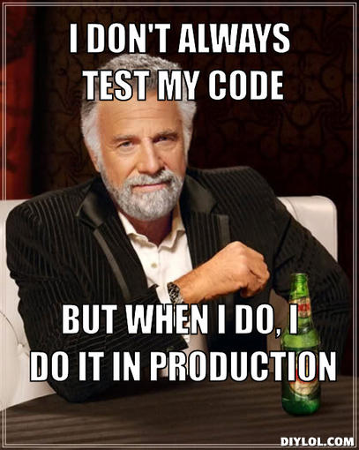

Slide 5

“Go ahead and complete all of your library code. There’s plenty of time later to see what people think of it. Just throw the code over the wall for now. I’m sure it’s fine.”
A quote from the devil himself, in Practices of an Agile Developer.

Slide 6
Live Tweet, Slides and Examples
Twitter: @RuthlessHelp @Apress
Slides: http://www.slideshare.net/ruthlesshelp
Code Samples: http://github.com/ruthlesshelp

Slide 7
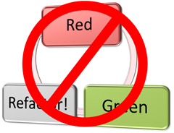
Top 10 Reasons NOT To Do Test Driven Development
Adapted From: http://www.softwareandi.com/2011/12/10-reasons-to-avoid-test-driven.html

Slide 8

10
You Have No Users

Slide 9

9
Your Users Love Bugs

Slide 10

8
Your Code Is Throwaway

Slide 11

7
The Design Is Perfect!

Slide 12
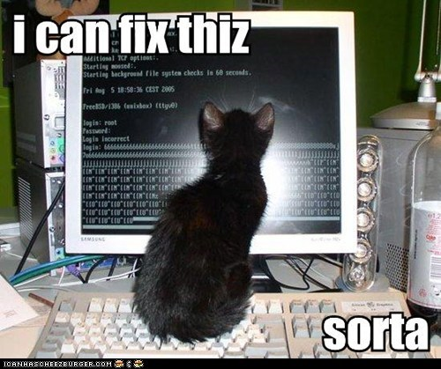
6
Documentation Is Perfect!

Slide 13

5
The Team Never Changes

Slide 14
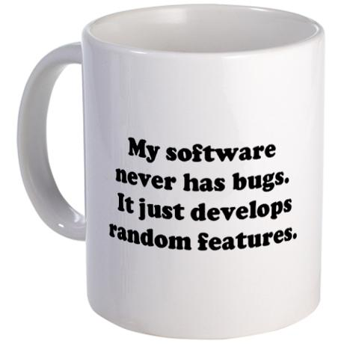
4
“Done” = “Checked In”

Slide 15
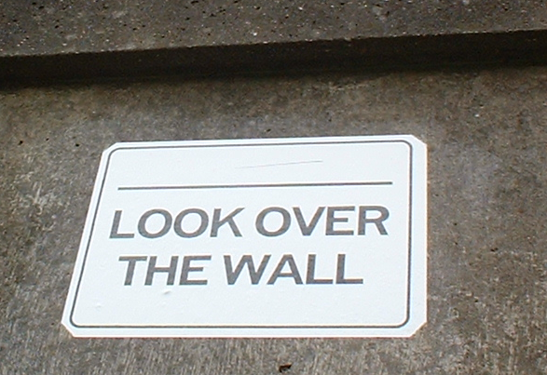
3
I’m Paid To Code. Quality Is Not My Job!

Slide 16
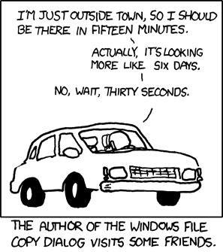
2
Estimating Is Better w/o TDD

Slide 17
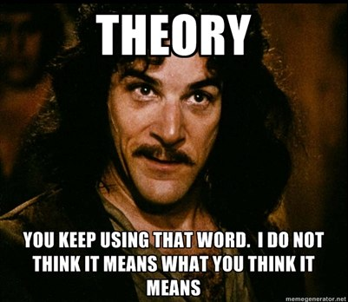
1
TDD Is Only A Theory

Slide 18
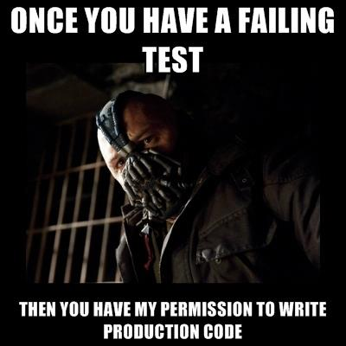

Slide 19
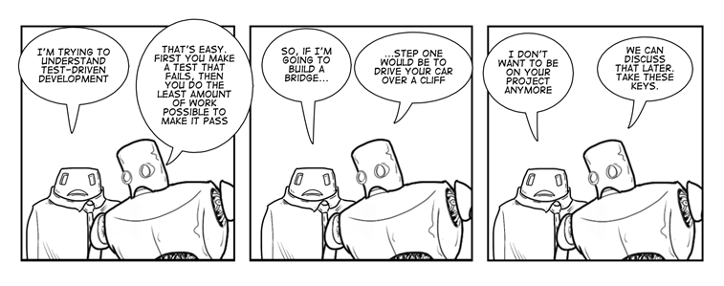

Slide 20


Slide 21
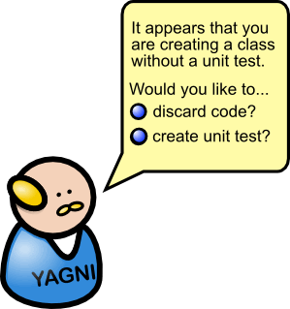

Slide 22
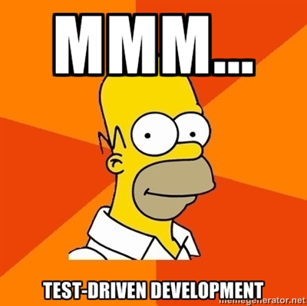

Slide 23
