Slide 2

Chrysler New Yorker

Slide 3

Overview
Unit Testing Databases Is Difficult
CRUD Operations on Tables
Complex Querying of Multiple Tables
Views
Functions
Stored Procedures
Triggers !?!
Notes:
Can we hold TOP SECRET clearances?
No
Where can we do SECRET work?
Clearance is through DoD, but it's accepted everywhere*
When can I get a clearance?
As needed
How long will my clearance last?
Until no longer needed
How does this help BD?
We can pursue opportunities that weren’t previously feasible
How does this help recruiting?
We can transfer a new hire’s SECRET clearance if they are going directly onto a project that requires the clearance
If we don’t have work, the new hire can still reinstate their clearance if they start doing SECRET work within 2 years

Slide 4

Overview
Automated Integration Testing With Databases Is Really Difficult
“Data Not In Known-State Before Test”
Notes:
Can we hold TOP SECRET clearances?
No
Where can we do SECRET work?
Clearance is through DoD, but it's accepted everywhere*
When can I get a clearance?
As needed
How long will my clearance last?
Until no longer needed
How does this help BD?
We can pursue opportunities that weren’t previously feasible
How does this help recruiting?
We can transfer a new hire’s SECRET clearance if they are going directly onto a project that requires the clearance
If we don’t have work, the new hire can still reinstate their clearance if they start doing SECRET work within 2 years

Slide 5
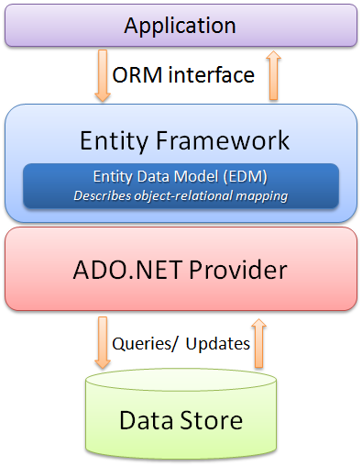
Overview
Object Relational Mapping (ORM)
Entity Framework
NHibernate
Linq2Sql
Linq Queries
Notes:
Can we hold TOP SECRET clearances?
No
Where can we do SECRET work?
Clearance is through DoD, but it's accepted everywhere*
When can I get a clearance?
As needed
How long will my clearance last?
Until no longer needed
How does this help BD?
We can pursue opportunities that weren’t previously feasible
How does this help recruiting?
We can transfer a new hire’s SECRET clearance if they are going directly onto a project that requires the clearance
If we don’t have work, the new hire can still reinstate their clearance if they start doing SECRET work within 2 years

Slide 6
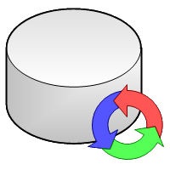
Overview
NDbUnit
Database Testing Framework
Borrows from the Java community’s DbUnit
“.NET library for managing database state during unit testing”
Apache License, Version 2.0
Free and Open Source
NDbUnit Project
http://code.google.com/p/ndbunit/
NuGet Package
http://nuget.org/packages?q=NDbUnit
Supports Many Databases
Microsoft SQL Server 2005 and 2008 (Express thru Enterprise)
Oracle (XE thru Enterprise, 9i and later)
SQLLite
Notes:
Can we hold TOP SECRET clearances?
No
Where can we do SECRET work?
Clearance is through DoD, but it's accepted everywhere*
When can I get a clearance?
As needed
How long will my clearance last?
Until no longer needed
How does this help BD?
We can pursue opportunities that weren’t previously feasible
How does this help recruiting?
We can transfer a new hire’s SECRET clearance if they are going directly onto a project that requires the clearance
If we don’t have work, the new hire can still reinstate their clearance if they start doing SECRET work within 2 years

Slide 7
Tell Me More …
How does NDbUnit work?
Perhaps an example would be helpful …

Slide 8
Unit Testing Databases Is Difficult
Unit Testing Databases Is Difficult
CRUD Operations on Tables
Complex Querying of Multiple Tables
Views
Functions
Stored Procedures
Triggers !?!
Perhaps an example would be helpful …

Slide 9
Automated Integration Testing With Databases Is Really Difficult
Automated Integration Testing With Databases Is Really Difficult
“Data Not In Known-State Before Test”
Perhaps an example would be helpful …

Slide 10
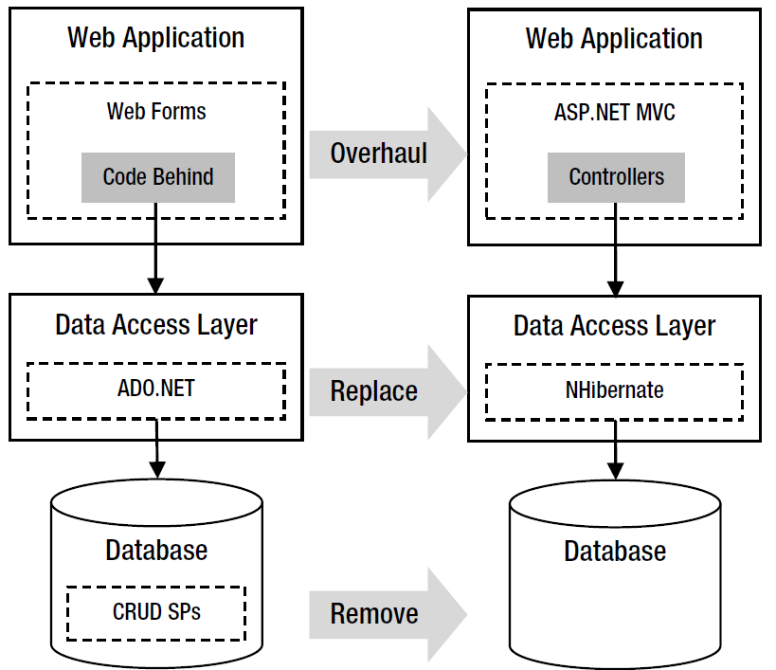
Automated Testing The “Surface API”
“Surface Testing”
DAL
Perhaps an example would be helpful?

Slide 11
Integration Testing The ORM Interface
“Surface Testing” Revisited
ORM Interface Surface
NDbUnit
Independently Controls the Data Store

Slide 12
NDbUnit Downside
Independence Has A Cost
Separately Defined The Schema
Separately Defined Each Known-Data-State
Changing Schema
Updating DataSet
Updating XML Files

Slide 13
NDbUnit Upside
Liberates Refactoring
Switch from CRUD Stored Procedures to ORM
Database Consolidation
Automated Integration Testing Legacy Code
Leap Forward
Reporting
Test Report Queries Independent of Reporting Tool
Browser Testing
Put Database In Known State
Smoke, Stability, Performance, Regression and Other Testing
Automated Integration Testing

Slide 14

Of Course It’s Safe … After You

Slide 15
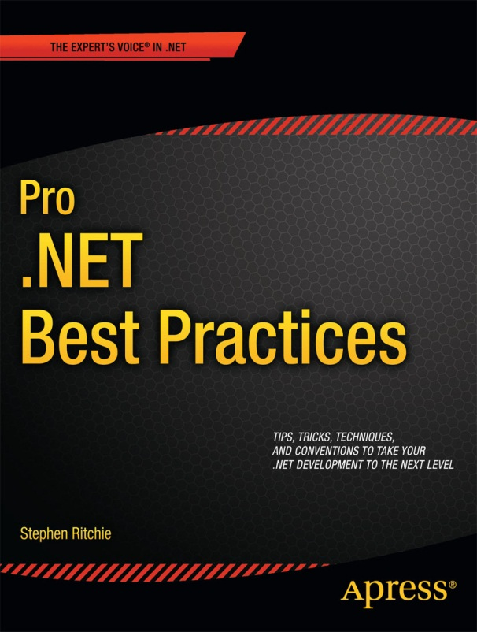
Shameless Self Promotion Time!
Get 40% off Pro .NET Best Practices!
Buy the eBook at Apress.com
Enter the promo code: CMAP12
Formats: PDF, ePub, or MOBI
Valid until May 31, 2012

Slide 16
More Shameless Self Promotion
Email: stephen.ritchie@excella.com
Twitter: @ruthlesshelp
Blog: http://ruthlesslyhelpful.net
LinkedIn: http://www.linkedin.com/in/sritchie
Facebook: http://www.facebook.com/ProDotNetBestPractices

