Slide 1
Notes:
The primary thing to know, we are talking about automated testing.
Automated testing implies:
Require zero setup or configuration, or only one-time setup and configuration
Every test is isolated from every other test
This is expectation that one or more tests run in a specific order
Once initiated, the tests can all run to completion, unattended
The tests result in either a pass or fail (or a defined status)
For this presentation, we create a local database on an instance of SQL Express. This is a one-time setup that provides isolation.

Slide 2

Chrysler New Yorker
Notes:
Introductory remarks.

Slide 3

Overview: Database “Units”
Unit Testing Databases Is Difficult
CRUD Operations on Tables
Complex Querying of Multiple Tables
Views
Functions
Stored Procedures
Triggers !?!
Notes:
The database is a subsystem that is often treated like a “black box”.
Development team often own the stored procedures, function, and triggers. They often have logic that satisfies an explicit or implicit requirement.
In many organizations, the DBA team owns the table schema.
Unit testing databases is difficult because a “unit”, such as a table, is hard to test in isolation. For example, your test code might need to use ADO.NET to query the table. Any number of configuration issues might prevent the test from passing. Besides, this is an integration test.
Unit testing stored procedures is difficult because it is difficult to “Arrange” that the data in the tables is mocked so that it is in a known state before the test code executes the SP.

Slide 4
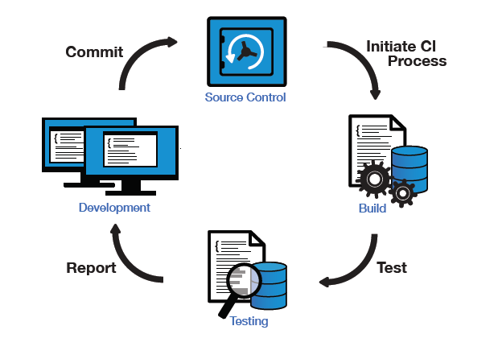
Overview: Automated Testing Requirements
Run Everywhere
Every developer must be able to run the combined collection of all the other developers’ tests.
Continuous Integration
The CI server must be able to run the entire suite of tests without manual intervention.
Deterministic, Isolated and Repeatable
The outcome of the tests must be unambiguous and repeatable. Usually, the standard is that if one test fails the entire test run fails.

Slide 5

Overview: Databases Present Hurdles
Automated Integration Testing with Databases
This is Really Difficult
Schema Not Migrated/Versioned
Data Not In “Known-State”
Concurrency Control

Slide 6

RoundhousE
Database Versioning and Change Management
Migrations Engine
Convention Over Configuration
Apache License, Version 2.0
Free and Open Source
NDbUnit Project
http://code.google.com/p/roundhouse/
NuGet Package
http://nuget.org/packages/roundhouse
Documentation
https://github.com/chucknorris/roundhouse/wiki

Slide 7
Tell Me More …
How does RoundhousE work?
Perhaps an example would be helpful …

Slide 8
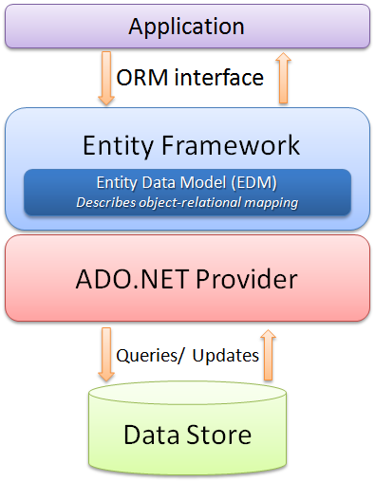
Motivation
Object Relational Mapping (ORM)
Entity Framework
NHibernate
Linq2Sql
Linq Queries

Slide 9
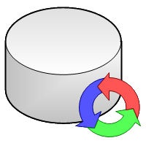
NDbUnit
Database Testing Framework
Borrows from the Java community’s DbUnit
“.NET library for managing database state during unit testing”
Apache License, Version 2.0
Free and Open Source
NDbUnit Project
http://code.google.com/p/ndbunit/
NuGet Package
http://nuget.org/packages?q=NDbUnit
Supports Many Databases
Microsoft SQL Server 2005 and 2008 (Express thru Enterprise)
Oracle (XE thru Enterprise, 9i and later)
SQLLite

Slide 10
Tell Me More …
How does NDbUnit work?
Perhaps an example would be helpful …

Slide 11
Unit Testing Databases Is Difficult
Unit Testing Databases Is Difficult
CRUD Operations on Tables
Complex Querying of Multiple Tables
Views
Functions
Stored Procedures
Triggers !?!
Perhaps an example would be helpful …

Slide 12
Automated Integration Testing With Databases Is Really Difficult
Automated Integration Testing With Databases Is Really Difficult
“Data Not In Known-State Before Test”
Perhaps an example would be helpful …

Slide 13
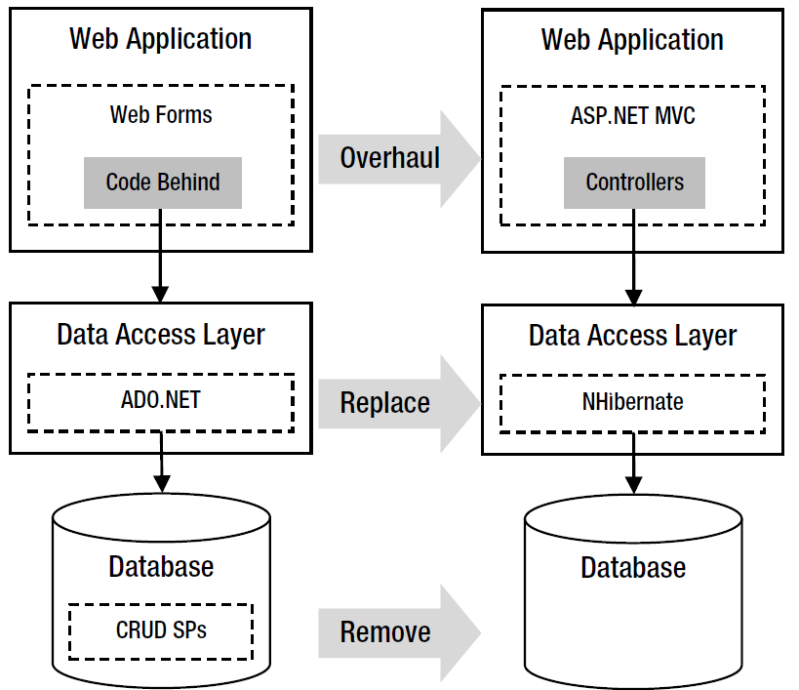
Automated Testing The “Surface API”
“Surface Testing”
DAL
Perhaps an example would be helpful?

Slide 14
Integration Testing The ORM Interface
“Surface Testing” Revisited
ORM Interface Surface
NDbUnit
Independently Controls the Data Store

Slide 15
NDbUnit Downside
Independence Has A Cost
Separately Defined The Schema
Separately Defined Each Known-Data-State
Changing Schema
Updating DataSet
Updating XML Files

Slide 16
NDbUnit Upside
Liberates Refactoring
Switch from CRUD Stored Procedures to ORM
Database Consolidation
Automated Integration Testing Legacy Code
Leap Forward
Reporting
Test Report Queries Independent of Reporting Tool
Browser Testing
Put Database In Known State
Smoke, Stability, Performance, Regression and Other Testing
Automated Integration Testing

Slide 17

Another Option: Microsoft SQL Server
tSQLt
Database Unit Testing Framework for SQL Server
Create & Execute Tests in SQL Server Management Studio
Free, Open Source
http://tsqlt.org/
Red Gate: SQL Test
Unit Test Add-In for SSMS
Commercial
“Powered by tSQLt” (API)
http://www.red-gate.com/products/sql-development/sql-test/

Slide 18

Of Course It’s Safe … After You

Slide 19
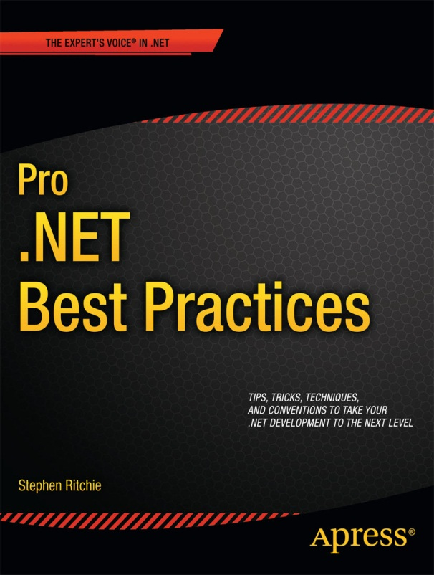
Shameless Self Promotion Time!
Get 40% off Pro .NET Best Practices!
Buy the eBook at Apress.com
Enter the promo code: PHN3T
Formats: PDF, ePub, or MOBI
Valid until May 31, 2012

Slide 20
More Shameless Self Promotion
Code: https://github.com/ruthlesshelp
Slides: http://www.slideshare.net/ruthlesshelp

Slide 21
Even More Shameless Self Promotion
Email: stephen.ritchie@excella.com
Twitter: @ruthlesshelp
Blog: http://ruthlesslyhelpful.net
LinkedIn: http://www.linkedin.com/in/sritchie
Facebook: http://www.facebook.com/ProDotNetBestPractices

