Slide 1
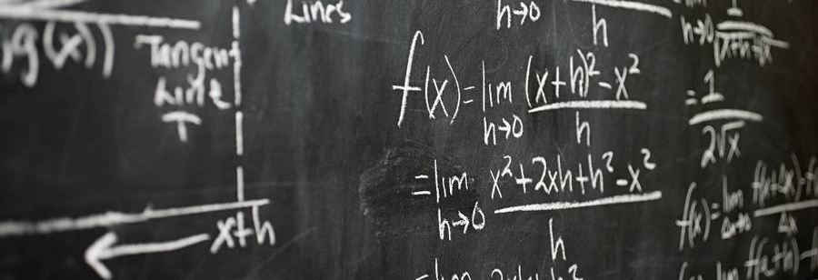
Statistics
Ruth Mburu

Slide 2

Topics
Introduction
Descriptive Statistics
Inferential Stats
What is Statistics
Types of Statistics
Population And Sample
Sampling Techniques
What are Variables?
Variable Measurement Scales
Mean, Median, Mode
Measure of dispersion with Variance And SD
Percentiles and Quartiles

Slide 3

Introduction to Statistics
Statistics is a mathematical science pertaining to the collection, presentation, analysis and interpretation of data.
Statistical and Non-Statistical Analysis
An analysis of any situation can be done in two ways:
Statistical analysis
Non- statistical analysis

Slide 4
Statistical Analysis
It is the science of collecting, exploring and presenting large amounts of data to identify patterns and trends.
It is also called quantitative analysis.
Non-Statistical Analysis
It provides generic information and includes text, sound, still images and moving images.
It is also called qualitative analysis.

Slide 5

Major categories of statistics
There are two major categories of statistics:
Descriptive Statistics
Inferential Statistics

Slide 6

Major categories of statistics
Descriptive statistics helps organize data and focuses on the main characteristics of the data.
It provides a summary of the data numerically or graphically.
Characteristics of the data
Descriptive Statistics
Average
Mode
SD
Correlation

Slide 7
Major categories of statistics
Inferential Statistics generalizes the large dataset and applies probability theory to draw a conclusion.
It allows you to infer population parameters based on sample statistics and to model relationships within the data.
Modelling allows you to develop mathematical equations which describe the interrelationships between two or more variables.
Start
Process step 1
Probability Theory
Choice 2
Decision
Choice 1
A

Slide 8
Statistical terms
There are various statistical terms that one should be aware of while dealing with statistics, They include;
Quantitative Variable
Population
Sample
Variable
Qualitative Variable
Discreet Variable
Continuous Variable
A population is the group from which data is to be collected

Slide 9
Statistical terms
There are various statistical terms that one should be aware of while dealing with statistics, They include;
Quantitative Variable
Population
Sample
Variable
Qualitative Variable
Discreet Variable
Continuous Variable
A sample is a subset of a population

Slide 10
Statistical terms
There are various statistical terms that one should be aware of while dealing with statistics, They include;
Quantitative Variable
Population
Sample
Variable
Qualitative Variable
Discreet Variable
Continuous Variable
A variable is a feature characteristics of any member of a population differing in quality or quantity from another member.

Slide 11
Statistical terms
There are various statistical terms that one should be aware of while dealing with statistics, They include;
Quantitative Variable
Population
Sample
Variable
Qualitative Variable
Discreet Variable
Continuous Variable
A variable differing in quantity is called a quantitative variable

Slide 12
Statistical terms
There are various statistical terms that one should be aware of while dealing with statistics, They include;
Quantitative Variable
Population
Sample
Variable
Qualitative Variable
Discreet Variable
Continuous Variable
A variable differing in quality is called a qualitative variable or attribute.

Slide 13
Statistical terms
There are various statistical terms that one should be aware of while dealing with statistics, They include;
Quantitative Variable
Population
Sample
Variable
Qualitative Variable
Discreet Variable
Continuous Variable
A discreet variable is one which no value can be assumed between two given values.
Eg. The number of children in a family

Slide 14
Statistical terms
There are various statistical terms that one should be aware of while dealing with statistics, They include;
Quantitative Variable
Population
Sample
Variable
Qualitative Variable
Discreet Variable
Continuous Variable
A continuous variable is one in which any value can be assumed between the two given values.
E.g. The time taken for a 100-meter run.

Slide 15
Sampling and Sampling Techniques
Sampling means choosing from a large population the respondents or subjects to answer your research questions. The entire population is involved in involved but for you research study, you choose only part of the whole.
Groups of sampling techniques are;
Probability sampling - this is a sampling method that makes you base your selection of respondents on pure chance
Non probability sampling - sampling techniques included in this category are not chosen randomly but purposefully.

Slide 16
Probability sampling
Simple random sampling
Systematic sampling
Cluster sampling
Stratified
Multi stage sampling

Slide 17
Probability sampling
Simple random sampling
Choosing of respondents based on pure chance.
It involves gathering a representative sample from a population where each member in the population has an equal chance of being selected.
An example is using a random number generator to select students in a class to complete a task
Systematic sampling
Every member in the population is given a number. After the first member is chosen at random the remaining members are chosen from a given interval. It is basically selecting a random starting point and then select every NTH subject in the population
An example is a list of people with the first names in alphabetical order and numbered the 5th person is chosen randomly followed by every subsequent 8th person.

Slide 18
Probability sampling
Cluster sampling
It randomly selects members from a list that is too large. Cluster sampling design is used when natural groups occur in a population. The entire population is subdivided into clusters (groups) and random samples where then gathered from each group
Stratified sampling
It involves choosing a sample that will later on be subdivided into strata, subgroups or sub samples during the stage of the data analysis. The population can be divided into at least different groups with common characteristics and then draw some subjects from each group.
An example is finding out a favorite Netflix movie from different age categories of people in a year group.

Slide 19
Probability sampling
Difference between strata and clusters
Although strata and clusters are both non-overlapping subsets of the population they differ in several ways.
All strata are represented in the sample; but only a subset of clusters are in the sample.
With stratified sampling, the best survey results occur when elements within strata are internally homogeneous. However, with cluster sampling, the best results occur when elements within clusters are internally heterogeneous.

Slide 20
Non-Probability sampling
Convenience sampling
Judgment sampling
Snowball sampling
Voluntary sample

Slide 21
Non-Probability sampling
Convenience sampling
It is used in exploratory research where the researcher is interested in getting an inexpensive approximation of the truth. As the name implies, the sample is selected because they are convenient. This non probability method is often used during preliminary research efforts to get a gross estimate of the results, without incurring the cost or time required select a random sample.
Judgement sampling
The researcher selects the sample based on judgment. This is usually an extension of convenient sampling. For example, a researcher may decide to draw the entire sample from one representative city, even though the population includes all cities. When using this method, the researcher must be confident that the chosen sample is truly representative of the entire population. hey

Slide 22
Non-Probability sampling
Snowball sampling
It is a method used when the desired sample characteristic is rare. It may be extremely difficult or costly to locate respondents in this situation. Snowball sampling relies on referrals from initial subjects to generate additional subjects. Well this technique can dramatically lower such costs, it comes at the expense of introducing bias because the technique itself reduces the likelihood that the sample will represent a good cross section from the population.
Quota sampling
It aims to create a sample where the groups e.g. males versus females workers, are proportional to their population. The population is divided into groups and the samples are gathered from each group to meet quota.
Voluntary sampling
A voluntary sample is made-up of people who self select into the survey. Often, these people have a strong interest in the main topic of the survey.

Slide 23
Variables
Nominal variables
Ordinal variables
Interval variables
Ratio Variables
Nominal variables are ones which have two or more categories, and it is impossible to order the values
Ordinal variables have values in a logical order. However, the relative distance between two data values is not clear.
For example the size of a coffee cup.
With an interval scale, equal differences between scale values do have equal quantitative meaning. An interval scale provides more quantitative information than the ordinal scale. The interval scale does not have a true zero point
Ratio scales are similar to interval skills index equal differences between skill values have equal quantitative meaning. It has a true zero point

Slide 24
Statistical Measures - Types
Measures of frequency
Measures of central tendency
Measures of spread
Measures of position
Frequency of the data indicates the number of occurrences of any particular data value in the given data set. The measures of frequency are number and percentage.
Central tendency indicates whether the data values accumulate in the middle of distribution or towards the end. The measures of central tendency are mean median and mode.
Spread describes how similar or varied the set of observed values are for a particular variable. The measures of spread are standard deviation, variance and quartiles. The measures of spread are also called measures of dispersion.
Position identifies the exact location of a particular data value in the given data set. The measures of position are percentiles, quartiles in standard scores.

Slide 25
Measures of central tendency
Mean
Median
Mode
The mean also known as the average, is calculated by summing up all the values in a data set and dividing by the number of values. It is sensitive to outliers, as extreme values can greatly influence the mean.
The median is the middle value in a data set when the values are arranged in ascending or descending order. If the data set has an odd number of values, the median is the middle value. If the data set has an even number of values, the median is the average of the two middle values. The median is less affected by outliers compared to the mean.
The mode is the value that occurs most frequently in a data set. A data set can have one mode, more than one mode (multimodal), or no mode if all values occur with the same frequency. The mode is useful for categorical or nominal data.

Slide 26
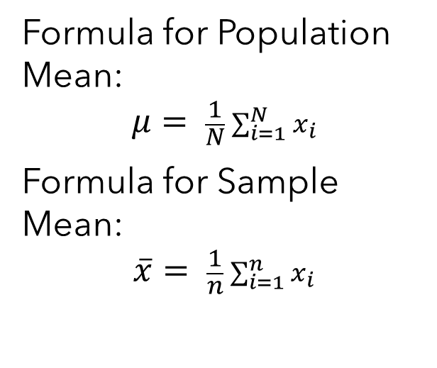
Measures of central tendency
Mean
Median
Mode
Formula for Population Mean:
$$μ= \frac{1}{N}\sum_{i=1}^{N}{x_{i}}$$
Formula for Sample Mean:
$$\overline{x}= \frac{1}{n}\sum_{i=1}^{n}{x_{i}}$$
Formula: Median = Middle Value (or Average of Middle Two Values)
Formula: No specific mathematical formula; it is determined by observing the frequency distribution of the data.

Slide 27
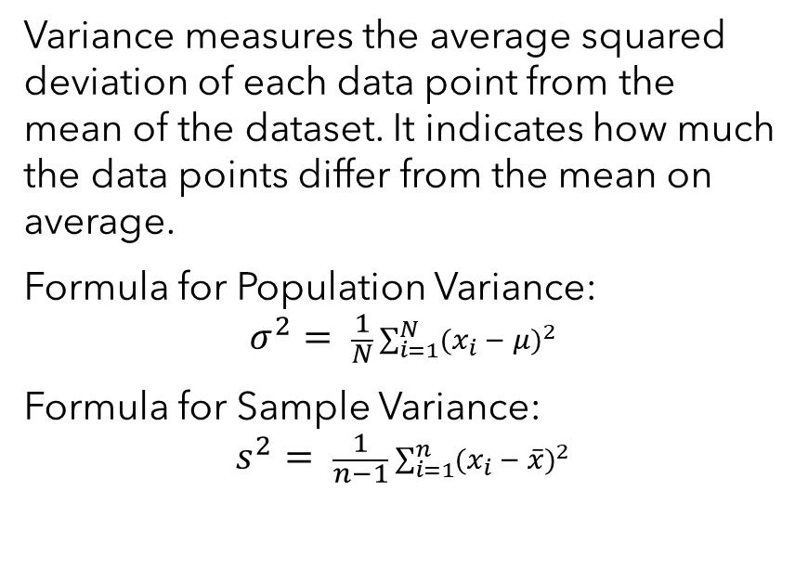
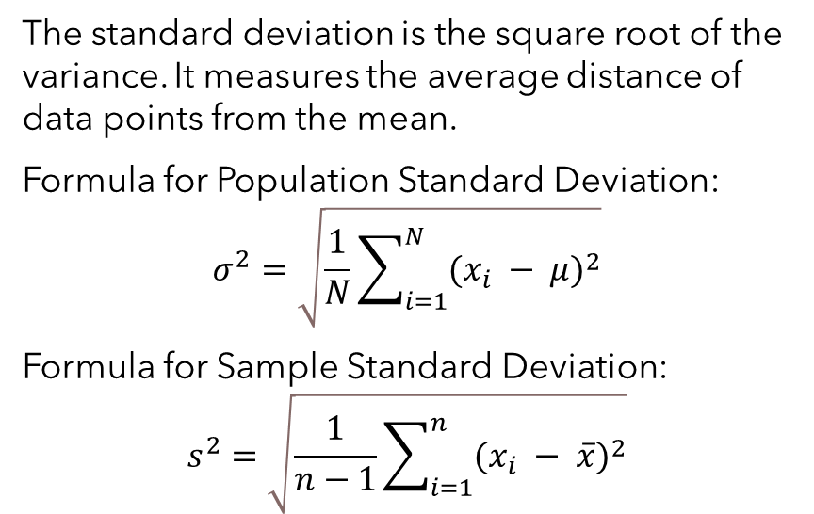
Measures of spread / Dispersion
Variance
Standard Deviation
Variance measures the average squared deviation of each data point from the mean of the dataset. It indicates how much the data points differ from the mean on average.
Formula for Population Variance:
$$σ^{2}= \frac{1}{N}\sum_{i=1}^{N}{{(x_{i} − μ)}^{2}}$$
Formula for Sample Variance:
$$s^{2}= \frac{1}{n−1}\sum_{i=1}^{n}{{(x_{i} − \overline{x})}^{2}}$$
The standard deviation is the square root of the variance. It measures the average distance of data points from the mean.
Formula for Population Standard Deviation:
$$σ^{2}=\sqrt{\frac{1}{N}\sum_{i=1}^{N}{{(x_{i} − μ)}^{2}}}$$
Formula for Sample Standard Deviation:
$$s^{2}=\sqrt{\frac{1}{n−1}\sum_{i=1}^{n}{{(x_{i} − \overline{x})}^{2}}}$$

Slide 28
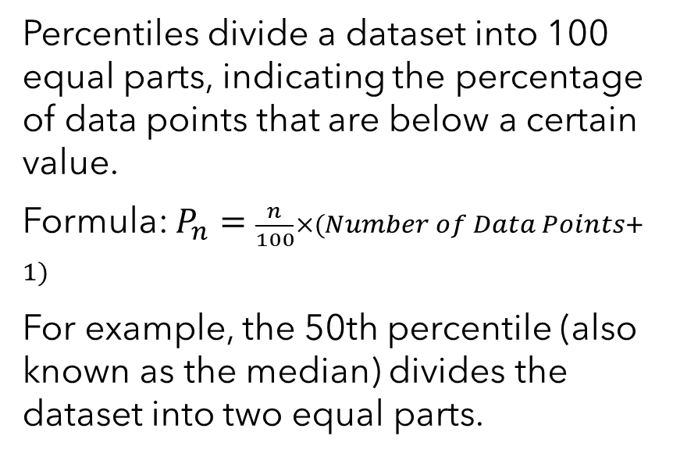
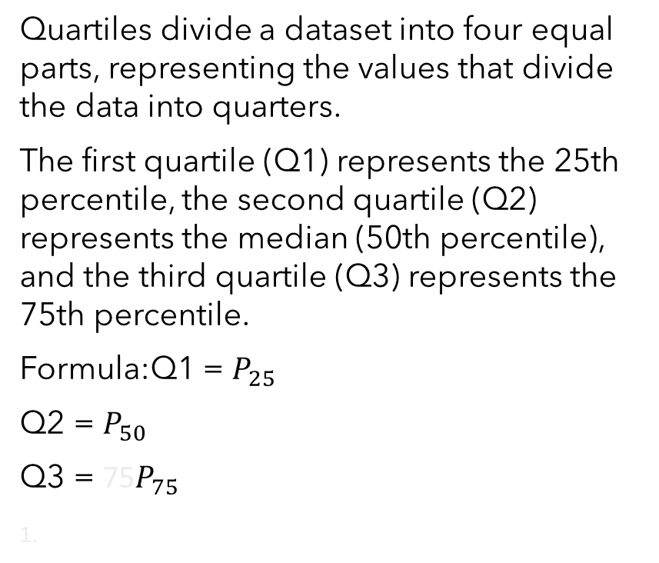
Measures of Position
Percentiles
Quartiles
Percentiles divide a dataset into 100 equal parts, indicating the percentage of data points that are below a certain value.
Formula: $P_{n}=\frac{n}{100}×(Number of Data Points+1)$
For example, the 50th percentile (also known as the median) divides the dataset into two equal parts.
Quartiles divide a dataset into four equal parts, representing the values that divide the data into quarters.
The first quartile (Q1) represents the 25th percentile, the second quartile (Q2) represents the median (50th percentile), and the third quartile (Q3) represents the 75th percentile.
Formula:Q1 = $P_{25}​$
Q2 = $P_{50}​$
Q3 = 75​$P_{75}​$

Slide 29



Summary
This brief introduction to statistics provides the necessary tools and concepts for understanding and interpreting data, making it a crucial foundation for various fields

Slide 30

Thank you

