Slide 1
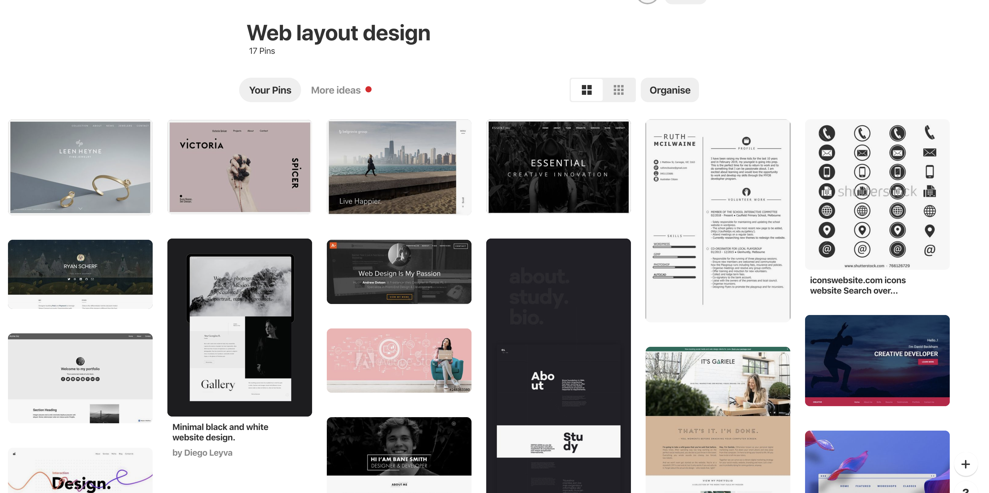

Slide 2
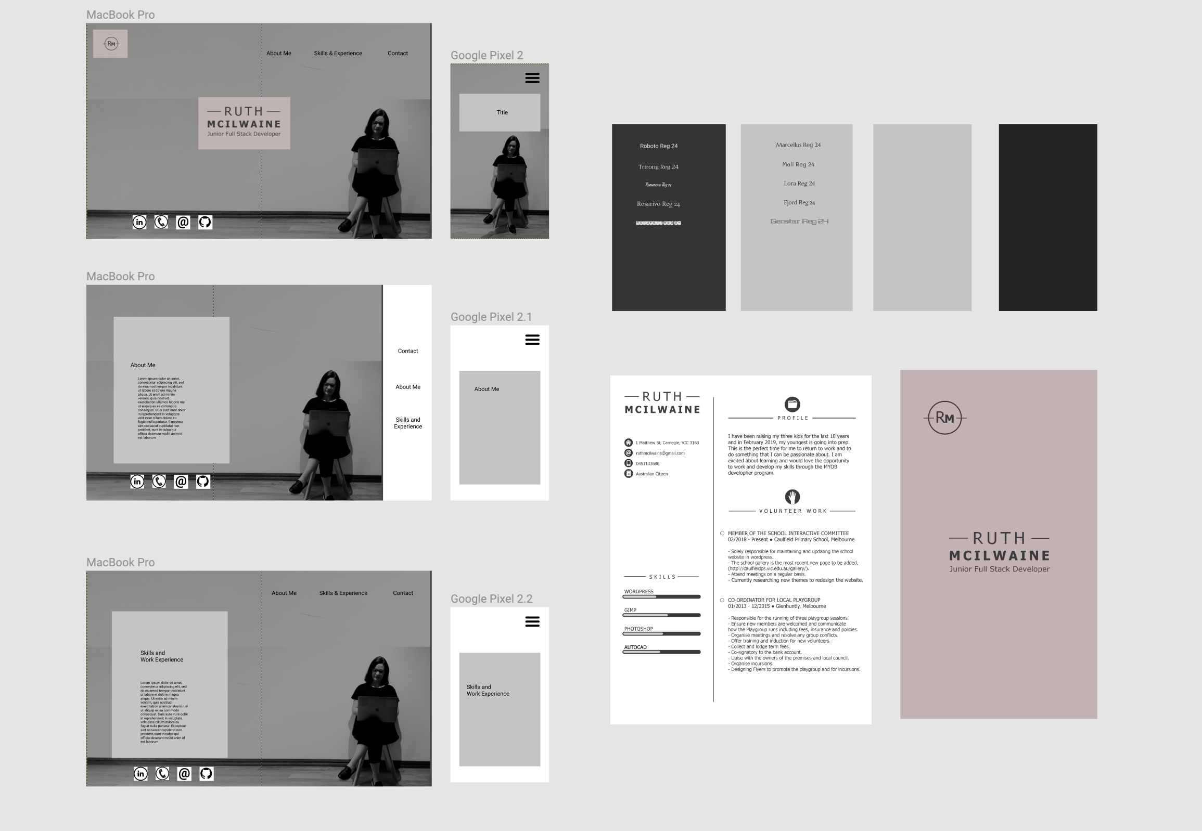

Slide 3
The build process
Grid Layout was challenging
Hamburger menu
Background Image size
Font awesome
Complete product

