Slide 1
MemGate
What to keep, what to forget
A measured study of the memory decision policy for long-running LLM agents, under a bounded store
Simar Singh Khanuja — 70562200088
Yash Ramchandani — 70562300097
SVKM’s NMIMS, Indore Campus
Capstone Project · Progress review, September 2026

Slide 2
Where the project stands
The measurement track is complete. Nine experiments run end to end; every claim carries a clustered confidence interval.
Workstream | State | Evidence
Harness, three-tier store, policies P0 / P1 | Complete | memgate/ — 5,430 lines of Python
LoCoMo wired; the evaluation leak removed | Complete | 3 label-blindness regression tests
Ablation study — 23 configurations | Complete | results/ablations_2048.csv
Storage budget — the corrected accounting | Complete | 35 configurations swept
Significance: bootstrap + exact McNemar | Complete | clustered by conversation, B = 10,000
Scaling to 182× · byte accounting · learned scorer | Complete | three separate sweeps
P2 LLM judge — built and evaluated | Complete | single-component swap, with CIs
End-task accuracy through a real reader | Pilot only | pipeline + cache built; 12-question run
Abstractive compression · LongMemEval · online learning | Not started | scoped, with effort estimates
The headline: +8.7 answer-recall points for choosing which turns to forget, over forgetting oldest-first — at identical storage, fidelity and retrieval.

Slide 3
First: a Review 1 number is withdrawn
Raised here rather than left for the panel to find.
• The Review 1 deck reported 95% recall for MemGate against 10% for a sliding window. That number was inflated by an evaluation leak.
• The leak. The memory policy was reading fact_id — the ground-truth answer key — when deciding what to keep. It was worth 45–47 recall points.
Synthetic set @ 800 tokens | As presented at Review 1 | Honest
P1 MemGate | 95.0% | 50.0%
P0 sliding window | 10.0% | 10.0%
• The fix is a test, not a comment. Strip every evaluation label from the input and the store must come out bit-identical. Each decision point added since — eviction under a storage budget, and demotion — was added to that test before any number from it was quoted.
• Everything after this slide is measured on a real benchmark, leak-free.
WHY IT LEADS A withdrawn result the students raise is worth more than one the panel discovers.

Slide 4
The problem
A 200K-token context window did not solve agent memory; it relocated it.
• Context rot. Chroma Research (2025) tested 18 frontier models: accuracy degrades 30–50% well before the documented context limit. It is a property of attention, not a training gap — so larger windows do not fix it. Curation does.
• Cost and latency. On LoCoMo, full context is ~26,000 tokens and 9.87 s median latency; selective memory reaches similar accuracy at ~1,800 tokens and 0.71 s — roughly 14× cheaper.
• The measurable gap. On LongMemEval, oracle retrieval scores ~92% where the same model interactively scores ~58%. That 34-point gap is memory selection failure, not reasoning failure.
WHERE THE GAP IS The open problem, named in a 2026 review: current systems “do not solve the fundamental challenge: deciding what to remember and what to forget.”

Slide 5
The question, and what is new
RESEARCH QUESTION How much of the memory-selection gap can a better decision policy recover, and under what budget does compression pay for itself?
• Tiered memory with forgetting is already shipped. Letta/MemGPT, Mem0 and Zep all ship it. Presented as “a memory layer with three tiers”, this work would already be done.
• What is not done is the decision itself. Colaco & Lahjouji (2026) frame every such decision as one rate–distortion problem — what to retain, at what fidelity, under a budget — but supply a framework, not a system.
• MemGate is the harness that makes the decision measurable. Policy-agnostic: competing policies are placed on one accuracy-per-token frontier, with each comparison constructed so that exactly one variable moves.
STATED PLAINLY The contribution is a measurement, and several of its results are negative.

Slide 6
System architecture
MemGate wraps a frozen LLM and controls what enters the prompt. Nothing is trained.
u ≥ τ_fact → Tier 3 durable fact
WRITE PATH — what to keep
Adaptive Memory Decision Engine
scores each item exactly once, on eviction
TIERED STORE
incoming turn
Tier 1 short-term raw verbatim turns
u ≥ τ_low → Tier 2 compressed gist
otherwise → dropped from context
Tier 2 working compressed gists
Tier 3 long-term facts + vectors
READ PATH — what to recall
new query
retrieve
semantic match over tier 3
assemble context
packs to the token budget
FROZEN LLM
response
Tiers are a lifecycle, not a partition: everything enters Tier 1, and the routing decision happens once — on eviction, when the budget binds.

Slide 7
Policies compared
Each comparison is built so that exactly one variable moves.
 | Policy | Retention rule | Fidelity
P0 | Sliding window | recency, budget-driven | verbatim
RAG | Store-all + retrieve | FIFO — the no-policy control | verbatim
P1 | MemGate threshold | scored at ingest, τ-routed | compressed
P1-A | MemGate adaptive | score orders eviction | compress on eviction
P1-S | MemGate select | score orders eviction | drop on eviction
P2 | LLM-judged salience | Qwen2.5-0.5B rates each turn | drop
P3 | Learned scorer | fitted, cross-validated | drop
Oracle | — | perfect selection (upper bound) | verbatim
Comparison | Held constant | The one thing that varies
P0 vs RAG | retention, storage | read path — recency vs retrieval
RAG vs P1-S | storage, fidelity, retrieval | which turns are forgotten
P1-S vs P1-A | storage, selection | fidelity — drop vs compress
P0 is given the same token budget as MemGate, so the only difference is which turns are chosen — never how many tokens may be spent. A fixed small window would be a strawman.

Slide 8
Two metrics, and why both are reported
• Evidence (strict) recall. Every gold evidence turn reached the context. A multi-hop question cites up to 19 turns, and 18 of 19 answers nothing.
• Answer recall. The answer text itself survived, scored over the 715 questions whose answer is recoverable from the evidence text. This is the metric to believe.
• Stored tokens / bytes. What the policy still holds, as opposed to what it spends per query.
WHY TWO Reporting both is essential rather than decorative: the two metrics disagree on exactly the comparison this project is about, and the disagreement is the finding.
• Evidence recall credits a pointer. A compressed gist keeps the evidence id of a turn whose text it has thrown away, and scores a hit with none of the answer behind it.
• Answer recall checks the content. During the consolidation work, evidence recall rose 8.1% → 14.8% while answer recall stayed pinned at 12.8%. The entire gain was bookkeeping.

Slide 9
Experimental setup
Deterministic, offline, and free to re-run on every change.
Element | Choice | Why
Benchmark | LoCoMo — 10 conversations, 5,882 turns, 1,527 scoreable questions | Real multi-session dialogue with gold evidence ids
Excluded | Adversarial items (category 5) | They carry evidence, but the correct behaviour is to decline
Embedder | all-MiniLM-L6-v2, 384-d | Retrieval ranking and semantic supersession
Tokenizer | tiktoken cl100k_base | Budgets are exact tokens, not a word-count proxy
P2 judge | Qwen2.5-0.5B-Instruct, run locally | One forward pass per turn, logit-expectation scored
Reader | Qwen2.5-1.5B-Instruct-4bit, greedy | Held fixed across arms, so any difference is the policy
Statistics | Paired bootstrap B = 10,000 + exact McNemar | Resampled by conversation, not by question
THE ONE STATISTICAL POINT THAT MATTERS 1,527 questions drawn from 10 conversations are not 1,527 independent trials. Every interval in this deck is clustered at the conversation level.

Slide 10
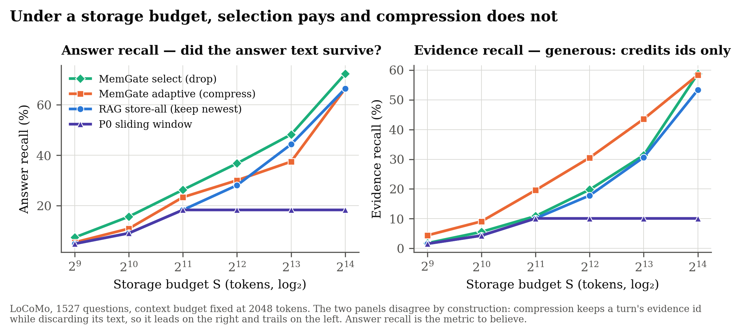
Storage was never budgeted — and that determined the answer
• Every experiment in this literature caps the context assembled per query and leaves the store unbounded. So does every experiment of ours before this point.
• Under that accounting, “keep everything and retrieve top-k” is charged nothing for holding all 419 turns of a conversation — so forgetting can only ever lose information.
• Our own ablation duly reported the compression machinery as a net loss against keeping everything. It was right to.
Fig. 1 — the storage-token frontier. Context pinned at 2048; the store swept.
THE CORRECTION Imposing a storage budget S changes the question from “what fits in context?” to “what is worth keeping at all?”
Under the corrected accounting the ranking inverts: what looked like a loss for the decision policy was an artefact of never charging for the store.

Slide 11
Selection pays; compression does not
Context budget fixed at 2048 tokens. Storage budget swept. Answer recall.
S (tokens) | RAG store-all | P1-A adaptive (compress) | P1-S select (drop) | P1-S − RAG
1,024 | 9.1% | 10.9% | 15.7% | +6.6
2,048 | 18.3% | 23.4% | 26.3% | +8.0
4,096 | 28.1% | 30.1% | 36.8% | +8.7
8,192 | 44.3% | 37.5% | 48.2% | +3.9
16,384 | 66.4% | 66.4% | 72.3% | +5.9
• The two metrics disagree, and that is the result. P1-A wins evidence recall (+12.9 at S = 8192) while losing answer recall (−6.9). A demoted gist keeps the evidence ids of a turn whose text it discarded. Reporting only evidence recall would have shown compression winning.
THE CLEANEST COMPARISON IN THE PROJECT RAG and P1-S hold the same verbatim turns, in the same space, retrieved the same way, and differ in one respect only: which turns they forget when the cap binds. RAG forgets oldest-first; P1-S forgets lowest-utility-first.

Slide 12
What survives clustering
Paired bootstrap, B = 10,000, resampled by conversation · exact McNemar · S = 4096
Comparison | Metric | Δ points | 95% CI (clustered) | McNemar p | Verdict
P1-S select vs RAG store-all | answer recall | +8.67 | [+4.77, +14.27] | 1.1×10⁻4 | significant
P1-S select vs RAG store-all | evidence recall | +1.96 | [-1.48, +5.52] | 0.16 | not significant
P1-S select vs P1-A compress | answer recall | +6.71 | [+4.24, +9.54] | 3.6×10⁻5 | significant
P1-S select vs P1-A compress | evidence recall | -10.74 | [-13.65, -7.90] | 4.7×10⁻20 | significant
P1-S select vs P0 recency | answer recall | +18.46 | [+14.68, +23.56] | 3.8×10⁻17 | significant
P1-S select vs P0 recency | evidence recall | +9.69 | [+6.85, +12.83] | 3.6×10⁻14 | significant
REPORTED AS IT STANDS We do not claim an evidence-recall improvement over RAG. +1.96 points does not survive clustering (p = 0.16). The answer-recall claim, +8.67 with the interval clear of zero, does.
A claim reported as not significant is a claim the panel does not have to find.

Slide 13
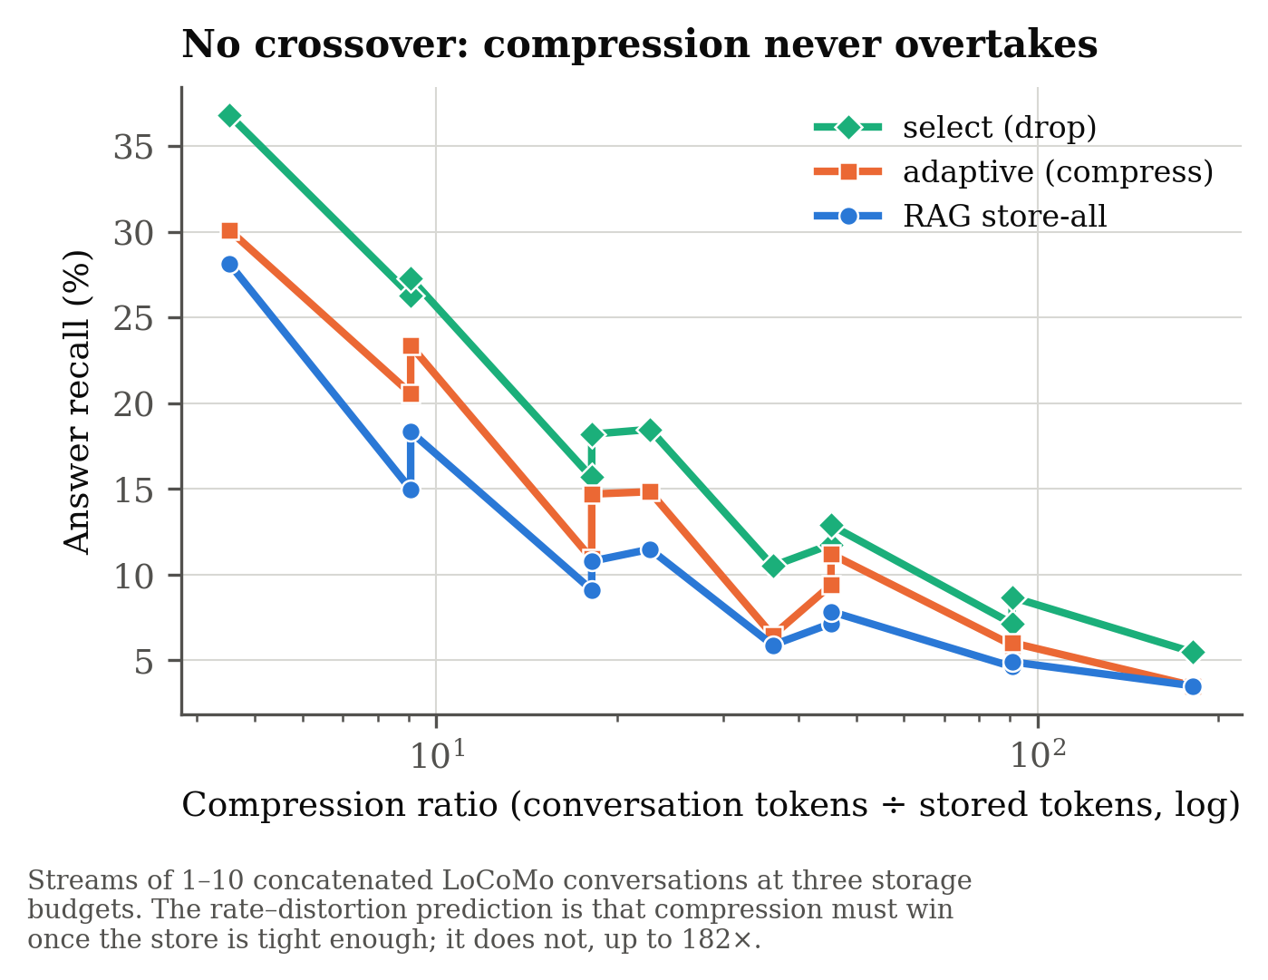
The rate–distortion prediction fails
Theory says compression must eventually win. It does not, anywhere we can reach.
• Sweeping S downward cannot test it. By S = 256 every policy sits at ~0.2% evidence recall — below the floor where anything works.
• The missing axis is length. We concatenate up to 10 LoCoMo conversations (186K tokens) and hold S fixed, so the compression ratio rises to 182×.
Compression ratio | RAG | P1-A (compress) | P1-S (drop)
9× | 18.3% | 23.4% | 26.3%
18× | 10.8% | 14.7% | 18.2%
45× | 7.8% | 11.2% | 11.7%
91× | 4.6% | 6.0% | 8.7%
RESULT No crossover to 182×, and the selection margin over RAG widens with pressure. At LoCoMo scale the optimum sits at the vertex: a subset at full fidelity beats everything at reduced fidelity.
Caveat: a concatenated stream is not a natural long conversation — each question concerns one constituent conversation, so the others act as distractors. It is a stress test of retention under pressure, not a long-dialogue benchmark.

Slide 14
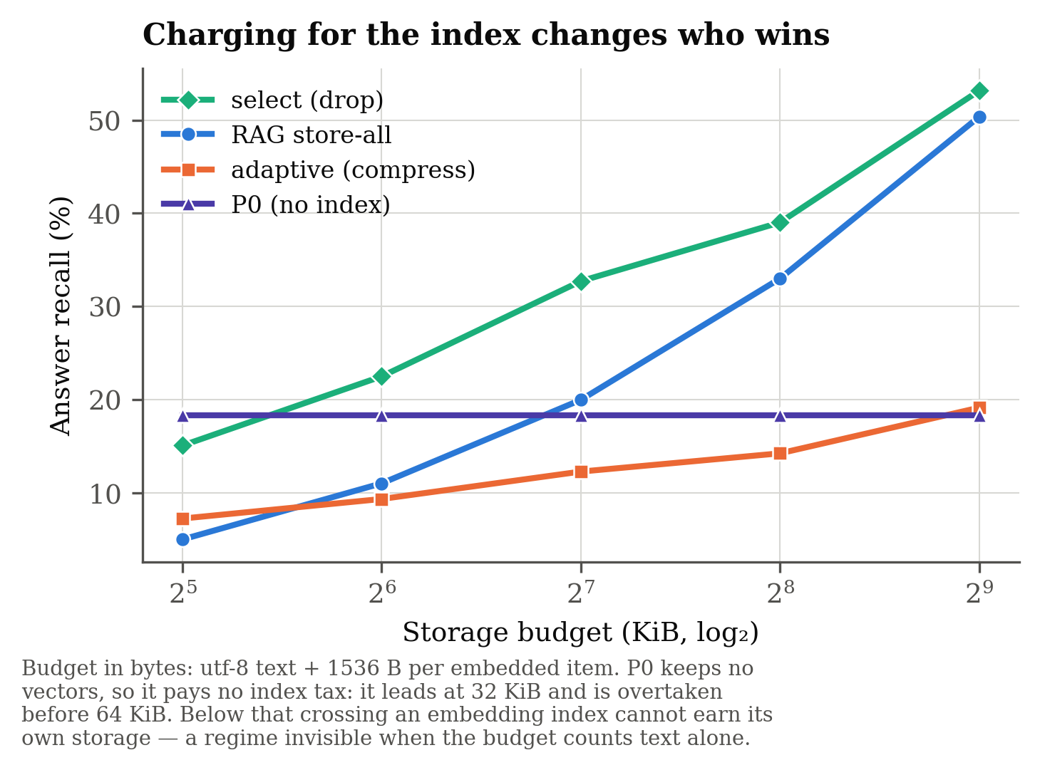
The index is not free
Storage denominated in text tokens silently gives the embedding index away.
• A 384-d float32 vector is 1,536 bytes against a turn’s ~130 bytes of text. The index outweighs the content ~12×, and the binding cost becomes the number of items, not their length.
Budget | P0 (keeps no index) | RAG store-all | P1-S select
32 KiB | 18.3% | 5.0% | 15.1%
64 KiB | 18.3% | 11.0% | 22.5%
256 KiB | 18.3% | 33.0% | 39.0%
Two results. The selection finding is unit-robust — it holds when the budget is counted in bytes. And below ~40 KiB an embedding index cannot earn its own storage: plain recency, which keeps no vectors at all, wins outright. That regime is invisible when the budget counts text alone.

Slide 15
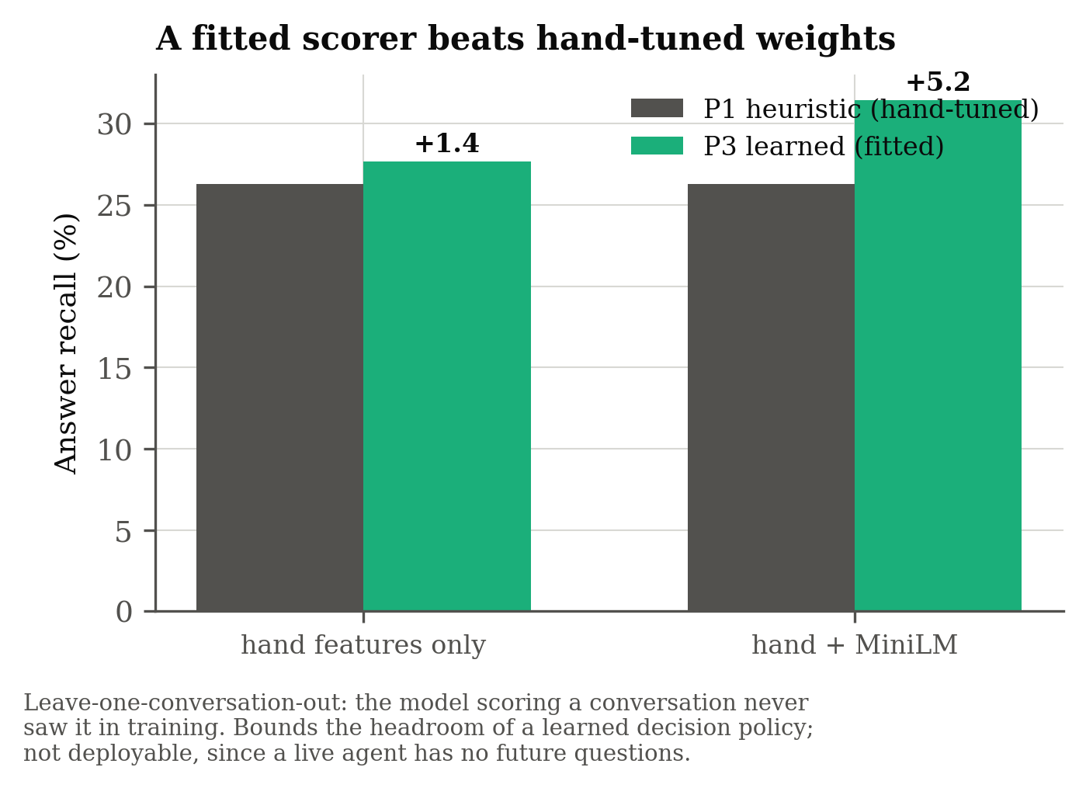
The scorer is the bottleneck — and it is learnable
Component removed | Δ evidence recall
retrieval (tier 3) | -30.32
demotion on pressure (but answer recall +6.7) | -10.74
scored eviction (FIFO) | -4.98
informative compressor | -3.8
consolidation merge | -2.55
supersession | -0.2
Scorer | AUC | Answer recall
P1 heuristic (hand-tuned) | — | 26.3%
P3 learned, hand features | 0.746 | 27.7%
P3 learned, + MiniLM | 0.793 | 31.5%
Leave-one-conversation-out: the model scoring a conversation never saw it in training.
WHAT THE MODEL LEARNED The fitted weights say something the heuristic never encoded: turn length is the strongest single predictor of evidence-worthiness — ahead of every hand-designed cue.

Slide 16
An LLM judge is the wrong instrument for salience
A single-component swap: policy, storage, retrieval and compression pinned at the winner — only the scorer varies, so anything that moves is the scorer.
Scorer | Evidence | Answer | Δ vs P1 | 95% CI (clustered)
P0 recency — no content judgement | 12.6% | 25.6% | -11.19 | [-17.24, -6.19]
P1 heuristic — regex + shallow NER | 19.8% | 36.8% | — | —
P2 LLM judge — Qwen2.5-0.5B | 14.0% | 30.9% | -5.87 | [-10.77, -1.76]
P3 learned — LOCO, a bound | 33.4% | 48.3% | +11.47 | [+4.90, +17.86]
• Scoring at all is load-bearing. +11.19 points over unscored recency — without this row the rest of the table would not be worth reading.
• The judge fails at it anyway. It loses to the regex by 5.87 points and the interval excludes zero, for ~15 minutes of GPU per corpus against microseconds.
• The headroom is real. +11.47 to the learned bound, so P2 was not defeated by a missing ceiling. The ceiling it failed to reach genuinely exists.
WHY IT LOSES The diagnosis is what the judge is shown: it rates each turn in isolation, and salience is not a property of a turn on its own. A phone number matters because something later asks for it.

Slide 17
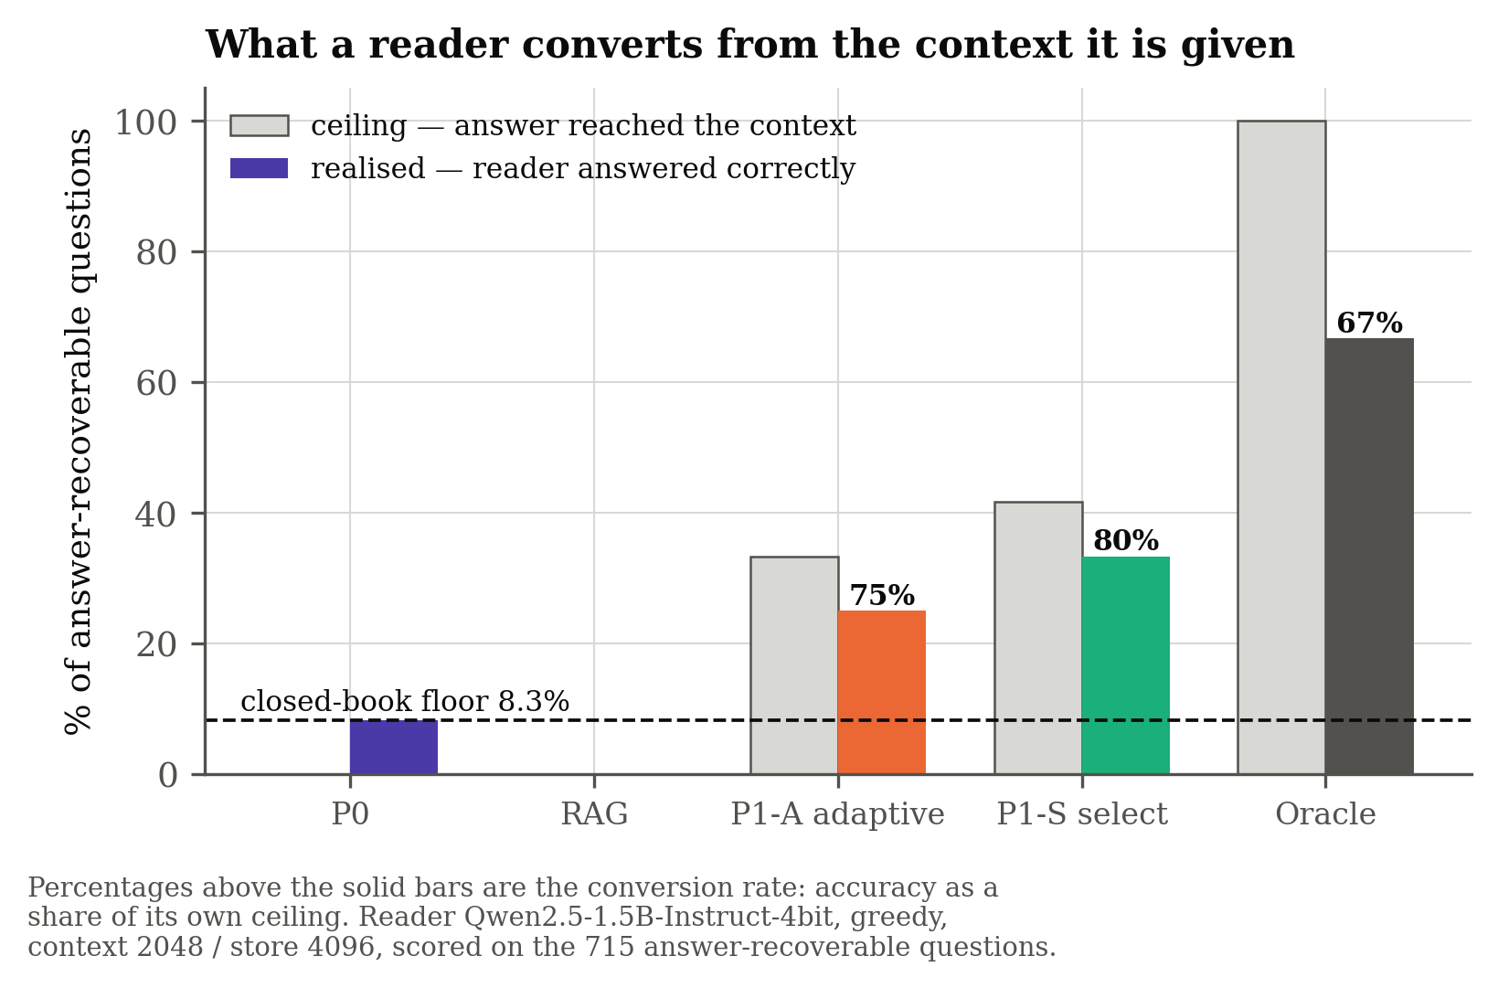
End-task accuracy — built, and honestly labelled
Every number so far is context recall: did the evidence reach the prompt? That is the ceiling on accuracy, not accuracy.
Arm | Accuracy | F1 | Answer present in context
closed-book | 8.3% | 12.5 | 0.0%
P0 sliding-window | 8.3% | 9.7 | 0.0%
RAG store-all | 0.0% | 12.5 | 0.0%
P1-A adaptive | 25.0% | 25.3 | 33.3%
P1-S select | 33.3% | 44.7 | 41.7%
Oracle | 66.7% | 76.9 | 100.0%
• Two controls the comparison cannot be read without. Closed-book is the floor — a model answering from parametric knowledge would make every policy look good. Oracle is the ceiling: exactly the cited evidence, perfectly selected.
READ THIS BEFORE THE NUMBERS This is a 12-question smoke run, not a result. It is shown because the pipeline, both controls and the generation cache work end to end — the remaining experiment is wired and ready. The full 715-question run is several hours of local generation and has not been made.

Slide 18
Three findings about measurement
Each was caught by a guard, not by reading the code.
 | Finding | What it cost
4.1 | *A policy that read its own answer key.* An early consolidation rule promoted items on fact_id — the evaluation label. | +45–47 recall points. Invalidated the Review 1 headline.
4.2 | *A component’s value is conditional on the bottleneck being elsewhere.* The MiniLM embedder measured at +0.2 points — true in the regime measured, where retrieval was saturated against a write path discarding 93% of the conversation. | Once that ceiling lifted, the same swap was worth +19.7.
4.3 | *A metric that credits pointers.* Evidence recall counts a turn as retrieved if its id reaches the context; a gist keeps the id and discards the text. | Evidence recall rose 8.1% → 14.8% while answer recall stayed at 12.8%.
AND A FOURTH A fourth, smaller instance: batched judge scoring returned NaN for exactly the short turns. The instinct was precision, and float32 did not fix it — the cause was left-padding creating fully-masked attention rows. Without the NaN guard, every filler turn would have scored NaN and quietly inverted the eviction order.

Slide 19
Tools and technology
What was proposed at Review 1, and what the results were actually produced with.
Area | Proposed at Review 1 | Actually used | Why it changed
Base model | Llama 3 / Mistral; OpenAI or Anthropic API | Qwen2.5-0.5B and 1.5B-4bit, run locally | No key, no rate limit, no per-run cost, bit-reproducible offline
Agent scaffolding | LangChain / LlamaIndex | None — a direct harness | A framework’s own retrieval would confound the variable under study
Vector store | FAISS / Chroma | NumPy cosine over an in-process store | At 10 conversations an ANN index adds approximation error, not speed
Embeddings | Sentence-transformers | all-MiniLM-L6-v2, 384-d | As proposed; ablated against a hashing fallback
Tokenisation | — | tiktoken cl100k_base | Budgets must be exact tokens, not a word-count proxy
Evaluation | End-task F1 on a long-conversation benchmark | Context recall + answer presence, then end-task | Recall isolates the policy from the reader’s reasoning, and bounds it
Statistics | — | Paired bootstrap (B = 10,000) + exact McNemar | 1,527 questions from 10 conversations are not 1,527 trials
WHY IT MATTERS This is not scope reduction. Running everything locally and free is what made 35 storage configurations, 23 ablations, a 10,000-sample bootstrap and a 36-point scaling sweep affordable to re-run on every change.

Slide 20
Verification and engineering discipline
Each guard exists because the failure it prevents already happened once.
Guard | What it prevents
61 tests (test_memgate.py) | Regression across the store, scorers, policies, compressor and harness
3 label-blindness invariants | The evaluation leak, re-armed. Routing, eviction and demotion must produce a bit-identical store when every evaluation label is stripped
Offline pinning on import (HF_HUB_OFFLINE) | A silently fetched or half-downloaded model relabelling a whole results table — this already happened once, with MiniLM
Backend provenance (backend_info()) | Reporting a MiniLM number that the hashing fallback actually produced
NaN guard in the judge | Filler turns scoring NaN and inverting the eviction order
Generation caches keyed by (model, prompt) | Non-reproducible LLM output; also what makes long runs resumable
Results committed with the code | A figure in a report that no longer matches the code that made it
THE RULE ADOPTED The fix for a leak is a test, not a comment. Each new decision point is added to the invariant before any number from it is quoted.

Slide 21
Deliverables
Everything below is in the repository and reproducible from source.
• REPORT.md — the paper-ready writeup: abstract, method, results with intervals, methodological findings, limitations.
• docs/REVIEW2_PROGRESS_REPORT.md — this review’s progress report: status, what changed since Review 1, the full technology inventory, and the plan to the final review.
• SESSION_RECORD.md — the complete working record, §1–§28, written to be picked up cold.
• frontend/index.html — an interactive results dashboard. Every figure on it is read from the committed CSVs by frontend/build_data.py; nothing is typed by hand.
• memgate/ — 5,430 lines of Python: the library, 13 runnable experiments, 61 tests.
• memgate/results/ — every CSV and every figure quoted in this deck, committed alongside the code that produced them.
• docs/make_review2_deck.py — this deck, generated from those same CSVs.
A reviewer can check every number in this deck without a nine-minute benchmark run: the results are committed, and each slide names the file it came from.

Slide 22
Timeline
Jul ’26
Aug ’26
Sep ’26
Oct ’26
Nov ’26
Dec ’26
Literature review, problem finalisation
System design and harness
LoCoMo evaluation, leak removed
Ablation study
Storage budget, significance, scaling
P2 judge, byte accounting, learned scorer
Full end-task run (715 questions)
Abstractive compression + LongMemEval
Online learning of the eviction policy
Final report, documentation, defence
● Review 1 · Jul
● This review · Sep
● Review 2 · Oct
● Final · Dec
Filled bars are complete. The critical path to the final review is the full end-task run — the pipeline is built and validated; what it needs is machine time.

Slide 23
Limitations, and what remains
Stated limitations
• Ten conversations. Clustered intervals are wide because the cluster count is small — and the one effect that does not survive clustering is reported as not significant.
• Context recall is the ceiling on end-task accuracy, not accuracy itself.
• Compression tested is extractive. The negative result is stated for that case only.
• Concatenated streams are synthetic.
• Single embedder, single judge model. The judge result is evidence about a 0.5B model prompted per turn, not about LLM judging in general.
• P3-learned is a headroom bound, not a component: a live agent has no future questions.
Remaining work
1. Full 715-question end-task run. Converts the project from a ceiling to an accuracy claim; pipeline, controls and cache already validated. ~4–6 h, resumable
2. Abstractive compression, to test whether the negative result is specific to extractive methods. 1 session
3. LongMemEval — genuinely long single conversations, replacing the concatenated-stream stress test. 1–2 sessions
4. Online learning of the eviction policy — the only route that makes a learned scorer deployable. 2 sessions

Slide 24
Conclusion as it stands
• With storage unbounded — the standard accounting — tiered compression is a net loss against keeping everything and retrieving.
• With storage bounded, the decision policy is worth +8.7 answer-recall points, while compression still loses 6.7.
• The rate–distortion crossover at which compression should pay is not reachable on this benchmark — to 182×, keeping a selected subset whole beats compressing everything.
• Charging for the embedding index inverts the ranking below ~40 KiB, where a policy with no index at all wins outright.
• An LLM judge — the obvious way to improve the scorer — loses to a regex, and the reason is diagnosable: it rates turns in isolation.
Practical guidance: keep a scored subset whole; do not compress everything. And denominate the budget in bytes, including the index, or the comparison is not the one you think you are making.
Presented as “a memory layer with three tiers”, this work would already have been done. Measured honestly, the more useful result is what doesn’t work.

Slide 25
References
1. Packer, C., et al. (2023). MemGPT: Towards LLMs as Operating Systems. arXiv:2310.08560. ← base paper
2. Maharana, A., et al. (2024). Evaluating Very Long-Term Conversational Memory of LLM Agents (LoCoMo). ACL. ← benchmark
3. Zhong, W., et al. (2024). MemoryBank. AAAI 38(17), 19724–19731.
4. Park, J. S., et al. (2023). Generative Agents. UIST ’23.
5. Xiao, G., et al. (2024). Efficient Streaming Language Models with Attention Sinks. ICLR.
6. Zhang, Z., et al. (2023). H2O: Heavy-Hitter Oracle. NeurIPS.
7. Jiang, H., et al. (2023). LLMLingua. EMNLP, 13358–13376.
8. Mu, J., Li, X. L., & Goodman, N. (2023). Learning to Compress Prompts with Gist Tokens. NeurIPS.
9. Chevalier, A., et al. (2023). Adapting Language Models to Compress Contexts. EMNLP.
10. Zhang, Z., et al. (2024). A Survey on the Memory Mechanism of LLM-Based Agents. arXiv:2404.13501.
11. Xu, W., et al. (2025). A-MEM: Agentic Memory for LLM Agents. NeurIPS, arXiv:2502.12110.
12. Chroma Research (2025). Context Rot. · Colaco & Lahjouji (2026). arXiv:2607.08032.
13. Wu, D., et al. (2024). LongMemEval. arXiv:2410.10813.
Author lists, venues and years were each verified against source pages. Several 2026 performance figures used in the motivation come from vendor blogs and are treated as indicative — re-measuring them under one harness is itself part of the contribution.

Slide 26
Thank you
Questions welcome — including on the results that did not work.
Simar Singh Khanuja · Yash Ramchandani
SVKM’s NMIMS, Indore Campus

Slide 27
Backup — the full storage sweep
Shown on request. Context budget pinned at 2048 for every row.
S | Policy | Evidence recall | Answer recall | Stored tokens | Context tokens
512 | P0 sliding-window | 1.6% | 4.9% | 497 | 496
512 | RAG store-all | 1.6% | 4.9% | 497 | 496
512 | P1 MemGate | 2.5% | 5.9% | 422 | 415
512 | P1-A MemGate adaptive | 4.4% | 5.5% | 491 | 486
512 | P1-S MemGate select | 1.8% | 7.4% | 485 | 473
1,024 | P0 sliding-window | 4.3% | 9.1% | 1,005 | 1,005
1,024 | RAG store-all | 4.3% | 9.1% | 1,005 | 987
1,024 | P1 MemGate | 6.1% | 11.5% | 906 | 886
1,024 | P1-A MemGate adaptive | 9.1% | 10.9% | 1,002 | 984
1,024 | P1-S MemGate select | 5.6% | 15.7% | 1,006 | 963
2,048 | P0 sliding-window | 10.1% | 18.3% | 2,031 | 2,031
2,048 | RAG store-all | 10.1% | 18.3% | 2,031 | 1,983
2,048 | P1 MemGate | 12.3% | 18.0% | 1,483 | 1,401
2,048 | P1-A MemGate adaptive | 19.6% | 23.4% | 2,022 | 1,758
2,048 | P1-S MemGate select | 10.9% | 26.3% | 2,025 | 1,932
4,096 | P0 sliding-window | 10.1% | 18.3% | 4,068 | 2,045
4,096 | RAG store-all | 17.8% | 28.1% | 4,068 | 2,018
4,096 | P1 MemGate | 14.1% | 20.3% | 2,059 | 1,424
4,096 | P1-A MemGate adaptive | 30.5% | 30.1% | 4,042 | 1,470
4,096 | P1-S MemGate select | 19.8% | 36.8% | 4,077 | 2,006
8,192 | P0 sliding-window | 10.1% | 18.3% | 8,172 | 2,046
8,192 | RAG store-all | 30.6% | 44.3% | 8,172 | 1,987
8,192 | P1 MemGate | 14.4% | 20.6% | 2,150 | 1,425
8,192 | P1-A MemGate adaptive | 43.5% | 37.5% | 8,160 | 1,170
8,192 | P1-S MemGate select | 31.4% | 48.2% | 8,171 | 1,772
16,384 | P0 sliding-window | 10.1% | 18.3% | 15,666 | 2,047
16,384 | RAG store-all | 53.3% | 66.4% | 15,666 | 1,965
16,384 | P1 MemGate | 14.4% | 20.6% | 2,150 | 1,425
16,384 | P1-A MemGate adaptive | 58.4% | 66.4% | 15,623 | 1,406
16,384 | P1-S MemGate select | 58.7% | 72.3% | 15,626 | 1,777

Slide 28
Backup — repository layout
Capstone Project/
REPORT.md paper-ready writeup
SESSION_RECORD.md working record, §1–§28
docs/
REVIEW2_PROGRESS_REPORT.md the progress report for this review
make_review2_deck.py builds this deck from the CSVs
frontend/
index.html interactive results dashboard
build_data.py regenerates data.js from results/*.csv
memgate/
memgate/ the library — types, utils, store, scoring,
policies, compress, judge, llm_judge, data, harness
run_locomo.py context-budget frontier
run_storage_sweep.py storage budget — 35 configurations
run_scaling.py compression ratio to 182×
run_cost_model.py byte accounting
run_significance.py bootstrap + McNemar
train_scorer.py learned scorer, leave-one-conversation-out
precompute_judge.py P2 judge scores (cached)
run_judge_eval.py scorer comparison with clustered CIs
run_endtask.py end-task accuracy (resumable)
run_ablations.py 23-configuration component attribution
diagnose.py attributes every miss to one component
make_figures.py fig1–fig5
test_memgate.py 61 tests
results/ every CSV and figure quoted in this deck
Not committed, by design: the LoCoMo benchmark (2.7 MB) and the model weights (~1 GB). Both are reproducible — memgate/README.md gives the exact fetch commands. The results CSVs are committed, so every number here is checkable without a nine-minute benchmark run.

