Slide 1
Predictive Model for Customer Booking Behavior Objective: Using predictive models to proactively acquire customers before they embark on their holidays
By: Ruth Omolara Ajagunna
October 2024

Slide 2
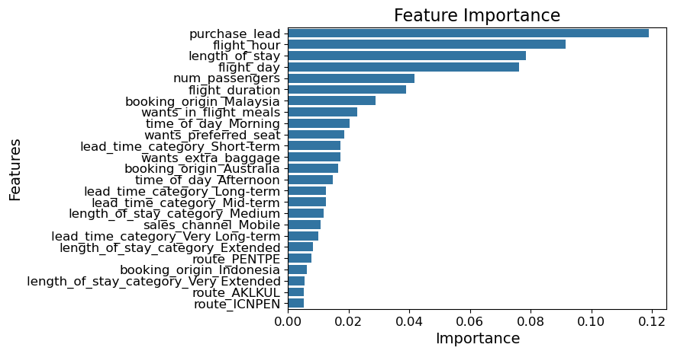
Results
Feature Importance (Top Factors)
Purchase Lead: Most important predictor.
Flight Hour, Length of Stay, Num Passengers: Key contributors.
Booking Origin (Malaysia, Australia): Significant for predictions.
Customer Preferences (In-flight meals, preferred seats, extra baggage) influence buying decisions.
Model Performance Metrics:
Accuracy: 85%
Precision (Class 0 - Non-Purchasers): 86%
Recall (Class 0 - Non-Purchasers): 99%
Precision (Class 1 - Purchasers): 54%
Recall (Class 1 - Purchasers): 9%
Key Takeaways
Model performs well for, but needs improvement for predicting actual purchasers. non-purchasers
Proactively targeting customers based on predictive data can boost early holiday sales.

