Slide 1
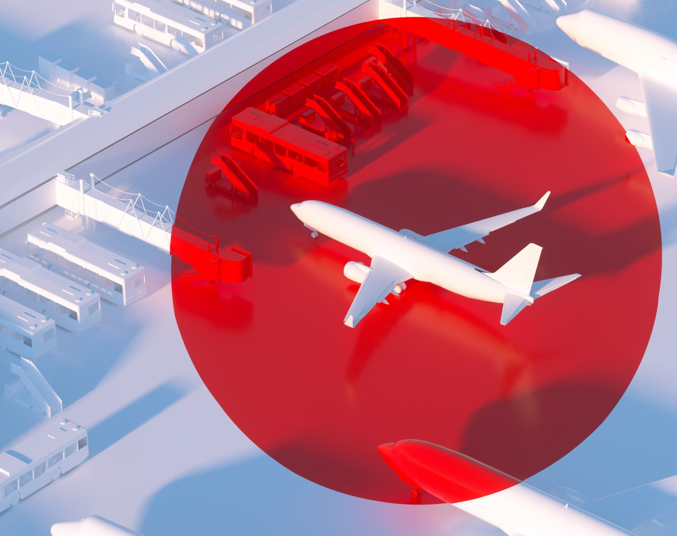
SKYTRAX AIRLINE REVIEW ANALYSIS
By: Ruth Omolara Ajagunna
October 2024

Slide 2
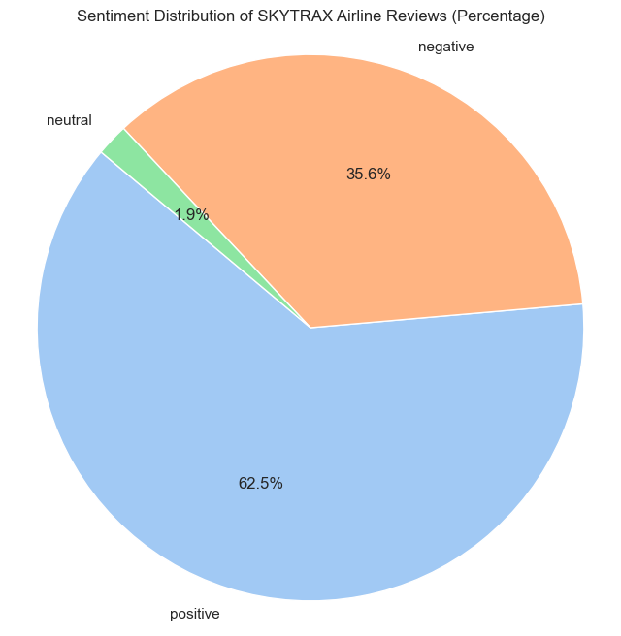
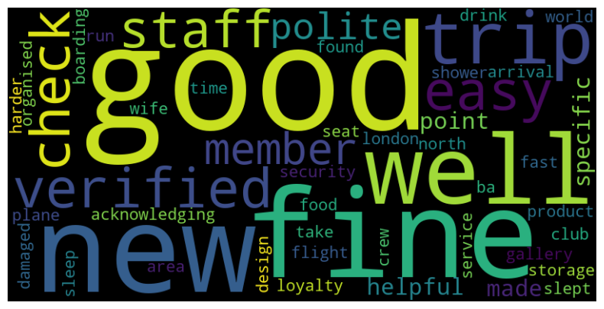
Results
Sentiment analysis indicates that 62.5% of the reviews were positive.
The main topics discussed in the reviews are product quality and customer service.
The most frequently used words in the reviews are 'good,' 'polite,' 'service,' and 'well.’
Out of 1000 reviews, 625 were positive, 356 were negative, and 19 were neutral.
This indicates that most reviews were either positive or negative, with very few neutral reviews.

