Slide 1
Design and Evaluation of a Secure Web-Based Access Control and Tamper-Evident Audit Logging Framework for Simulated Electronic Health Records
Msc Cyber Security Project - Presentation
Name: Ruth Sara Shajan
Banner ID: B01828711
Supervisor: Dr Raman Singh
Date: 21 August 2026

Slide 2
Research Problem, Aim and Objectives
Research Problem:
RBAC alone can grant overly broad access to EHR records, while mutable audit logs cannot reliably demonstrate that event history remains unchanged.
Research Question:
To what extent can a secure web-based access-control prototype enforce role-based permissions and maintain a tamper-evident audit history for simulated EHRs, and how do SHA-256 and ML-DSA compare in integrity, authenticity, processing time and storage overhead?
Aim:
Design, implement and evaluate a Flask/SQLite simulated EHR using fictional data, five-role access control, record-level authorisation and SHA-256 tamper-evident audit logging.
Objectives:
Enforce patient ownership and patient-clinician assignment checks.
Record and verify structured security events through a SHA-256 hash chain.
Test ten security scenarios and separately benchmark SHA-256 and ML-DSA-44 for processing time, storage and tamper detection.

Slide 3
Literature Review and Identified Gap
Access Control
RBAC simplifies permission management.
Clinical access also requires patient-specific relationships.
This supports combining roles with ownership and assignment checks.
Audit Integrity
Structured audit events supports accountability and investigation.
SHA-256 chaining can reveal inconsistent historical changes.
Hash chaining is tamper-evident, not immutable.
Post-Quantum Signatures
ML-DSA-44 provides and supports public key verifiable authenticity.
It introduces key-management requirements.
Greater processing and storage overhead is expected.
Identified Gap: The mechanisms are established individually, but there is limited applied integration and evaluation within a manageable simulated EHR prototype.
Key Sources:
Ferraiolo and Kuhn (1992)
Sandhu et al. (1996)
Schneier and Kelsey (1999)
Blobel (2004)
NIST (2015; 2024)

Slide 4
Main Project Contribution
Access and administration
Auditing and evaluation
Access Enforcement
Five Roles: administrator, patient, doctor, nurse and GP.
Server-side role, ownership and clinician-assignment checks.
Website Workflows
Create fictional patient and staff accounts.
Process GP registration and assign clinicians through the website.
Tamper-Evident Auditing
Structured recording of authorised and denied security events.
SHA-256 hash chaining with administrator verification.
Cryptographic Evaluation
Separate ten-run comparison of SHA-256 and ML-DSA-44.
Evaluated processing time, storage overhead and tamper detection.

Slide 5
Methodology: Prototype Development and Evaluation
Literature and Requirements
Defined the security problem, roles and evaluation criteria.
Cryptographic Evaluation
Compared SHA-256 and ML-DSA-44 using repeated timing, storage and tamper-detection tests.
System Design
Designed access rules, database relationships, workflows and audit chaining.
Iterative Implementation
Built and refined the prototype using Flask, SQLite, HTML and CSS.
Security Testing
Conducted ten manual scenarios covering authentication, authorisation, auditing and sessions.
The prototype was evaluated in a controlled local environment using only fictional patient data.
ML-DSA-44 was evaluated in a separate experiment, while live application used SHA-256 audit hash chain.

Slide 6
System Architecture and Design
USERS AND ROLES
Administrator, Patient, Doctor, Nurse & GP
FLASK WEB APPLICATION
Login dashboards,
Patient records & Administrative workflows
SERVER-SIDE SECURITY
Session authentication, Role checks, Patient ownership & Clinician assignment
SQLITE DATA LAYER
Users, Patients, Assignments
& Audit logs
SEPARATE ML-DSA-44 EXPERIMENT
Key generation, signing, verification
Timing, storage, changed-data detection
Not integrated into each live audit entry
LIVE TAMPER-EVIDENT AUDIT FLOW
Security event → structured entry → SHA-256 hash chain → administrator verification
Entries record the actor, action, target, outcome and details.

Slide 7
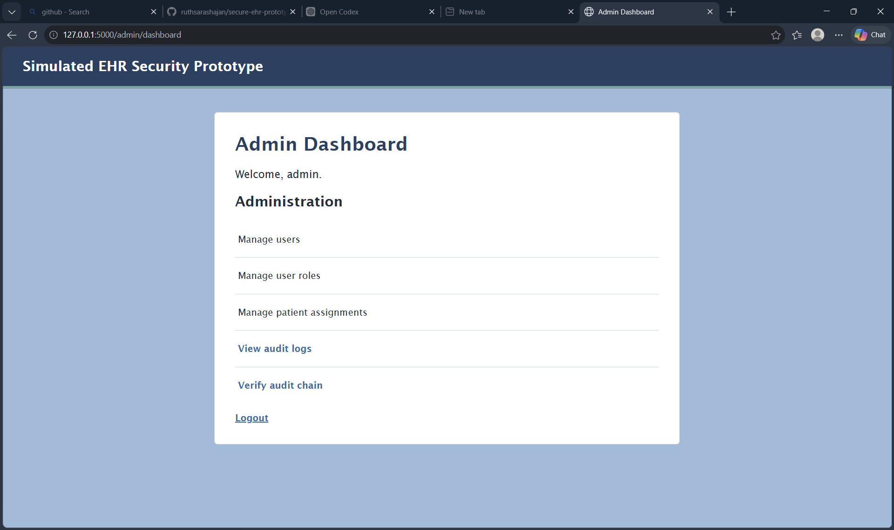
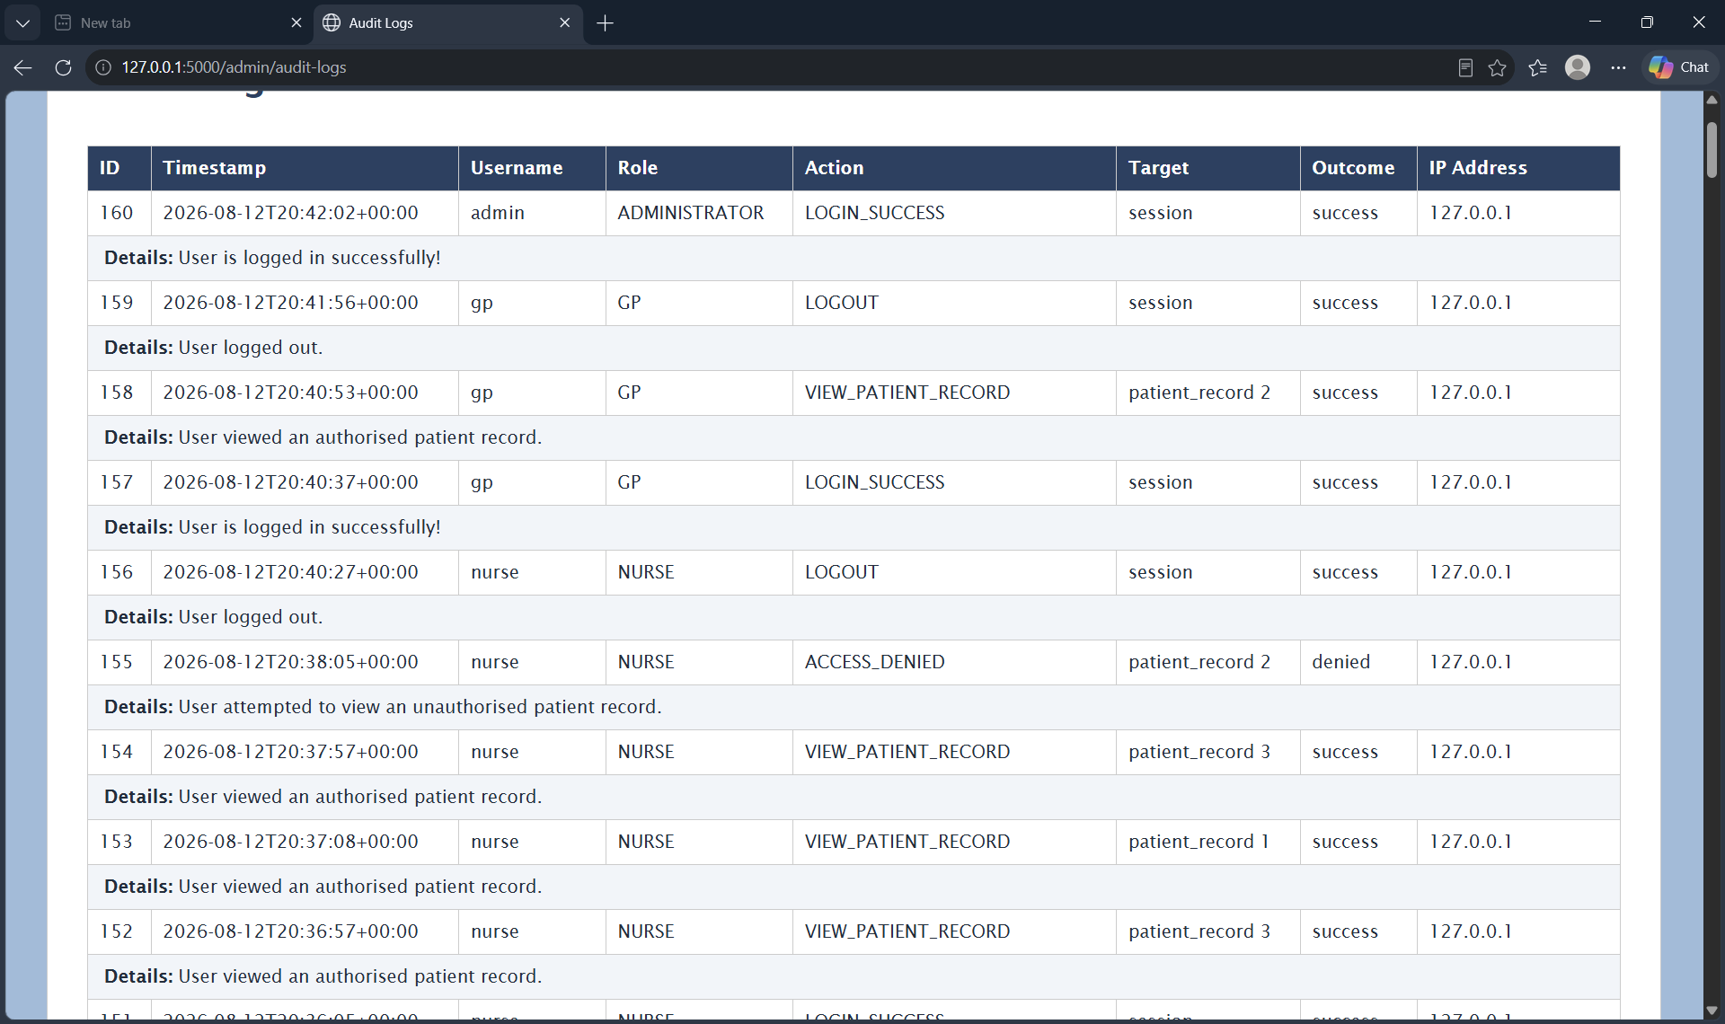
Prototype Implementation
Core Security Controls
Password hashing and session-based authentication.
Five-role server-side access control.
Patient ownership and clinician-assignment checks.
Authorised and denied actions recorded in the audit log.
Website Workflows
Create fictional patients and staff accounts.
Process GP registration requests.
Assign doctors, nurses and GPs.
Verify the SHA-256 audit chain.
Administrator dashboard and security-management functions
Structured audit log recording authorised and denied events

Slide 8
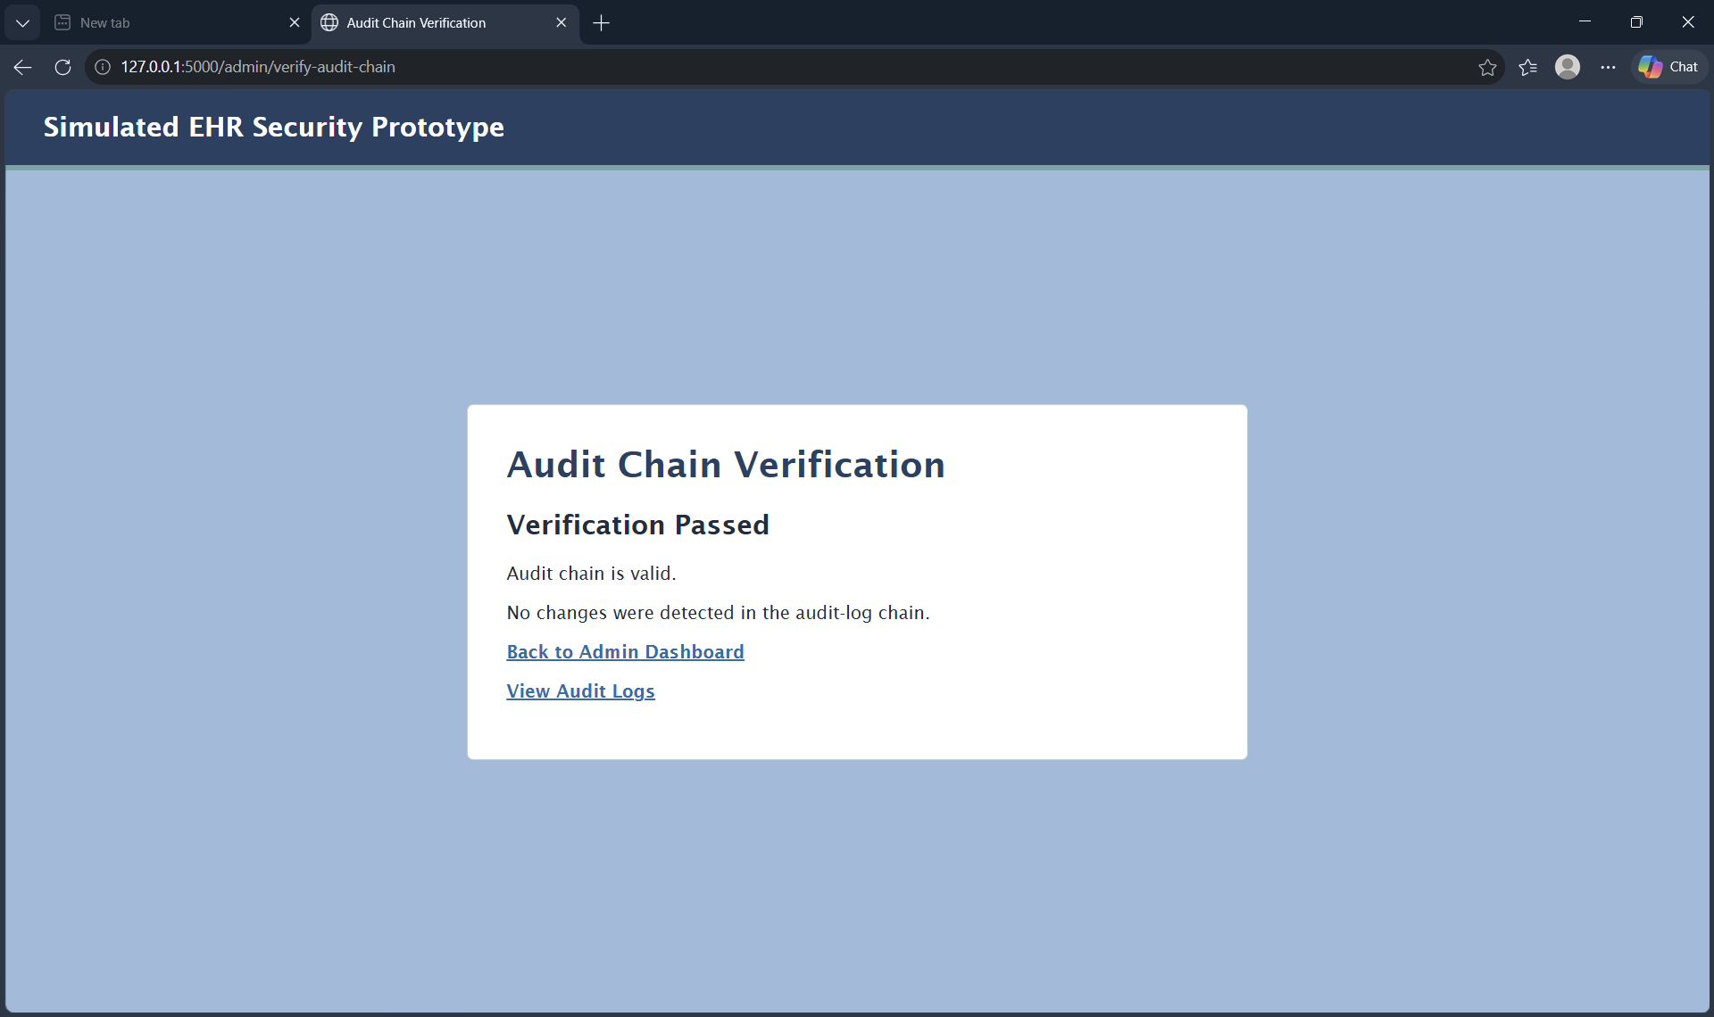
Testing and Evaluation
Manual Security Testing
Ten scenarios across all five roles.
Invalid login and direct-URL attempts.
Ownership and assignment enforcement.
Audit logging, chain verification and logout protection.
Cryptographic Evaluation
Successful verification of the live SHA-256 audit chain
10 saved runs; 30 internal tests each.
SHA-256 hashing compared with ML-DSA-44 key generation, signing and verification.
Time, storage and changed-data detection were measured.
ML-DSA-44 remained separate from the live audit chain.
Test Outcomes
10/10 manual security tests passed.
Live audit chain: 'Verification Passed’.
Both techniques detected changed data in 10/10 saved runs.

Slide 9
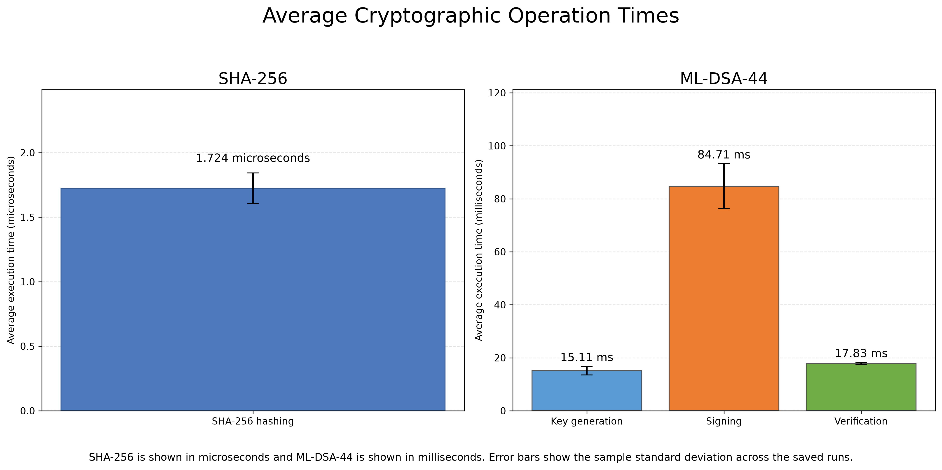
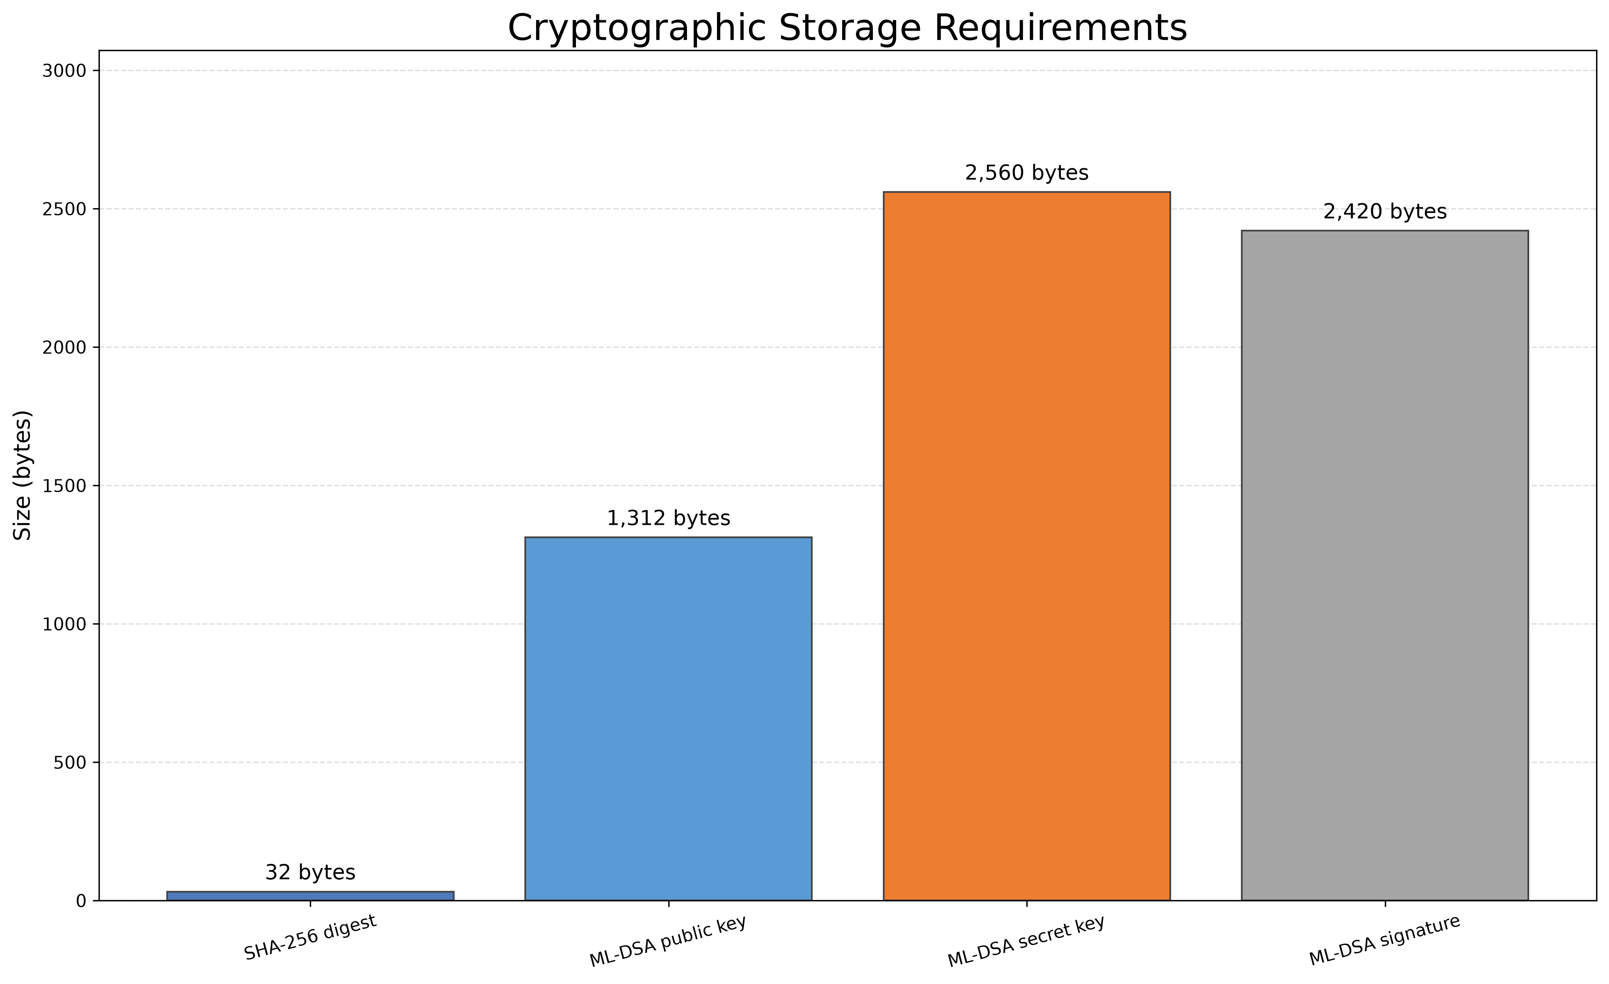
Results and Critical Discussion
Average SHA-256 and ML-DSA-44 operation times
SHA-256 digest and ML-DSA-44 key and signature sizes
Critical Interpretation
• SHA-256 averaged 1.724 microseconds and produced a 32-byte digest, supporting efficient live audit chaining.
• ML-DSA-44 signing was slowest at 84.711 ms; its keys and signatures introduced substantially greater overhead.
• Both detected changed data in 10/10 saved runs, but ML-DSA adds post-quantum authenticity: the mechanisms are complementary, not interchangeable.

Slide 10
Conclusion and Future Work
Conclusion
• Five-role access control, patient ownership and clinician-assignment checks enforced patient-specific access.
• Structured audit logging and SHA-256 chaining enabled historical changes to be detected.
• All ten manual tests passed, and both techniques detected changed data in all ten saved runs.
Limitations
• The system remained a local SQLite prototype using fictional data, a limited test population and no professional penetration testing.
• ML-DSA-44 remained a separate experiment and was not integrated into the live audit entries.
Future Work
• Add automated and adversarial testing, CSRF protection, MFA, TLS, rate limiting and stronger deployment controls.
• Introduce secure key management and evaluate ML-DSA signatures at selected audit checkpoints.

Slide 11
THANK YOU

