Slide 1
Novel approach for detection of Epileptic seizure using Deep Learning
Notes:
Find limitation of one of the papers using LSTM and say that lstm+svm might bridge the gap

Slide 2
ABSTRACT
Epilepsy is the third most common brain disorder which affects the nerve cell activity in the brain causing seizures.
Leads to social isolation of individuals and economic difficulties
Treatment can help, but this condition cannot be cured.
Early prediction is useful because the attack can be avoided by the drug.
Visual inspection of EEG is a time-consuming and laborious process
Notes:
if random_state = Integer : Will produce the same results across different calls

Slide 3
CONTENTS
Project Requirements
Literature survey
Block diagram
Dataset
Preprocessing
Data imbalance
Channel Selection
LSTM
How we arrived at LSTM+SVM
Other Classification Models
K-fold Cross Validation
Results
Documentation
References
Lessons learnt
Notes:
Channel wise
Patients
Add literature survey

Slide 4
PROJECT REQUIREMENTS
DEPENDENCIES
Language: Python 3.7 (100%)
Libraries: NumPy, TensorFlow, Keras, scikit, Pyeeg, Pandas, Mlib,Seaborn, Sklearn, SciPy, MNE
Hardware Requirements: OS-Windows or MacOS. Min RAM of 4 GB. Min of 32 GB hard drive space
CONSTRAINTS
Hardware limitations resulted in gaps between consecutively-numbered .edf files,
Insufficiency in data collection for large scale implementation.
Memory insufficiency in the product with large number of subjects.
ASSUMPTIONS
Only the CHB-MIT dataset considered for analysis which focuses on seizures in children.

Slide 5
LITERATURE SURVEY
1). Tofiq, Sirwan & Mohammadi, Mokhtar. (2019). Epileptic Seizure Detection using Deep Learning Approach. UHD Journal of Science and Technology
Abstract: The paper talks about a deep learning approach for epileptic seizure detection using LSTM, the authors have worked on the pre - processing of the data using techniques like filtration and normalization. There model used the Freiburg dataset.
Takeaway: This paper gave insights about the various noises possible in a eeg signal and
gave the range of the frequencies to consider while working on eeg signals for epilepsy.

Slide 6
2). Alotaiby, T., El-Samie, F.E.A., Alshebeili, S.A. et al. A review of channel selection algorithms for EEG signal processing. EURASIP J. Adv. Signal Process. 2015, 66 (2015). https://doi.org/10.1186/s13634-015-0251-9
Abstract: They talked about the popular 10-20 system by which the EEG data is collected.
They survey the developments in the field of EEG channel selection methods and explained the importance of selecting channels and doing channel specific analysis.
Takeaway: Doing analysis using single channels reduces the computational power required
and usage of selected channels reduces the problem of overfitting.

Slide 7
3) Y. Liu et al., "Deep C-LSTM Neural Network for Epileptic Seizure and Tumor Detection Using High-Dimension EEG Signals," in IEEE Access, vol. 8, pp. 37495-37504, 2020, doi: 10.1109/ACCESS.2020.2976156.
Abstract: They proposed a deep C-LSTM model that includes a DCNN module as well as LSTM networks.
DCNN structure captures characteristics from raw EEG data.Two comparable convolutional modules with varying parameters are constructed in the DCNN model. Both have a convolutional layer, as well as BN and ReLU functions. their suggested deep C-LSTM model have the highest average accuracy , but it also has the lowest standard deviation.
Takeaway: they had showed that lstm network are better when compared to the classic
ML models when comes to automatic feature extraction and multiclassification problem.

Slide 8
4). Forrest Sheng Bao, Xin Liu, Christina Zhang, "PyEEG: An Open Source Python Module for EEG/MEG Feature Extraction", Computational Intelligence and Neuroscience, vol. 2011
Abstract: This paper talks about an open source Python module for extracting EEG features that has the potential to save much time for computational neuroscientists. Pyeeg had two sets of functions- pre processing functions and feature extraction functions.
Takeaway: we learnt about the possible list of features that can be extracted and that can be used to analyse the eeg signals
Notes:
PyEEG is a Python module that focuses only on extracting features from EEG/MEG segments. There[1]fore, it does not contain functions to import data of various formats or export features to a classifier
Users can easily hook PyEEG up with various existing open source software to build toolchains for their EEG/MEG research. PyEEG consists of two sets of functions. (1) Preprocessing functions, which do not return any feature values)
Feature extraction functions, that return feature val[1]ues.
PyEEG does not define any new data structure, but instead uses only standard Python and NumPy data structures.
The inputs of all functions are a time sequence as a list of floating-point numbers and a set of optional feature extraction parameters. Parameters have default values. The output of a feature extraction function is a floating-point number if the feature is a scalar or a list of floating-point numbers (a vector) otherwise

Slide 9
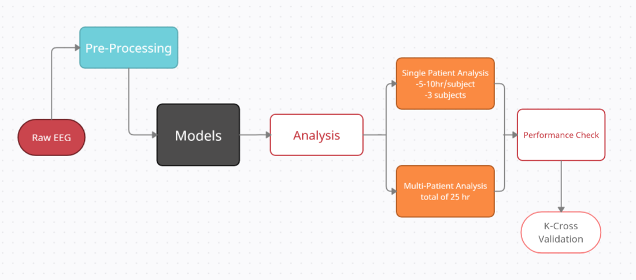
METHODOLOGY
Fig : Flowchart of the proposed system
Notes:
The process involves the collection of raw eeg data in edf format which has frequency sample of 256hz taken from the chb- mit dataset.
Following that we will be doing pre processing, which involves the usage of bandpass filter to remove noise. This is done by setting the frequency range with lower limit of 0.25hz and higher limit as 25hz , during the pre- processing the edf format of data are converted into the csv format for each of the patients which in our case includes 5 patients as available in the chb- mit dataset.
The pre- processed data based on our project then undergoes processing in 3 different models that are LSTM+Svm, LSTM and SVM
Following the predictive analysis with 3 different models the output then obtained will be used for doing single patient analysis ( taking 3 subjects with 25-35hr/subject ) and multiple patient analysis (35hrs of eeg ).
The results obtained will be used for performance check and comparitive analysis between models.
The final part involves cross validation to verify the results and accuracy of our model(i.e. LSTM + SVM ) using k-fold cross validation which allows us to test our model on a limited data segment to gauge how it works normally without the training set.
This approach involves randomly dividing the set of observations into k groups, or folds, of approximately equal size. The first fold is treated as a validation set, and the method is fit on the remaining k − 1 folds.
If k=5 the dataset will be divided into 5 equal parts and the process will run 5 times, each time with a different holdout set.

Slide 10
DATASET
CHB MIT - DATASET
This database, collected at the Children’s Hospital Boston, consists of EEG recordings from subjects with intractable seizures and was taken from Physionet.org
Consists of 969 Hours of scalp EEG recordings with 173 seizures.
Recordings, grouped into 23 cases, were collected from 22 subjects (5 males, ages 3–22; and 17 females, ages 1.5–19)
Each case (chb01, chb02, etc.) contains between 9 and 42 continuous .edf files from a single subject
The diversity of patients (Male, Female, 1-22 years old)
Notes:
Subjects were monitored for up to several days following withdrawal of anti-seizure medication in order to characterize their seizures and assess their candidacy for surgical intervention.
different types of seizures contained in the datasets are ideal for assessing the performance of automatic seizure detection methods in realistic settings.

Slide 11
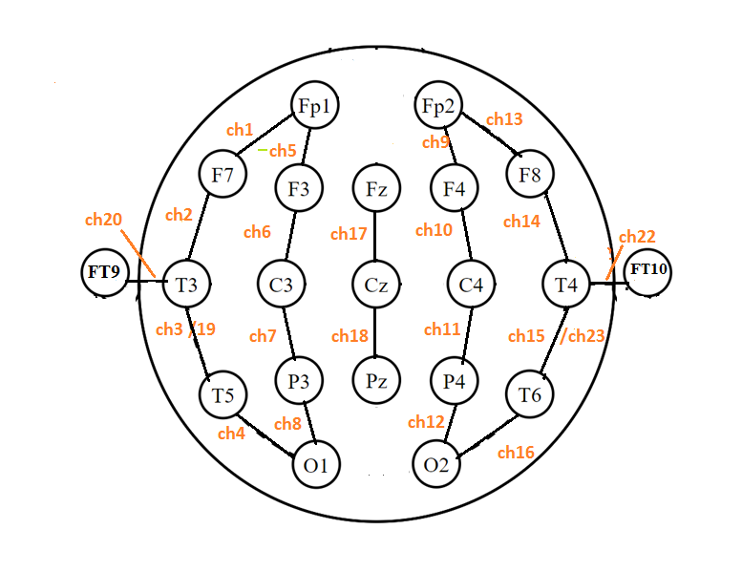
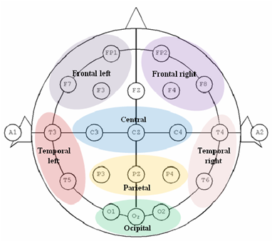
10-20 SYSTEM OF ELECTRODE PLACEMENT
Fig . Placement of electrodes along with channels
Fig. Electrodes placement marked with the regions[17]
Notes:
F- Frontal
T- temporal
P - posterior
O- ocipital
Note : Frontal lobe seizures are a common form of epilepsy, a neurological disorder in which clusters of brain cells send abnormal signals and cause seizures.
The 10–20 system or International 10–20 system is an internationally recognized method to describe and apply the location of scalp electrodes in the context of an EEG exam, polysomnograph sleep study, or voluntary lab research. This method was developed to maintain standardized testing methods ensuring that a subject's study outcomes (clinical or research) could be compiled, reproduced, and effectively analyzed and compared using the scientific method. The system is based on the relationship between the location of an electrode and the underlying area of the brain, specifically the cerebral cortex.
The "10" and "20" refer to the fact that the actual distances between adjacent electrodes are either 10% or 20% of the total front–back or right–left distance of the skull.
The following shows the 10-20 electrode placements of the chb mit dataset where the nomenclature is used to identify the 21 electrodes which have been used to depict the 23 channels in the dataset. All of which have been sampled at 256hz.
When recording a more detailed EEG with more electrodes, extra electrodes are added using the 10% division, which fills in intermediate sites halfway between those of the existing 10–20 system. This new electrode-naming-system is more complicated giving rise to the Modified Combinatorial Nomenclature (MCN). This MCN system uses 1, 3, 5, 7, 9 for the left hemisphere which represents 10%, 20%, 30%, 40%, 50% of the inion-to-nasion distance respectively.

Slide 12
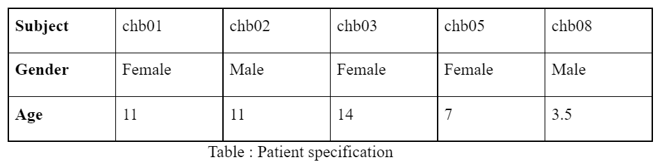
DATASET CREATION
Owing to the current computation capacity, the data of five patients has been considered for our analysis.
Single and Multi patient data were created for our project by selecting the edf files having seizures.
Each of the single patient files has 3-5 hrs of eeg data and the multi patient data all combined together is about 25 hrs.
Analysis on each of these dataset architecture are done separately.
Notes:
sampling rate of 256 samples per second for all the signals with a 16 bit resolution, most of them contain 23 EEG signals
Dataset contains a list of 664 .edf files
The file RECORDS-WITH-SEIZURES lists 129 of those files that contain one or more seizures.
In total, there were 198 seizures.
Beginning and end of each seizure is annotated.

Slide 13
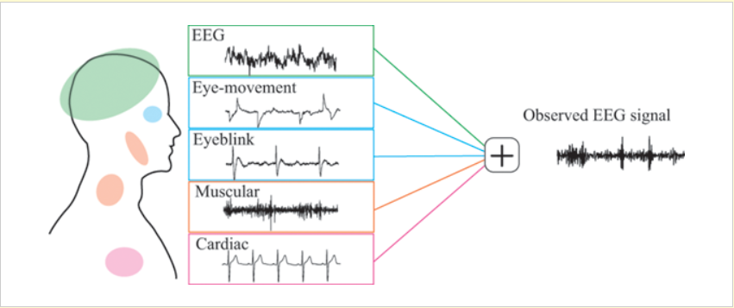
Artefacts in EEG Signals
Unwanted noise in an EEG recording.
Physiological artifacts: Generated due to disturbances caused by subject’s body

Slide 14
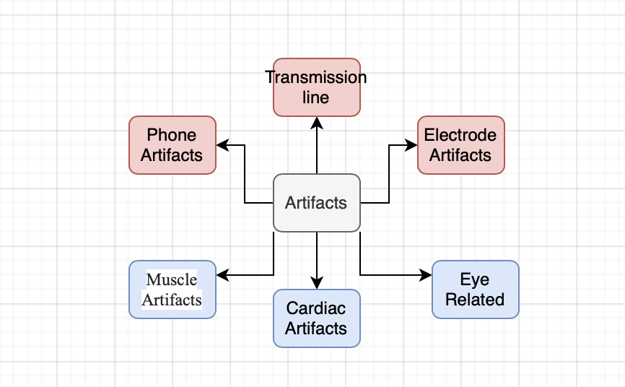
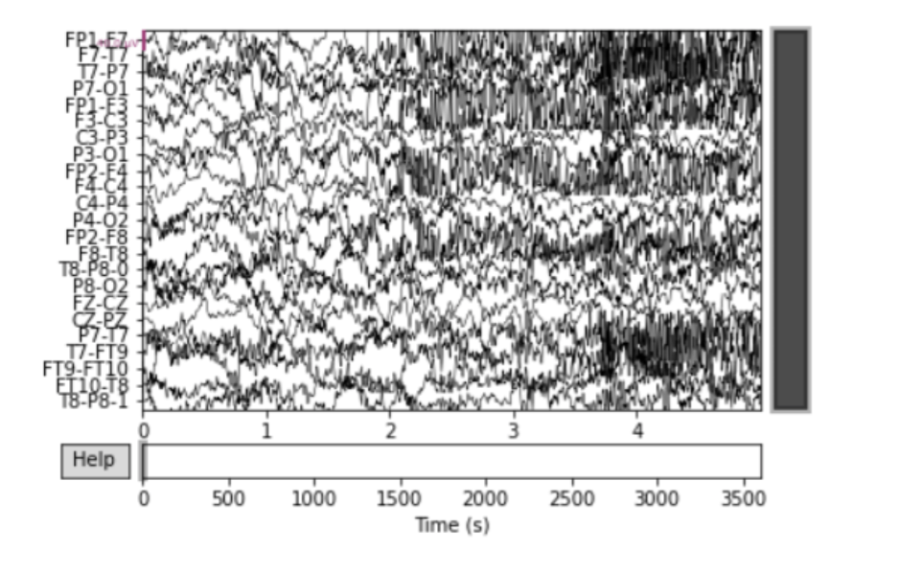
PRE PROCESSING
Noise Removal:
EEG signals have Physiological and External artefacts leading to distortion of the signal.
Unwanted noises are removed by filtering techniques
25Hz Low Pass filter and 0.25 Hz high pass filter used( Python Package: MNE) to remove high and low frequency artefacts respectively.
Filtering done for 1 hour long edf files in iterations of 10 second epochs.
Fig: Distortion of EEG signal due to noise [16]
Fig: Physiological(blue) and external(red) artifacts
Fig: Raw EEG signal

Slide 15
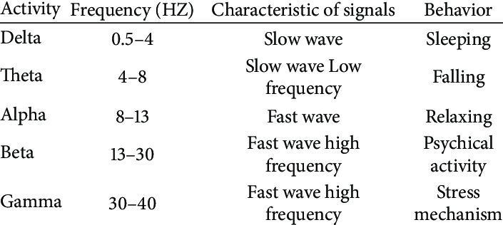
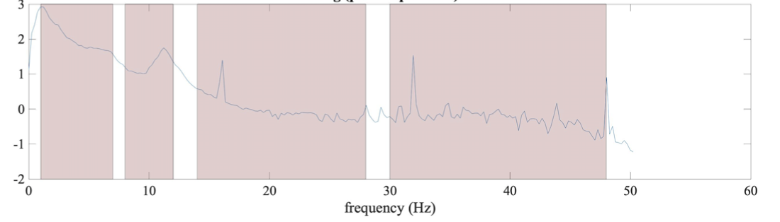
PRE PROCESSING
Feature identification:
Identification of germane features boosts accuracy of model under consideration
feature extraction over the EEG signal for BCI systems is very important for optimal classification performances.
PyEEG library used to extract features.
Removal of highly correlated features (corr>0.9) to prevent overfitting.
Extraction of time and frequency domain features
fig:Sub-bands in frequency spectrum
fig:Sub-bands in frequency spectrum

Slide 16

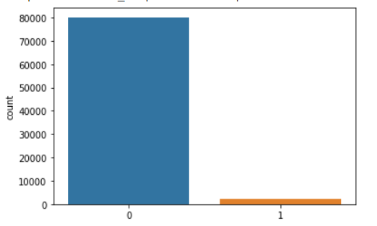
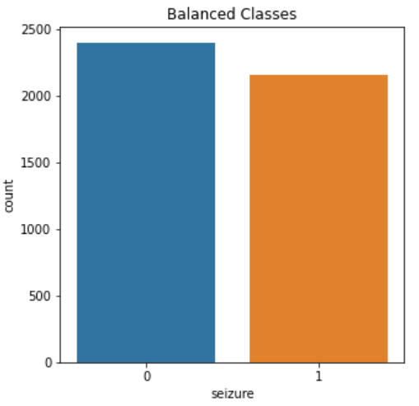
PRE PROCESSING (contd)
Highly imbalanced dataset.
Seizure class forming 1% of the dataset
Overfitting
Poor performance despite good accuracy.
Multidimensional dataset consisting of 15 features tackled using undersampling of non seizure class
Unbalanced Classes
Fig : Before Undersampling the dataset
Fig : After Undersampling the dataset.
Fig : Features selected

Slide 17
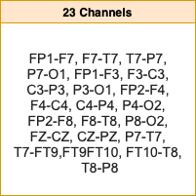
CHANNEL SELECTION
Increase in number of channels leads to increase in computational complexity.
Research shows that majority of seizures occur at frontal and Temporal lobes
Accuracy for multichannel analysis was 59%
Analysis performed on all 23 channels individually.
Running separately on one of the channels we observed stable results with channel named P7-T7

Slide 18
LSTM MODEL IMPLEMENTATION
Following pre - processing, We tested our model against traditional Long Short-Term Memory (LSTM) neural network.
The LSTM network is a subclass of Recurrent Neural Networks (RNNs) which solves the “vanishing gradient” problem.
The network receives its input through a sequence input layer, and following the LSTM layer, there is a fully connected layer and an output layer that performs the softmax operation, completing the network's classification design.
Training and testing were done using 70-30 split.
The model consists of 3 layers with the input layer using a relu activation function and same is used by the one hidden layer , the last layer uses “softmax” activation function.
The model is fitted and run for 200 epochs to get the accuracy value of 91.6

Slide 19
LSTM+SVM MODEL IMPLEMENTATION
Deep learning using neural networks have claimed state-of-the-art performances in a wide range of tasks. Mostly, the softmax activation function is used for classification.
Support vector machine is an widely used alternative to softmax for classification
We arrive at our current DLSVM architecture
The LSTM layers consists of 2 layers with the input layer using a relu activation function and same is used by the following hidden layer
The softmax layer is replaced by the SVM layer utilizing kernel regularizer “l2”. Loss is calculated using hinge loss to incorporate the SVM.
Training and testing were done using 70-30 split.
The model is fitted with a batch size of 5 and is run for 50 epochs.
Switching from softmax to SVMs appear to be useful for classification tasks.

Slide 20
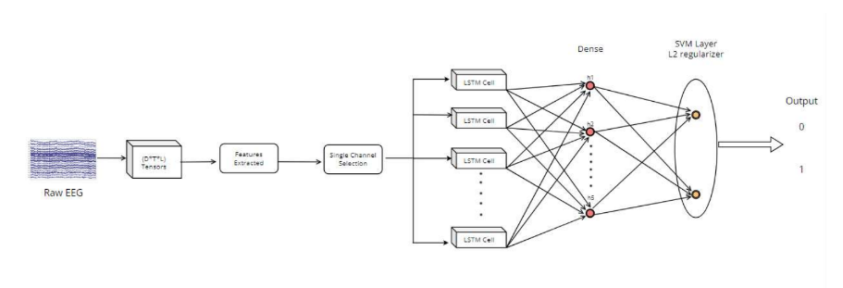

Slide 21
OTHER ML CLASSIFIERS
We use various models to tabulate results of epileptic seizure detection:
SVM
Kernel - RBF
80-20 splitting for training and testing
Class weight attribute is set to balanced for handling the dataset.
Model is used for single and multi - patient analysis.
Random Forest Classifiers
Handling the unbalanced set using class attribute.
In general a combination of decision trees
80-20 splitting done
Model is used for single and multi - patient analysis.

Slide 22
KNN - K nearest Neighbour
Basic level of modeling
K value is set as 2
80-20 splitting for training and testing purposes.
As the value of K grows, the computational complexity increases
Features with zero variance are removed.
ADABOOST CLASSIFIER
Default values were considered.
In general in each iteration in it selects a feature set.
80-20 splitting
Zero variance features were removed
Both data set architecture were used for analysis.

Slide 23
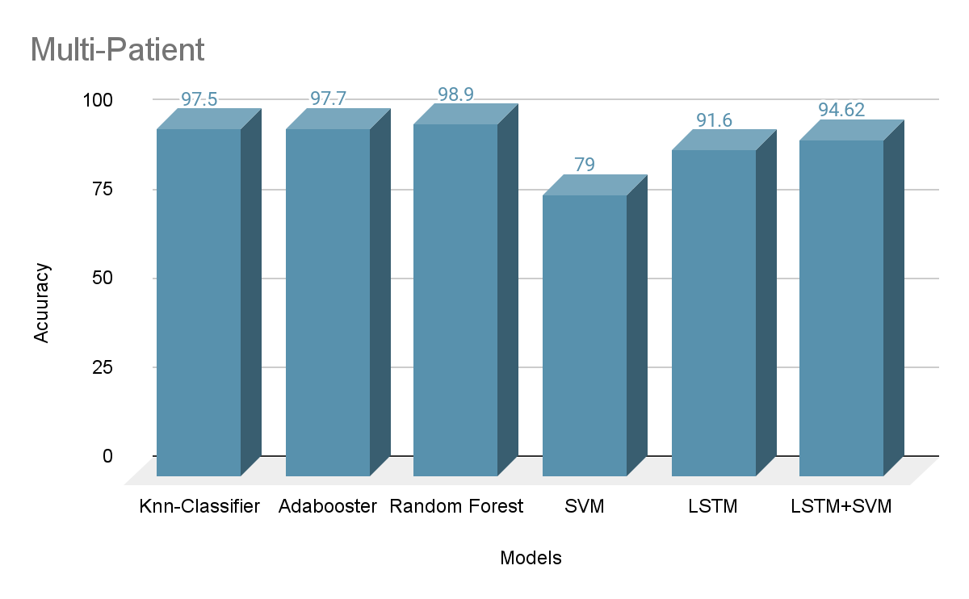
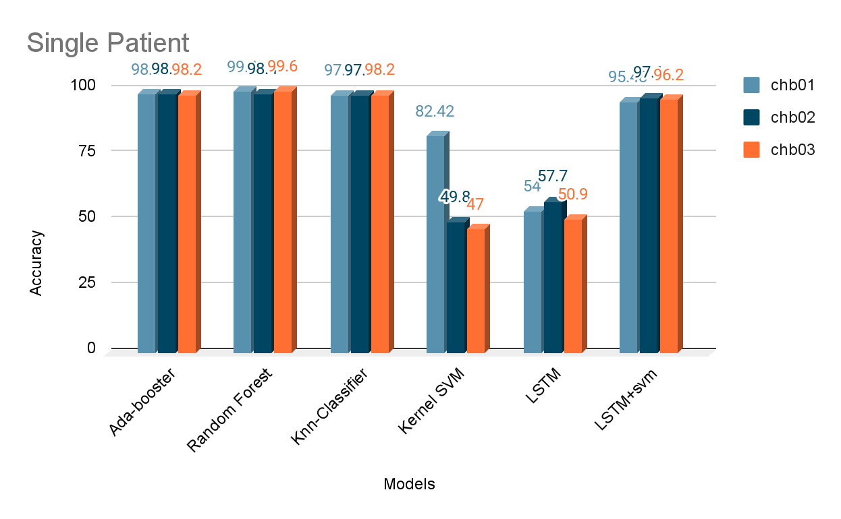
RESULTS
Consideration of factors like precision, recall, f1 score.
Performance of single patient analysis for chb01,chb02,chb03
Multi Patient analysis for chb01,chb02,chb03,chbo5 and chb08
Comparison of Accuracies Adaboost, Random Forest, KNN, Kernel SVM, LSTM, LSTM+SVM

Slide 24
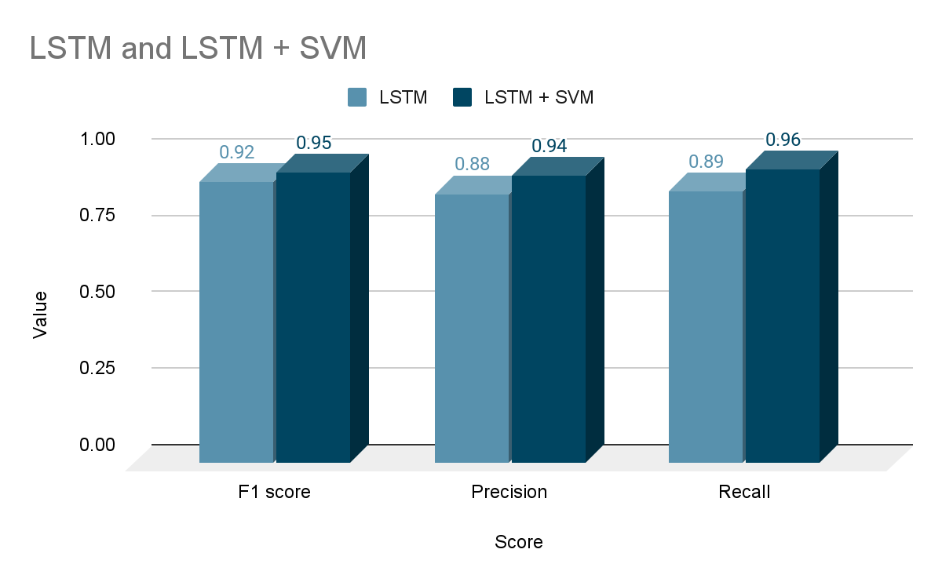
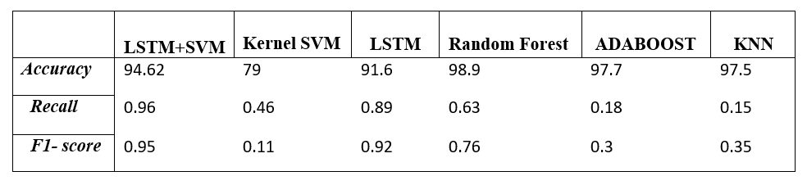
Found out Recall and f1 scores for multi patient data
Table :Multi patient analysis
fig:Scores for Multi patient analysis

Slide 25
K-FOLD CROSS VALIDATION
The training data is separated into subgroups without being repeated in this method.
This process is repeated 5 times and obtain 5 accuracy scores.
It helped us in reducing the overfitting problem.
 | Iteration 1 | Iteration 2 | Iteration 3 | Iteration 4 | Iteration 5 | Mean
LSTM+SVM (multi-patient) | 91.6 | 93.31 | 94.07 | 94.07 | 94.6 | 93.53
LSTM+SVM (chb03) | 94.8 | 98.5 | 96.7 | 98.1 | 99.5 | 97.52
Table: K-Fold Iteration Results

Slide 26
CONCLUSION
By doing an extensive literature survey we tried to find a way so that we can combine both the functionalities of LSTM and SVM to use it for seizure detection purposes.
Our developed model architecture was able to perform well for both set of data architecture i.e, single patient and multi patient datasets.
Our model LSTM+SVM is more suitable for brain seizure prediction using time series data and that it outperforms all the other models compared with in terms of accuracy, specificity and sensitivity.

Slide 27
Random forest
This is a Machine learning algorithm which is a combination of decision trees.
For the model parallelization is high which improves the efficiency operationally
good with high dimensional data and is fast. This is suitable for high dimension data .
Higher levels of accuracy are obtained only when hyperparameters are optimized. A large number of hyperparameters are generated by the algorithm during training and it may be difficult to determine optimal hyperparameters even when tried by well experienced coders while manually debugging.
In our model, The min_sample_split attribute is also used in the model to set the minimum number of samples that must be present in our data for a split to occur

Slide 28
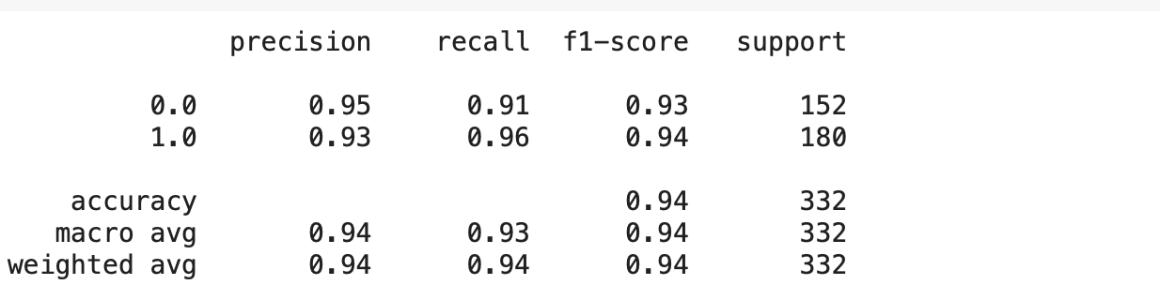
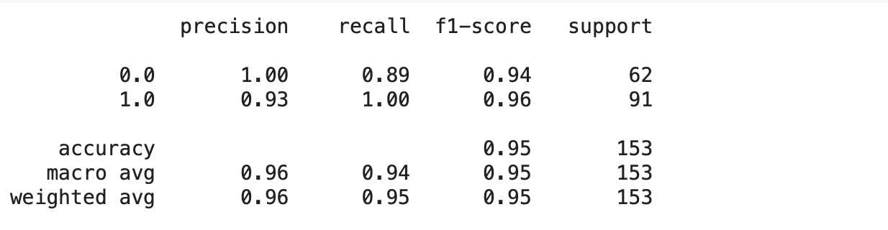
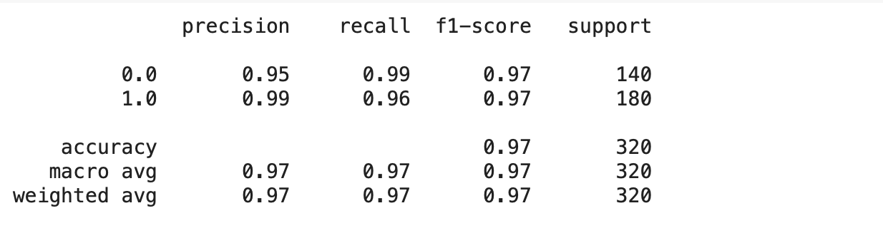
chb_01
chb_02
chb_03

Slide 29
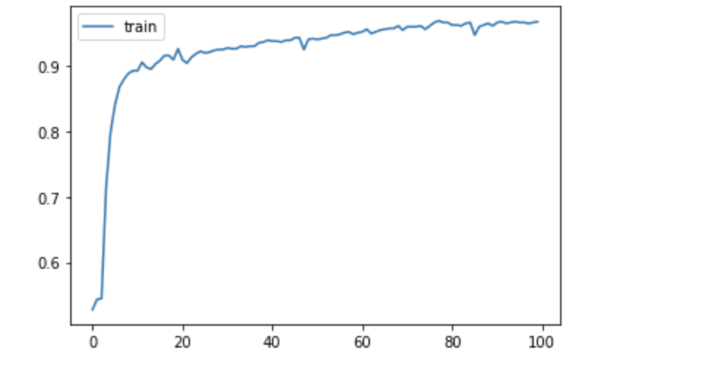
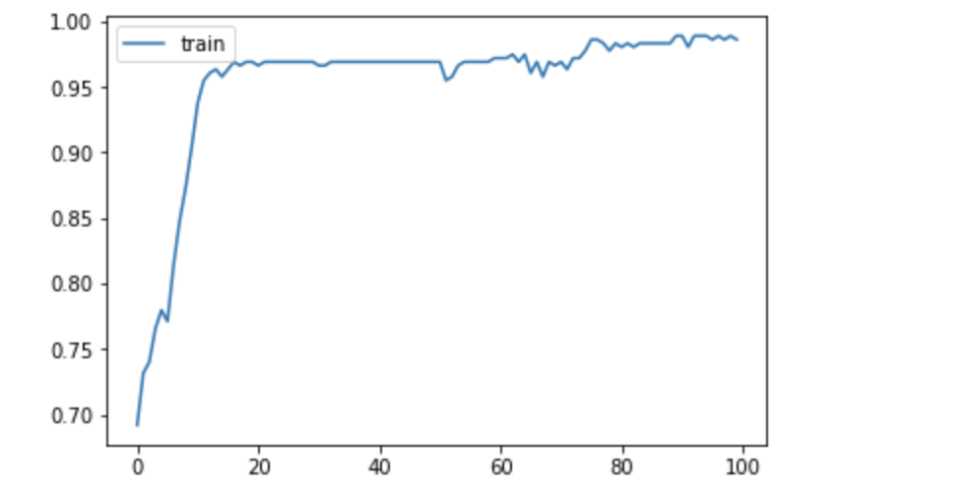
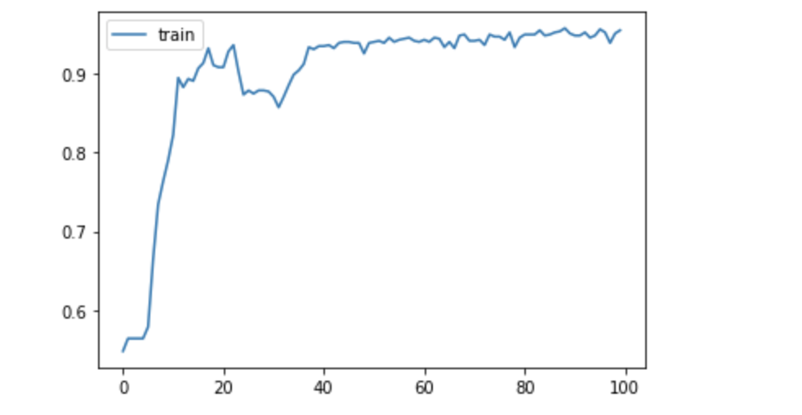
chb_01
chb_02
chb_03

Slide 30


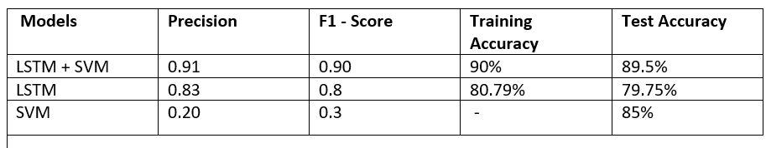
Model Comparison

Slide 31
Time Domain Features - RMS, variance, skewness, kurtosis,
Frequency Domain Features - Power_1hz, Power_5hz, Power_10Hz, Power_15Hz, Power_20Hz
From the epoch level dataset obtained from EEG preprocessing, we remove the features with zero variance and features that are highly correlated with each other. Since feature values have a wide range of negatives and positives, we apply feature normalization.
EEG PREPROCESSING
The raw eeg data is recorded in one-hour long edf files.
We apply a 25 Hz low pass filter and 0.25 Hz high-pass filter on raw data to remove the noise of brain signals, since it has been shown that most seizure and non-seizure signals fall in this range.
Division of epochs is chosen as a sequence of 10 seconds. Each epoch is a unit increment of the previous epoch.

Slide 32
Patient Specific Analysis
We have performed patient specific analysis for 3 patients, chb_01, chb_02,chb_03.
We did this by choosing channel P7-T7
Trained and Tested the model

