Slide 1
Spam message detection BY: RUTHVIK.N (15MIS1096)
Under the Guidance
Dr.S.Graceline Jasmine

Slide 2
Problem Description/ Problem Statements:
Monitoring and preserving spam message has become one of the most essential activities in many ISP‘s today.
Unwanted emails irritating internet connection
Critical email message are missed and delayed
Spam can crash main servers and fill up hard derives

Slide 3
Objective:
The goal is to develop a machine learning model for real-time spam message forecasting, to potentially replace the updatable supervised machine learning classification models by predicting results in the form of best accuracy by comparing supervised algorithm.
The objective of identification of spam e-mails are:
To give knowledge to the user about the fake e-mails and relevant e-mails
To classify that mail is spam or not

Slide 4
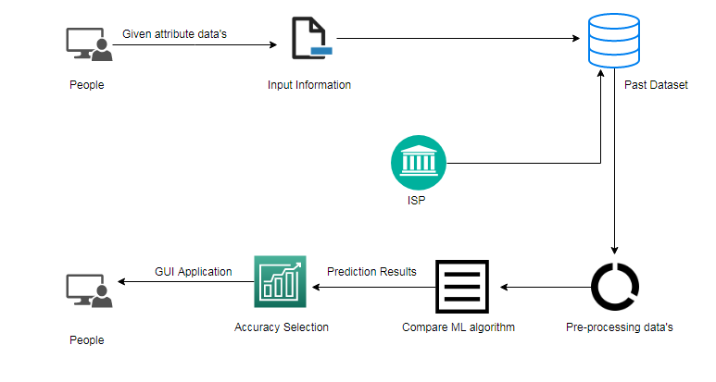
Business diagram/System Architecture

Slide 5
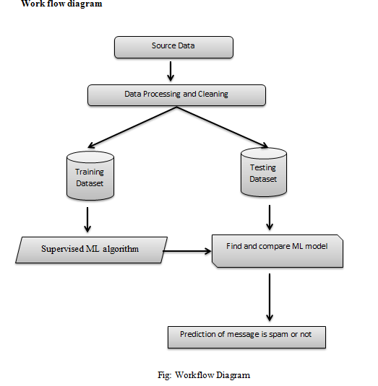

Slide 6
Modules implementation:
Preparing the Dataset
The dataset is now supplied to machine learning model based on this data set the model is trained. In the first step of accumulating information, data from previously patients datasets from online sources are gathered . These datasets are merged to form a common dataset, on which analysis will be done.

Slide 7
Training the Dataset
The first line imports iris data set which is already predefined in sklearn module and raw data set is basically a table which contains information about various varieties.
For example, to import any algorithm and train_test_split class from sklearn and numpy module for use in this program.
To encapsulate load_data() method in data_dataset variable. Further divide the dataset into training data and test data using train_test_split method. The X prefix in variable denotes the feature values and y prefix denotes target values.
In the next line, we fit our training data into this algorithm so that computer can get trained using this data. Now the training part is complete.
.

Slide 8
Testing the Dataset
Now, the dimensions of new features in a numpy array called ‘n’ and we want to predict the species of this features and to do using the predict method which takes this array as input and spits out predicted target value as output.
So, the predicted target value comes out to be 0. Finally to find the test score which is the ratio of no. of predictions found correct and total predictions made and finding accuracy score method which basically compares the actual values of the test set with the predicted values

Slide 9
Results and discussion:
Comparison of accuracy calculations using machine learning algorithm:
Parameters | LR | DT | RF | SVC | NB | KNN
Precision | 0.87 | 0.95 | 0.95 | 0.89 | 0.87 | 0.93
Recall | 1 | 0.95 | 0.95 | 1 | 1 | 0.97
F1-Score | 0.93 | 0.95 | 0.95 | 0.94 | 0.93 | 0.95
Sensitivity | 1 | 0.94 | 0.95 | 0.99 | 1 | 0.97
Specificity | 0 | 0.66 | 0.64 | 0.18 | 0 | 0.51
Accuracy (%) | 86.60 | 90.84 | 90.90 | 89.05 | 86.60 | 91.02

Slide 10
Accuracy Comparison of proposed work:
Performance of Spam classifier parameters:
Parameters | LR | DT | RF | SVM | NB | KNN | SC (TF-IDF) | SC (BOW)
Accuracy (%) | 86.60 | 90.84 | 90.90 | 89.05 | 86.60 | 91.02 | 94.91 | 92.73
Parameters | SC (TF-IDF) | SC (BOW)
Precision | 0.89 | 0.87
Recall | 0.72 | 0.57
F1-Score | 0.80 | 0.69
Accuracy (%) | 94.91 | 92.73

Slide 11
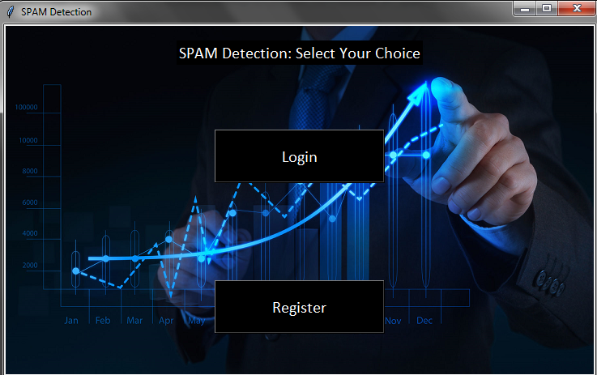
INPUT:
Select your choice process:

Slide 12
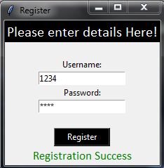
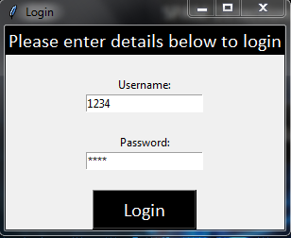

Registration process Login process
Login success:

Slide 13
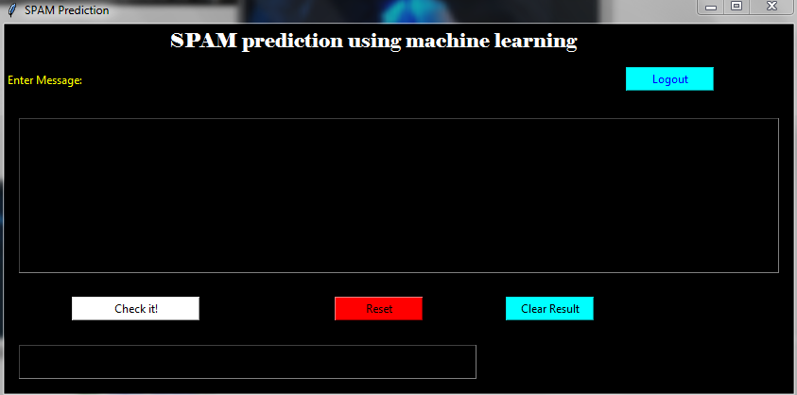
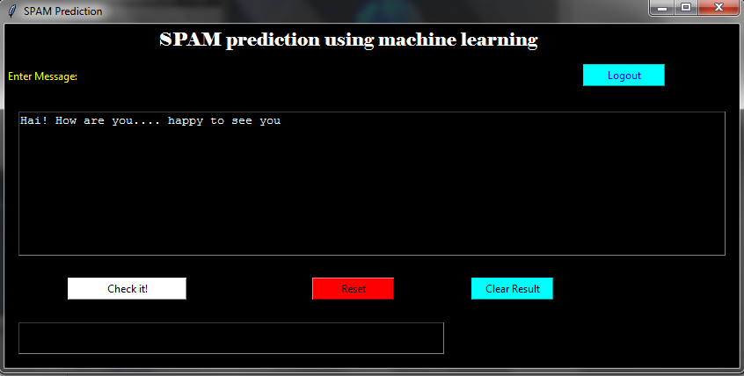
GUI prediction window:

Slide 14
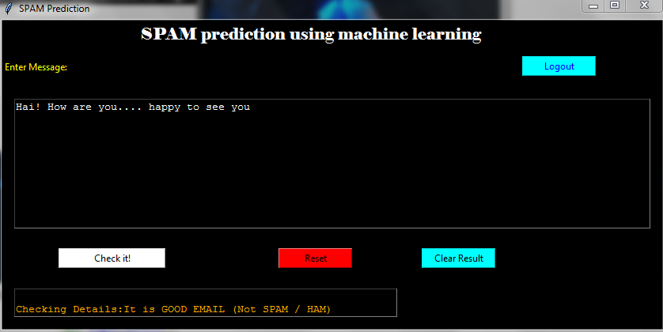
OUTPUT:
Spam or ham prediction process:

Slide 15
Conclusion
The analytical process started from data cleaning and processing, missing value, exploratory analysis and finally model building and evaluation. Find and compare the accuracy of each algorithm which is helpful for future perdition and the highest accuracy result is Spam classifier of TF-IDF method classifier (94.91%). additionally, calculate classification report and confusion matrix on public test set of given attributes by supervised machine learning algorithm method.
Future Work
ISP wants to automate the detecting the message as spam or not by given attributes from eligibility process (real time).
To automate this process by show the prediction result in web application or desktop application in future.
To optimize the work to implement in Artificial Intelligence environment.

Slide 16
Reference
[1] https://www.kaggle.com/uciml/sms-spam-collection-dataset
[2] https://nlp.stanford.edu/IR-book/html/htmledition/tokenization-1.html
[3}https://nlp.stanford.edu/IR-book/html/htmledition/stemming-and-lemmatization-1.html
[4]https://nlp.stanford.edu/IR-book/html/htmledition/dropping-common-terms-stop-words-1.html
[5]MagMaguluri, L.P., Ragupathy, R., Buddi, S.R.K., Ponugoti, V. and Kalimil, T.S., 2019, March. Adaptive Prediction of Spam Emails: Using Bayesian Inference. In 2019 3rd International Conference on Computing Methodologies and Communication (ICCMC) (pp. 628-632). IEEE.
[6] Gupta, M., Bakliwal, A., Agarwal, S. and Mehndiratta, P., 2018, August. A comparative study of spam SMS detection using machine learning classifiers. In 2018 Eleventh International Conference on Contemporary Computing (IC3) (pp. 1-7). IEEE.arch]
[7]Roy, P.K., Singh, J.P. and Banerjee, S., 2020. Deep learning to filter SMS Spam. Future Generation Computer Systems, 102, pp.524-533.rity

