Slide 1
CS215 / DAI OPEN PROJECT • GROUP 043
The Incumbency
Paradox
01
02
03
04
05
06
Do sitting candidates carry a measurable electoral advantage?
RATE
YEAR
MARGIN
OLS
ADJUST
CLOSE
From pooled win rates to adjusted comparisons and close-election evidence
RESEARCH TEAM
RAM
ARJUN
RUTHVIK
PRAVEEN
MENTOR • MAYANK JAIN
25b1079
25b0963
25b0981
25b1037
TCPD Lok Dhaba Election Dataset / Lok Sabha 1962–2021

Slide 2
THE QUESTION
The observed advantage may mix office-holding with candidate selection
A raw comparison is a starting point - not yet an answer about the effect of incumbency.
THE CORE QUESTION
PARTY RE-NOMINATION
01
Parties decide which sitting candidates to field again.
Do incumbents win more often because they hold office - or because parties re-field candidates they expect to perform well?
↓
NON-RANDOM GROUPS
02
The incumbent group may differ in prior performance and party strength.
↓
RAW GAP
We measure both the chance of winning and the size of victory.
03
A pooled comparison combines office status with those group differences.
KEEP THE DISTINCTION CLEAR
Raw association ≠ adjusted association ≠ causation
GROUP 043 / THE INCUMBENCY PARADOX
02

Slide 3
INVESTIGATION ROADMAP
Six questions, each prompted by the previous result
The sequence moves from describing the observed gap to probing what sits behind it.
01
WIN RATES
02
BY ELECTION YEAR
03
VICTORY MARGINS
Do incumbents win more often?
Is the gap consistent over time?
Do incumbent winners win more comfortably?
Pooled proportions + 95% CI
Temporal stratification
Mean, median, spread
04
PAST PERFORMANCE
05
ADJUSTED MODEL
06
CLOSE CONTESTS
Does the previous margin carry forward?
What remains after two measured controls?
What follows a narrow prior win or loss?
Simple linear regression
Multiple linear regression
Outcome + re-contestation rates
DESCRIBE THE PATTERN
Stages 01–03
ADD CONTEXT / PROBE SELECTION
Stages 04–06
PROJECT LOGIC
Each stage answers one question - then makes the next question necessary.
GROUP 043 / THE INCUMBENCY PARADOX
03

Slide 4
DATA & DEFINITIONS
First, define the records and outcomes we compare
Candidate–election records from the TCPD Lok Dhaba Election Dataset (TCPD-IED).
91,669
44
1962–2021
SOURCE RECORDS
SOURCE VARIABLES
OBSERVED PERIOD
Candidate-election observations
Columns in the supplied source file
Lok Sabha election years reported
PREPARATION PIPELINE
OPERATIONAL CHOICES
01
FILTER
poll_type = 0
Unit: one candidate in one election.
General elections: by-elections excluded.
Unknown status: known incumbent status, numeric position, and nonblank margin_percentage.
Longitudinal match: same-constituency candidate pairs; prior contest may fall within a six-year window.
02
CLASSIFY
Known incumbent status
03
DEFINE
Win = position 1
04
ANALYSE
Rates, margins, models
Tools: Python • Pandas • NumPy • SciPy / stats • Matplotlib • LaTeX
Pooled win-rate and winner-margin analyses use the complete-case rule above; matched and regression samples use their stated linked/complete-case filters.
GROUP 043 / THE INCUMBENCY PARADOX
04

Slide 5
STEP 01 / WIN RATES
Do incumbents win more often?
A pooled comparison of candidate-election win proportions, with uncertainty shown explicitly.
OBSERVED WIN RATE • 95% CONFIDENCE INTERVAL
OBSERVED GAP
INCUMBENTS
+17.71
2,835 wins / 4,898 records
57.88%
percentage points
NON-INCUMBENTS
5,160 wins / 12,844 records
95% CI
40.17%
16.08 to 19.32 pp
The interval lies above zero: the pooled difference is clearly positive under the interval assumptions.
0%
20%
40%
60%
70%
Whiskers mark the 95% interval for each estimated rate.
WHAT THIS LEAVES OPEN
Is the pooled gap present in every election year - or does it vary over time?
GROUP 043 / THE INCUMBENCY PARADOX
05

Slide 6
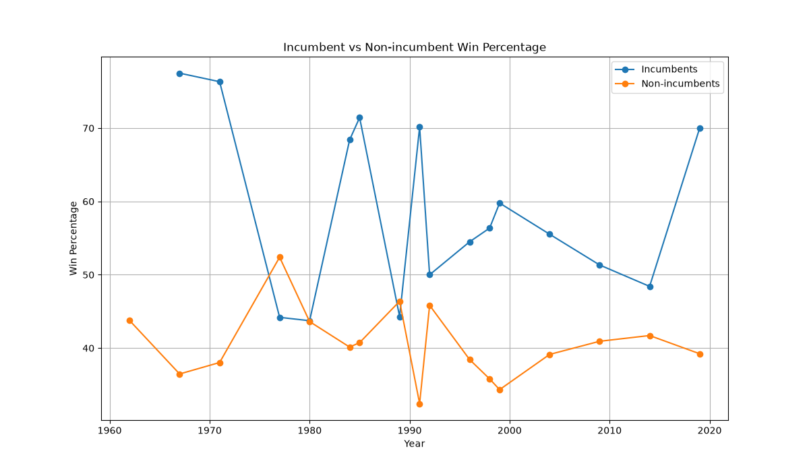
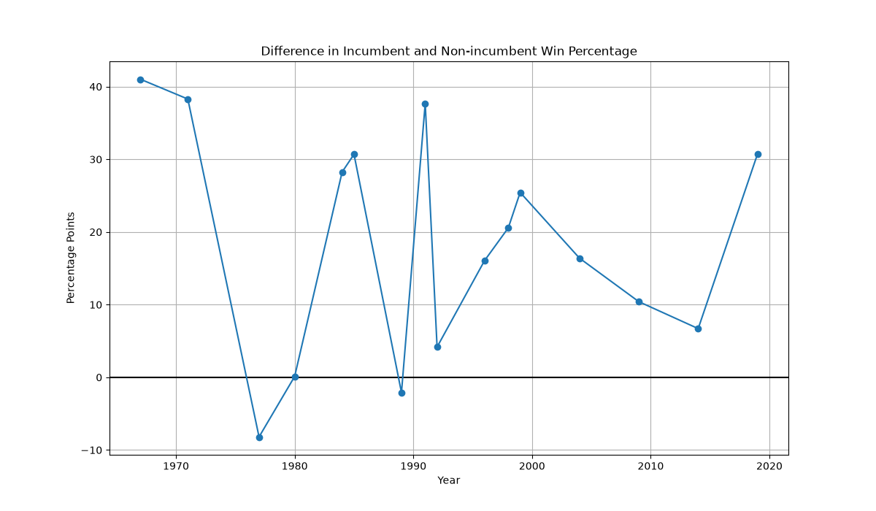
STEP 02 / YEAR-WISE PATTERN
Does the advantage hold in every election?
Disaggregating by year shows that the pooled average hides important reversals.
WIN RATES BY ELECTION YEAR
GAP: INCUMBENT MINUS NON-INCUMBENT
1967
+41.02 pp
1977
−8.20 pp
1980
+0.12 pp
1989
−2.09 pp
2019
+30.74 pp
Conclusion: the gap changes sign in 1977 and 1989, is nearly zero in 1980, and is not a steady upward trend.
NEXT QUESTION
A win rate says how often candidates win - but does not measure how comfortably winners win.
GROUP 043 / THE INCUMBENCY PARADOX
06

Slide 7
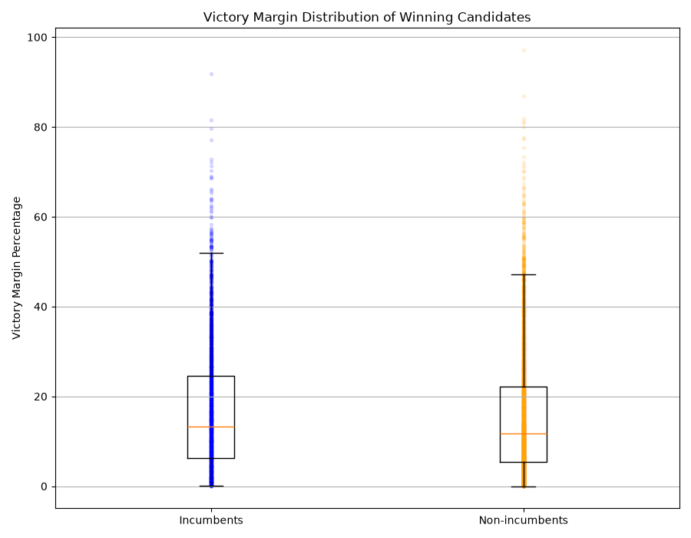
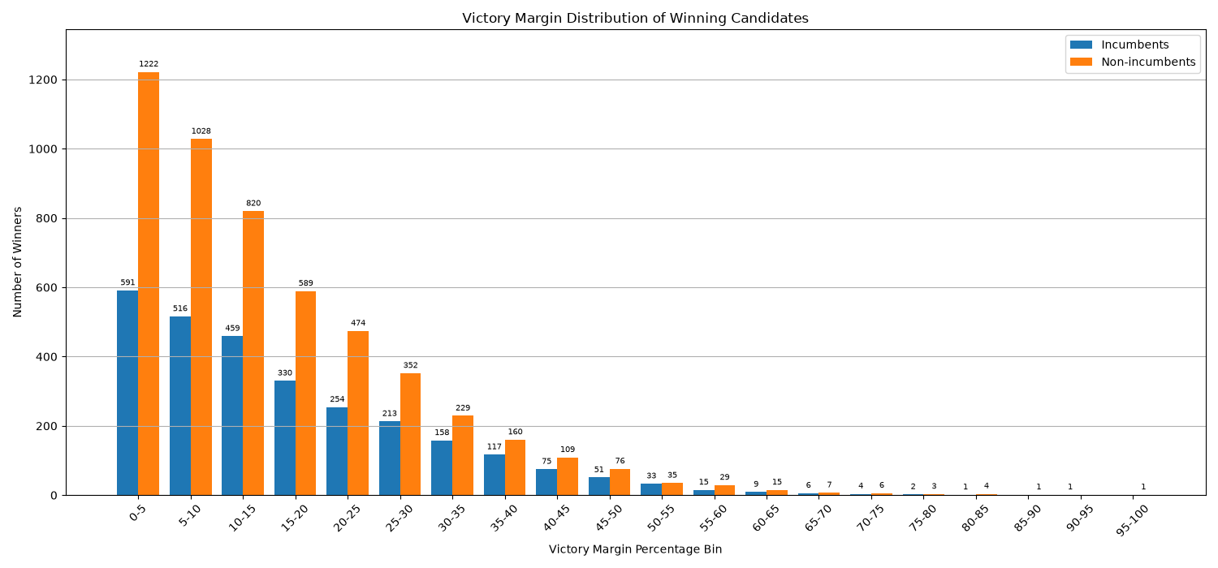
STEP 03 / VICTORY MARGINS
When incumbents win, do they win by larger margins?
This step switches from win probability to the size of victories among successful candidates only.
MARGIN DISTRIBUTION
BOX PLOT • CENTRE & SPREAD
16.75%
15.29%
+1.47 pp
INCUMBENT WINNERS • MEAN
NON-INCUMBENT WINNERS • MEAN
DIFFERENCE IN MEAN MARGIN
Medians: 13.19% vs 11.81% (+1.38 pp) • Standard deviations: 13.64 pp vs 12.99 pp.
NEXT QUESTION
Winner-only margins cannot explain who wins; does a candidate’s previous performance carry forward?
GROUP 043 / THE INCUMBENCY PARADOX
07

Slide 8
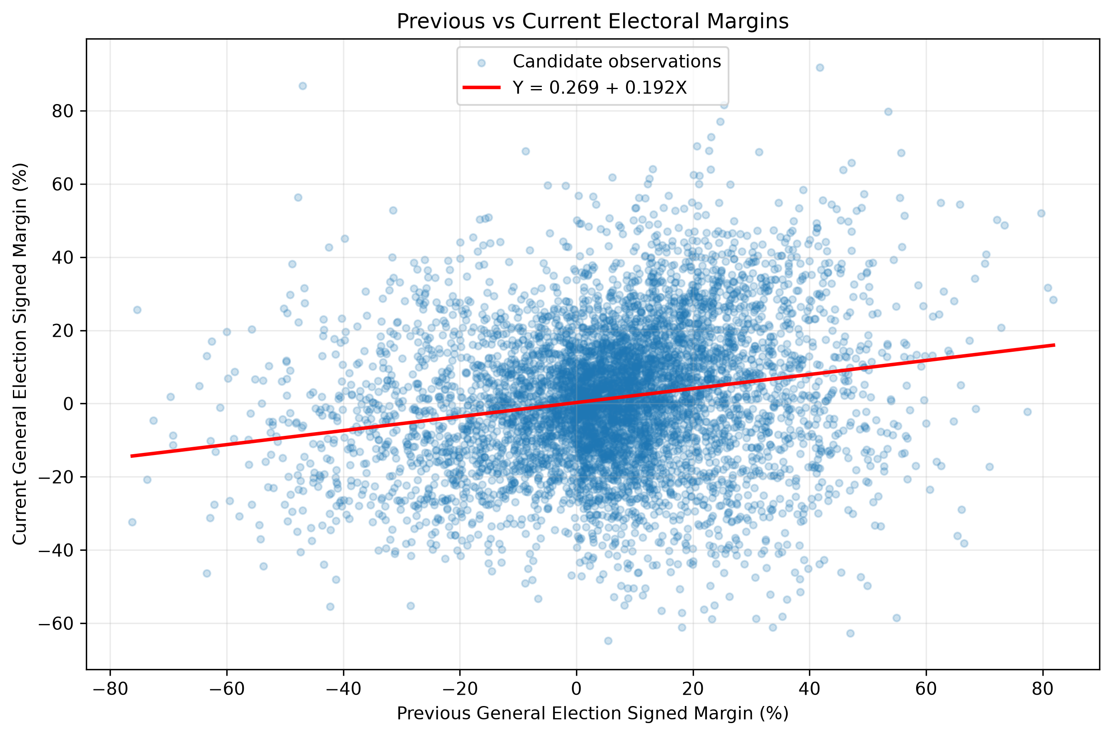
STEP 04 / SIMPLE REGRESSION
Does previous electoral performance carry forward?
A same-constituency matched-pair model relates previous signed margin to the subsequent signed margin.
FITTED RELATIONSHIP
Ŷ = 0.2690 + 0.1916X
A 1 pp higher previous signed margin is associated with about 0.192 pp higher predicted current margin.
R² = 0.0389
Only 3.89% of variation in current margins is explained by previous margin alone.
n = 6,168 matched observations
Matching permits a previous contest within a six-year window; not every pair represents immediately consecutive cycles.
NEXT QUESTION
Past margin matters, but weakly. What changes when incumbency and party strength are included?
GROUP 043 / THE INCUMBENCY PARADOX
08

Slide 9
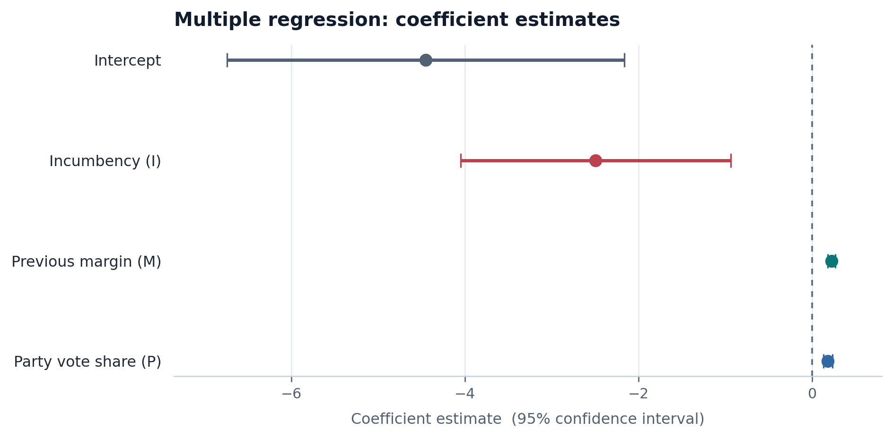
STEP 05 / MULTIPLE REGRESSION
What remains after accounting for prior margin and party strength?
Current election poll_type = 0; previous candidate and party histories use all poll_type values. Complete model N = 5,181.
Ŷ = −4.4527 − 2.4944I + 0.2237M + 0.1808P
I
INCUMBENCY
M
PREVIOUS MARGIN
P
PARTY STRENGTH
1 = incumbent; 0 = otherwise
Candidate’s previous signed margin
Previous party vote share
ADJUSTED INCUMBENCY COEFFICIENT
−2.4944 pp
95% CI −4.0522 to −0.9365
p = 0.001705
Holding M and P fixed, the model predicts a 2.49 pp lower current signed margin for incumbents.
Model fit: R² = 0.0850 • 8.50% of observed variation explained
NEXT QUESTION
Why is the adjusted coefficient negative when the pooled win-rate difference is positive?
GROUP 043 / THE INCUMBENCY PARADOX
09

Slide 10
INTERPRETATION / THE PARADOX
The two headline results answer different questions
The signs differ, but the quantities are not direct estimates of the same effect.
RAW GROUP COMPARISON
ADJUSTED OLS COEFFICIENT
+17.71 pp
−2.49 pp
Difference in the probability of winning
Coefficient for current signed margin
Outcome: win / not win
Pooled comparison; no controls for prior margin or party vote share.
Outcome: current signed margin
Controls: previous candidate margin and previous party vote share.
WHY THEY CAN DIFFER
The pooled incumbent group may differ in candidate history and party strength; the regression conditions on two measured predictors.
The adjusted coefficient is a conditional association - not proof that incumbency itself reduces performance.
GROUP 043 / THE INCUMBENCY PARADOX
10

Slide 11
STEP 06 / CLOSE-ELECTION DESIGN
What follows a narrowly won or lost previous election?
We compare candidates near the prior-election margin threshold, then track their next-election outcome.
PREVIOUS ELECTION SIGNED MARGIN
TWO WINDOWS
±2%
±5%
NARROW WINDOW
BROADER WINDOW
−5%
−2%
0
+2%
+5%
Follow each group into the next Lok Sabha election.
Narrow prior losers
Narrow prior winners
ALL-CANDIDATE WIN RATE
CONDITIONAL WIN RATE
Subsequent wins ÷ everyone in the previous narrow-win / narrow-loss group.
Subsequent wins ÷ only those who contested again. “Did not contest” remains a separate outcome.
This is a close-margin cohort comparison; it is not, by itself, a formal causal regression-discontinuity estimate.
NEXT QUESTION
Do narrow winners win more often because they return to contest - or because returners win more often?
GROUP 043 / THE INCUMBENCY PARADOX
11

Slide 12
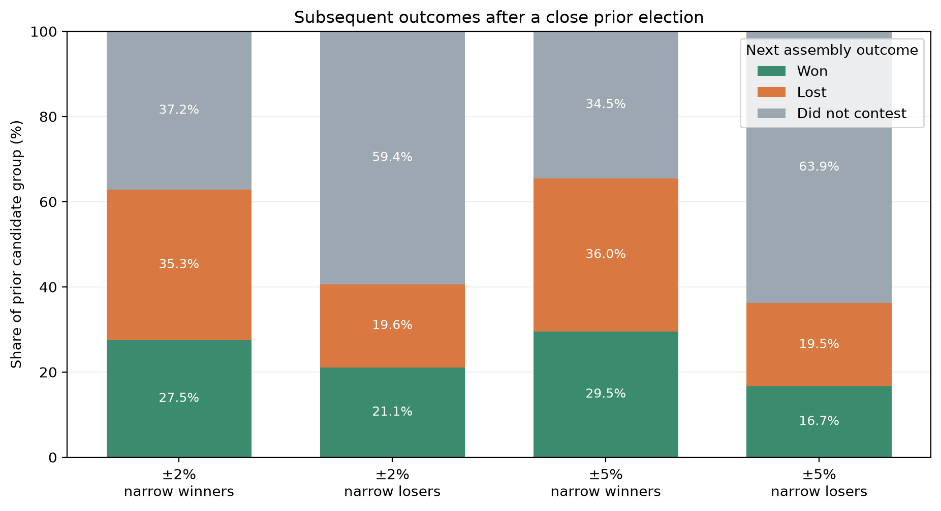
STEP 06 / CLOSE-ELECTION RESULTS
Re-contestation changes how we read the close-election gap
Narrow previous winners have higher all-candidate win rates - and are also much more likely to run again.
±2% WINDOW • PRIOR NARROW WINNERS vs LOSERS • n = 705 vs 721
27.52% vs 21.08%
+6.44 pp • 95% CI: 1.98 to 10.86
Re-contest: 62.84% vs 40.64% | Among returners: 43.79% vs 51.88%
±5% WINDOW • PRIOR NARROW WINNERS vs LOSERS • n = 1,714 vs 1,813
29.52% vs 16.66%
+12.86 pp • 95% CI: 10.10 to 15.61
Re-contest: 65.52% vs 36.13% | Among returners: 45.06% vs 46.11%
TAKEAWAY
The all-candidate gap coincides with much higher return rates; among re-contestants, win rates are close.
The ±2% window is nested within ±5%; the two samples overlap.
GROUP 043 / THE INCUMBENCY PARADOX
12

Slide 13
SYNTHESIS
What the full sequence tells us
No single statistic captures the relationship between incumbency, candidate strength and electoral outcomes.
OBSERVED GAP
NOT UNIVERSAL
01
Incumbents win more often in the pooled comparison (+17.71 pp).
02
The gap changes substantially across elections and reverses in some years.
SMALLER MARGIN EDGE
WEAK PERSISTENCE
03
Among winners, mean margins are only 1.47 pp higher for incumbents.
04
Previous margin is positively related to later margin, but R² = 0.0389.
CONDITIONAL RESULT
RETURN MATTERS
05
The adjusted signed-margin model has a negative incumbency coefficient (−2.49 pp).
06
Narrow winners are more likely to re-contest; returner win rates are close.
BOTTOM LINE
A pooled incumbent win rate is not a clean measure of an independent incumbency effect.
The results are consistent with multiple interacting factors: candidate selection, prior performance, party strength and re-contestation.
GROUP 043 / THE INCUMBENCY PARADOX
13

Slide 14
INTERPRETATION BOUNDARIES
What the analysis can - and cannot - establish
The distinction between association and causation is central to the project’s conclusion.
WHAT THE EVIDENCE SUPPORTS
WHAT THE EVIDENCE DOES NOT PROVE
Pooled pattern: incumbents have a higher observed win rate.
Temporal variation: the gap is not consistent across election years.
Winner-only margins: incumbent winners have a modestly higher mean margin.
Conditional association: the multiple regression coefficient is negative after two controls.
Close cohorts: all-candidate win gaps coexist with large differences in re-contestation.
Causality: the data are observational; no causal incumbency effect is identified.
Complete adjustment: the main model controls only previous margin and party vote share.
Strong prediction: R² is 0.0389 in the simple model and 0.0850 in the multiple model.
Immediate succession: a six-year matching window means some pairs are not adjacent cycles.
Random close-election assignment: the close-margin cohort comparison is not a formal RDD estimate.
INTERPRETATION: observed electoral patterns reflect more than one dimension of candidate and party strength.
GROUP 043 / THE INCUMBENCY PARADOX
14

Slide 15
SOURCES & PROJECT MATERIALS
Thank you
The Incumbency Paradox in Indian Elections • Team 043
PROJECT REPORT
The Incumbency Paradox in Indian Elections – An Analysis of Win Rates and Margins, Group 043, pp. 2–5.
DATASET
TCPD Lok Dhaba Election Dataset (TCPD-IED), Trivedi Centre for Political Data, Ashoka University; compiled from Election Commission of India reports.
REPOSITORY
https://github.com/cs215-cse-iitb/dai-aug-2026-openproject-group-43.git
STATISTICAL REFERENCE
Mease & Najmi (24 March 2025), “Quantifying the statistical skills needed to be a Google Data Scientist”, Appendix #1.
COURSE CONTEXT
DAI Open Project Announcement and Checkpoint 2 presentation requirements supplied with the project materials.
RAM 25b1079 • ARJUN 25b0963 • RUTHVIK 25b0981 • PRAVEEN 25b1037
Mentor: Mayank Jain

