Slide 1
AgroVision AI
Deep Learning for Plant Disease Detection
AlexNet · GoogLeNet · Grad-CAM Explainability · Robustness Analysis
Abeoseh Flomo · Ruthwik Narreddy · Bhavana Vasireddy
PlantVillage Dataset
DSBA 6165 · AI & Deep Learning · University of North Carolina at Charlotte
54,306 images · 33 disease classes · 14 crop species
54,306
33
2
5
>98.5%
Leaf Images
Disease Classes
CNN Models
Train/Test Splits
Peak F1
April 2026

Slide 2
Problem & Motivation
Why automated plant disease detection is an urgent global challenge
The Crisis
Key Challenges
▸ Traditional visual inspection is slow, costly, and demands domain expertise unavailable to small farmers
▸ 33 distinct disease classes share overlapping visual symptoms — very fine-grained classification problem
▸ Leaf appearance varies with lighting conditions, growth stage, and camera quality in real field settings
▸ Models must remain reliable under real-world image degradation: blur, over-exposure, JPEG compression
$220B+
Annual global crop losses due to plant diseases
20–40%
Yield reduction in developing nations
1 Billion
Our Solution — AgroVision AI
People face food insecurity linked to crop failures
Binary Classification
AlexNet & GoogLeNet trained on 54K+ images → Healthy or Disease
70%
Multiclass (33 types)
Identify exact disease type from 33 classes across 14 crops
Loss reduction possible with early detection
Grad-CAM XAI
Visualize which leaf regions drive each prediction — trustworthy AI
10,000+
Robustness Testing
Evaluate under noise, blur, brightness, contrast, JPEG corruption
Known plant diseases — only experts can identify
Streamlit App
Real-time web inference: upload a leaf image, get instant diagnosis

Slide 3
Related Work
Three papers that directly informed our dataset choices, architecture, and methodology
2016
Using Deep Learning for Image-Based Plant Disease Detection
Gap:
Black-box models — no explainability. No robustness testing under real-world image degradation.
Mohanty, Hughes & Salathé · Frontiers in Plant Science
First major CNN benchmark on PlantVillage (54,306 images). AlexNet & GoogLeNet achieved 99.35% accuracy with ImageNet transfer learning across 26 diseases and 14 crop species. Established the 80/10/10 train/val/test split as best practice.
→ We:
We directly replicate their AlexNet + GoogLeNet comparison and 80/10/10 split. We extend with Grad-CAM explainability and robustness analysis — both absent from their work.
2026
AI-Powered Detection of Pumpkin Leaf Diseases Using DualFusion-CBAM-Stochastic
Gap:
Single crop (pumpkin) with no cross-dataset generalization. No XAI analysis or robustness evaluation.
Bhuria et al. · Frontiers in Plant Science
Fused DenseNet121 + EfficientNetB3 with a CBAM attention module on 2,000 pumpkin leaf images. Achieved ~96% accuracy. Demonstrated that attention-augmented CNN fusion improves fine-grained agricultural disease classification.
→ We:
Motivated our inclusion of the pumpkin dataset and our multi-architecture comparison strategy. Validated the CNN approach for fine-grained multiclass disease detection.
2024
An Improved Pear Disease Classification Using Cycle Generative Adversarial Network
Gap:
GAN augmentation is computationally expensive. Scope limited to pear diseases — generalization not tested.
Alshammari et al. · Scientific Reports (Nature)
Applied CycleGAN for cross-domain data augmentation on the DiaMOS pear dataset. Compared VGG19, ResNet50, and EfficientNetB0. GAN-based augmentation improved classification accuracy by ~7% on average across architectures.
→ We:
Motivated our use of the DiaMOS pear dataset. Validated CNN-based multiclass classification on field-captured agricultural images beyond controlled lab settings.

Slide 4
Dataset & Training Pipeline
Three datasets · Data augmentation · 5 train/test splits · Best-F1 checkpointing
PlantVillage
DiaMOS Pear
Pumpkin
54,306
3,505
2,000
images
images
images
· 26 diseases · 14 crop species
· Healthy + diseased categories
· Controlled lab conditions
· Primary training dataset
· 4 pear disease classes
· Field-captured photographs
· Variable lighting & angles
· Real-world conditions
· Multiple disease classes
· Outdoor capture conditions
· Diverse lighting scenarios
· Smallest dataset — challenging
End-to-End Training Pipeline
Raw Images
Augmentation
Resize & Norm
Backbone
Custom Head
Training
Evaluation
54K+ JPEGs 3 datasets merged dataset_split.csv
H/V Flip · Rotate Zoom · ColorJitter Brightness ±10%
224×224 pixels ImageNet mean/std μ=[.485,.456,.406]
AlexNet features GoogLeNet inception Frozen + fine-tuned
AlexNet: 4096→N GoogLeNet: 1024 →500→ReLU→N
30 epochs · Adam lr=1e-4 · Best-F1 checkpointing
Acc · F1 · Prec Recall · 5 splits Binary + 33-class
→
→
→
→
→
→

Slide 5
Model Architecture
Transfer learning — ImageNet pretrained features + custom classification heads
AlexNet (Krizhevsky et al. 2012)
GoogLeNet (Szegedy et al. 2014)
Backbone (ImageNet pretrained — features frozen)
Backbone (ImageNet pretrained — features frozen)
• 5 convolutional layers with max pooling
• 3 fully connected layers (classifier)
• ~60 million parameters total
• Dropout for regularization
• Target layer: features[10] (last conv)
• 22 layers deep (Inception v1)
• 9 Inception modules with parallel conv paths
• ~6.8 million parameters (more efficient)
• aux_logits=False for fine-tuning
• Target layer: inception5b (final block)
Binary Head
Multiclass Head (33 diseases)
Binary Head
Multiclass Head (33 diseases)
classifier[-1] = Linear(4096 → 1)
Loss: BCEWithLogitsLoss
Output: sigmoid probability → Healthy/Disease
classifier[-1] = Linear(4096 → 33)
Loss: CrossEntropyLoss
Output: softmax over 33 disease classes
fc = FC1(1024→500) → ReLU → FC2(500→1)
Loss: BCEWithLogitsLoss
Output: sigmoid probability → Healthy/Disease
fc = FC1(1024→500) → ReLU → FC2(500→33)
Loss: CrossEntropyLoss
Output: softmax over 33 disease classes
Key insight: Simpler architecture — lower parameter count in head → better generalizes for 33-class task
Key insight: Deeper architecture captures richer features — edges out AlexNet at binary but loses on 33-class

Slide 6
Results — Binary Classification (Healthy vs Disease)
AlexNet vs GoogLeNet across 5 train/val/test split ratios · 30 epochs · Best-F1 checkpoint saved
Split Ratio (Train/Val/Test)
AlexNet Accuracy
AlexNet F1
AlexNet Precision
GoogLeNet Accuracy
GoogLeNet F1
Best Model
80 / 10 / 10
99.11%
98.31%
97.29%
99.27%
98.62%
GoogLeNet ★
60 / 20 / 20
99.26%
98.59%
98.30%
98.99%
98.06%
AlexNet
50 / 25 / 25
99.06%
98.20%
98.00%
99.02%
98.13%
AlexNet
40 / 30 / 30
98.95%
98.00%
97.61%
99.11%
98.29%
GoogLeNet
20 / 40 / 40
98.75%
97.63%
97.30%
98.72%
97.55%
AlexNet
Key Observations
▸ Both models exceed 98.5% F1 on 80/10/10 — confirming ImageNet transfer learning is extremely effective for plant pathology.
▸ GoogLeNet edges AlexNet at 80/10/10 (98.62% vs 98.31% F1) but AlexNet leads at 60/20/20 — no single dominant model.
▸ Performance degrades gracefully: even at 20/40/40 (only 20% training data), both stay above 97.5% F1 — very data-efficient.
▸ Results match and reproduce Mohanty et al. (2016) — validating our pipeline implementation.

Slide 7
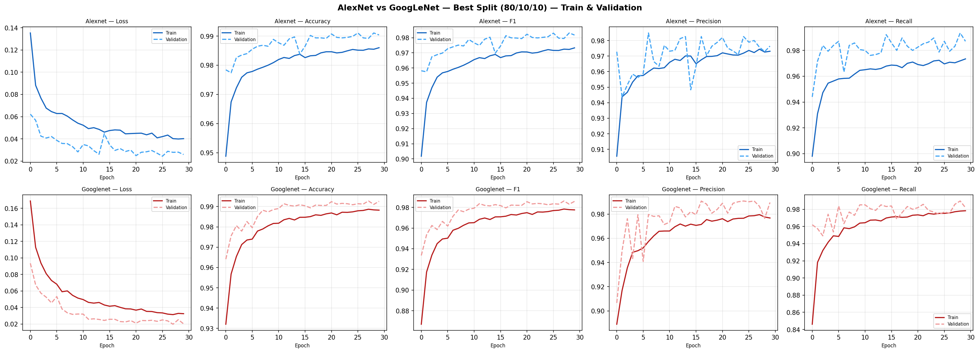
Training Curves — Binary Classification
AlexNet (blue) vs GoogLeNet (red) · Best split 80/10/10 · Loss · Accuracy · F1 · Precision · Recall
Convergence:
F1 plateau:
Loss shape:
Both models converge within 10–15 epochs. No significant overfitting — validation tracks training closely throughout 30 epochs.
GoogLeNet validation F1 plateaus ~0.4% higher at 80/10/10. AlexNet shows more consistent convergence across all 5 splits.
Loss decreases smoothly — Adam + BCEWithLogitsLoss is well-suited. No spikes or instability detected in any run.

Slide 8
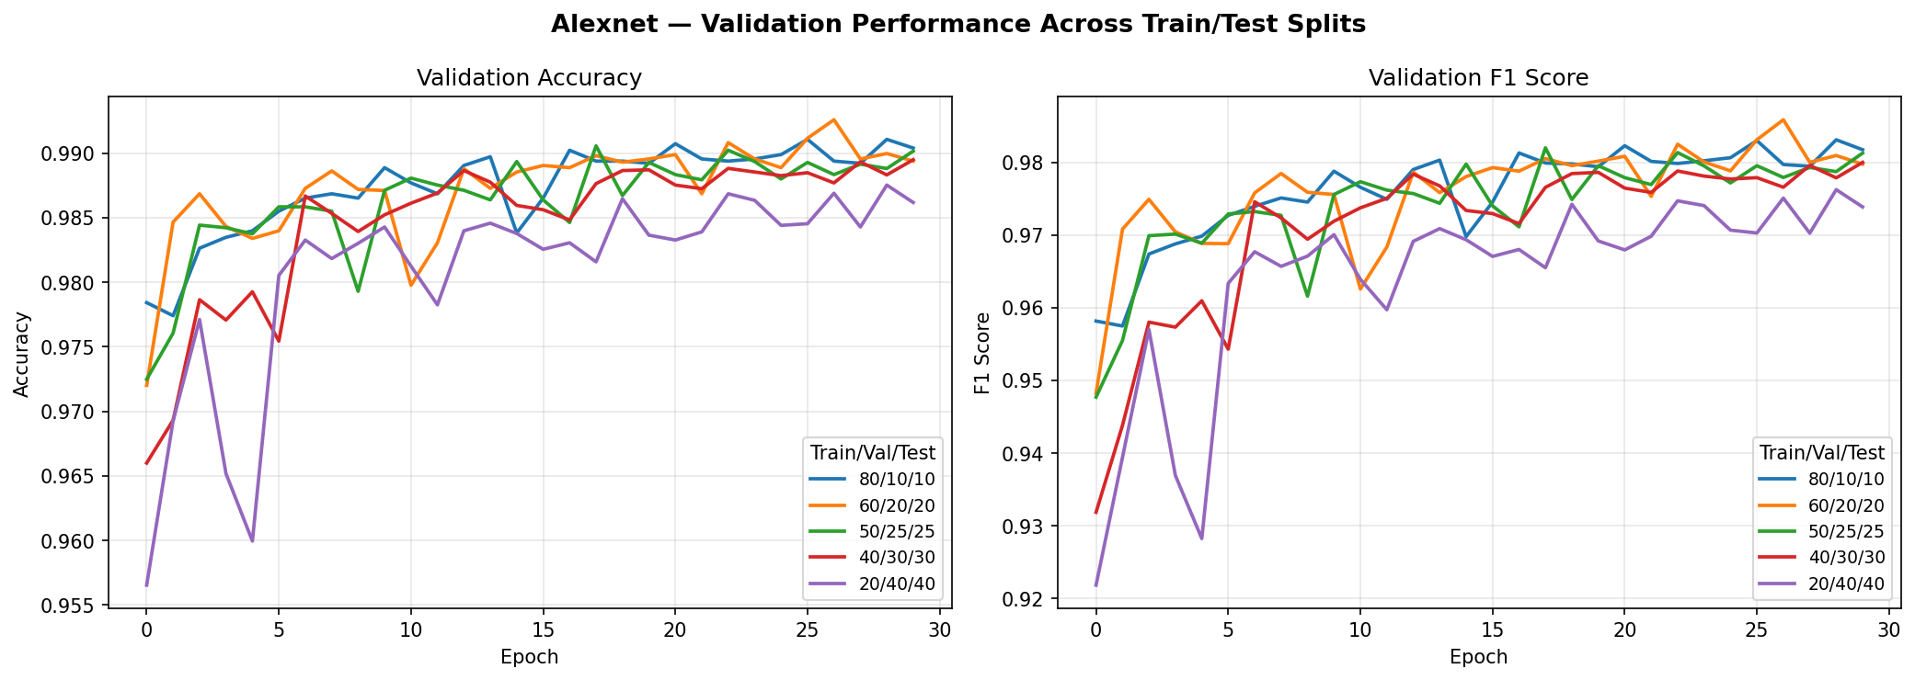
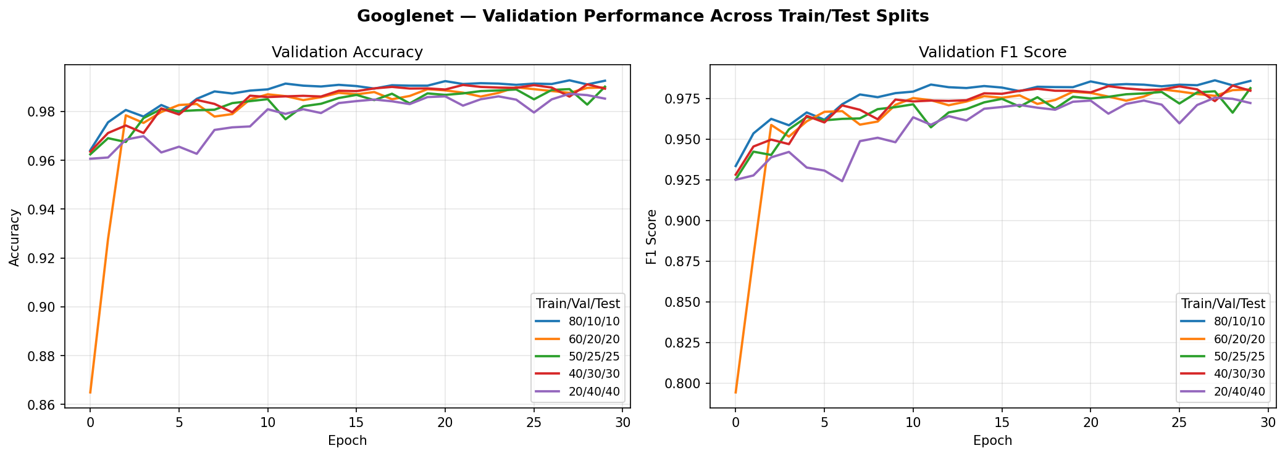
Validation Performance Across All Splits
How does each model perform as training data shrinks from 80% → 20%?
Both models show graceful degradation as training data shrinks. The 80/10/10 split (blue) consistently delivers the best validation accuracy and F1. Even at 20/40/40, accuracy stays above 98.7% — demonstrating strong generalization from ImageNet pretraining.

Slide 9
Results — Multiclass Disease Classification (33 Types)
Identifying the exact disease from 33 classes across 14 crop species · CrossEntropyLoss · 30 epochs
Split Ratio (Train/Val/Test)
AlexNet Accuracy
AlexNet F1
AlexNet Recall
GoogLeNet Accuracy
GoogLeNet F1
Winner
80 / 10 / 10
95.34%
95.31%
95.28%
93.44%
93.40%
AlexNet ★
60 / 20 / 20
95.50%
95.48%
95.46%
93.23%
93.23%
AlexNet
50 / 25 / 25
95.01%
95.01%
94.98%
92.79%
92.82%
AlexNet
40 / 30 / 30
94.50%
94.46%
94.44%
92.25%
92.17%
AlexNet
20 / 40 / 40
93.53%
93.49%
93.47%
90.84%
90.80%
AlexNet
Key Observations
▸ AlexNet dominates GoogLeNet on all 5 splits — a consistent ~2% F1 advantage. Simpler head generalizes better for 33-class task.
▸ Both models exceed 90% F1 even at 20/40/40 — transfer learning scales effectively to fine-grained agricultural classification.
▸ AlexNet's direct FC(4096→33) outperforms GoogLeNet's deeper FC1(1024→500)→FC2(500→33) stack for multiclass.
▸ Binary task is easier (>98.5% F1) than multiclass (93–95.5% F1) — as expected for a 33-class fine-grained problem.

Slide 10
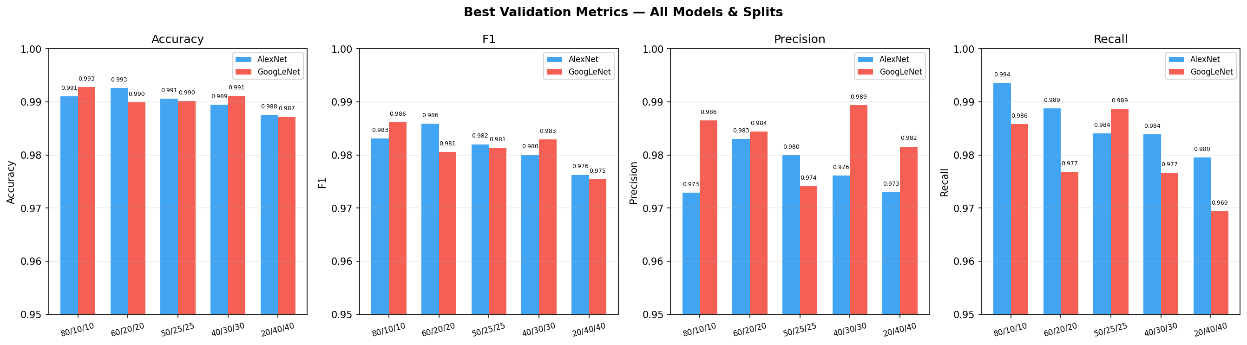
Performance Summary — Best Metrics Across All Splits
Binary Classification · Validation set · Bar = best-epoch metric for each model/split combination
Blue = AlexNet · Red = GoogLeNet · Each cluster = one train/val/test split. GoogLeNet leads at 80/10/10 on all four metrics. AlexNet closes the gap or leads at larger test splits. Both models remain above 97.5% across all metrics and splits — exceptionally robust transfer learning performance.

Slide 11
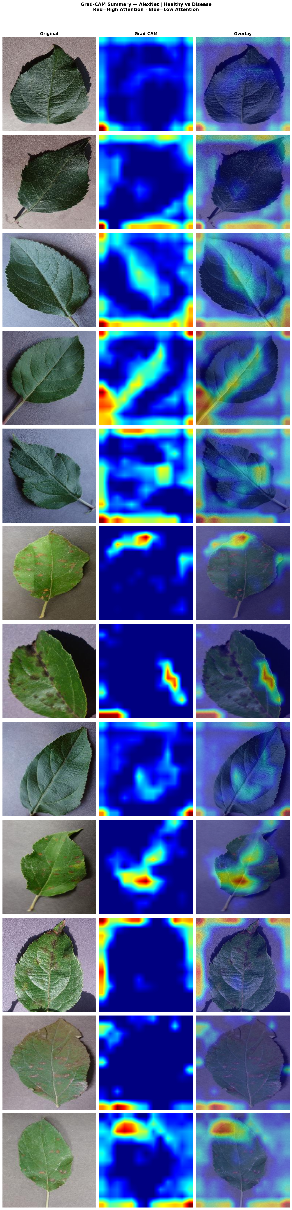
Grad-CAM Explainability
Visualizing where models focus — building trust in AI-driven disease detection
How Grad-CAM Works
Grad-CAM Output — AlexNet on Real Test Images
1 Forward Pass
Run image through the model. Save feature map activations at the target convolutional layer. AlexNet → features[10] | GoogLeNet → inception5b
2 Backward Pass
Compute gradient of the predicted class score with respect to the saved activations using backprop. Tensor-level hook used to avoid inplace ReLU conflict in PyTorch.
3 Weight Computation
Global average pool the gradients across spatial dimensions (H×W) → one weight per channel. High weight = that feature map strongly drives the prediction.
4 Weighted Activation Sum
Multiply each activation map by its weight, sum across all channels. Apply ReLU to keep only positive influence regions.
5 Heatmap Generation
Normalize result to [0, 1]. Upsample to 224×224 using bilinear interpolation. Red = high attention · Blue = low attention · Overlay on original image.

Slide 12
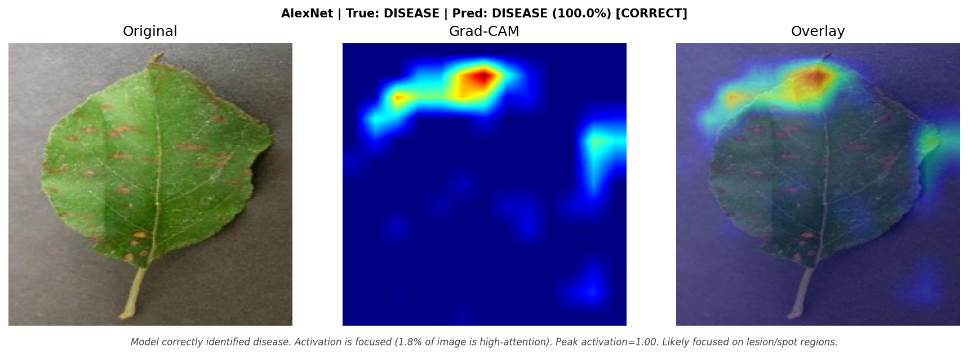
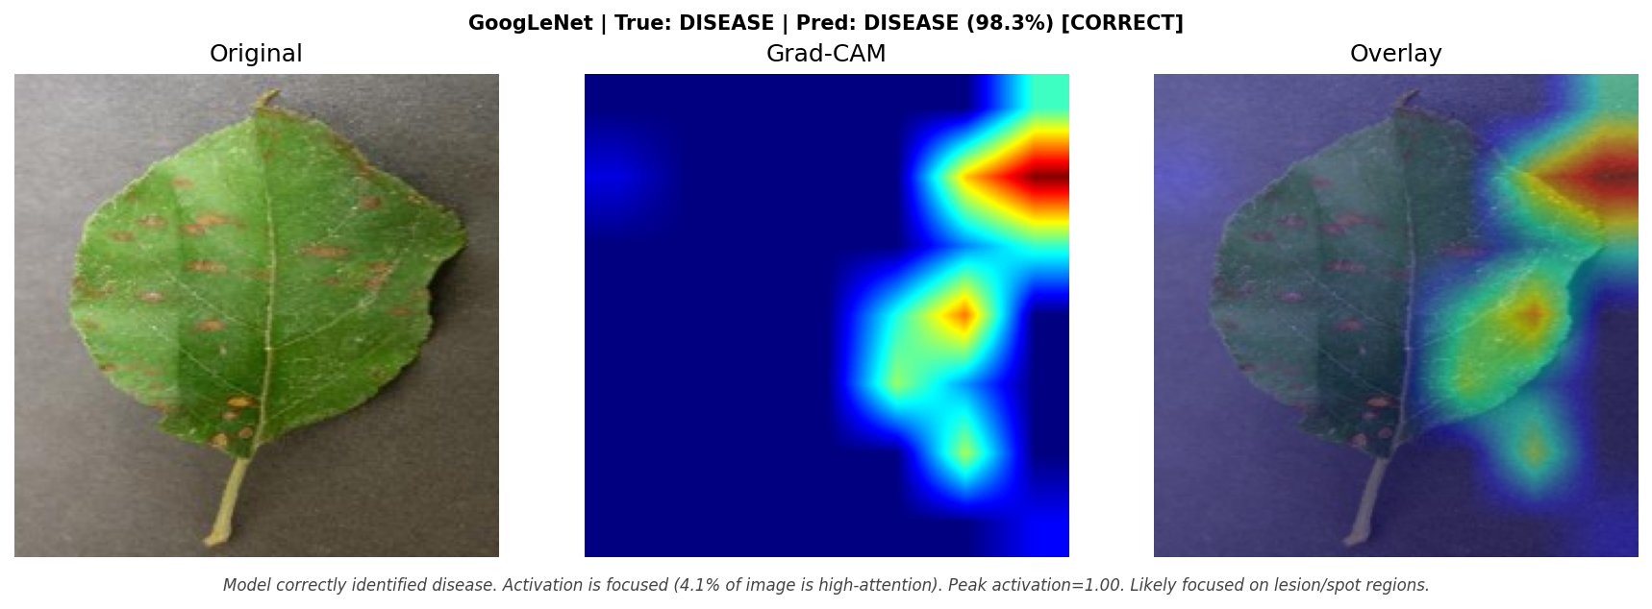
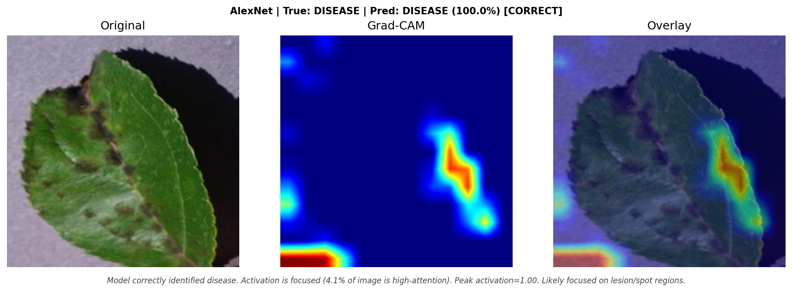
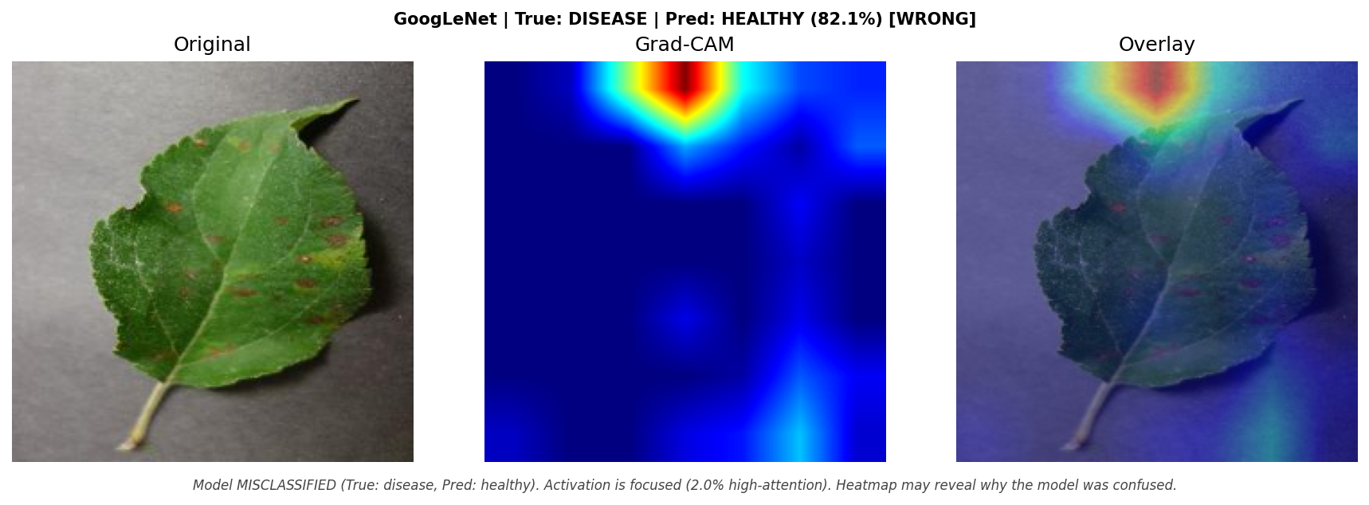
Grad-CAM Results — Disease Images
Cedar Rust & Apple Scab · Original | Grad-CAM Heatmap | Overlay
Cedar Rust — AlexNet ✓ CORRECT (100.0%)
Cedar Rust — GoogLeNet ✓ CORRECT (98.3%)
Disease images: Grad-CAM attention is tightly focused on lesion/spot regions (1–10% of image area). Peak activation = 1.0 on correctly classified disease images. GoogLeNet misclassified Cedar Rust images show attention on stem/background — not on rust pustules — revealing the failure mode.
Apple Scab — AlexNet ✓ CORRECT (100.0%)
Cedar Rust — GoogLeNet ✗ WRONG (pred: Healthy 82.1%)

Slide 13
Grad-CAM — Findings & Biological Validation
12 real PlantVillage test images · 6 Healthy (Raspberry) · 4 Cedar Rust · 2 Apple Scab
✓
AlexNet — 100% Accuracy
△
GoogLeNet — 75% (9/12)
◈
Disease Pattern (Correct)
◉
Healthy Pattern (Both Models)
▸ All 12 test images correctly classified
▸ Disease images: attention focused on rust pustules, scab spots (1–5% of image)
▸ Healthy images: diffuse attention on leaf veins and mid-blade texture
▸ No false-positive hotspots detected on healthy leaves
▸ Peak activation = 1.0 for every disease prediction
▸ 9/12 correct · 3 Cedar Rust misclassified as Healthy
▸ Misclassified images: heatmap attention on stem/background not rust spots
▸ Correctly classified disease images show focused attention
▸ Lower confidence on borderline cases (50–55% probability)
▸ More sensitive to image composition and leaf orientation
▸ Attention clusters tightly on visible disease markers
▸ Cedar Rust: hotspot on orange/rust pustule clusters
▸ Apple Scab: hotspot on dark scab lesions and spots
▸ Pattern confirms models learned biology, not artifacts
▸ Focus area: 1–10% of 224×224 image — highly specific
▸ Healthy leaves show diffuse, low-peak attention
▸ Model attends to overall leaf texture and vein structure
▸ No false disease spots highlighted
▸ Confirms model is not confusing background or lighting
▸ Biologically valid: healthy leaves have no localized markers

Slide 14
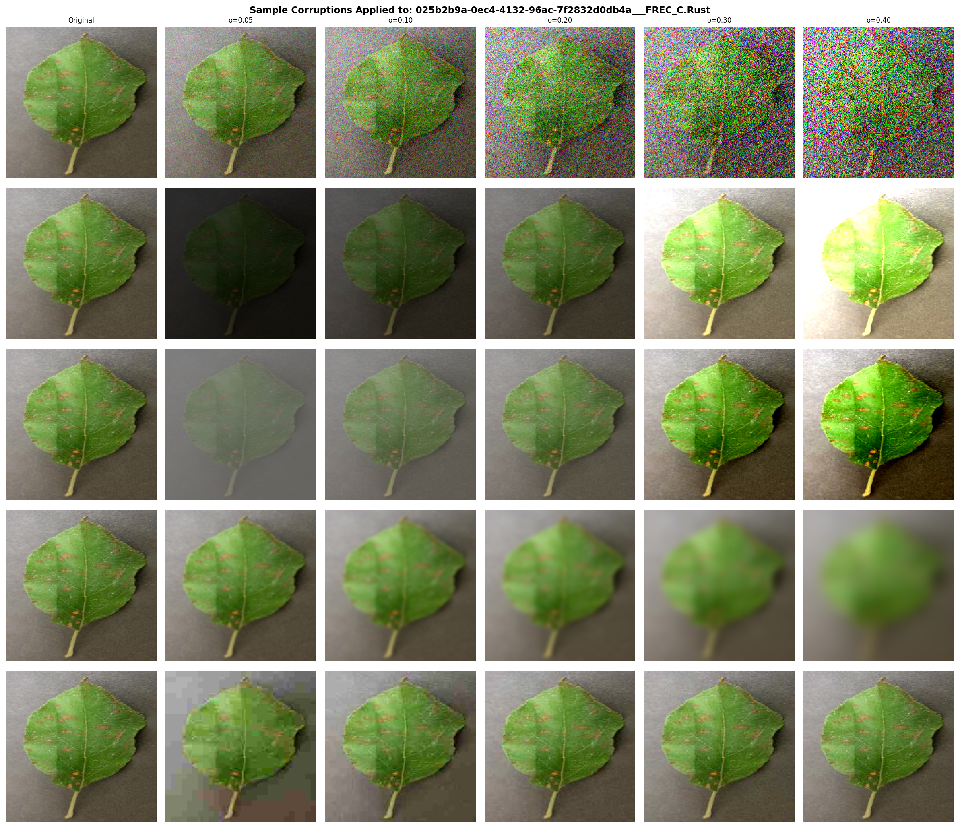
Robustness Analysis — Method
Evaluating model stability under real-world image corruptions · Adapted from Hendrycks & Dietterich (2019)
5 Corruption Types × 5 Severities
Gaussian Noise
σ: 0.05 → 0.40 Adds random pixel noise Simulates sensor/low-light
Brightness Shift
Factor: 0.25× → 2.0× Darken or overexpose Simulates bad lighting
Contrast Shift
Factor: 0.25× → 2.0× Flat or harsh contrast Simulates processing
Gaussian Blur
Radius: r=1 → r=9 Softens fine details Simulates camera blur
JPEG Compression
Quality: q=10 → q=80 Lossy artifact blocks Simulates phone uploads

Slide 15
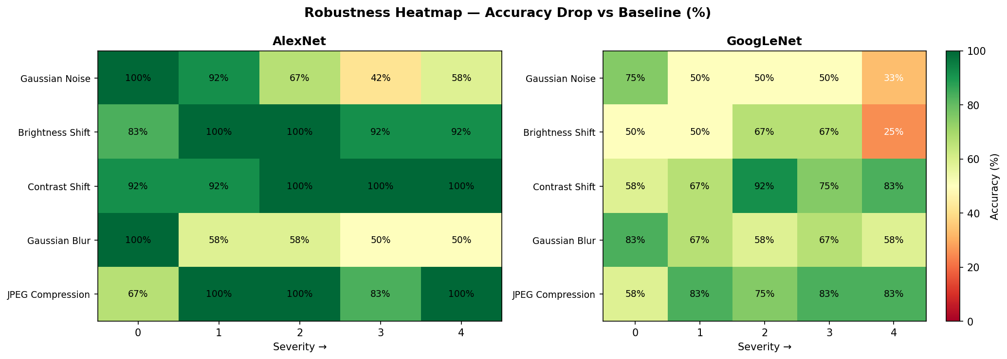
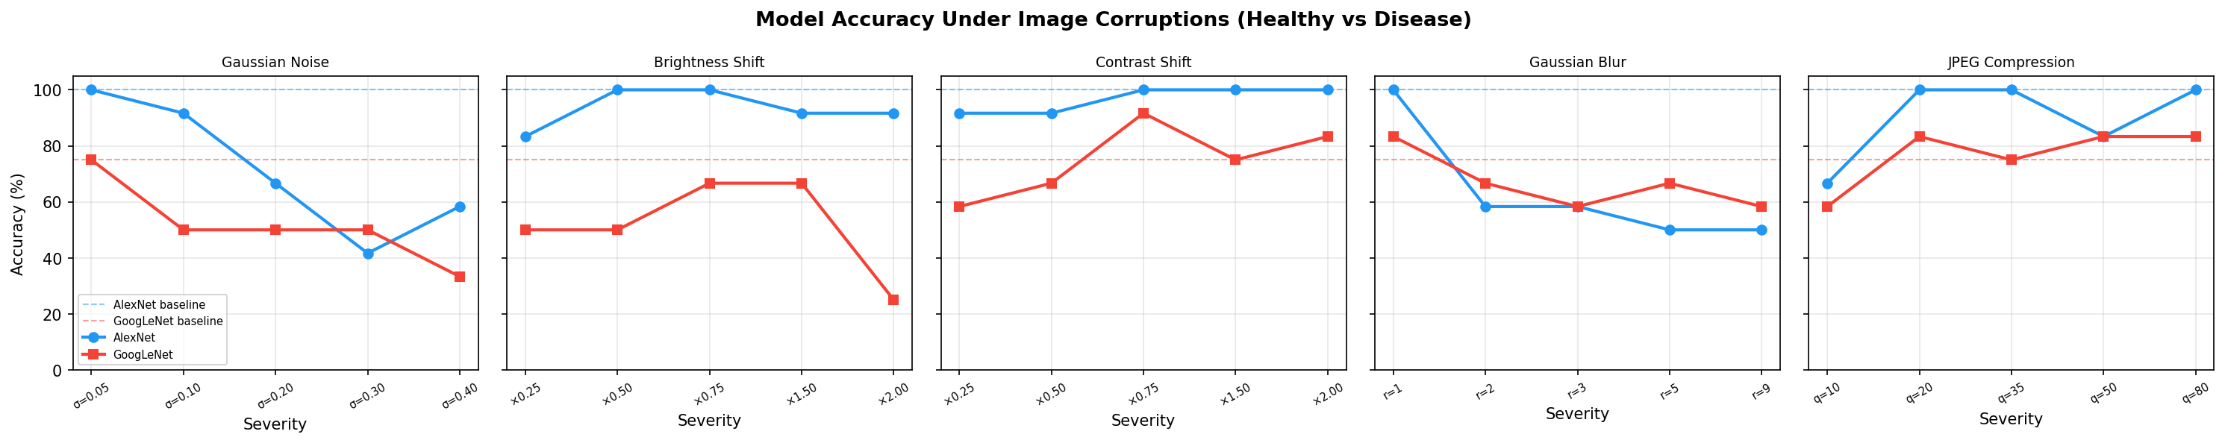
Robustness Results — Accuracy Heatmap
AlexNet (left) vs GoogLeNet (right) · Green = high accuracy · Red = model fails
Cell values = Accuracy% Green ≥ 70% · Yellow = borderline · Red < 40%
Gaussian Noise
Most destructive. AlexNet: 100%→42%→58% GoogLeNet: 75%→33%
Gaussian Blur
High blur (r≥5) breaks both. AlexNet: 50%, Goog: 58% Fine spots vanish
Brightness
×0.25 hurts both. ×2.0 collapses GoogLeNet to 25% accuracy
Contrast
Most robust corruption. AlexNet: 91–100% GoogLeNet: 58–83%
JPEG q=10
Severe compression drops both to 58–67%. q≥20: both recover well

Slide 16
Robustness Findings & Deployment Implications
What corruptions reveal about model behavior — and what it means for production use
AlexNet is more robust overall
Noise & Blur are the Biggest Threats
Contrast & Moderate JPEG are Safe
GoogLeNet is Brightness-Sensitive
Baseline: 100% · Under worst noise (σ=0.40): 58% · Under worst blur (r=9): 50% Consistently outperforms GoogLeNet under every corruption type tested. Simpler architecture avoids brittle feature combinations in the head. Recommendation: deploy AlexNet when image quality cannot be controlled.
Gaussian noise σ≥0.20 destroys performance in both models. Gaussian blur r≥5 removes the fine-grained disease spots models rely on. Implication: cameras with sensor noise or out-of-focus images significantly reduce reliability. Production fix: reject images below a sharpness/SNR threshold before inference.
Contrast shifts: AlexNet 91–100% across all levels. Models adapt well. JPEG compression ≥ q=20: both models recover to near-baseline accuracy. Only extreme compression (q=10) causes meaningful degradation. Implication: JPEG uploads from smartphones (typically q=75–95) are safe.
At ×2.0 brightness, GoogLeNet accuracy collapses to 25% — far below AlexNet (92%). Likely cause: deeper Inception modules amplify overexposed feature maps. Practical impact: field images taken in direct sunlight may fail on GoogLeNet. Fix: add automatic brightness normalization in pre-processing pipeline.

Slide 17
Contributions — What We Used vs What We Built
Clear attribution as required by course rubric · Existing works cited · Original contributions highlighted
Existing Work (Reused / Adapted)
Our Original Contributions
PlantVillage Dataset
Abeoseh Flomo
Hughes & Salathé (2015) — openly licensed CC BY 4.0 https://github.com/spMohanty/PlantVillage-Dataset
· End-to-end training pipeline — train_healthy_disease.py, train_disease_type.py
AlexNet Architecture
· 5-split experimental design with best-F1 checkpointing strategy
Krizhevsky et al. (2012) — torchvision.models.alexnet ImageNet pretrained weights via PyTorch Hub
· Full training loop: Adam optimizer, BCEWithLogitsLoss, CrossEntropyLoss
GoogLeNet Architecture
Szegedy et al. (2014) — torchvision.models.googlenet ImageNet pretrained weights via PyTorch Hub
· Streamlit web app for real-time inference (in progress — demo ready for presentation)
Grad-CAM Algorithm
Ruthwik Narreddy
Selvaraju et al. (2017, ICCV) — gradient-based XAI Core algorithm adapted; our PyTorch hook implementation is original
· Grad-CAM engine (scripts/gradcam.py) — custom PyTorch hook solving inplace ReLU conflict
80/10/10 Split Strategy
Mohanty et al. (2016) — their experimental recommendation We replicate their split ratio and compare across 5 ratios
· Test image evaluation + biological analysis (run_gradcam_test_images.py)
Robustness Corruption Protocol
· Training curve visualization suite — 14 plots (plot_training_curves.py)
Hendrycks & Dietterich (2019, ICLR) — ImageNet-C framework We adapt 5 of their corruption types for agricultural domain
· Robustness testing framework — 5 corruptions × 5 severities + heatmap analysis
· Presentation slides and project documentation

Slide 18
Conclusion & Future Work
Conclusion
Future Work
Binary Classification
ResNet / EfficientNet / ViT Comparison
Both models exceed 98.5% F1 at 80/10/10 split. GoogLeNet edges AlexNet (98.62% vs 98.31%). Transfer learning from ImageNet is highly effective.
Test modern architectures. Vision Transformer expected to excel at 33-class due to global attention.
Multiclass (33 diseases)
Augmentation Ablation Study
AlexNet wins decisively — 95.5% vs 93.4% F1. Consistent advantage across all 5 splits. Simpler classification head generalizes better.
Quantify contribution of each augmentation. How much does ColorJitter vs Flip individually help?
Adversarial Robustness
Grad-CAM Explainability
FGSM / PGD adversarial attack testing. Adversarial training to harden the production model.
Models attend to biologically meaningful regions. AlexNet: 100% accuracy, precise lesion focus. GoogLeNet fails on 3 Cedar Rust — heatmap reveals why.
Field Data Collection
Robustness Analysis
Capture real smartphone photos under field conditions. Quantify distribution shift from lab dataset.
Gaussian noise and blur are the biggest threats. AlexNet is more robust overall across all corruption types. Contrast variation and JPEG (q≥20) handled well by both.
Streamlit Full Deployment
Upload leaf image → Binary + Multiclass prediction + Grad-CAM visualization in one real-time click.
Overall Achievement
AgroVision AI reproduces SOTA results from Mohanty et al. We add explainability and robustness testing — gaps they left. Ready for real-world agricultural deployment with quality checks.
Federated Learning
Train across farmer devices without centralizing data — privacy-preserving plant disease detection.

Slide 19
Thank You
AgroVision AI · Group 8 · DSBA 6165
Questions & Discussion
GitHub:
github.com/ruthwiknarreddy/AI-and-Deep-Learning-Group-8--6165
Dataset:
PlantVillage — Hughes & Salathé (2015) · DiaMOS · Pumpkin Dataset
Models:
AlexNet (Krizhevsky et al. 2012) · GoogLeNet (Szegedy et al. 2014)
XAI:
Grad-CAM — Selvaraju et al., ICCV 2017
Robustness:
Hendrycks & Dietterich, ICLR 2019 (ImageNet-C)

