Slide 1
TEDxPORPS Youth
SPONSORSHIP PROPOSAL • 2026
THE NEXT
IDEAS
START HERE.
SPONSORSHIP DECK
P. Obul Reddy Public School, Jubilee Hills, Hyderabad
21 November 2026 • Independently Organised TEDx Event
01 / 20

Slide 2
TEDxPORPS Youth
02 — PARTNERSHIP INVITATION
Partner with us. Support ideas.
Be part of the conversation.
“Platforms like TEDxPORPS Youth do not just showcase present talent; they shape the trajectory of tomorrow’s intellectual discourse.”
We invite forward-thinking organizations to align with an intellectual platform dedicated to unearthing powerful youth perspectives in Hyderabad.
TEDxPORPS Youth • 21 November 2026
02 / 20

Slide 3
TEDxPORPS Youth
03 — OVERVIEW
ABOUT THE PLATFORM
A student-led crucible for transformative local ideas, global mindsets, and unfiltered dialogue.
TEDxPORPS Youth is built on the belief that young minds possess profound clarity regarding the structures governing our world. Operating under official license from TED, our event brings together dynamic speakers and an engaged community to challenge conventional wisdom.
This is an independently organized event operated under the leadership of student curators and faculty advisors at P. Obul Reddy Public School.
TEDxPORPS Youth • 21 November 2026
03 / 20

Slide 4
TEDxPORPS Youth
04 — CORE METRICS
DATE
LOCATION
FORMAT
21 NOV
HYDERABAD
TEDx YOUTH
2026 Edition
P. Obul Reddy Public School, Jubilee Hills
Curated Talks & Live Delegate Interactions
TEDxPORPS Youth • 21 November 2026
04 / 20

Slide 5
TEDxPORPS Youth
05 — CONCEPT FOCUS
OFFICIAL THEME 2026
“THE WEIGHT OF
EXPECTATIONS”
TEDxPORPS Youth • 21 November 2026
05 / 20

Slide 6
TEDxPORPS Youth
06 — CONTEXTUAL DEPTH
Examining the invisible pressures that frame modern development.
01 Family
02 School
03 Society
Every generation inherits structures built long before their birth. This year, we dissect the burden placed on youth across core dimensions of daily life.
04 Culture
05 Ourselves
TEDxPORPS Youth • 21 November 2026
06 / 20

Slide 7
TEDxPORPS Youth
07 — PROGRAM FLOW
A carefully architected day of intellectual immersion.
PHASE I
PHASE II
PHASE III
Registration & Welcome
Opening Session
TEDx Talks
Networking and onboarding.
Curator address & key talks.
Core speaker sessions.
PHASE IV
PHASE V
PHASE VI
Interactive Segment
Speaker Interaction
Closing Session
Audience workshops.
Direct Q&A circles.
Insights synthesis & wrap.
TEDxPORPS Youth • 21 November 2026
07 / 20

Slide 8
TEDxPORPS Youth
08 — VOICES ON STAGE (TENTATIVE)
SUBJECT TO FINAL AVAILABILITY AND CONFIRMATION
ACADEMIC & RESEARCH
FILM & NARRATIVE
Prof. J. Anuradha Jonnalagadda
Ms. B. V. Nandini Reddy
CONSERVATION & ARTS
AEROSPACE & INNOVATION
Ms. Amala Akkineni
Mr. Pawan Kumar Chandana
TEDxPORPS Youth • 21 November 2026
08 / 20

Slide 9
TEDxPORPS Youth
09 — GOVERNANCE & EXECUTION
Structured for precision, driven by student leadership.
Executive Board & Core Team
Content & Speaker Management
Sponsorship & Partnerships
Marketing & Communications
Design & Creative Studio
Operations & Event Execution
TEDxPORPS Youth • 21 November 2026
09 / 20

Slide 10
TEDxPORPS Youth
10 — COMMUNITY REACH
Engaging the core anchors of the educational ecosystem.
01 Ambitious Students
02 Educators & Leadership
Rather than relying on inflated metrics, our focus remains absolute: deep, highly targeted resonance among key intellectual communities.
03 Broader Hyderabad Community
TEDxPORPS Youth • 21 November 2026
10 / 20

Slide 11
TEDxPORPS Youth
11 — FINANCIAL PARTNERSHIP
INVESTMENT THRESHOLD
₹50,000+
Direct support levels structured to enable production excellence while offering clean, tasteful brand positioning.
TEDxPORPS Youth • 21 November 2026
11 / 20

Slide 12
TEDxPORPS Youth
12 — PARTNER BENEFITS
01 Social Media Promotion
04 Video Recognition
02 Event-Space Branding
05 On-Event Recognition
03 Dedicated Stall Opportunity
06 Sponsor Thank-You
TEDxPORPS Youth • 21 November 2026
12 / 20

Slide 13
TEDxPORPS Youth
13 — TOUCHPOINTS
Harmonized visual integration across physical and digital spaces.
DIGITAL
PHYSICAL
ENGAGEMENT
Social & Video
Venue & Event
Stall & Thanks
Curated digital insertions and pre-roll acknowledgements.
Tasteful placement within conference architecture and stage views.
Interactive presence areas and formal verbal acknowledgements.
TEDxPORPS Youth • 21 November 2026
13 / 20

Slide 14
TEDxPORPS Youth
14 — STRATEGIC RATIONALE
Associate with ideas worth spreading.
Support a student-led platform
Connect with an engaged youth & school community
Support an independent student initiative that values intellectual rigor above commercial noise.
Champion curiosity, confidence & new perspectives
TEDxPORPS Youth • 21 November 2026
14 / 20

Slide 15
TEDxPORPS Youth
15 — REQUIREMENTS
Clear, transparent collaboration requirements.
01 ₹50,000 or above contribution
02 Timely financial/asset processing
We believe in straightforward partnerships built on mutual alignment and respectful execution.
03 Alignment on brand guidelines
TEDxPORPS Youth • 21 November 2026
15 / 20

Slide 16
TEDxPORPS Youth
16 — FUND ALLOCATION
01
02
03
04
Infrastructure
Production
Speaker Care
Engagement
Venue styling, seating, and audio-visual setups.
Livestreaming setup, lighting, and recording.
Hospitality, travel, and speaker lounge coordination.
Interactive delegate kits and workshop resources.
TEDxPORPS Youth • 21 November 2026
16 / 20

Slide 17
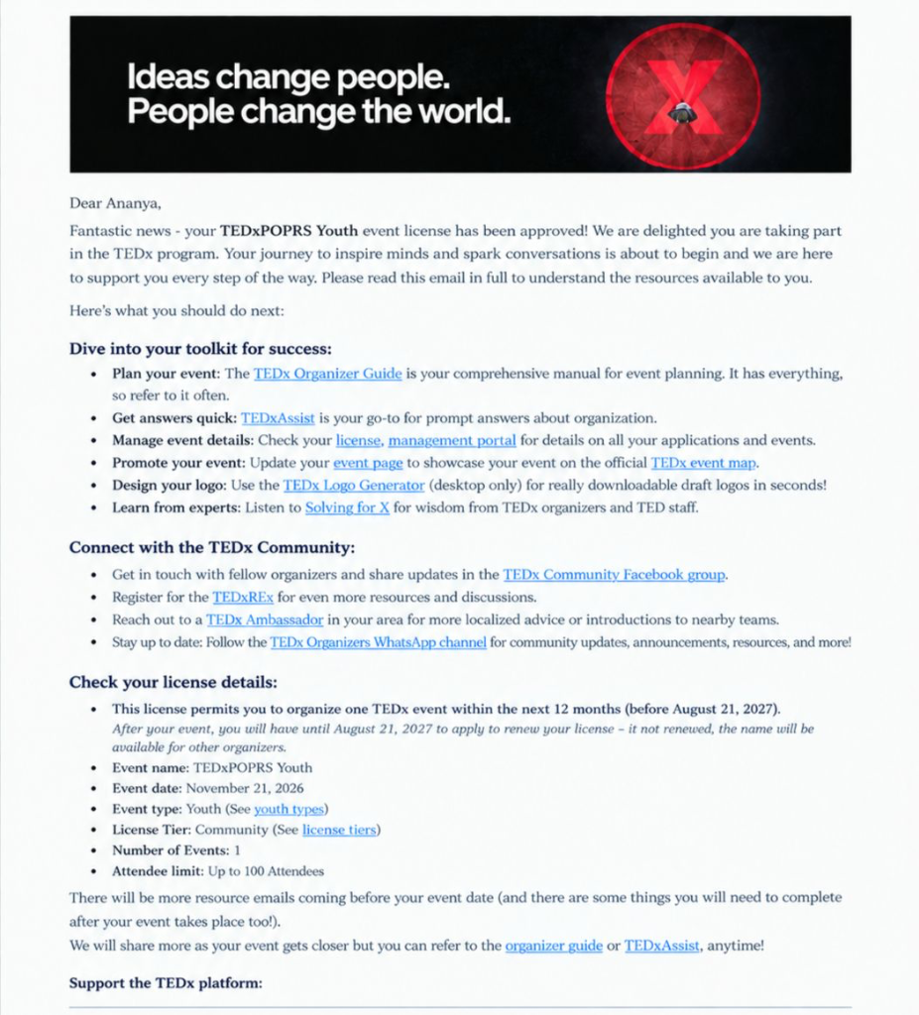
TEDxPORPS Youth
17 — AUTHORIZATION
OFFICIAL CONFIRMATION
TEDx Applications confirmed approval of the TEDxPORPS Youth license on 21 August 2026.
Operating under complete compliance with official TED parameters for independent youth events.
TEDxPORPS Youth • 21 November 2026
17 / 20

Slide 18
TEDxPORPS Youth
18 — CALL TO ACTION
JOIN US IN
SUPPORTING
IDEAS WORTH SPREADING.
TEDxPORPS Youth • 21 November 2026
18 / 20

Slide 19
TEDxPORPS Youth
19 — DIRECT ENQUIRIES
CO-ORGANISER
CO-ORGANISER
TEACHER ORGANISER
Yelamanchili Ananya
Abhirami Vutla
Ms. C. Shruti Reddy
Co-Organiser, TEDxPORPS Youth 2026
Co-Organiser, TEDxPORPS Youth 2026
Teacher Organiser, TEDxPORPS Youth 2026
Email: yananyaanu@gmail.com
Phone: 8977540506
Email: Abhiramivutla@gmail.com
Phone: +91 99593 02051
P. Obul Reddy Public School
Phone: +91 91 77071 678
TEDxPORPS Youth • 21 November 2026
19 / 20

Slide 20
TEDxPORPS Youth
20 — CONCLUSION
THE NEXT IDEA
COULD START HERE.
TEDxPORPS Youth • 21 November 2026
20 / 20

