Slide 1


Interactive Power BI Dashboard – Sales & Financial Analytics
Presented by: Rutikesh Pawar GitHub: github.com/rutikeshpawar Date: August 2025

Slide 2
Content
1. Objective
2. Dataset & Tools Used
3. Dashboard Features
4. Business Insights
5. Dashboard Screenshot

Slide 3
Objective: To design an interactive and insightful Power BI dashboard that provides key financial and sales insights to business stakeholders.
Key Goals:
Visualize sales, profit, and growth KPIs
Enable interactivity through filters and slicers
Present time-series and regional trends
Aid decision-making for management

Slide 4
Dataset & Tools Used
Dataset:
Source: Super Store (CSV)
Rows: ~10,000
Columns: Date, Region, Category, Sales, Profit, COGS, Quantity, etc.
Tools Used:
Power BI Desktop
DAX (for calculated measures)
Power Query Editor
GitHub for version control and submission

Slide 5
Dashboard Features
Key Visual Elements:
🔹 KPI Cards: Total Sales, Profit, COGS, Profit Margin
📈 Time Series: Monthly Sales Trend
📊 Bar Charts: Category-wise and Region-wise Sales
🍩 Donut Charts: Profit by Region
🌍 Map: Sales by Country/City
🧾 Table: Conditional formatting for profitability
Interactivity:
✅ Slicers for Region, Date, Category
🔁 Dynamic visuals based on user input
🧭 Consistent design & colour theme

Slide 6
Business Insights
Key Insights from Dashboard:
✅ Region A is the top performer with highest profit margins
⚠️ Category B has high sales but low profitability — needs review
🔼 Consistent YoY growth observed in Product C
🧾 Areas with high COGS and low profit identified for optimization

Slide 7
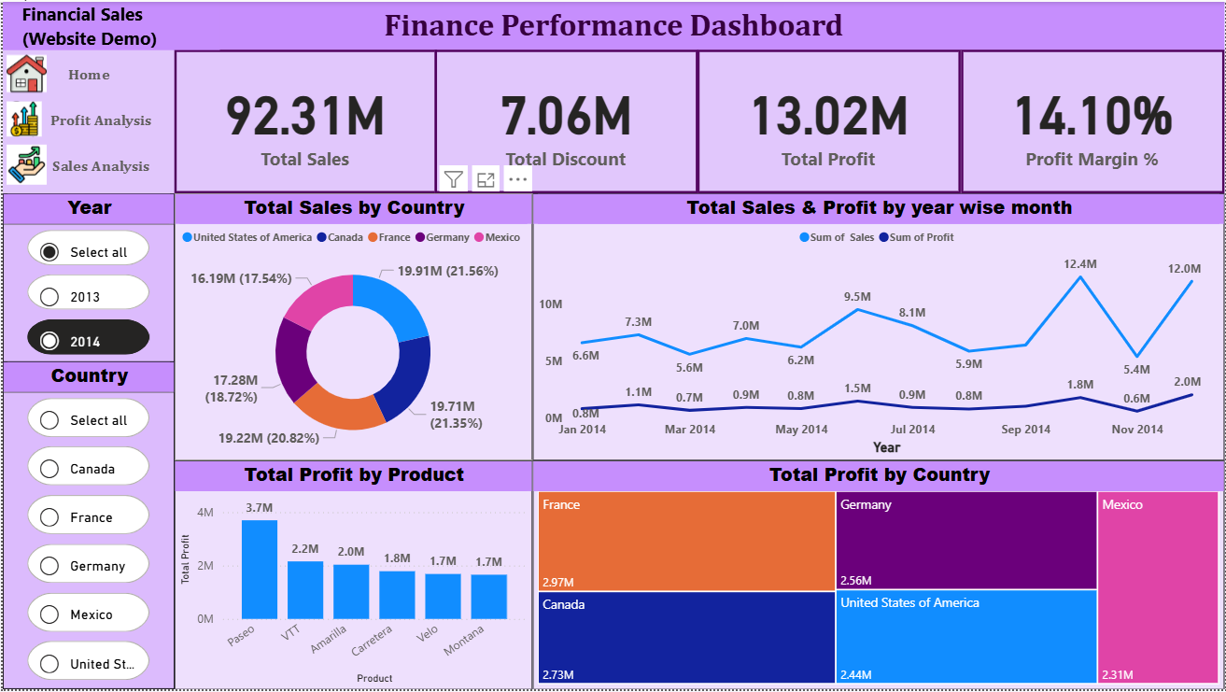
Dashboard Screenshots

