Slide 1
Coal fired processes with a low environmental impact

Slide 2
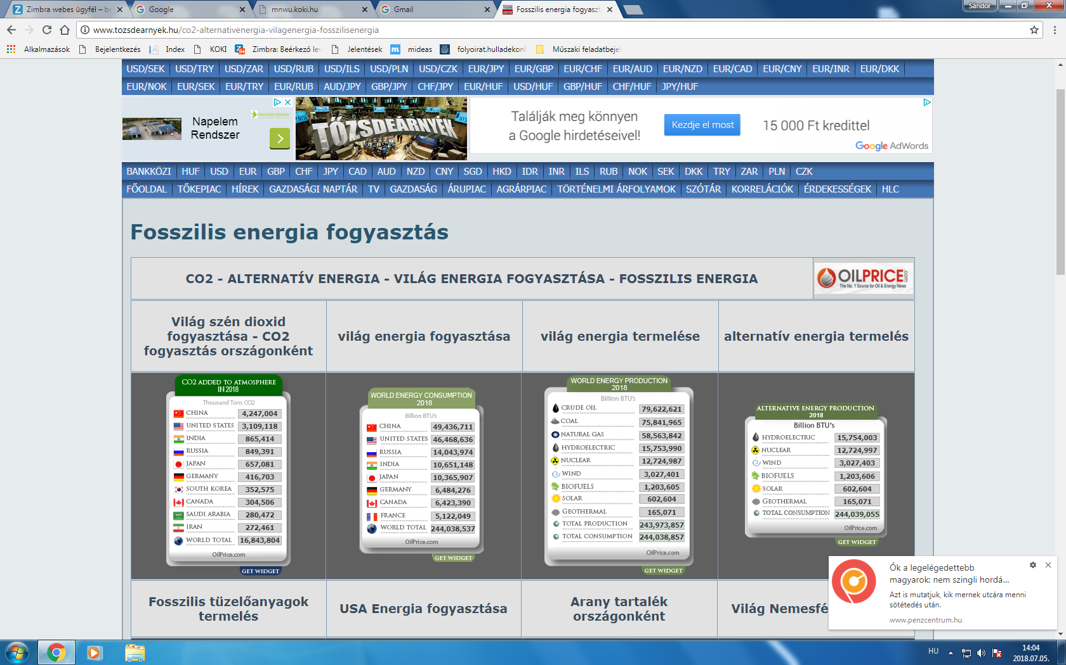
2018/07/05 – Energy production, consumption and CO₂ emission of the world

Slide 3
Importance of coal
Though the importance of coal is decreasing in primary energy consumption, it does not fall below 30%.
In case of high oil prices it becomes a replacement primary energy source.
As coal sources are located in politically stable regions, the price of the resource can be considered stable.

Slide 4
Aim of coal fired technologies
The primary goal is to burn coal with the highest possible efficiency which results less CO₂ emission.
Utilization of energy saving is an important factor.
As the coal powered power plants are equipped by Nox, sulfur dioxide, and dust reducing equipments, the main focus shifts to decreasing CO₂ emission.

Slide 5
Disadvantages of low environmental impact coal fired processes
Initial high investment.
Complexity of equipments results harder maintenance.
Because of these reasons it cannot offer a competetive alternative to other primary energy sources.

Slide 6
The recommended direction of development
Highly efficient, low energy operation.
Decreased CO₂ emission.
Decrease of environmental effect or keeping it on an acceptable level.
It cannot impact the environment heavier than other fossile energy sources.
Lower initial investments.
Easier maintenance.

Slide 7
The goal of coal fired processes with a low environmental impact.
The parameters of flue gas is similar to gas firing.
Higher efficiency coal fired processes.
Better decarbonization values.

Slide 8
Effect of coal fired processes with a low environmental impact
The primary effect of low environmental impact coal fire process is to produce similar flue gas parameters as gas firing.
Excess air needed for coal combustion can be decreased.
Soot number decreases to the same level as gas firing in gases which leave the fire box.
Coal bark does not contain any remaining combustible matter.

Slide 9
Main advantage of the process
Advantages are: primarily environmental protection, secondarily higher efficiency.
Higher efficiency can be reached by decreasing excess air, soot number, and remaining combustible matter.
Environmental advantage is met by decreased soot number, favourable flue gas composition, and higher efficiency, thus creating less CO₂ emission.

Slide 10
Results of low environmental coal fired processes
Energy saving by higher efficiency.
Decarbonization effect.
Cleaner soot gases mean less burden on operation and to environment.
Easier to integrate a cleaner and more efficient firing process.

Slide 11
Values of advantages
The amount of advantages can be measured by thermal efficiency.
This advantage comes from the increase in fire efficiency by ~10% resulting 10% of decarbonization.
Further efficiency increase can be achieved by decreasing excess air during firing coal. The usual number of 1.5 can be reduced to 1.2-1.3 thus resulting a 4-6% of effciency increase.
Decreasing combustible matter by 2% in coal bark means an additional 2% of increase of efficiency.
We can measure a decrease in soot number because of the better composition of flue gas which is now similar to gas firing.

Slide 12
Advantages compared to other techniques
Many coal burning prorcesses can be known from professional literature of which many are used in practice.
Highly efficient techniques usually require high initial investments.
Pure coal firing technique requires high initial investments. Because of this reason pure fire technique is more favorable from investment point of view, and can be used successfully with traveling grate combustion technology.

Slide 13
Production and operation safety
Production is simple, it relies on known components.
Well designed with high quality engineering design. It ensures that the primary goal can be achieved by using different types of coal.
Operation safety and uninterrupted operation is guaranteed by using simple components and design.
Traveling grate combustion technology machines can be modified to use this technology.

Slide 14
Summary
The primary goal is to burn coal with higher efficiency, thus decreasing CO₂ emission.
Pure fire technology fills the gap between current coal burning equipments and current burning techniques.
Cleaner and more efficient burning techniques can be integrated into systems easier, therefore revolutionize coal burning.
Flue gas quality is going to be similar to gas burning. Thermal efficiency increases by 10% resulting a 10% decarbonization.

