Slide 1

URBAN REDEVELOPMENT AUTHORITY OF PITTSBURGH
INTERN PROJECT HANDOVER
LandCare Assurance
For this service period, which assigned parcels were serviced, by whom, and with what evidence.
ura-gis/land-care-assurance
/monitoring/ · /kpi/ · /contractor/
rutomo@ura.org (Rizaldy Utomo)
Notes:
Handover of LandCare Assurance v1.0: what it is, why it exists, how to keep building it.

Slide 2
01 · PROBLEM CONTEXT
Contractor Compliance and Monitoring was lagging
THE TRIGGER
THE UNIVERSE
AT STAKE
~11.7%
1,127
$775k
REPORTED
ASSIGNED
ANNUAL SPEND
Blends Active and Request Only parcels, with no stated definition.
From a tag filter with no ownership check — sold parcels stayed in the denominator.
Spend judged against evidence that could not be traced to a parcel .
WHY I BUILT IT THIS WAY
WHAT V1.0 DELIVERS
Outside GIS control: contractor compliance, Regrid's interface, field capacity. Inside: the assignment query, the schemas, the metric definition, the published app.
Map Monitor — evidence displayed at the assignment polygon
KPI Dashboard — completion, budget, contractor exposure by period
Contractor portal — pick a parcel on the map or list, submit prefilled evidence
A map gives leadership something to act on that a percentage cannot.
A stated metric — period, denominator, source, and freshness on every number
Notes:
The trigger was a completion rate nobody could reproduce, on an assignment universe with no ownership check.

Slide 3
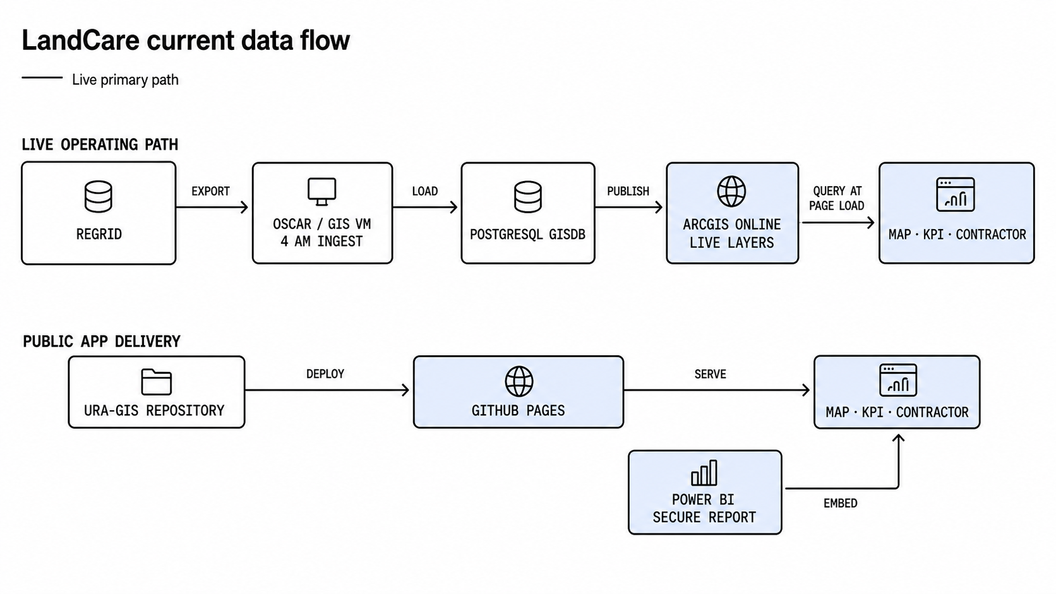
02 · SYSTEM ARCHITECTURE AND DATA FLOW
One nightly job, everything else live at page load
Period: the 15th of one month through the 14th of the next
OWNERSHIP SPLIT
ADAPTER BOUNDARY
DAILY CHECK
GIS and data operations own ingestion and store. Web and dashboard owner owns publish and application.
survey-layer.js and assignment-layer.js absorb every ArcGIS field rename. Endpoints live nowhere else.
4:00 AM upstream ran · Map and KPI agree on the period count · Power BI embed loads · Pages green after code changes.
Notes:
Three bands: nightly ingestion, published application, approved evidence. Live ArcGIS is authoritative at page load.

Slide 4
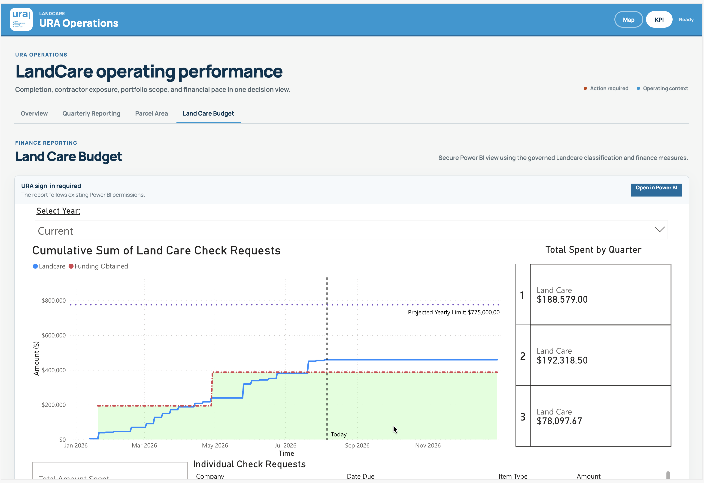
03 · FINANCE GOVERNANCE
KPI dashboard · Land Care Budget tab URA sign-in required
Power BI reports it, NetSuite records it
POWER BI
NETSUITE
WORKBOOK
Authoritative reporting
Upstream accounting
Contract expectations
Land Care Budget and Parcel Area are authenticated embeds, so each viewer sees the report through their own permissions and the numbers cannot drift from Finance.
Saved search 1618 on account 66220 Lawn Maintenance. The importer in the repo is supervised reconciliation, not a feed.
Term, parcels, and forecast. The contracted shape of the work, held outside both systems.
Land Care Budget report · URA Finance workspace
Imported on request, reconciled by hand
Held by the contract manager, not in the repo
HOW THE EMBED WORKS
Land Care Budget and Parcel Area are secure Power BI embeds, not native cards. The page hosts the report; Microsoft authenticates each viewer, so the figures come straight from the Finance semantic model.
AUDITED 5 AUGUST 2026
SPENT TO DATE
OF THE $775,000 LIMIT
$458,995.17
59.23%
Q1
Q2
Q3
$188,579.00
$192,318.50
$78,097.67
Notes:
Power BI is the authoritative report; NetSuite is the upstream ledger; the workbook holds contract expectations. The native finance cards are still a 4 August snapshot.

Slide 5
04 · BUILDING AND ITERATING WITH CODEX AND CLAUDE
AGENTS.md is read automatically by Codex. Keep it current.
Four blocks in every prompt
A
CONTEXT CALLING — FILES TO READ FIRST
B
CONTRACT — GOAL, SOURCE, METRIC RULE
Read AGENTS.md,
handover/04-readiness-checklist.md,
handover/01-owner-guide.md,
docs/landcare-metrics-context.md first.
Goal: [outcome and which page it affects].
Source: [ArcGIS item, table, published JSON].
Metric rule: completion uses raw assignment-
matched survey records over Active assigned;
Request Only is excluded.
Inherits the source-of-truth and change rules before the agent plans anything.
C
TOOL CALLS — WHAT THE AGENT MUST RUN
D
CUSTOM SNIPPETS — ADD PER TASK TYPE
python -m unittest discover -s tests
node --test tests/survey-layer.test.mjs
Pages validation + read-only ArcGIS smoke test
Metric change: update the metrics doc and its test in the same change; show before and after for the latest period.
New page or restyle: use the design system rules; no framework, no build step.
Endpoint or field mapping: change only the adapter files; keep normalized property names stable.
@chrome
read the live route, its map and console
computer use
drive the contractor flow, confirm the prefill
Shared adapter: move every importer's ?v= version together.
Name the tool. Report result, evidence, and rollback before commit.
SIX FAILURE MODES
Denominator drift
Stale cache-busting versions
Hardcoded endpoints outside the adapters
Hand-editing docs/landcare/data/
Guessing a NetSuite vendor alias
Calling the native finance cards Power BI-backed
Notes:
Every prompt has four parts: context calling, the goal and metric contract, tool calls the agent must run, and repo-specific snippets. Paste them in that order.

Slide 6
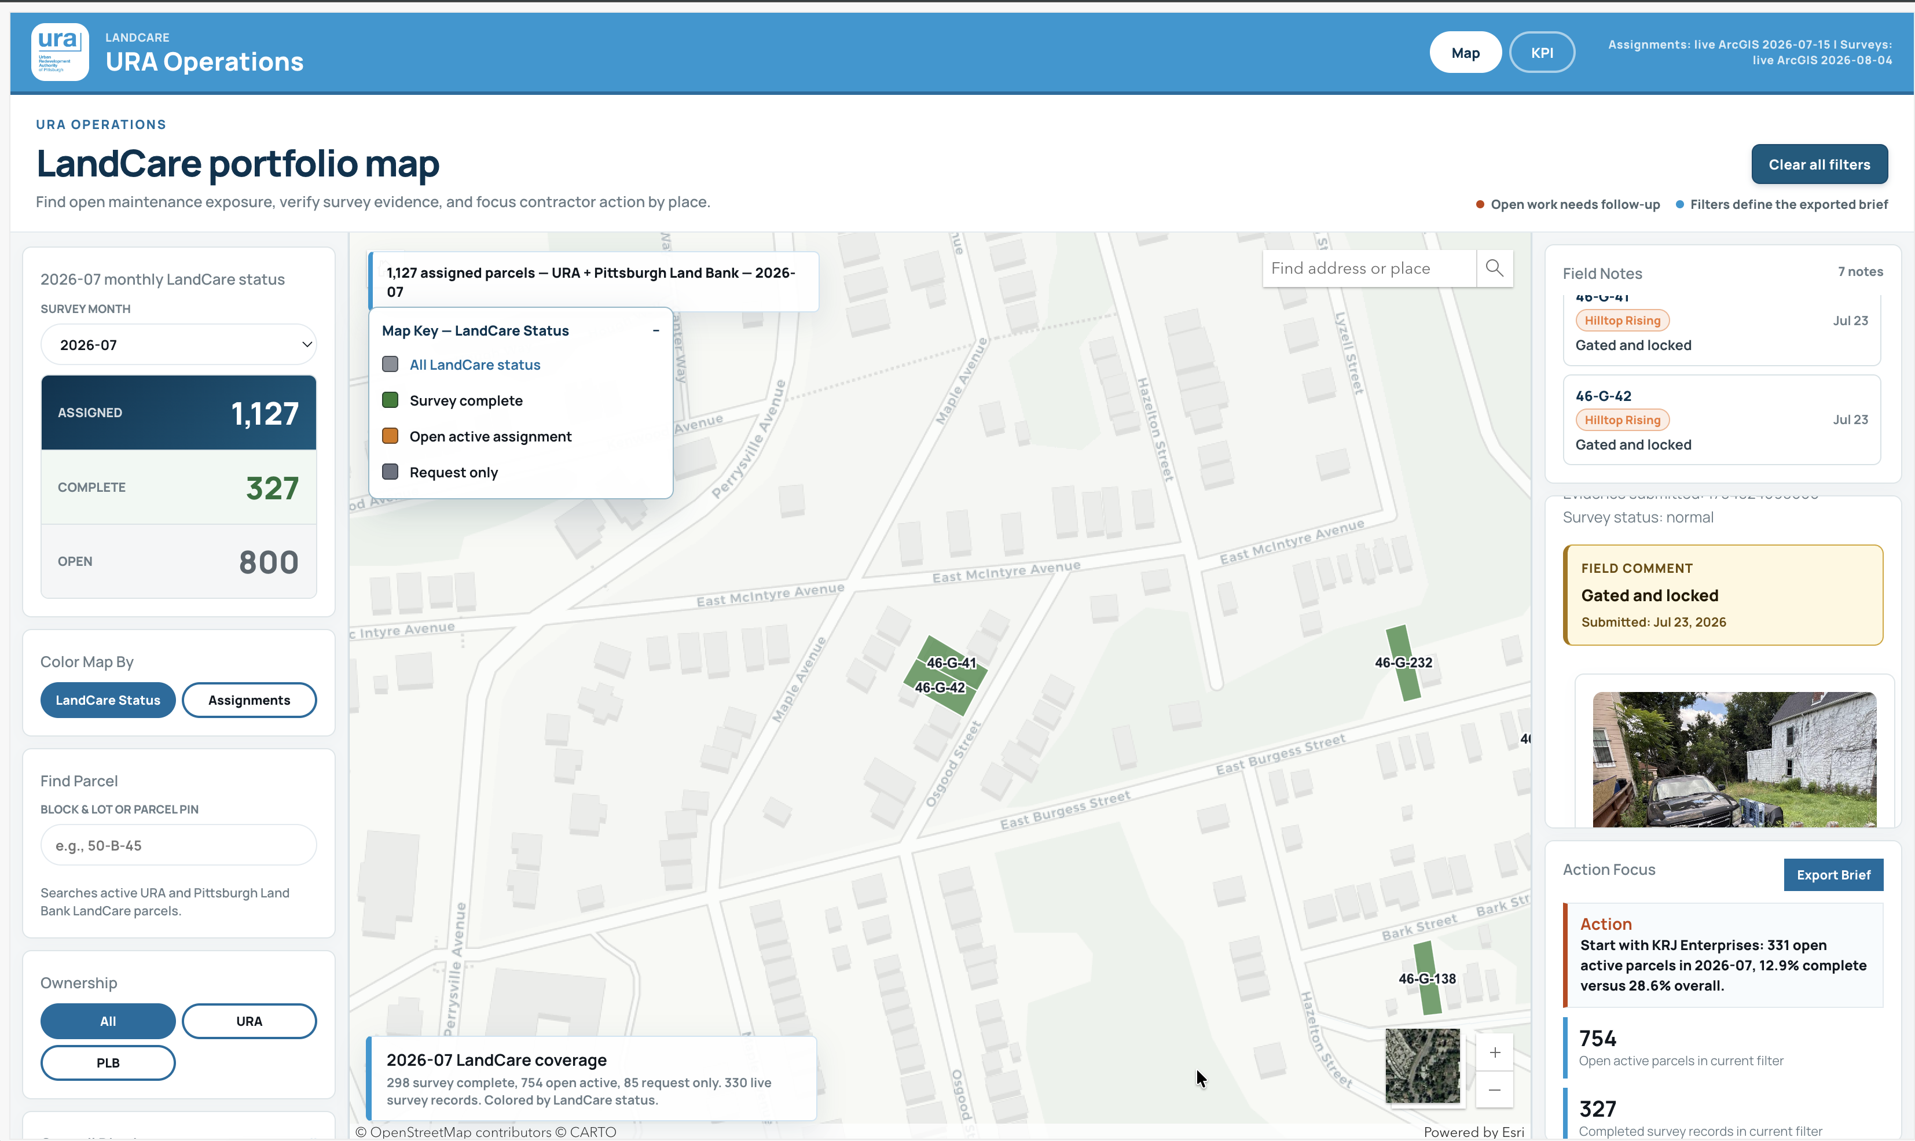
05 · DESIGN SYSTEM USAGE
Reusable Style for future GIS Web App
Manrope only · four hues plus ink, muted, and line neutrals
APP.CSS
EXECUTIVE-BI.CSS
~2,800 lines, coupled to the ArcGIS theme. Edit to change an existing page.
156 portable lines. Copy to start a new dashboard , with design-system/example.html.
TOKENS OVER COMPONENTS
--bi-primary #006c9f · analysis, active controls
--bi-deep #00334f · headings, authoritative detail
--bi-risk #c2410c · action, risk, follow-up
--bi-success #2e7d32 · target, complete, stable
Override the variables at .bi-dashboard level rather than restyling a component.
FIXED PAGE ORDER
Masthead
Tabs
Context + filters
Decision question
3–5 metrics
Dominant map or chart
Operational ledger
Checked in review: colour always paired with a label; every number shows source, period, denominator, freshness; contrast ≥ 4.5:1; explicit loading, empty, stale, error states.
Map Monitor, live · fixed blue header, pill filters, hairline cards, and status colours always paired with a label.
Notes:
app.css for the existing product, executive-bi.css for anything new. Tokens over components; page order is fixed.

Slide 7
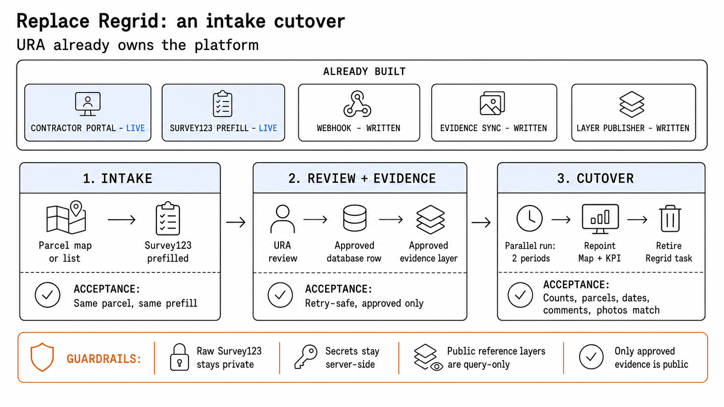
06 · REPLACING REGRID, STAYING GROUNDED IN ARCGIS
Assignments, parcel geometry, ownership, dashboard and portal are already URA property
The scope is one intake form and one export
STILL GROUNDED IN ARCGIS
STILL IN DEVELOPMENT
Parcels, assignments, and evidence stay hosted feature layers , queried live at page load. URA owns the intake; Esri carries the geometry and sharing model.
Submitted surveys pipeline need to be checked. Webhook, evidence sync, and layer publisher are written but not deployed, to fully replace regrid. Deploying that path is the last step before cutover.
Notes:
Scope: an intake form and an export. Three stages, each with an acceptance test. Everything stays on ArcGIS.

Slide 8
07 · OWNER OPERATING PLAYBOOK
Keep the source, the metric, and the release path stable
Status: handover/04-readiness-checklist.md Deep reference: handover/01-owner-guide.md
1 · DAILY CHECK
2 · SAFE CHANGE
4 AM ArcGIS freshness
Map and KPI agree
Power BI embed loads
Read sources
Define metric
Edit adapter
Run tests
PR + deploy
→
→
→
→
→
→
3 · DO NOT DRIFT
4 · DESIGN SYSTEM
!
Raw matched records, not unique parcels
Existing product docs/landcare/app.css
New dashboard docs/design-system/executive-bi.css
!
Move shared ?v= versions together
!
Endpoints live in the adapter files
Decision first · 3 to 5 KPIs · one dominant map or chart · operational ledger
!
Never hand-edit docs/landcare/data/
!
Never embed Power BI page 8c93bab49c96aa8e3bd2 — wrong scope
OPEN ITEMS FOR THE NEXT OWNER TO DECIDE
Survey123 evidence path is code-complete but not deployed. The single blocker on replacing Regrid.
Power BI workspace administration is not yet granted. Refresh history and service-principal access stay blocked until it is.
The deprecated 7 AM task still needs archiving and disabling on the VM — not deleting on day one.
Notes:
Daily check, safe change path, drift guards, and the five open decisions.

