Slide 1
Project Report
HO Ching-Ru
October 25th, 2021

Slide 2
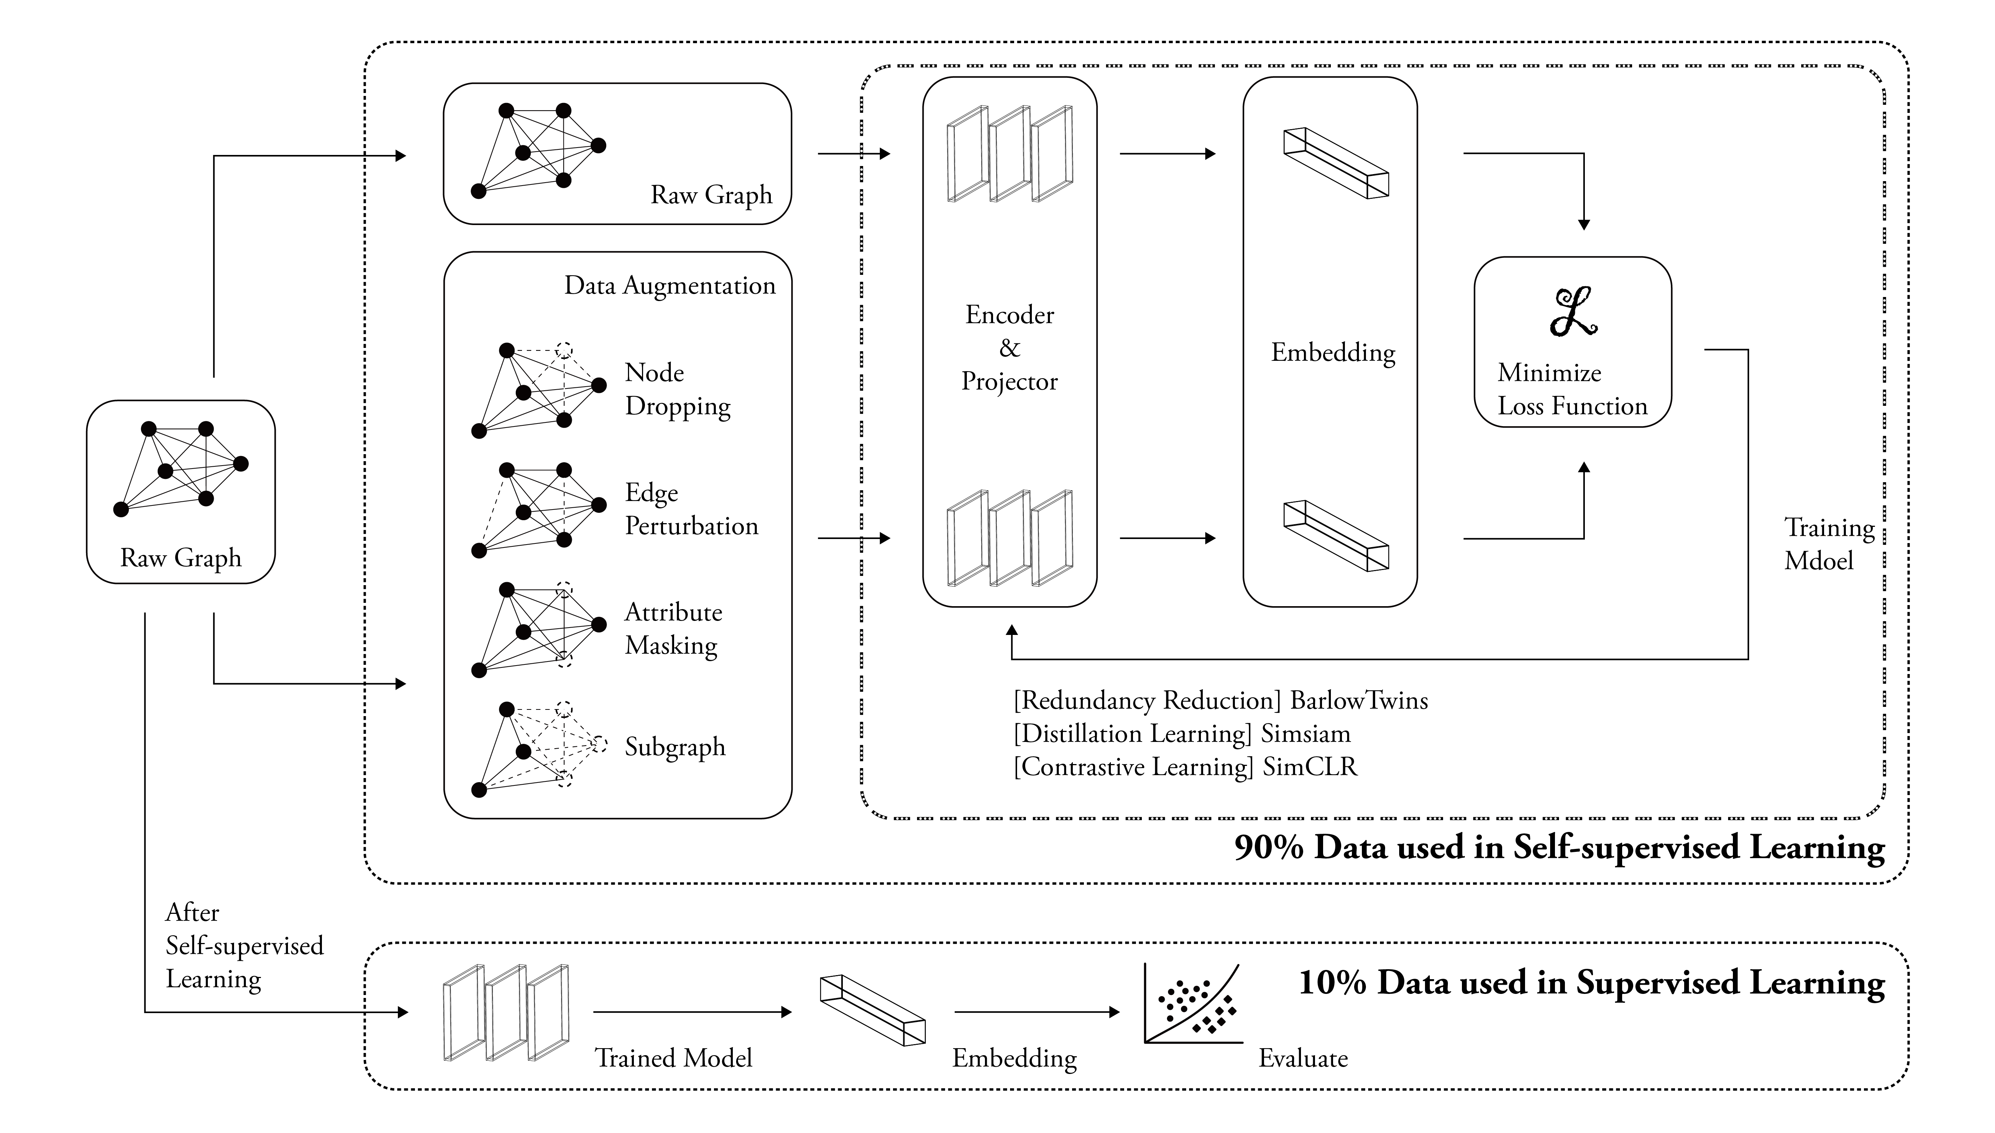

Slide 3
Detail of TUDataset
 | MUTAG | PROTEINS | NCI1 | DD | COLLAB | RDT-B
# Graphs | 188 | 1113 | 4110 | 1178 | 5000 | 2000
Classes | 2 | 2 | 2 | 2 | 3 | 2
Avg. Nodes | 17.93 | 39.06 | 29.87 | 284.32 | 74.49 | 429.63
Avg. Edges | 19.79 | 72.82 | 32.30 | 715.66 | 2457.78 | 497.75
Node Labels | + | + | + | + | - | -
Edge Labels | + | - | - | - | - | -
Node Attr. | - | + | + | - | - | -
Reference: https://chrsmrrs.github.io/datasets/docs/datasets/

Slide 4
Detail of Models (Total: 144)
Model | Augmentation Method | Batch Size | Hidden Dimension | # Encoder Layers | # Projector Layers | Learning Rate | Epoch | Data Prop.
SimCLR | Node Dropping | 64 | 64 | 1 | 3 | 0.001 | 200 | 90% Self-supervised
BarlowTwins | Edge Perturbation | 256 | 512 | 2 |  |  |  | 10% Supervised
Simsiam | Attribute Masking |  |  | 3
 | Subgraph |  |  | [Linear] [ReLU] [Linear] | [Linear] [BatchNorm] [ReLU]

Slide 5
Detail of Experiment (144, repeat 5 times)
 | MUTAG | PROTEINS | NCI1 | DD | COLLAB | RDT-B
Top Ranking | 100.00 | 84.91 | 87.20 | 95.67 | 95.62 | 93.15
10% Baseline |  | 70.40±1.54 | 73.72±0.24 | 73.56±0.41 | 73.71±0.27 | 86.63±0.27
10% Aug. |  | 70.29±0.64 | 73.59±0.32 | 74.30±0.81 | 74.19±0.13 | 87.74±0.39
10% GAE |  | 70.51±0.17 | 74.36±0.24 | 74.54±0.68 | 75.09±0.19 | 87.69±0.40
10% Infomax |  | 72.27±0.40 | 74.86±0.26 | 75.78±0.34 | 73.76±0.29 | 88.66±0.95
10% GraphCL |  | 74.17±0.34 | 74.63±0.25 | 76.17±1.37 | 74.23±0.21 | 89.11±0.19
10% SimCLR | 97.00 | 80.56 | 74.23*
10% BarlowTwins | 93.99 | 83.19 | 73.24*
10% Simsiam | 95.00 | 75.89 | 73.46*
Average Cost Time (Training+Embed) | 41.47 sec. per Exp. | 438 sec. per Exp. | 1.73 hr. per Exp.
Reference: You, Y., Chen, T., Sui, Y., Chen, T., Wang, Z., & Shen, Y. (2020). Graph contrastive learning with augmentations. Advances in Neural Information Processing Systems, 33, 5812-5823.

Slide 6
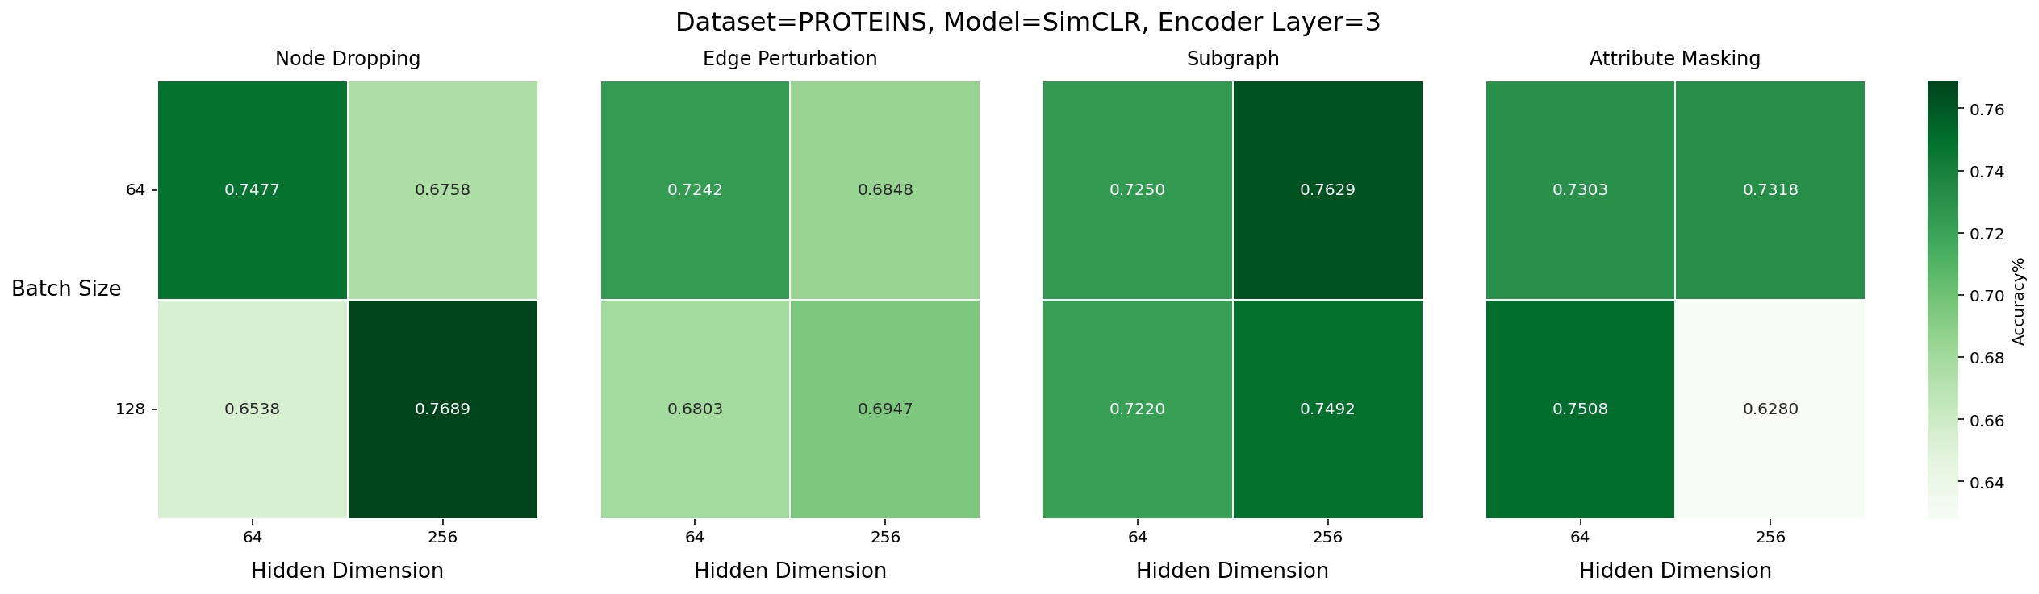
Result in Heatmap (PROTEINS)

Slide 7
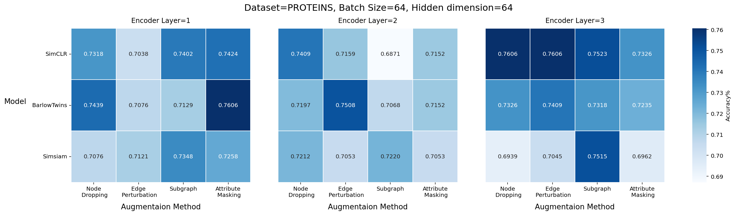
Result in Heatmap (PROTEINS)

