Slide 1
Project Report
March 14, 2022
HO Ching-Ru

Slide 2
Deeper Encoder performs better
Generally and intuitive, except DD.

Slide 3
Molecular Dataset

Slide 4
Bioinformatics Dataset

Slide 5
Hidden Dimension affects not much as imagination
It seems that hidden dimension is not a key factor at all.

Slide 6
Molecular Dataset

Slide 7
Bioinformatics Dataset

Slide 8
Batch Size’s effects on SimCLR is not apparent
Probably due to the size of dataset, or due to the small batch size.

Slide 9
Molecular Dataset

Slide 10
Bioinformatics Dataset

Slide 11
Subgraph performs “stable” in Bioinformatics dataset
Related to the structure of bioinformatics?
(sensitive or tolerant)

Slide 12
Molecular Dataset

Slide 13
Bioinformatics Dataset

Slide 14
SimCLR performs better in molecular dataset
Especially in NCI1

Slide 15
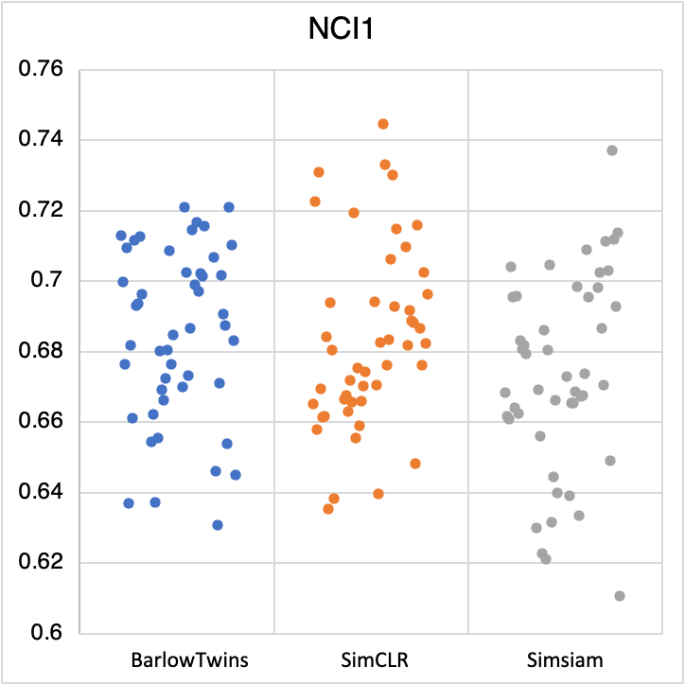
Molecular Dataset

Slide 16
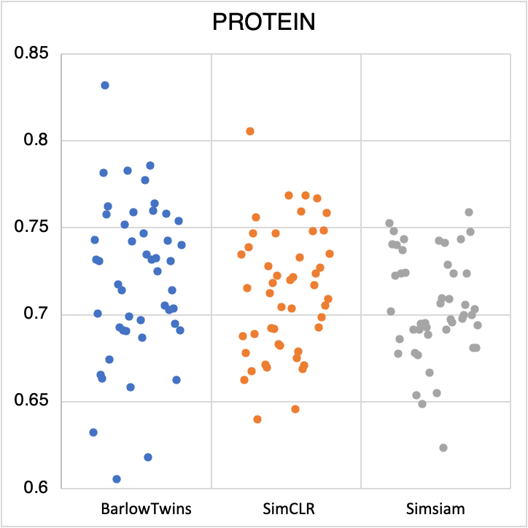
Bioinformatics Dataset

