Slide 1

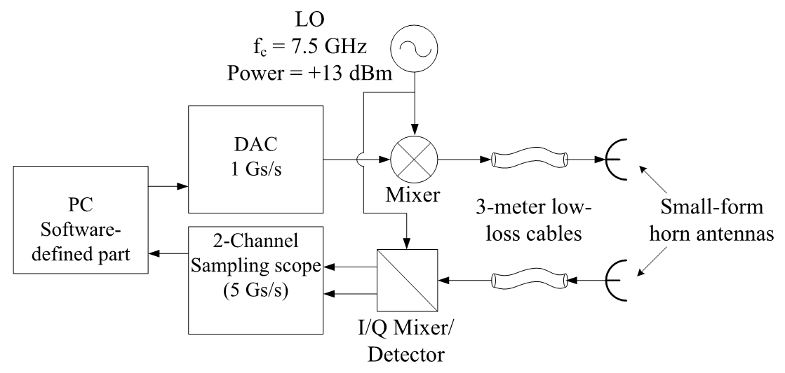
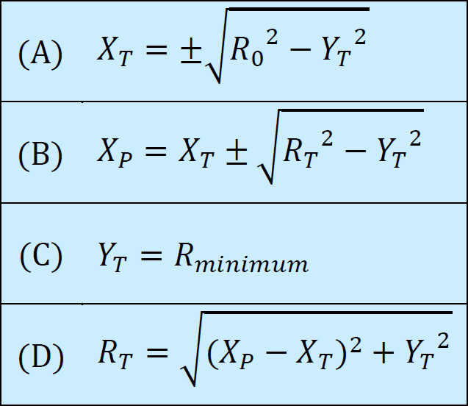
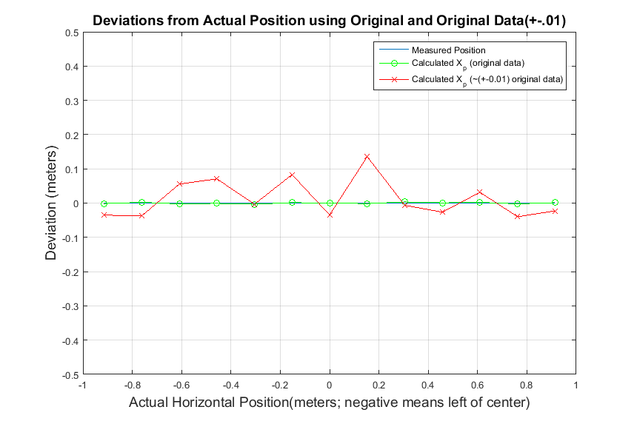
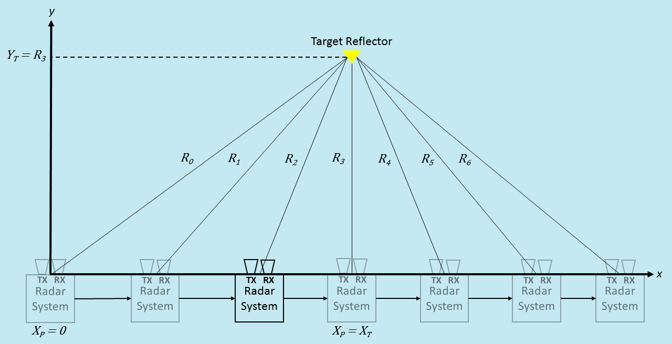
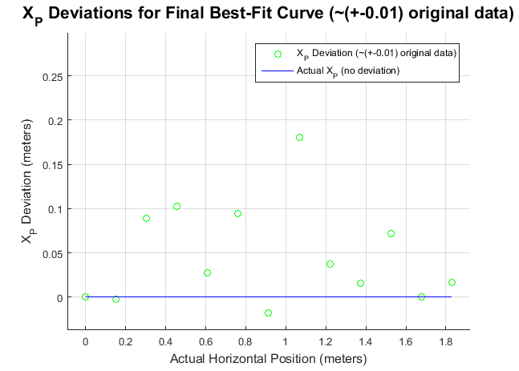
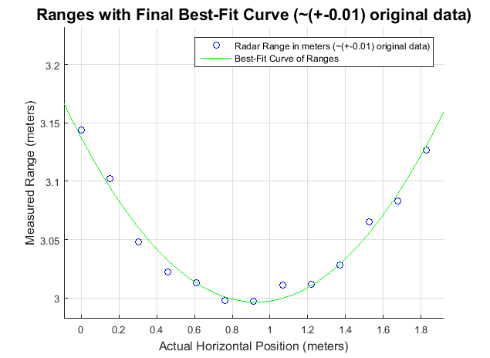
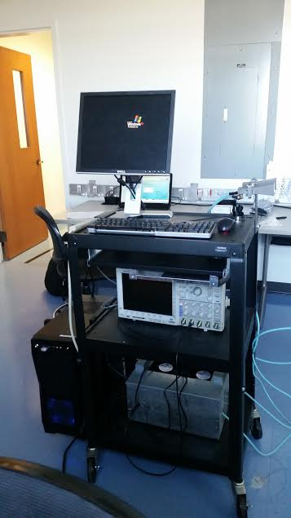
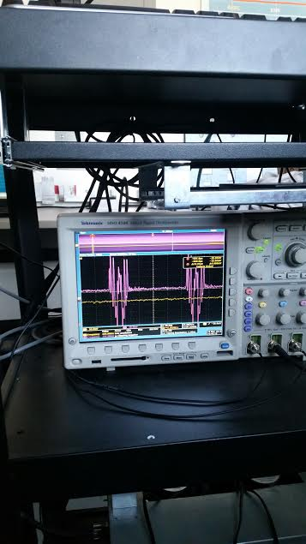
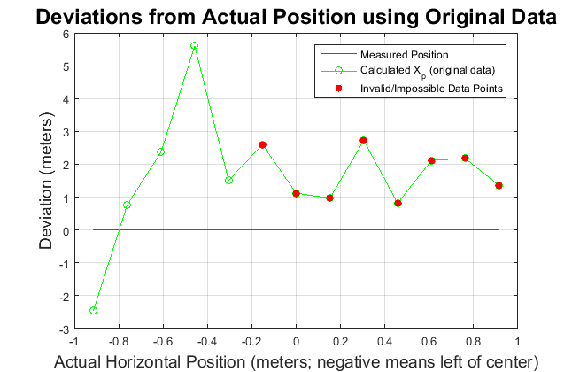
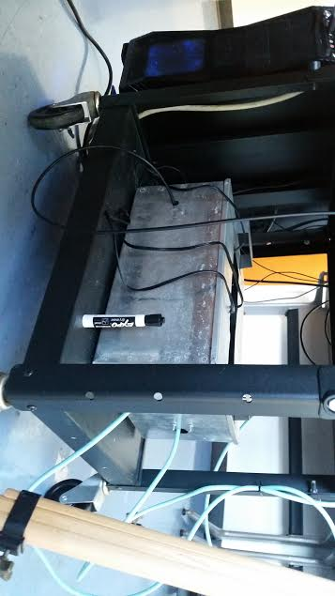
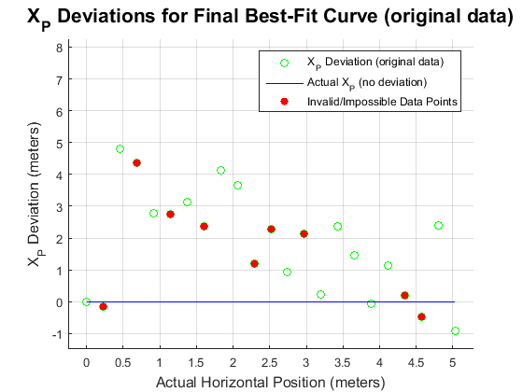
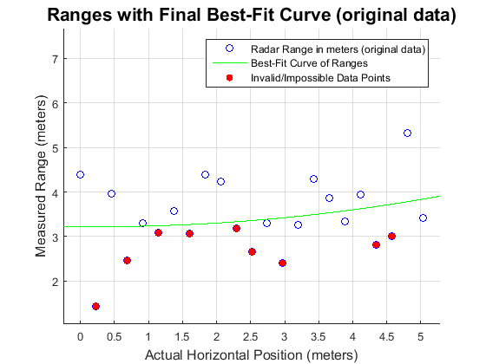
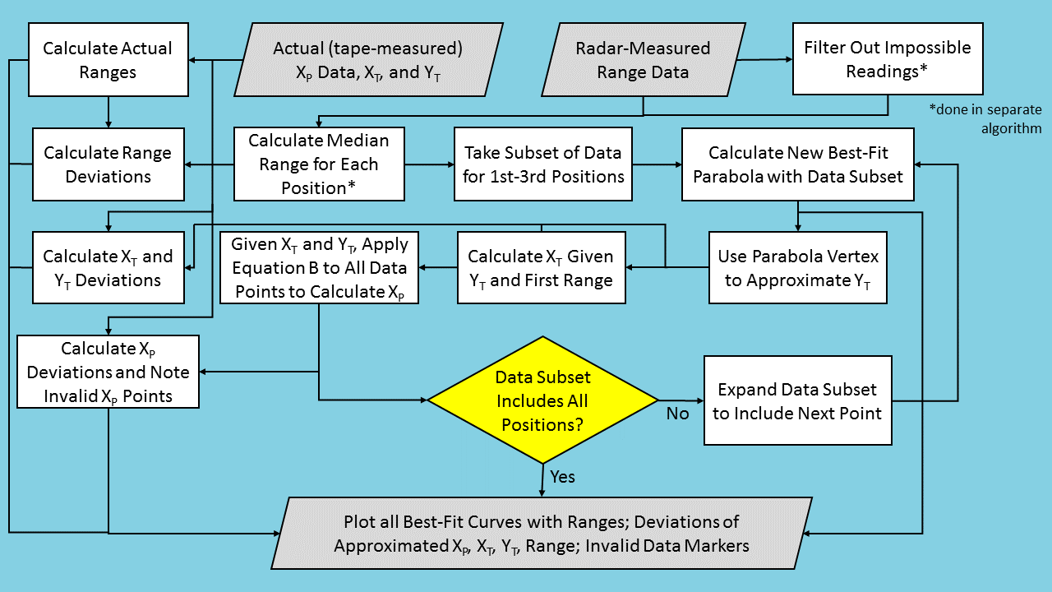
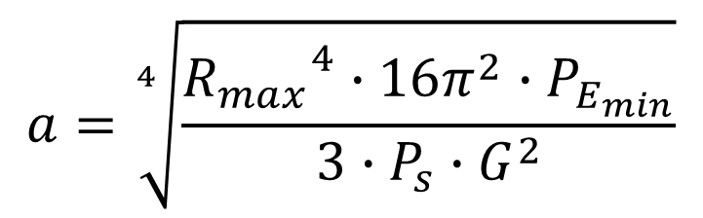
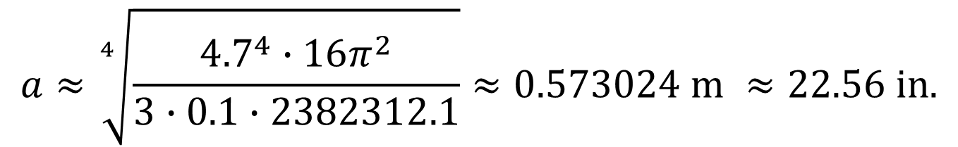
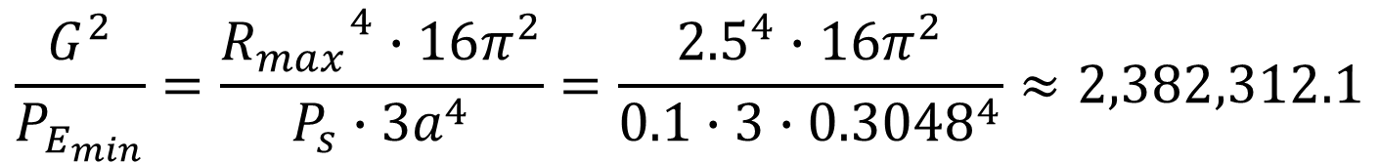
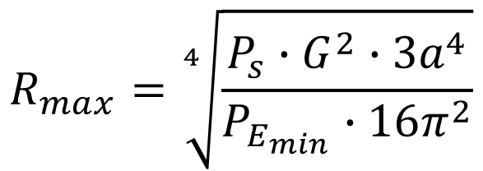
2D Radar-Based ‘Dead Reckoning’ Navigation Aided by Small Scale Ultra Wideband Software Defined Monostatic Radar System Aimed at a Fixed Target
Devante Johnson, Zak Abner, Daniel Balch
Adviser: Dr. Dmitriy Garmatyuk
Objectives
Our project aims to explore the use of radar for ‘dead reckoning’ navigation (e.g. if GPS goes down). By collecting range data from a radar at multiple positions along a line in front of a stationary corner reflector, and then running the data through a post-hoc 2D navigation algorithm, the coordinates of those positions can be estimated. We also designed and implemented a much-needed thermal management solution for the system's analog front-end.
System Components
Experimentation and Navigation Scenario
Each experiment consists of taking many range readings at a number of positions along a linear path (which we define as our x-axis) in front of a target corner reflector. The radar system transmits a pulse at the reflector and uses the propagation delay of the return signal to calculate the distance to the target. After the experiment, the data is run through our navigation algorithm to approximate the system’s positions along the path and simulate radar-based navigation.
Results
The charts shown below (except for ideal data charts) make use of data from two separate experiments, which were conducted under the following conditions:
# | Date | Location | # of Positions | Position Interval | Actual Y_{T}
1 | 2/29/16 | Small Lab | 13 | 15.24 cm (6 in.) | 2.997 m (118 in.)
2 | 3/24/16 | Parking Garage | 23 | 22.86 cm (9 in.) | 3.937 m (155 in.)
Variable | Definition
R_{T} | Range to Target
R₀ | Range at 1st Position
X_{T} | Target X-Coordinate
Y_{T} | Target Y-Coordinate
X_{P} | Radar X-Coordinate
X_{P} = 0 at First (leftmost) Radar Position
Conventions and Key Equations
Example of Simulated (Ideal) Results using Simple Navigation Algorithm
Parameters | Value | Units
Baseband Signal Bandwidth | 600 | MHz
Transmitted Signal Bandwidth | ~6.9-8.1 | GHz
Pulse Width | Variable
Max Available CW Transmit Power | ~100 | mW
Experimental Radar Range, as Tested | ~0.5-5 | meters
Experimental Range Resolution | 0.30 | meters
Example Experiment Setup / Navigation Geometry
Example of Simulated (Ideal) Results using Best-Fit Curve Algorithm
System Information
Software Defined Radar
UWB (Ultra Wideband), ~30cm Resolution in Ranging Data
Flexible Real-Time Signal Design
Scope used to show Transmitted and Received Signals
Results from 1st Experiment using Simple Navigation Algorithm
Navigation Alogrithm
Data Preprocessing (separate from main algorithm)
A separate program finds the medians of the ranging data for every radar position. It also creates a filtered version of the data and medians of the filtered datasets. The filtering removes negative range values, as they cannot be true.
Simple Navigation Algorithm Summary
Earlier on, we used a simpler algorithm that tries to find a data point representing X_{T} and Y_{T} by looking for a sign change in the slope of the range data. Otherwise, it functions very similarly to the algorithm described in the block diagram below.
Notes Pertaining to Best-Fit Curve Algorithm
This algorithm tries to approximate Y_{T} using parabolas fitted to subsets (to simulate real-time positioning) of the ranging data. It separately processes the original and filtered data, then plots all results when finished. Its functional details are shown below.
Best-Fit Curve Navigation Algorithm Block Diagram
Results from 2nd Experiment using Best-Fit Curve Algorithm
Software Defined Radar System
Analog Front-End
Analog Front-End Specifications (shown just above on the right)
12”x15”x7”
Ventilation Ports on Side and Lid; Cooled with 2 AC Fans
Power Sources Elevated Off of Housing Floor to Facilitate Airflow
References
Corner Reflectors [Online]. Available:
http://www.microwaves101.com/encyclopedias/corner-reflectors
D. Garmatyuk, J. Schuerger and K. Kauffman, "Multifunctional Software-Defined Radar Sensor
and Data Communication System," in IEEE Sensors Journal, vol. 11, no. 1, pp. 99-106, Jan. 2011.
H. Durrant-Whyte, E. Bell and P. Avery, "The design of a radar-based navigation system for large
outdoor vehicles," Robotics and Automation, 1995. Proceedings., 1995 IEEE International Conference on, Nagoya, 1995, pp. 764-769 vol.1.
K. Kauffman, J. Raquet, Y. Morton and D. Garmatyuk, "Real-Time UWB-OFDM Radar-Based
Navigation in Unknown Terrain," in IEEE Transactions on Aerospace and Electronic Systems, vol. 49, no. 3, pp. 1453-1466, July 2013.
Y. M. Madany, H. M. Elkamchouchi and M. M. Ahmed, "Robust navigation based on bistatic radar
and BiSensors for unmanned air systems (UASs) using integration of multiple sensors fusion architecture," Radar Conference, 2014 IEEE, Cincinnati, OH, 2014, pp. 670-673.
Conclusions
Our algorithms seem to be functioning correctly (except for data filtering being ineffective; those results were omitted from this poster), but our data quality is very poor. We believe our trihedral corner reflector is too small (1’ x 1’x 1’) for the ranges we have been using. Rather than use shorter ranges (and lower the number of possible positions), we aim to use a larger corner reflector, the size of which is determined using the formulae below:
Variable | Definition
R_{max} | Max. Effective range
P_{S} | Transmitted Power
G | Antenna Gain
a | Reflector Side Length
P_{E,} _{min} | Min. Detectable Received Power
$$R_{max}=\sqrt[4]{\frac{P_{s}∙G^{2}∙3a^{4}}{P_{E_{min}}∙16π^{2}}}$$
$$a=\sqrt[4]{\frac{{R_{max}}^{4}∙16π^{2}∙P_{E_{min}}}{3∙P_{s}∙G^{2}}}$$
For Current Reflector (with R_{max} ≈ 2.5 m and a = 0.3048 m):
$$\frac{G^{2}}{P_{E_{min}}}=\frac{{R_{max}}^{4}∙16π^{2}}{P_{s}∙3a^{4}}=\frac{{2.5}^{4}∙16π^{2}}{0.1∙3∙{0.3048}^{4}}≈2,382,312.1$$
For Proposed New Reflector (with R_{max} ≈ 4.7 m) :
$$a≈\sqrt[4]{\frac{{4.7}^{4}∙16π^{2}}{3∙0.1∙2382312.1}}≈0.573024 m ≈22.56 in.$$

